Slide 1

A BRIEF HISTORY OF HST: INCEPTION TO LAUNCH
David Leckrone
October 11, 2010

Slide 2
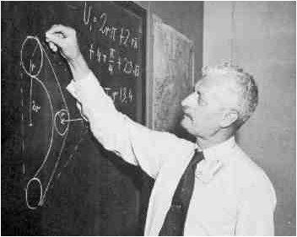
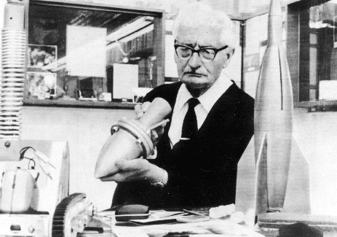
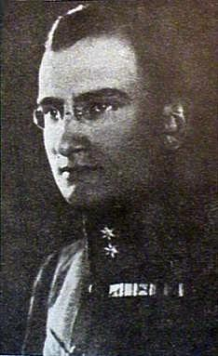
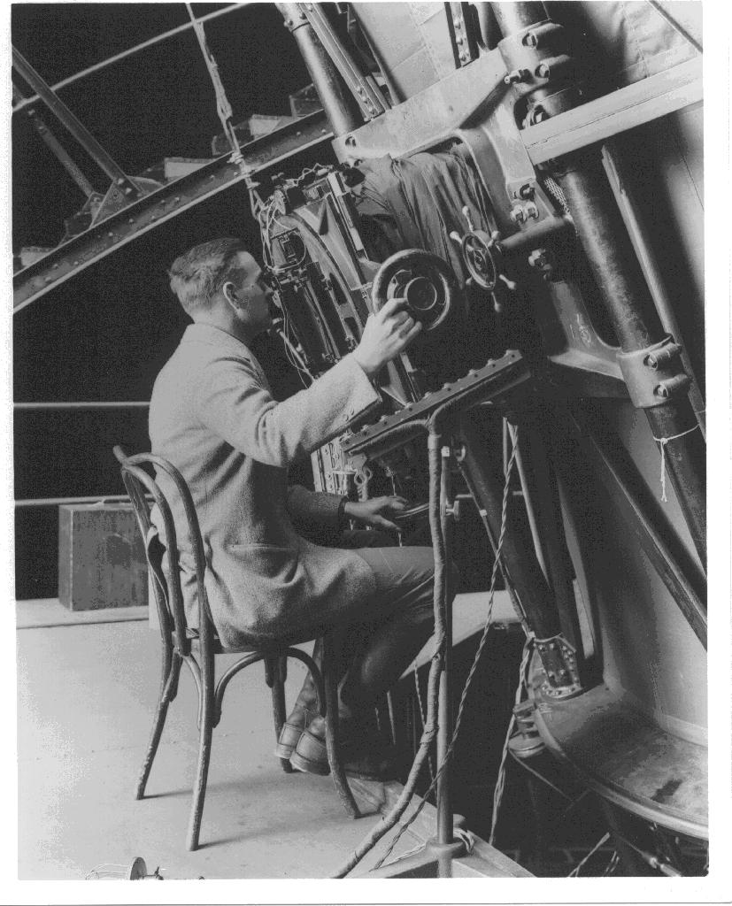
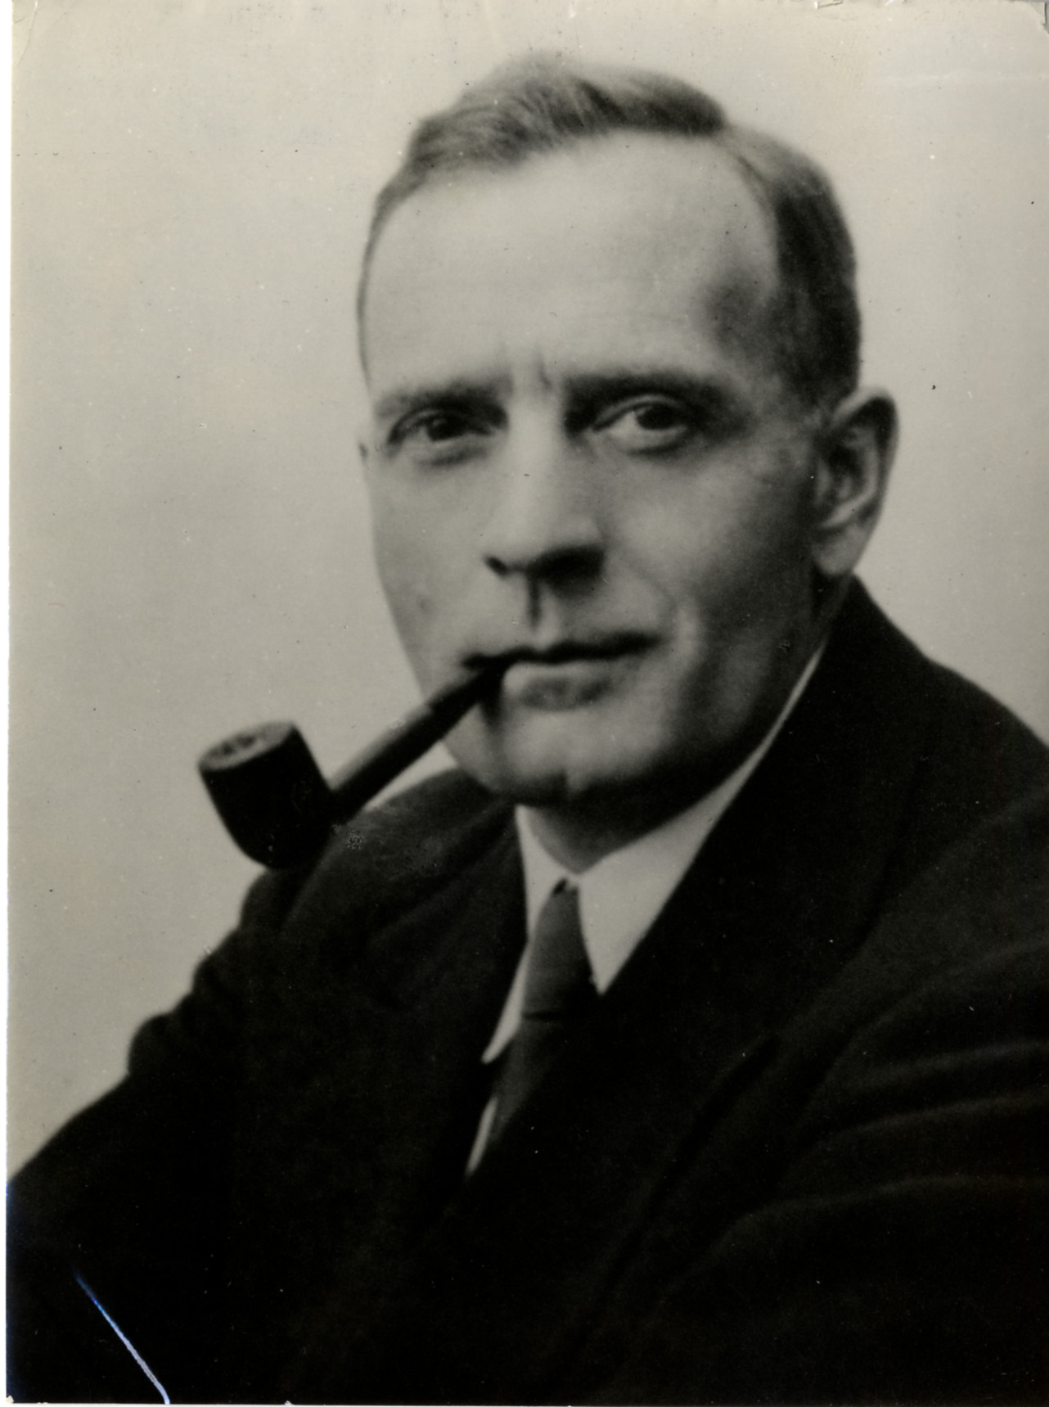
1923, 1929 – Hermann Oberth described practical and scientific applications of space travel, including a space station and space telescopes; 1929 – Hermann Noordung expanded Oberth’s ideas with a detailed description of an orbiting manned observatory, including large-aperture telescopes.
1922-1931 – Edwin Hubble and colleagues established the existence of external galaxies and demonstrated that the Universe is expanding.

Slide 3
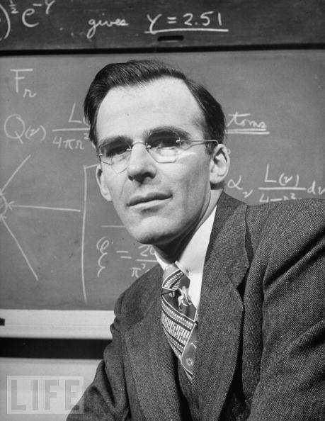
1946 – Lyman Spitzer wrote a report for the RAND Corporation entitled, “Astronomical Advantages of an Extra-Terrestrial Observatory.”
He discussed advantages of space telescopes of aperture 5 – 15 meters. He discussed two main advantages of observing above the Earth’s atmosphere – 1. unlimited access to ultraviolet and infrared wavelengths, and
2. dramatic improvement in the sharpness of images in the absence of atmospheric turbulence.
Spitzer gave as the best reason to build space telescopes “[to] uncover new phenomena not yet imagined, and perhaps to modify profoundly our basic concepts of space and time.”

Slide 4
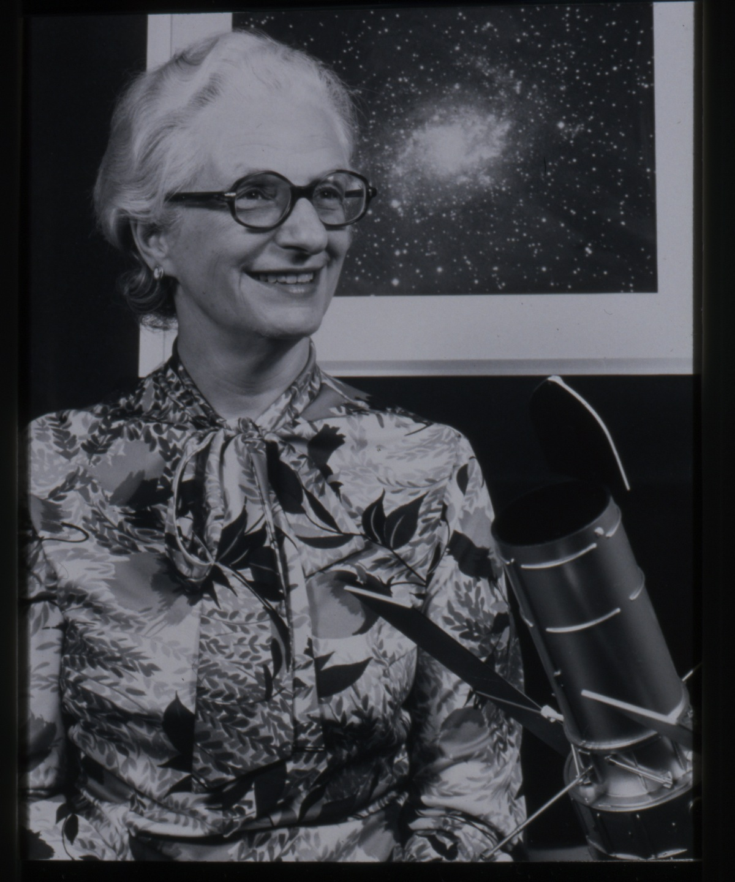
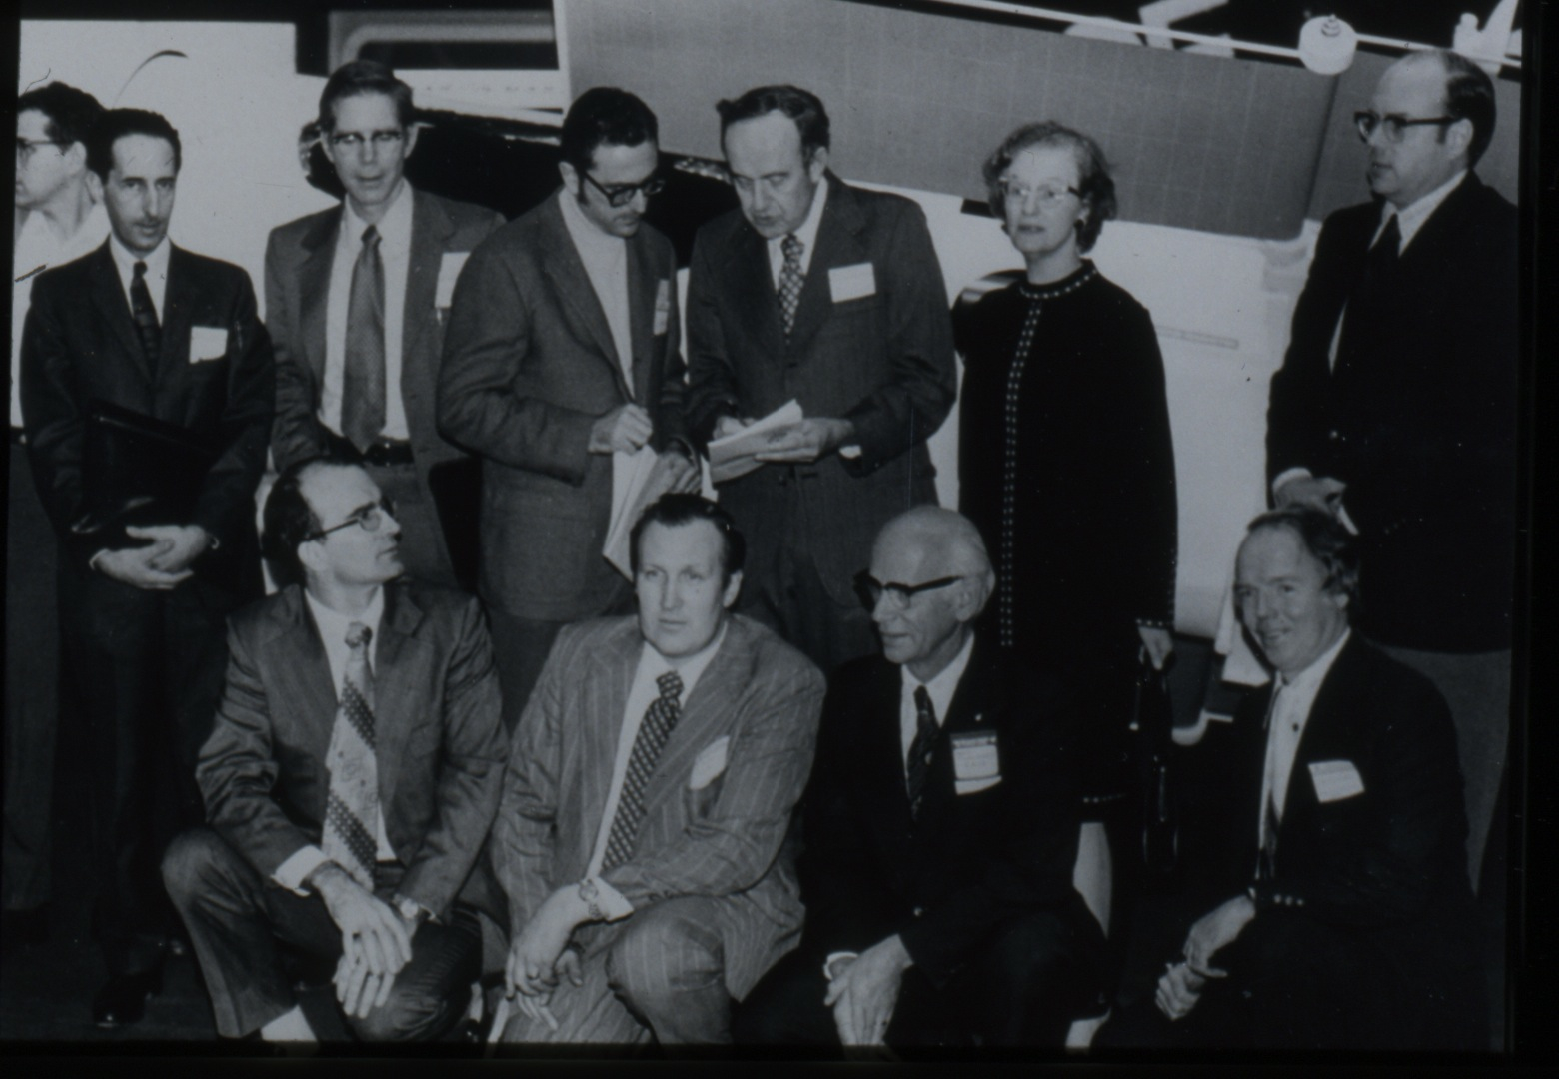
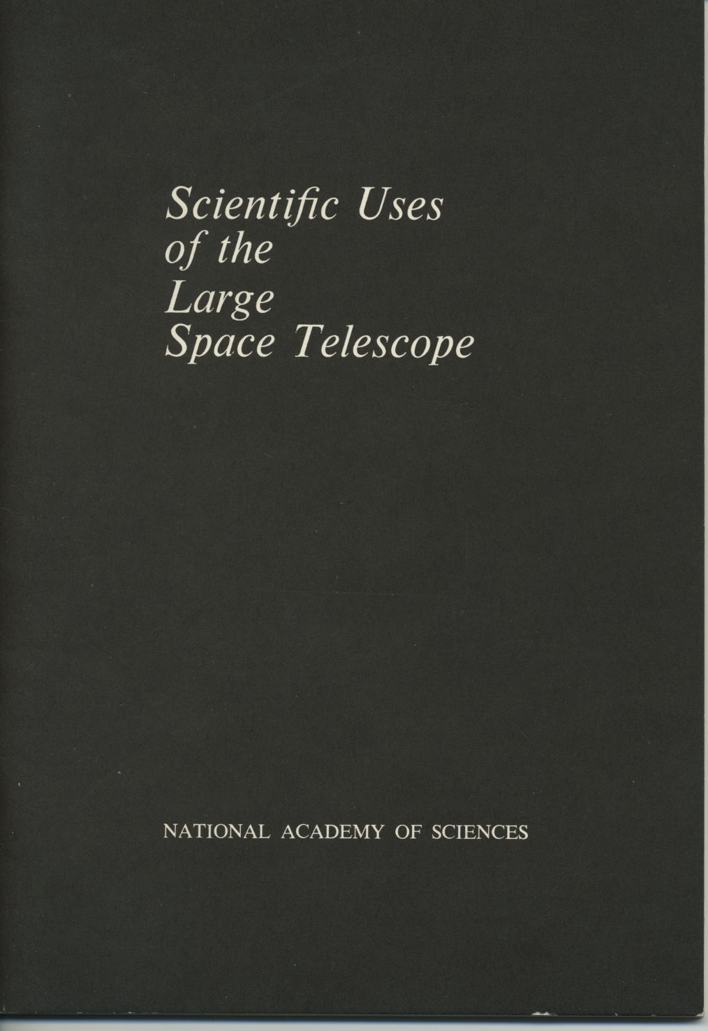
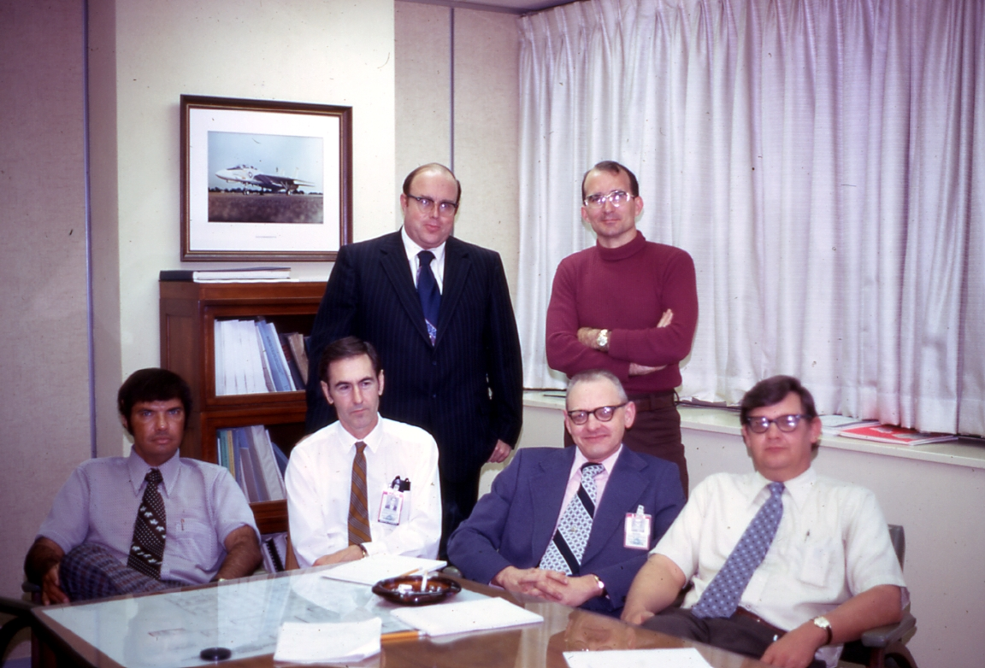
The 1960’s and ‘70’s – Building Support, Laying the Scientific/Technical Foundation

Slide 5
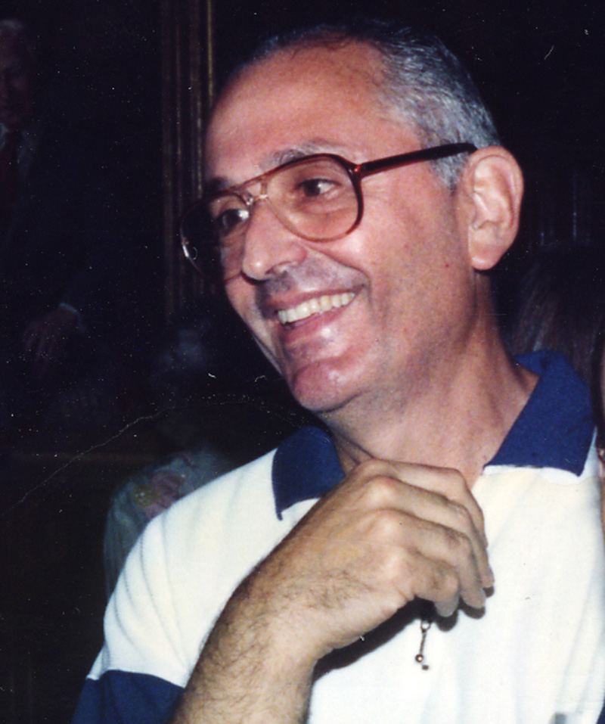
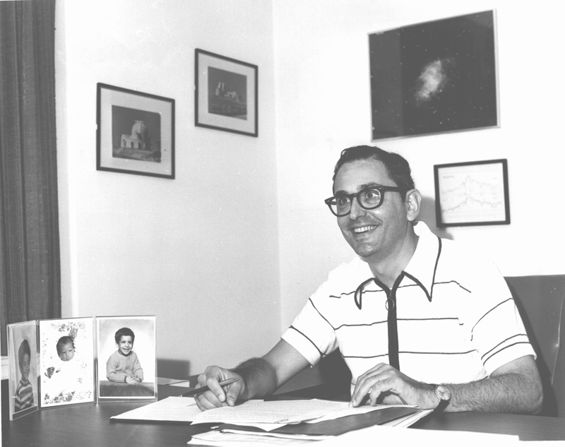
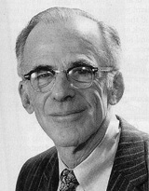
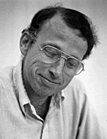
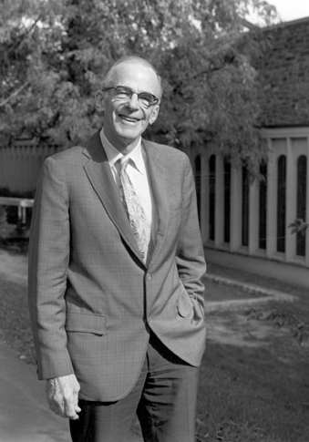
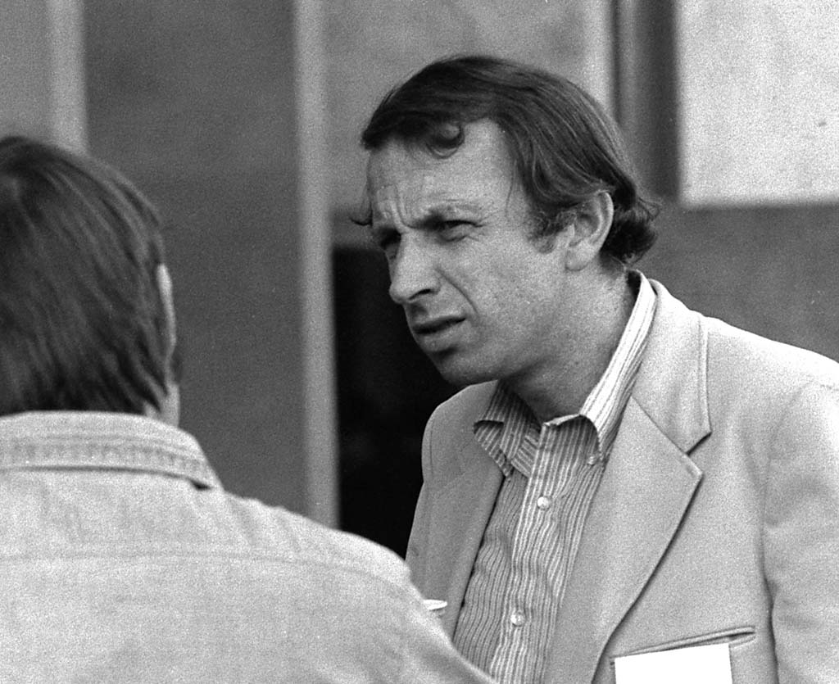
Advocating a (Large) Space Telescope to the Federal Government
John Bahcall
Lyman Spitzer
George Field

Slide 6
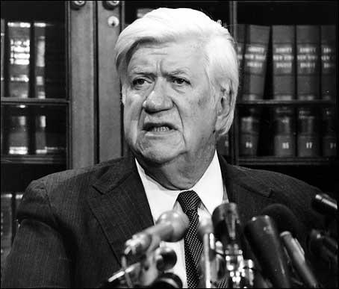
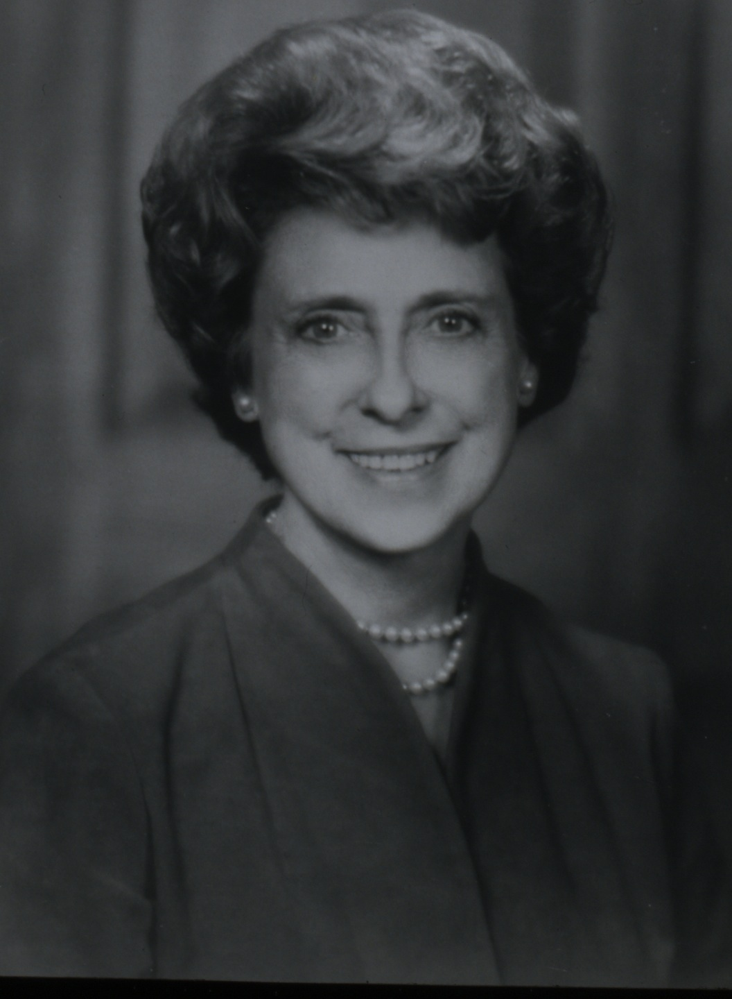
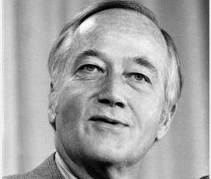
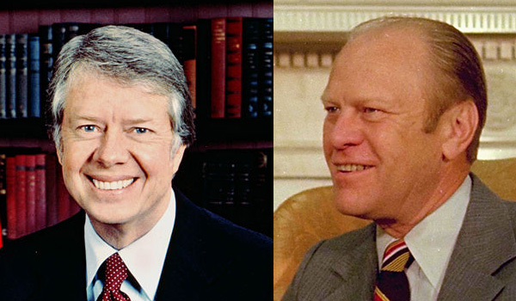
Political Support for a (Large) Space Telescope
Congressman Tip O’Neill, D-Ma
Congresswoman Lindy Boggs, D-La
Senator Charles (‘Mac’) Mathias, R-Md
Presidents Jimmy Carter (D) and Gerald Ford (R)

Slide 7
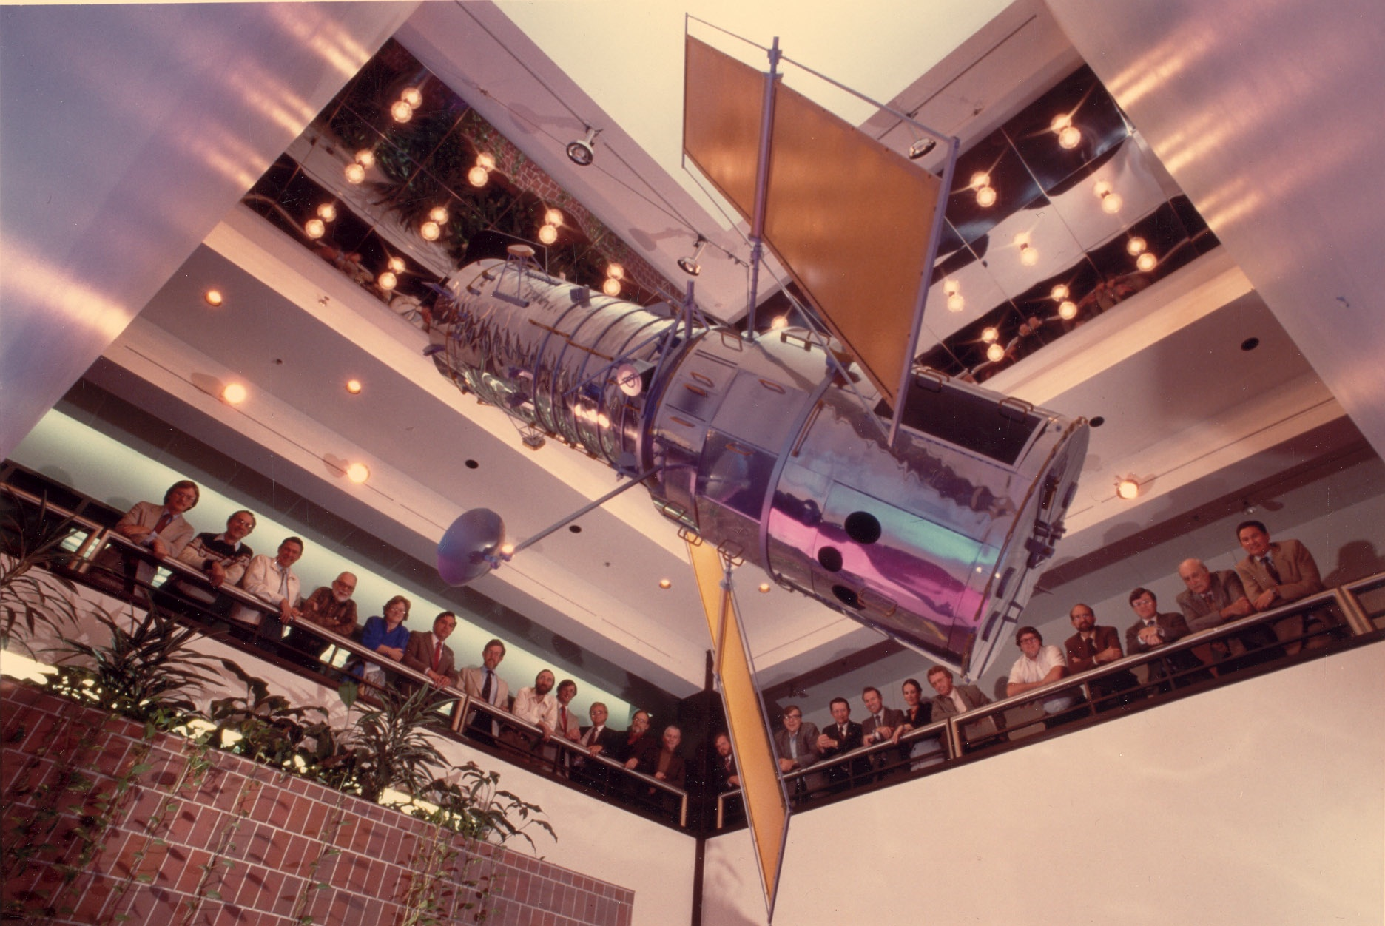
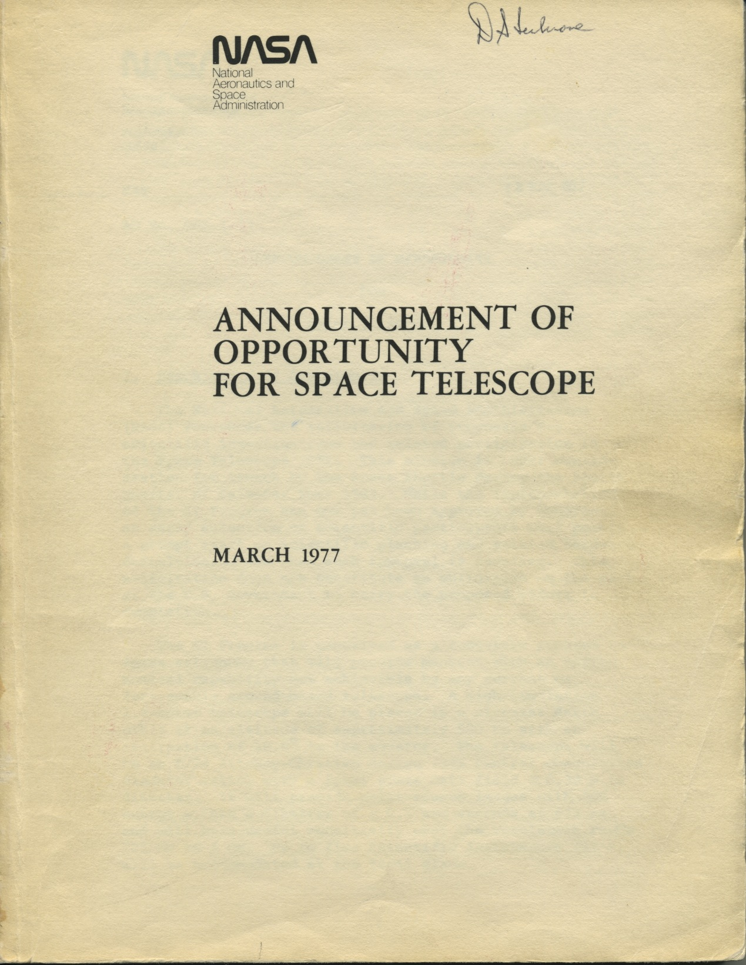
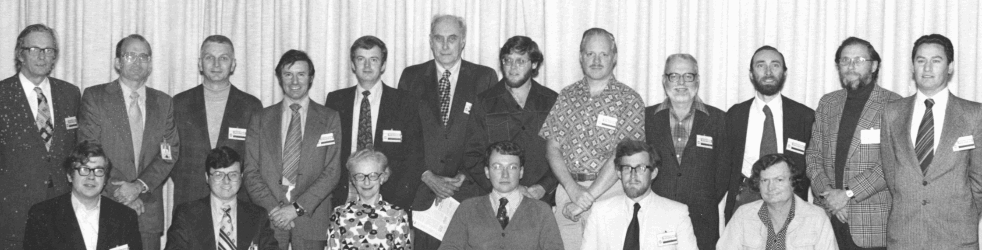
Scientific Instruments and the Phase C/D Science Working Group

Slide 8
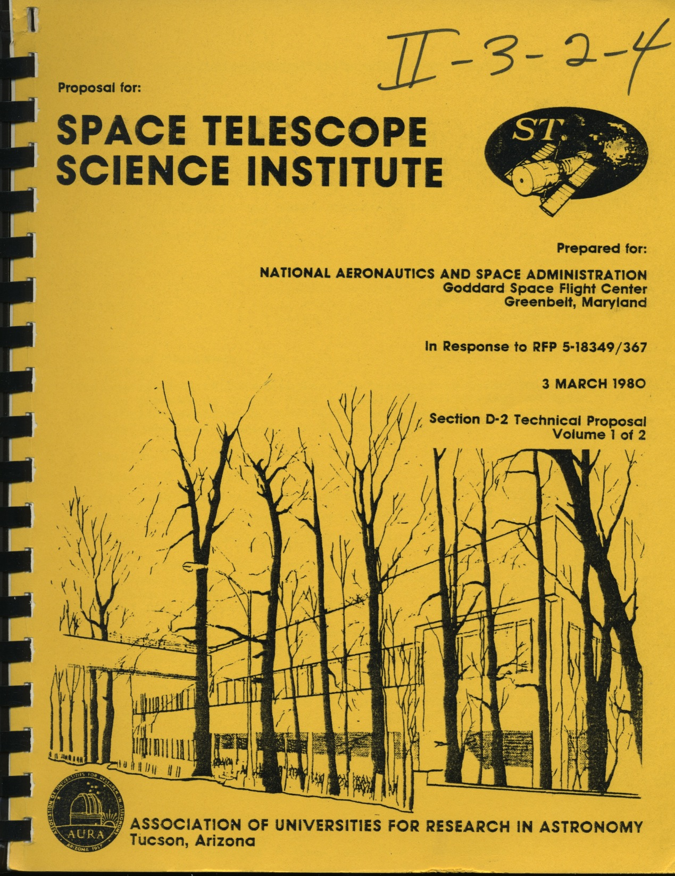
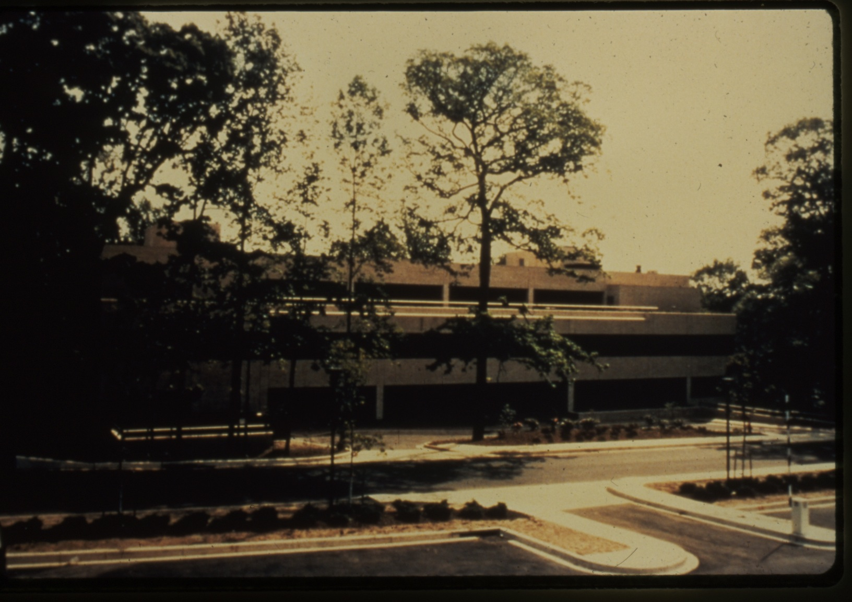
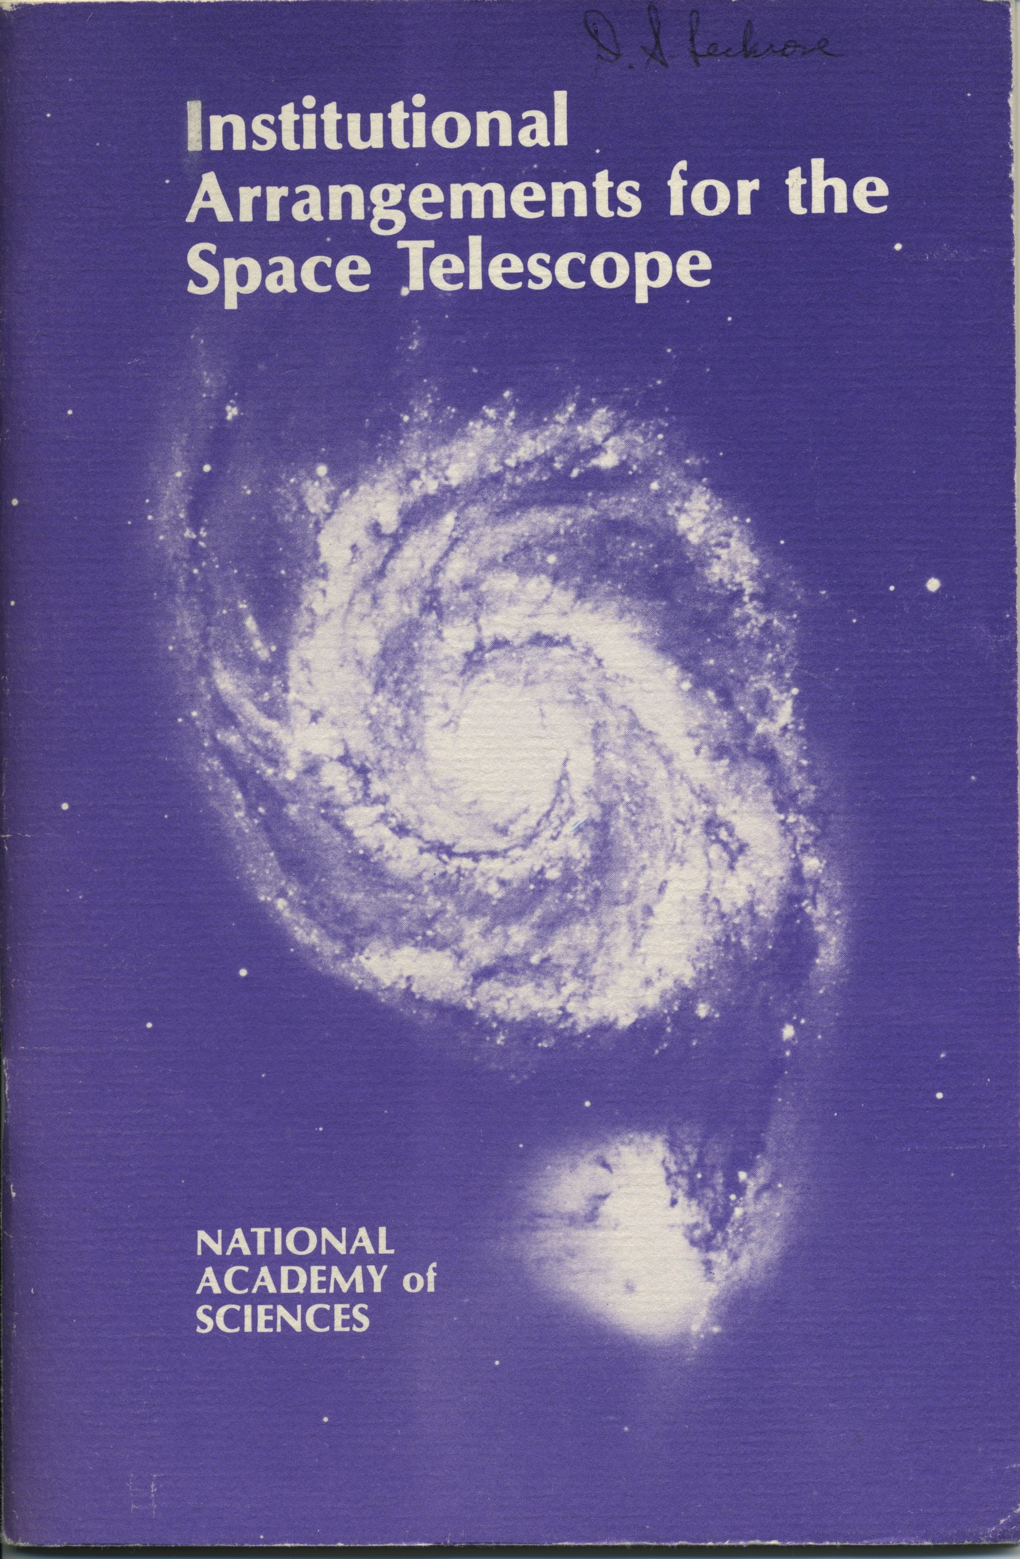
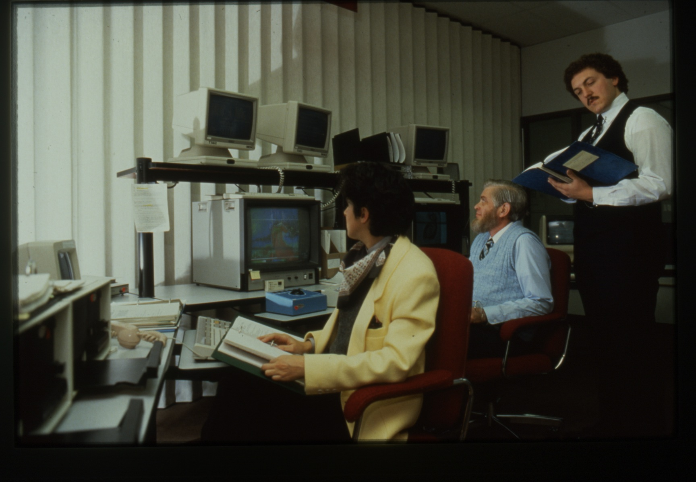
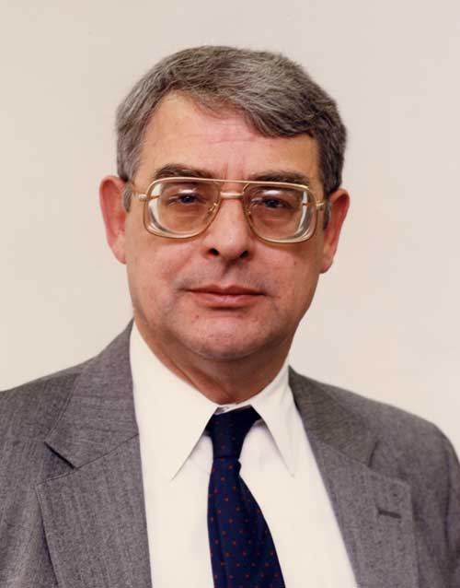
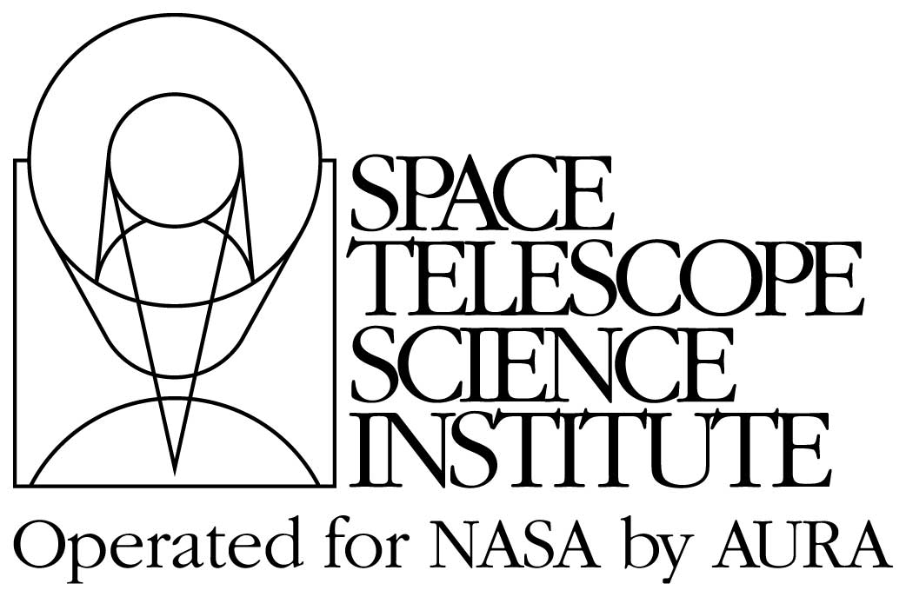
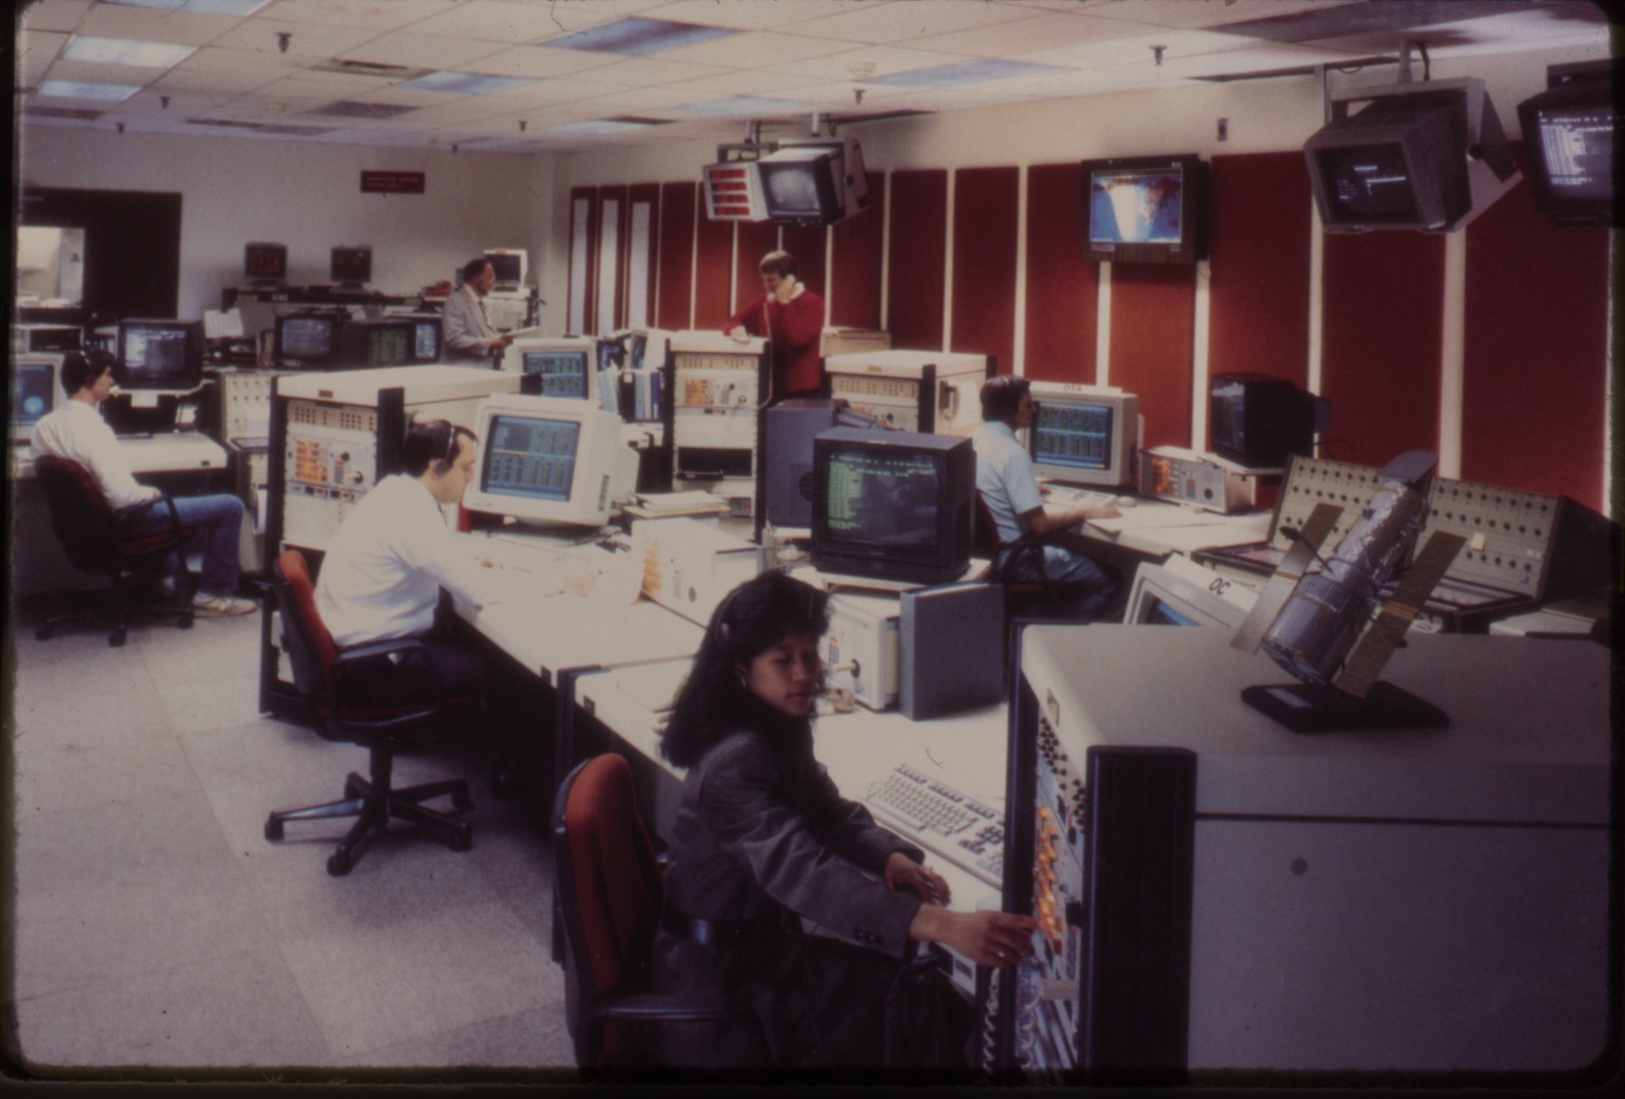
A New Paradigm
For
Science Operations

Slide 9
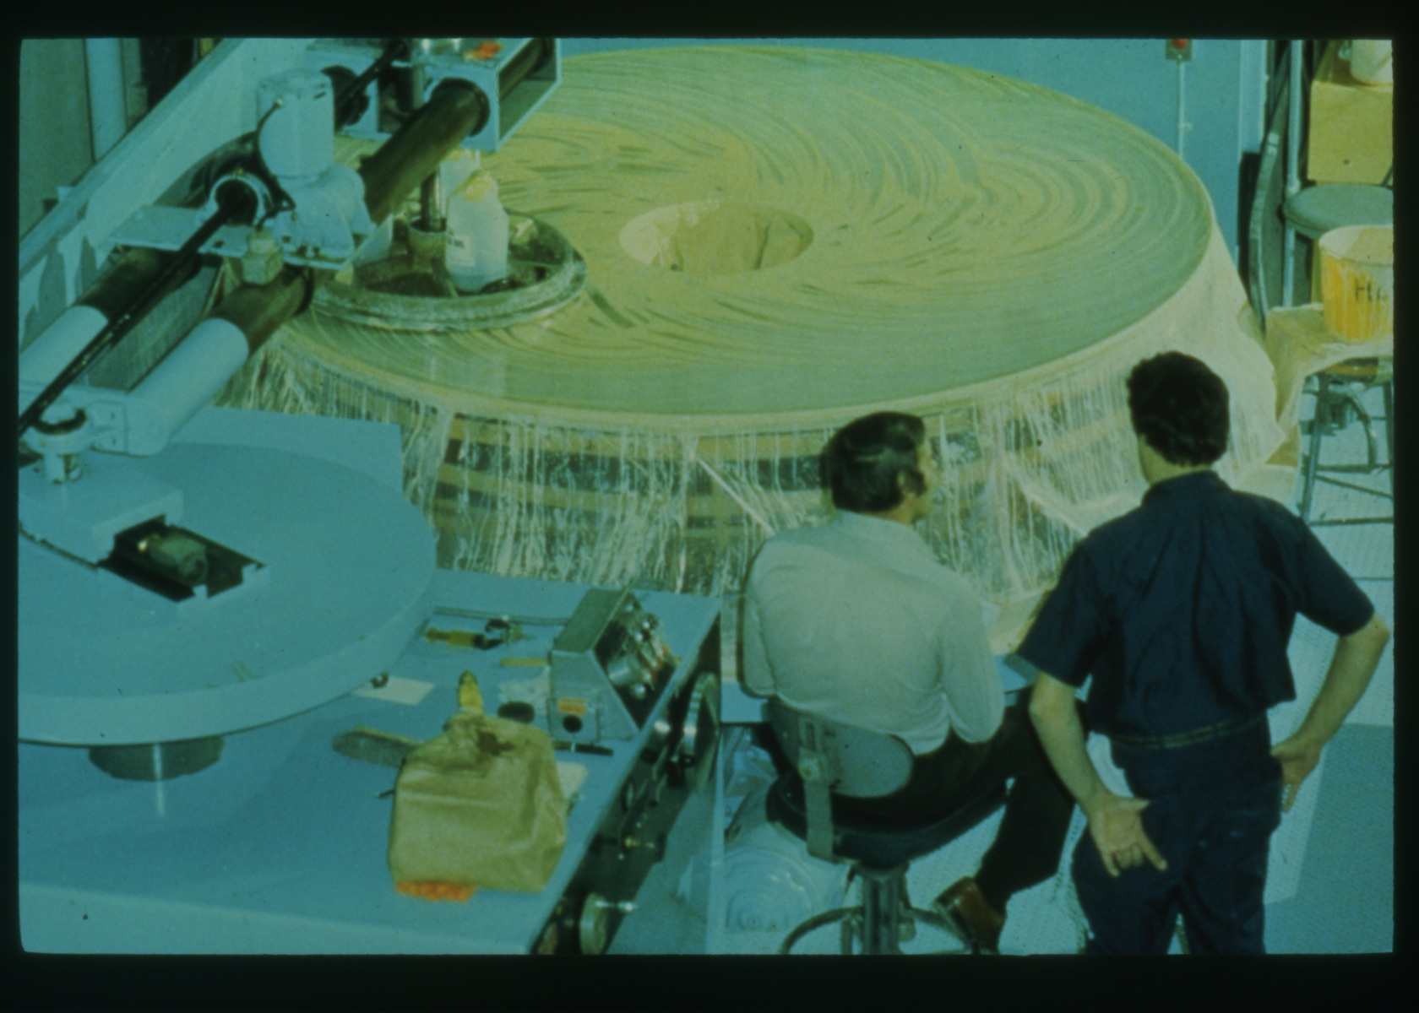
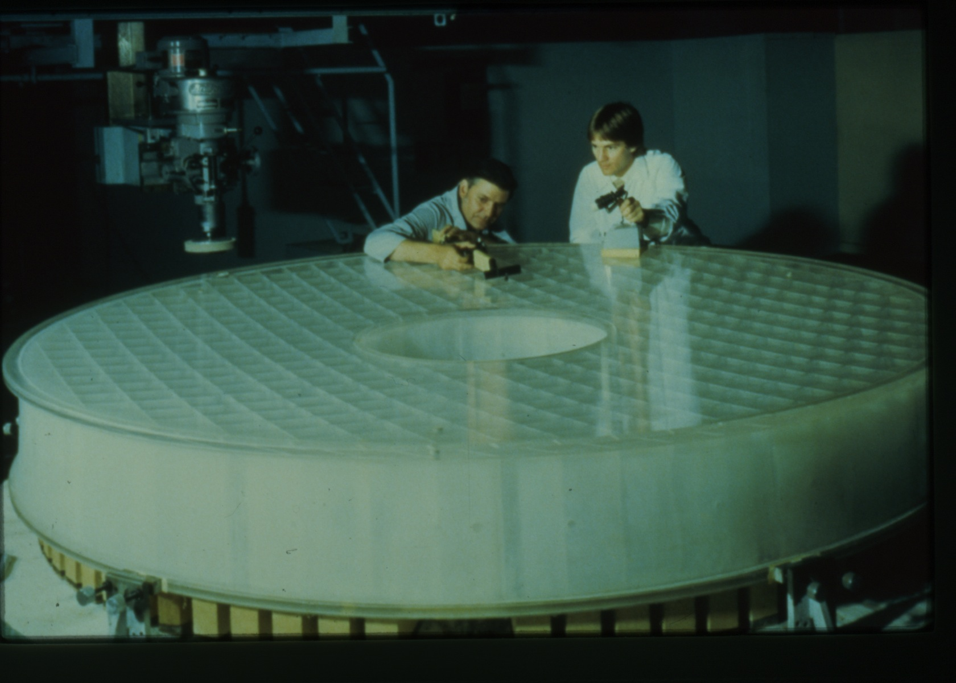
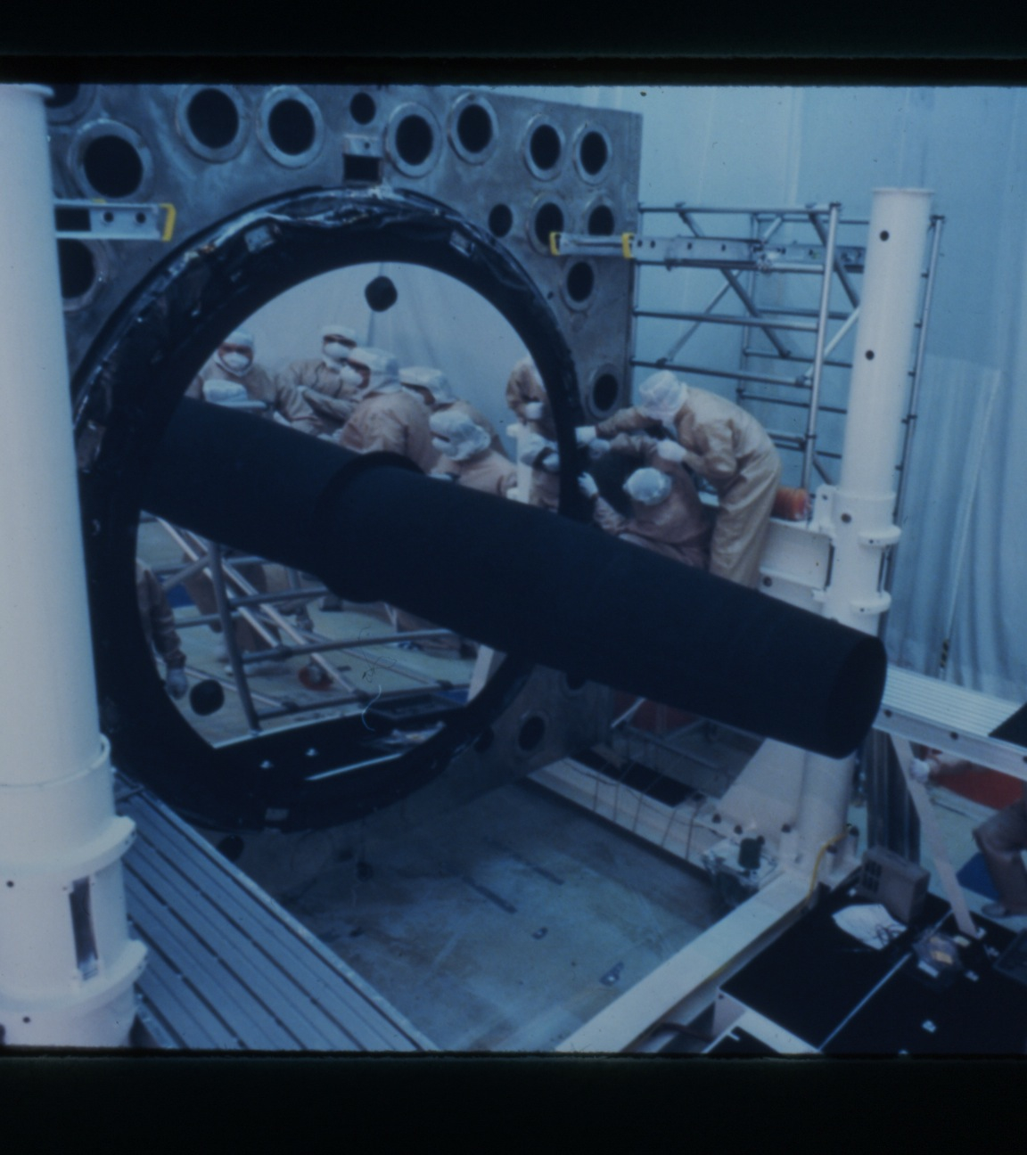
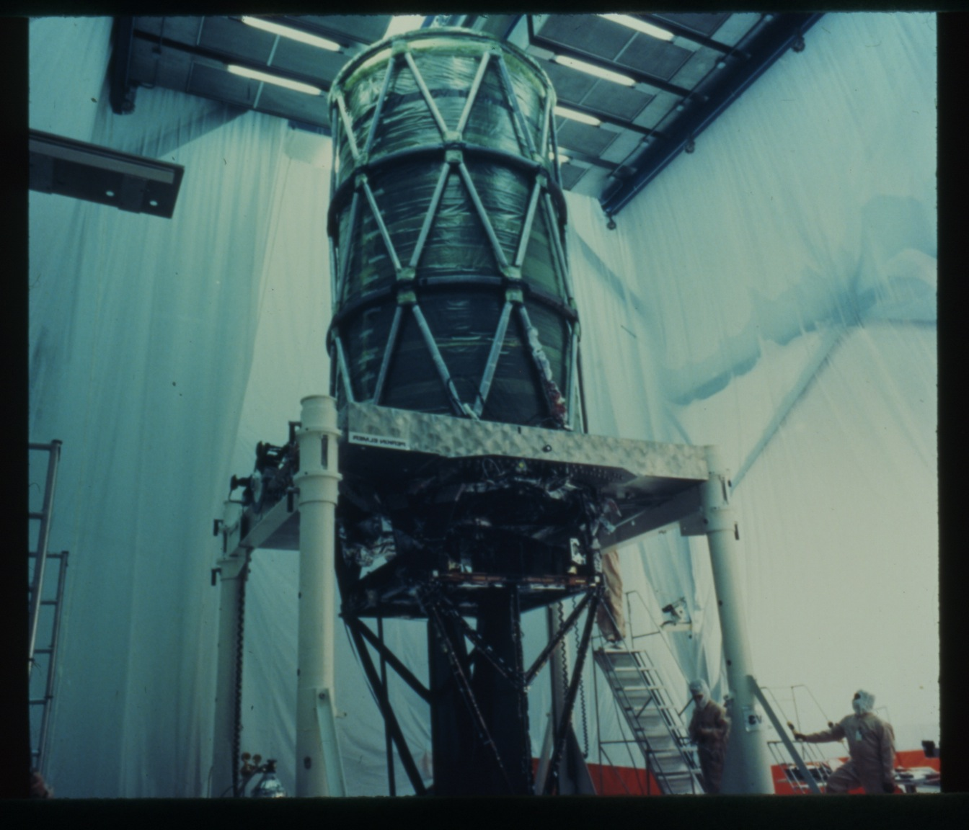
Building the Optical Telescope Assembly at Perkin-Elmer

Slide 10
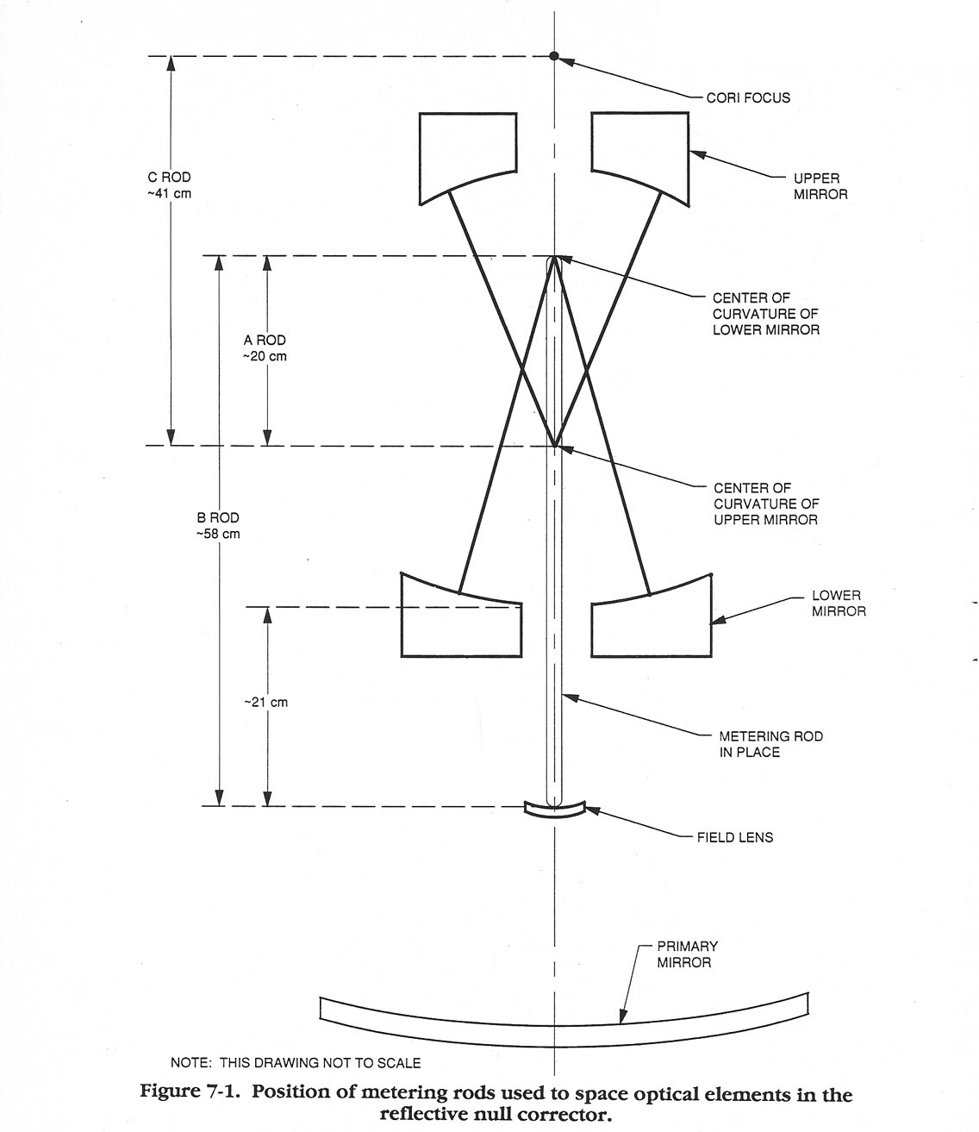
The Source of
Spherical Aberration

Slide 11
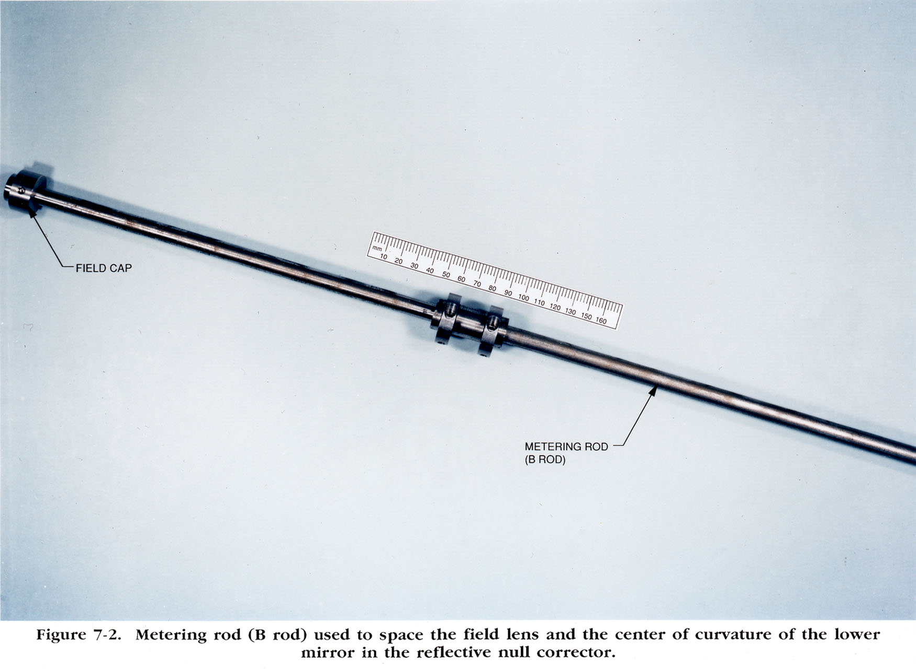
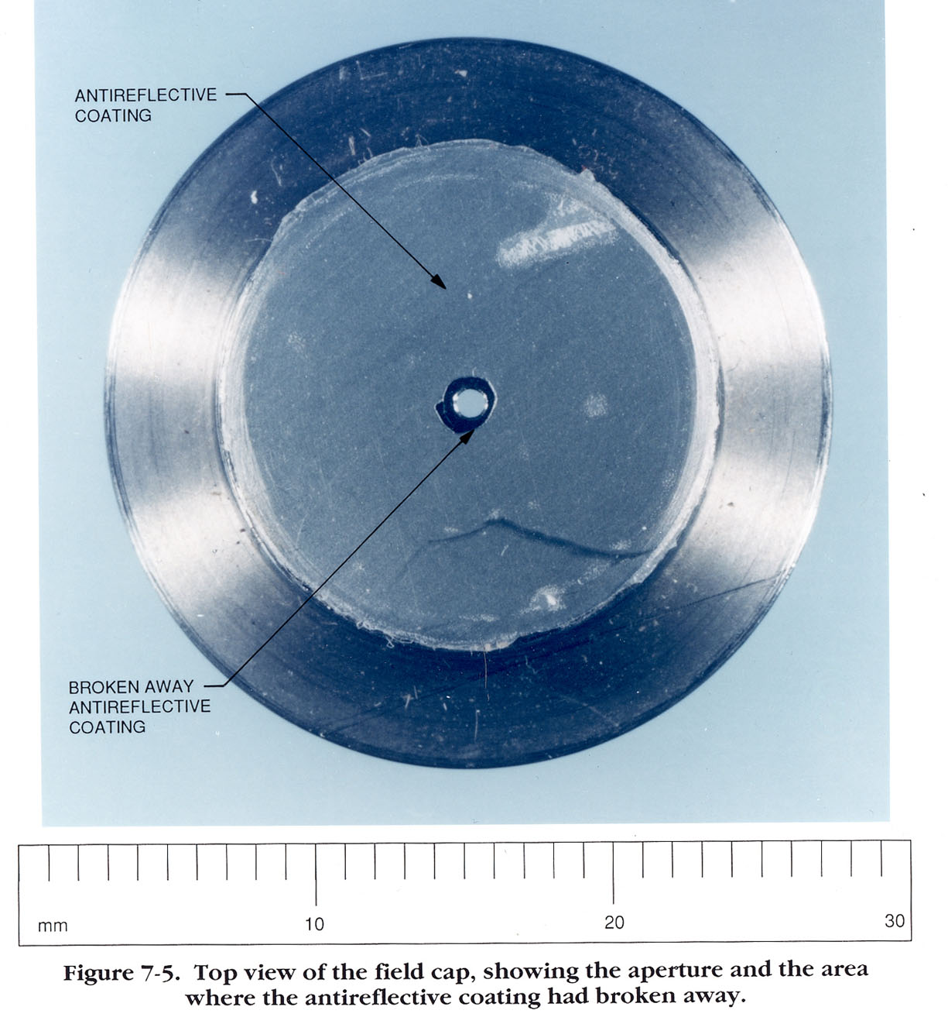
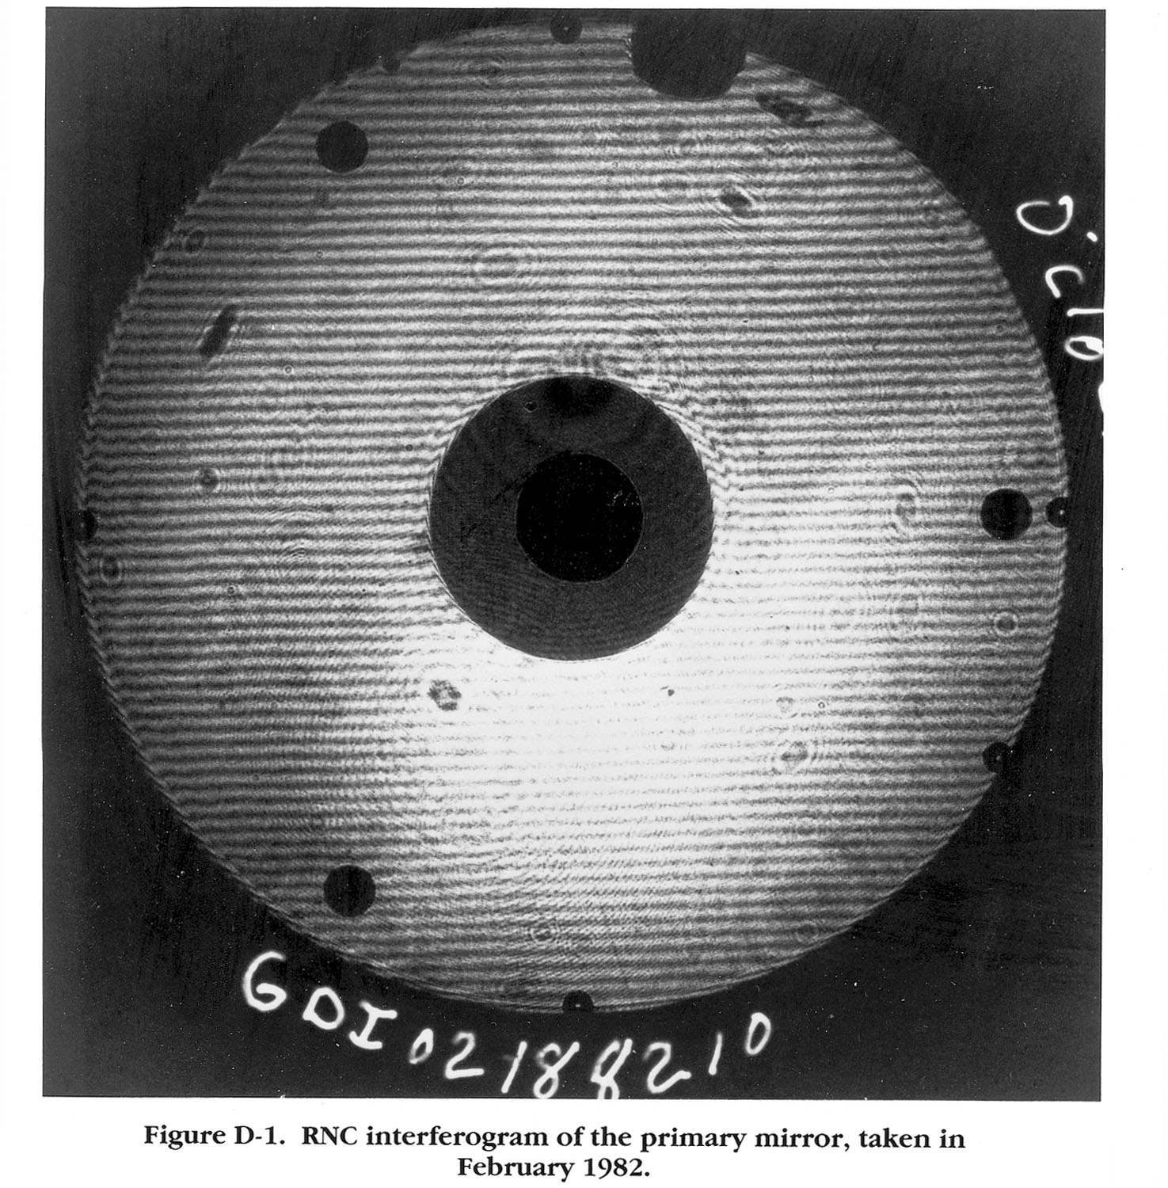
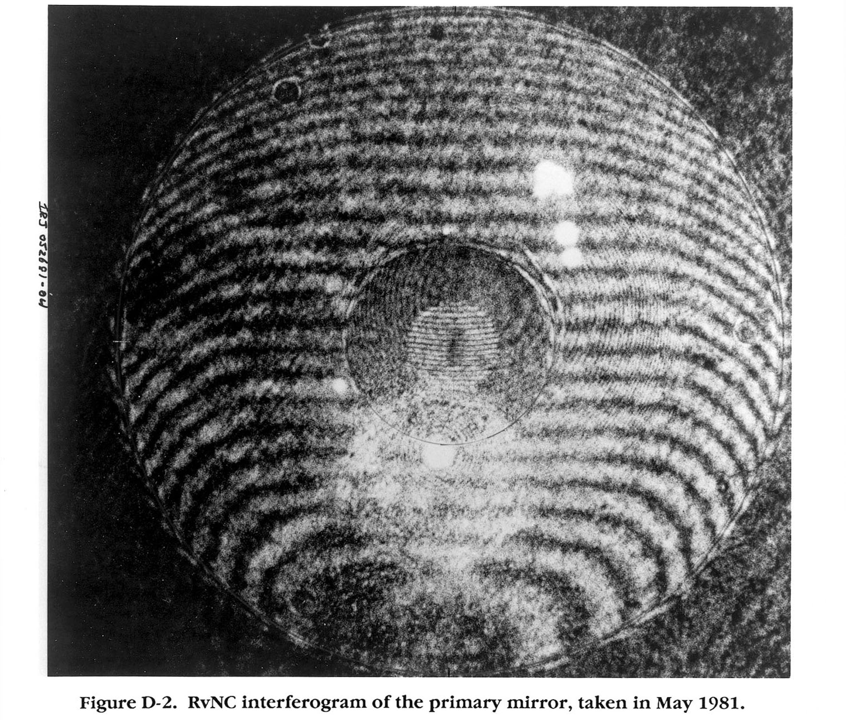

Slide 12
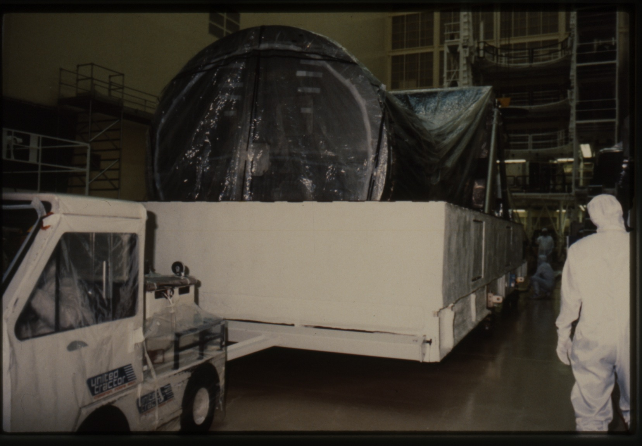
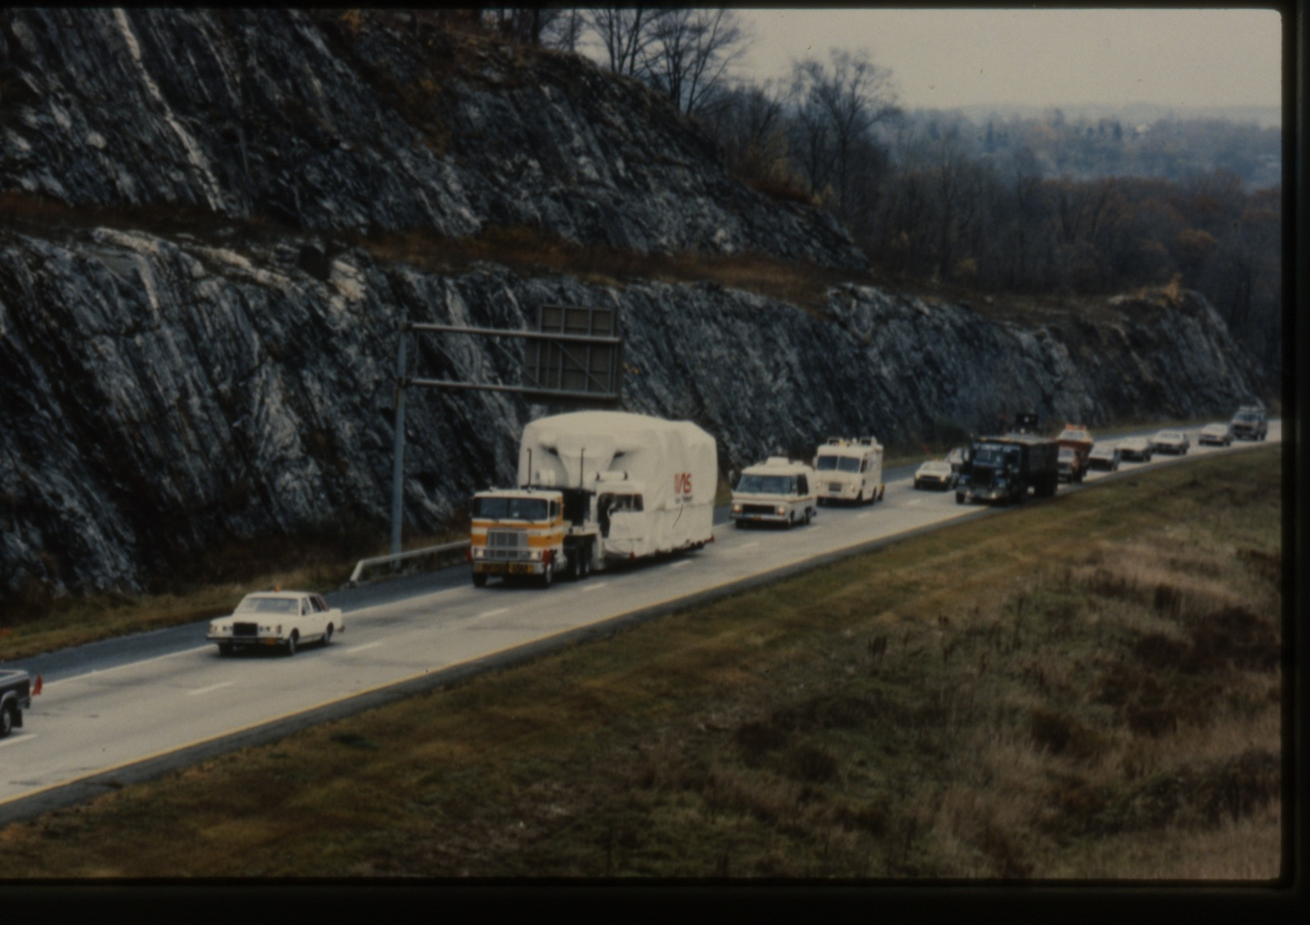
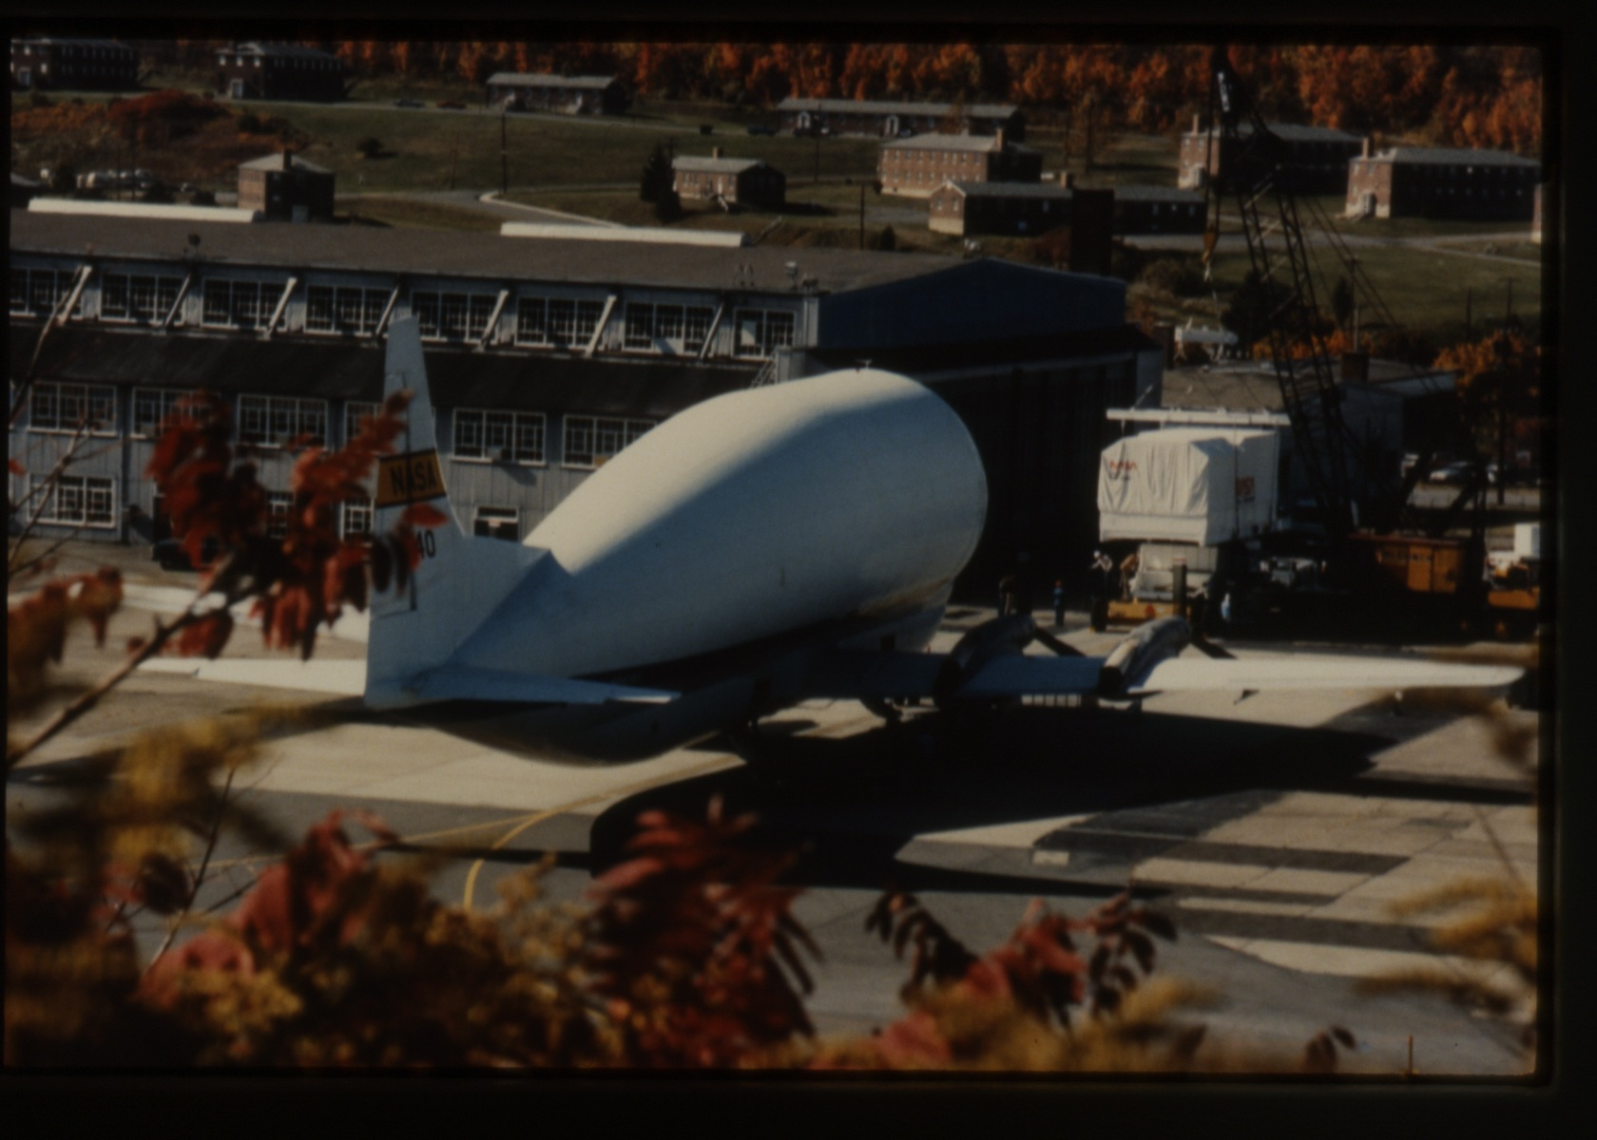
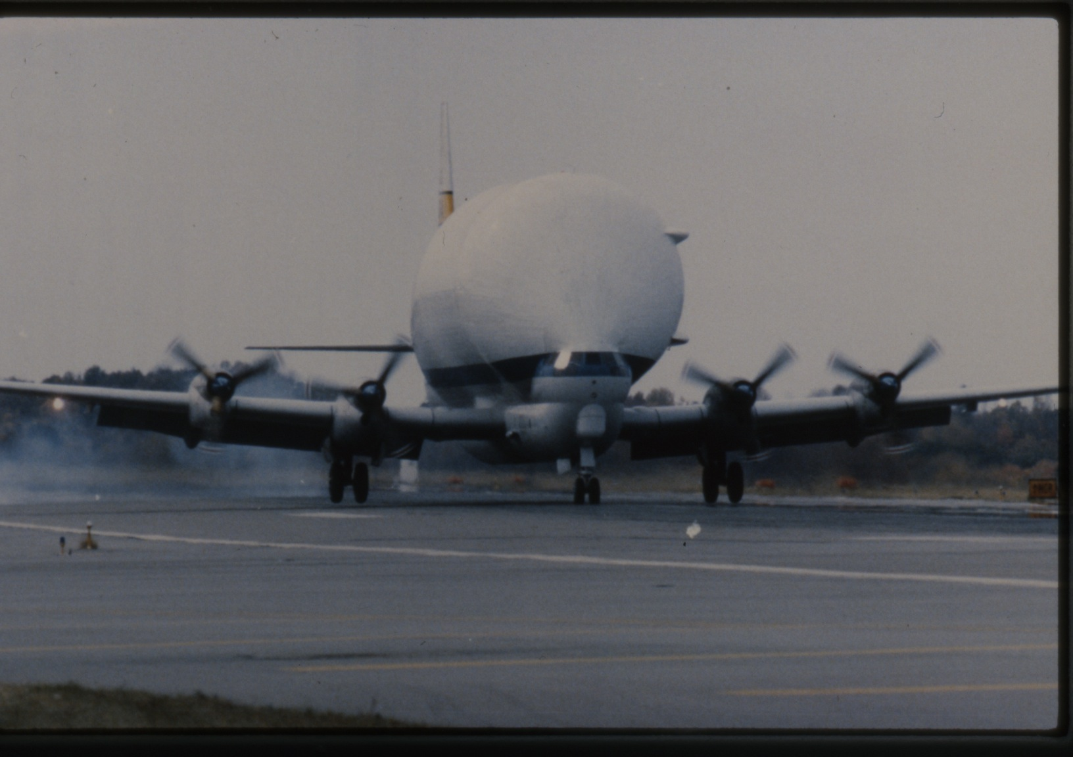
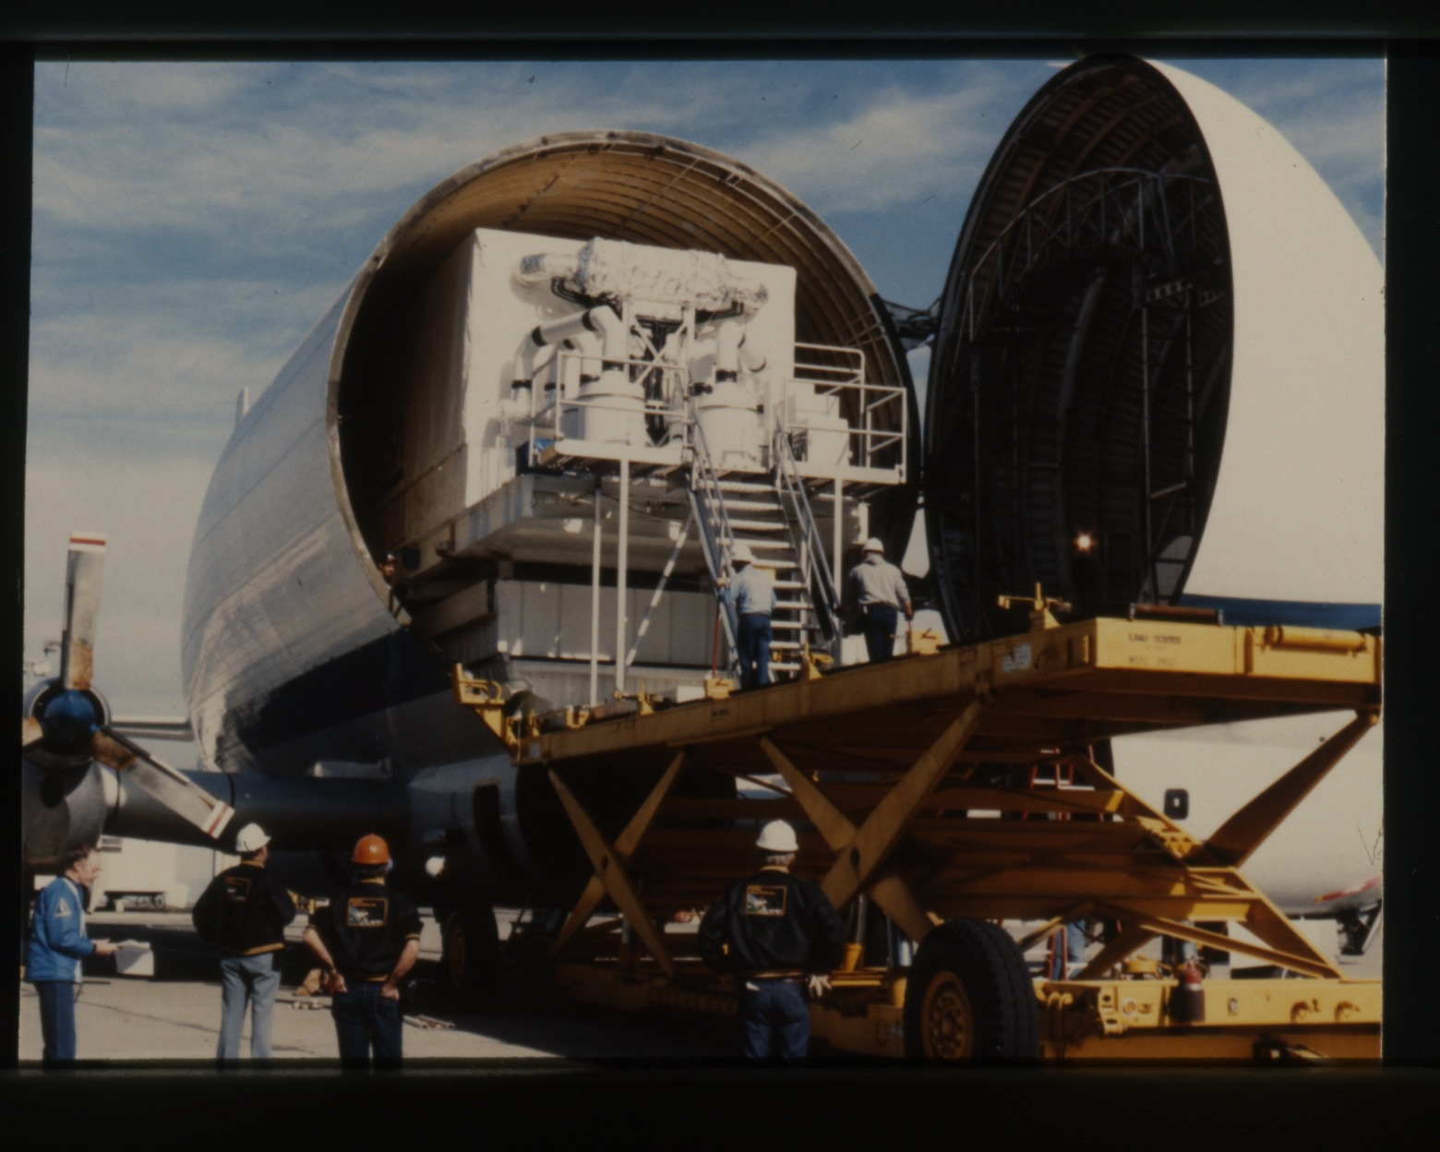
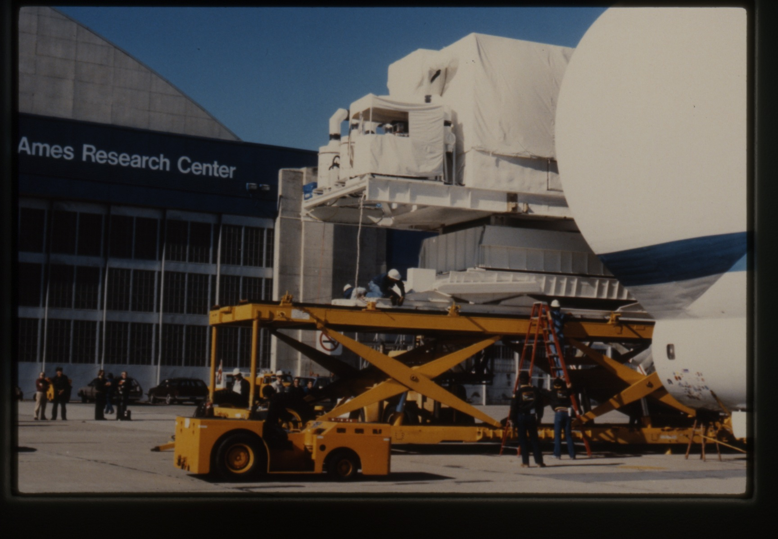
Transporting the OTA from Perkin-Elmer to Lockheed
Oct. 29 – Nov. 1, 1984

Slide 13
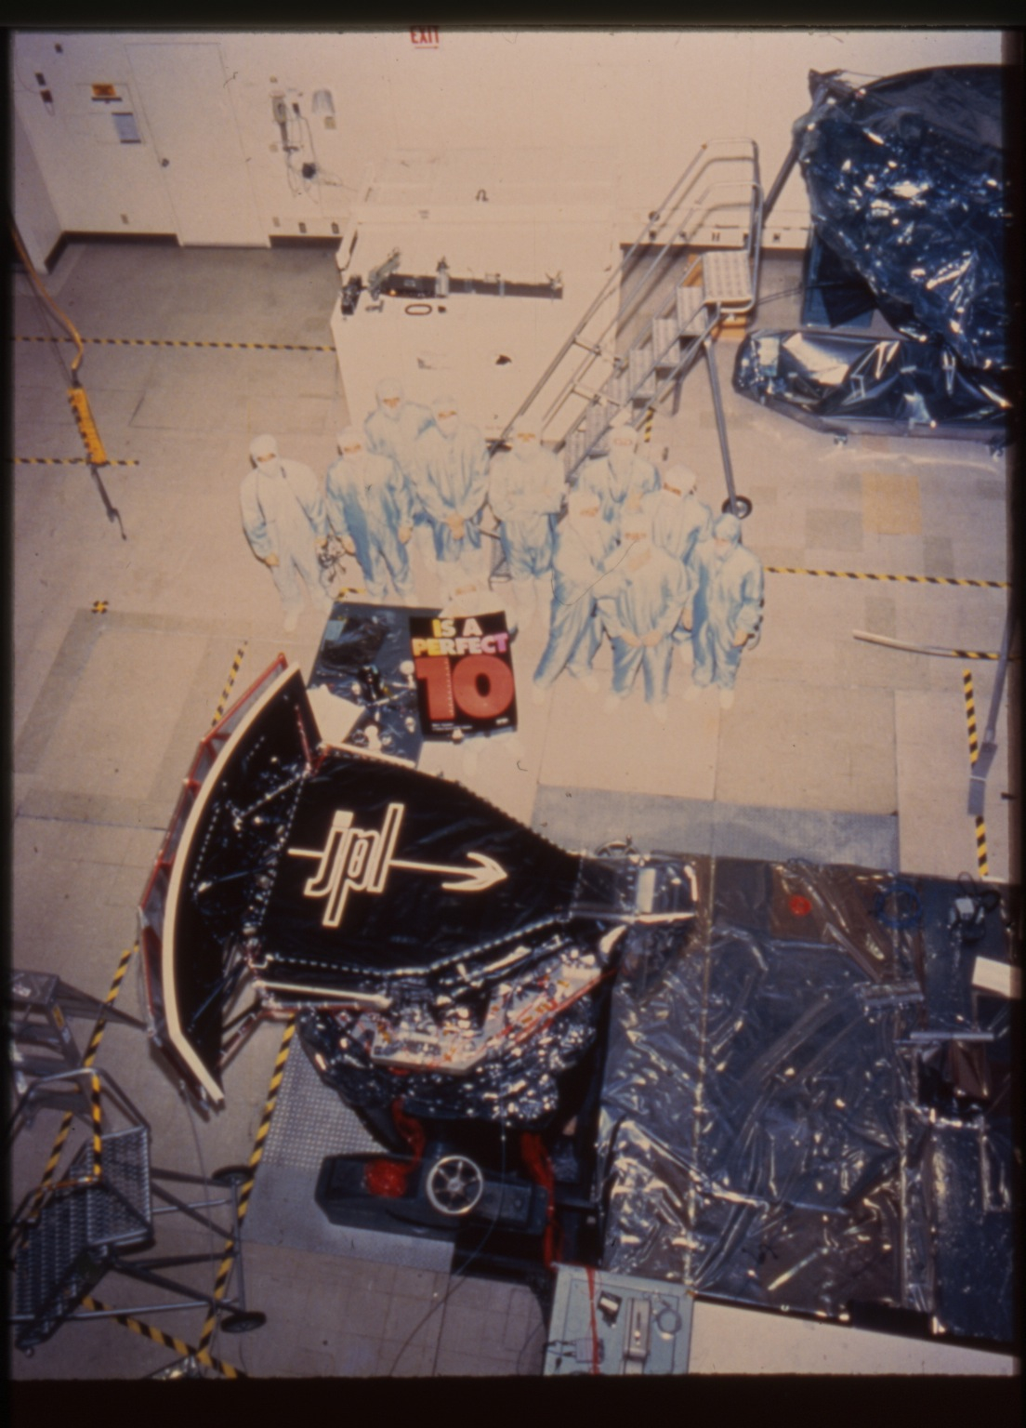
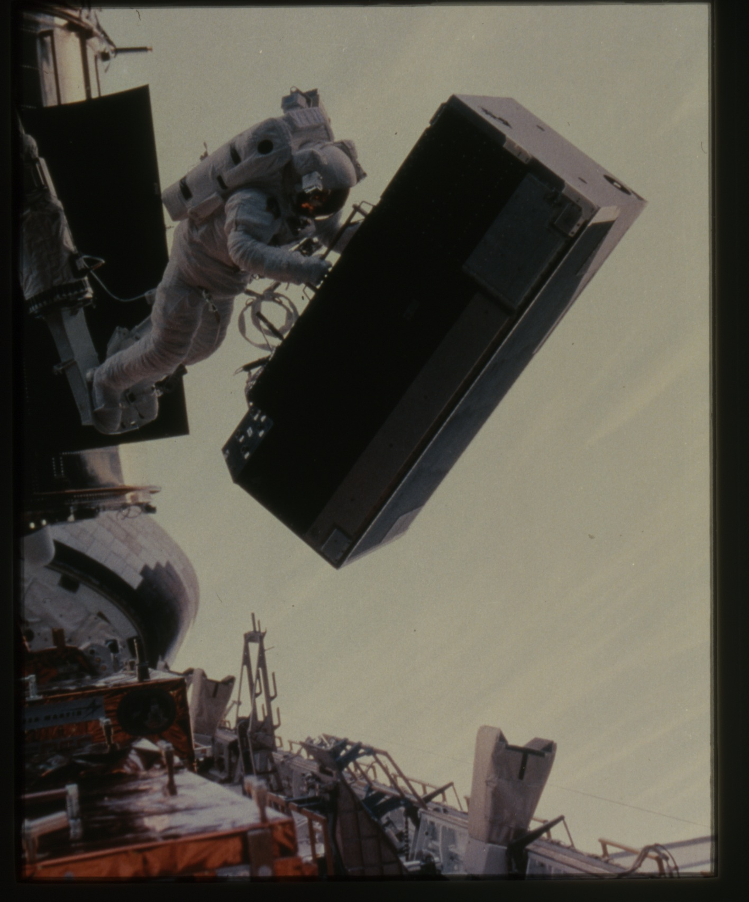
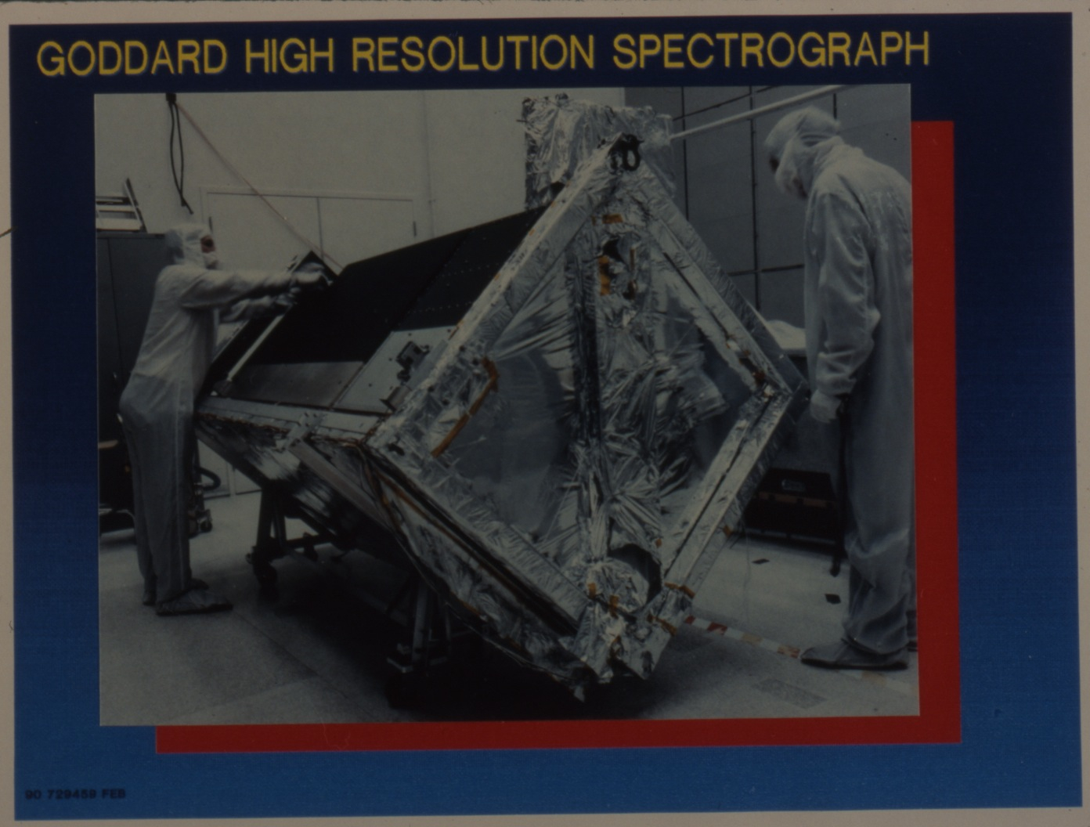
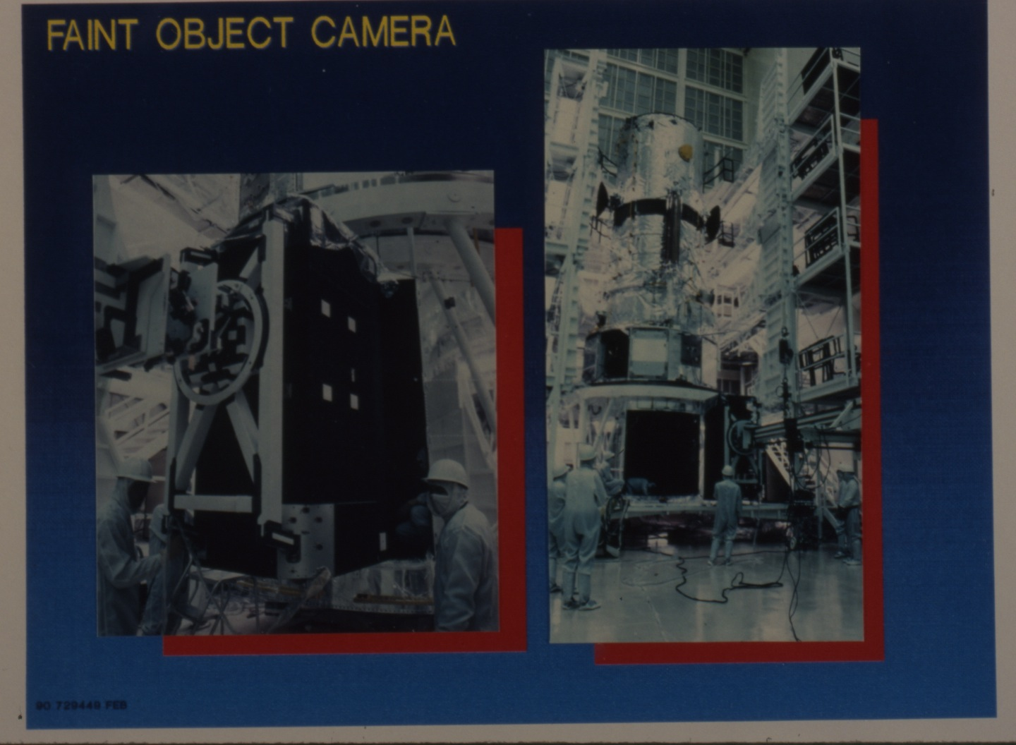
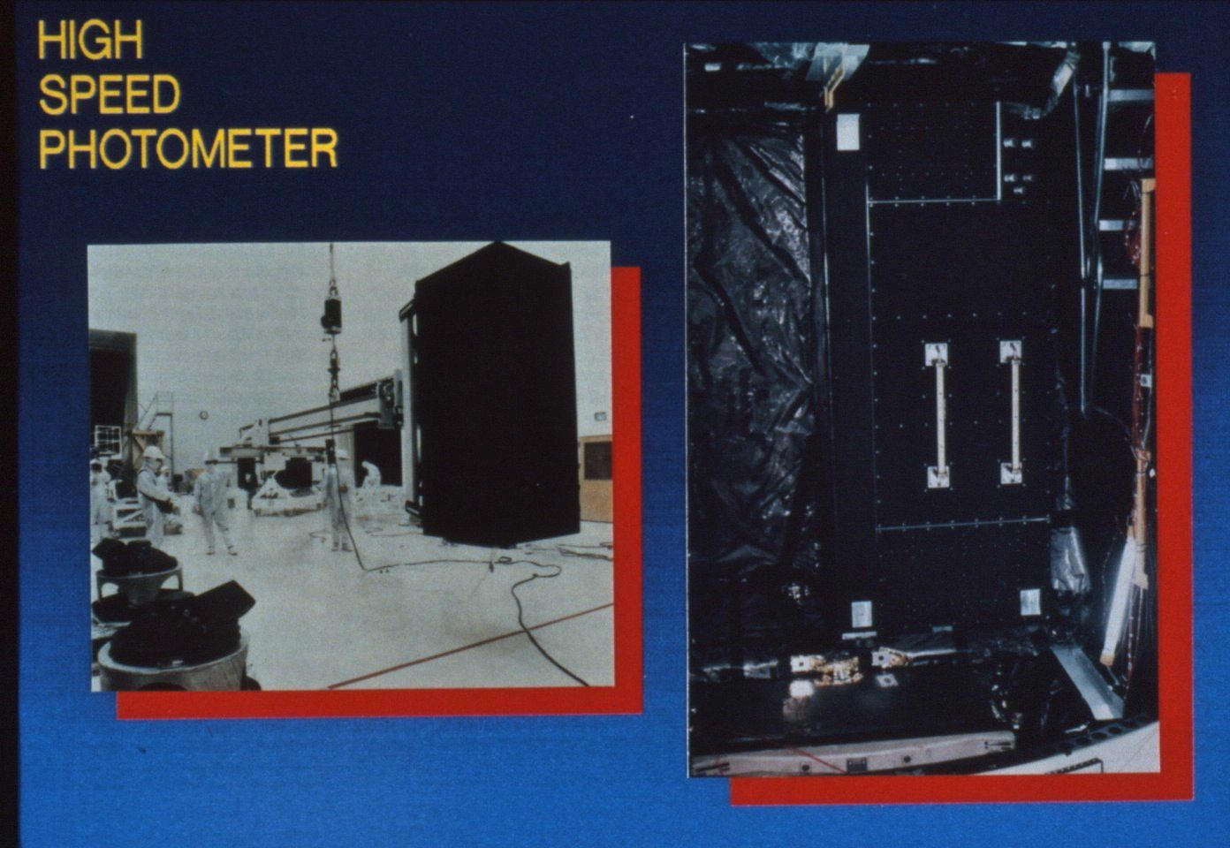
First HST Scientific Instruments
WFPC
FOS in 1997

Slide 14






Integration at Lockheed
Completed Feb. 15, 1985

Slide 15



Other Key Milestones of the 1980’s
The “Revolution” of 1983
  Science Working Group and others concluded “we just can’t get there from here.”
  Inadequate budget, schedule and systems engineering oversight
  Headquarters’ intervention infused Project with added funds, schedule relief and new management
Initiation of development of a “clone” WFPC at JPL
  Primary impetus came from HQ Program Scientist, Ed Weiler
  Imaging was the “heart and soul” of HST science
  Couldn’t imagine HST “going blind”
Challenger disaster in January, 1986 delayed HST launch indefinitely
  Launch date in August, 1986 had been slipped to October
  Four-year Delay allowed Project to complete work on ground system and to make needed “tweaks” to flight hardware

Slide 16





STS-31, Discovery
April 24, 1990

