Slide 1
Globular Cluster observations with HST
Giampaolo Piotto
Dipartimento di Astronomia
Universita’ di Padova

Slide 2
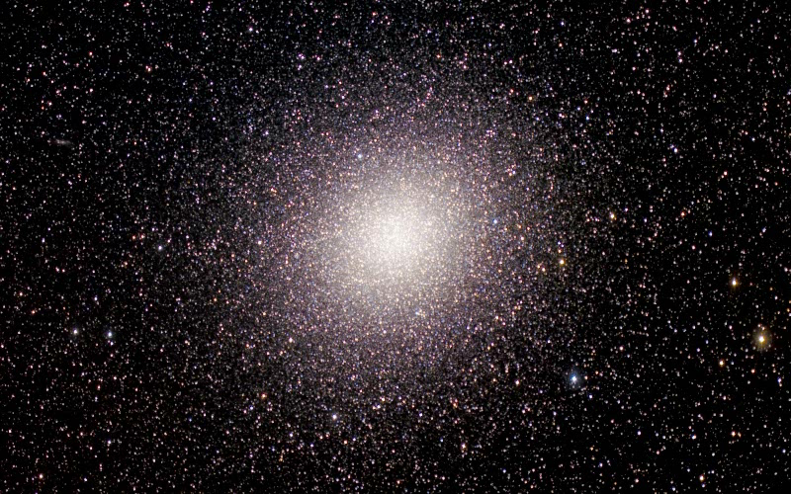
Jay Anderson courtesy

Slide 3
HST has wonderful astrometric capabilities
On well exposed stars, astrometric precision on
single images is of ~0.01 pixels, which implies:
WFPC2 : 1.00 milliarcsec (mas)
PC : 0.50 mas
HRC/ACS : 0.25 mas
WFC3 : 0.30 mas
But you can use many images, and reach higher
precision in relative stellar positions, with local transformations (J. Anderson great idea!)

Slide 4
HST high astrometric precision implies
high precision proper motions
Bulk motions:
membership: fast evolving stars, WDs, binaries, exotics like CVs, blue stragglers, etc.
2) Absolute motions:
clusters, field stars, rotations
3) Internal motions:
Internal dynamics, IMBH?, absolute distances

Slide 5
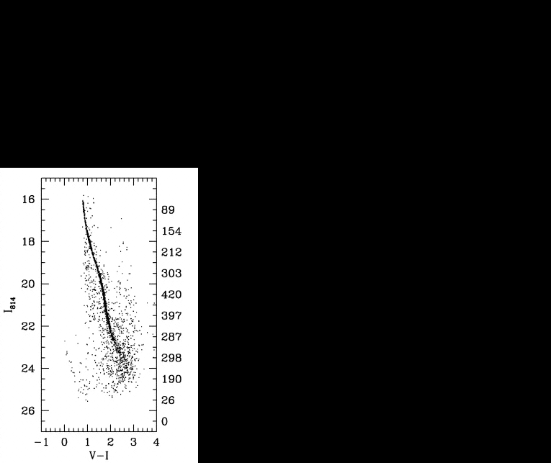
6397STRIP1
Ivan King and the faint stars in NGC 6397
  End of sequence lost in field stars
  How to identify the members?
Proper motions!!

Slide 6
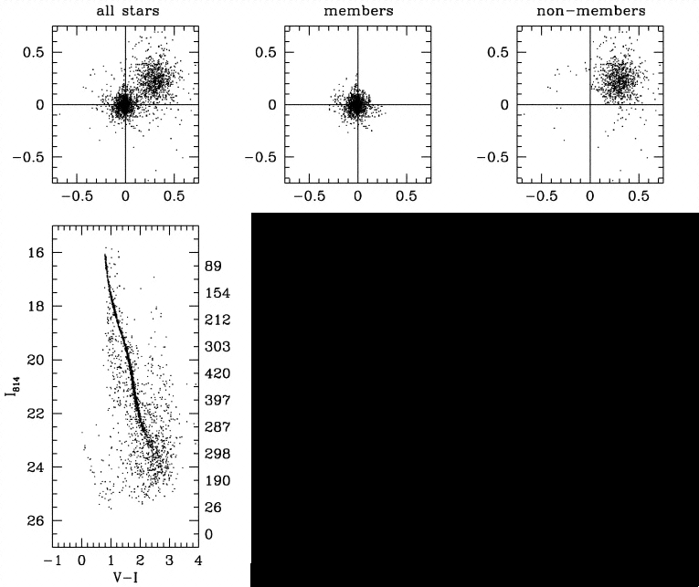

Slide 7
6397STRIP3

Slide 8
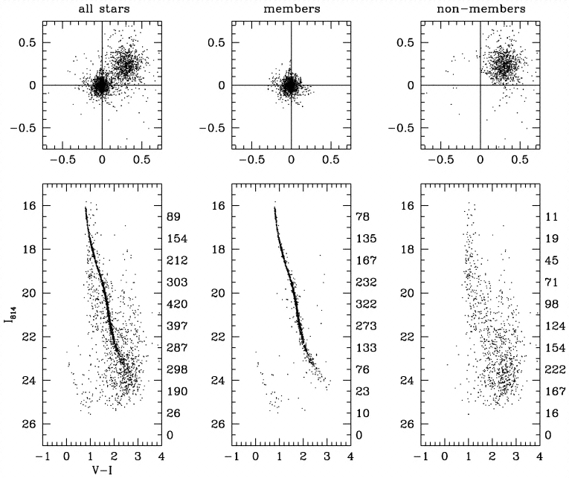
6397STRIP4
King, Anderson, Cool, Piotto 1998, ApJ, 492, L37

Slide 9
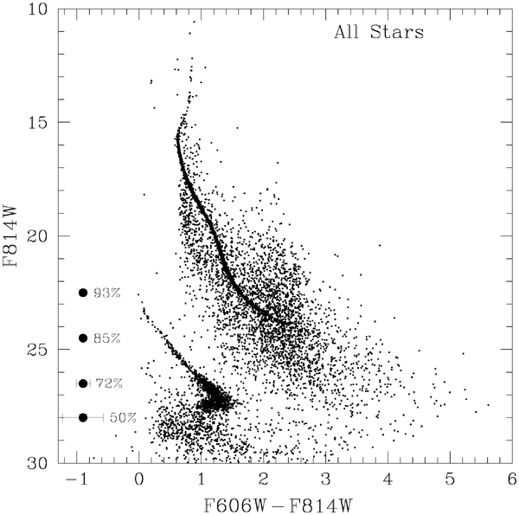
NGC6397 II: pushing HST to the limits
Richer et al. (2005) observed NGC6397 with 126 orbits
  Discoveries
    End of WD cooling sequence
    Blue hook at the WDCS bottom!
    End of MS?
  Again: limitations: field stars and galaxies!
WDCS
HBL?

Slide 10
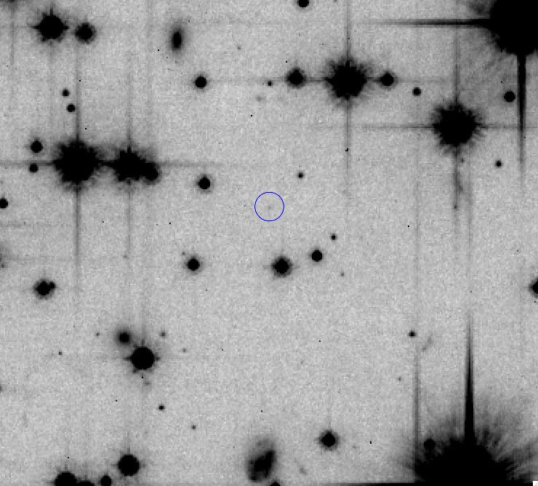
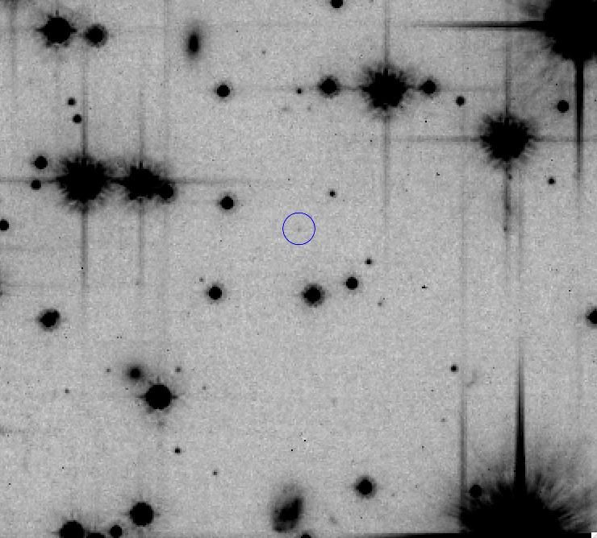
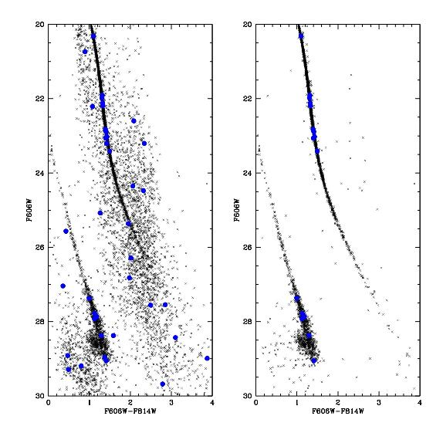
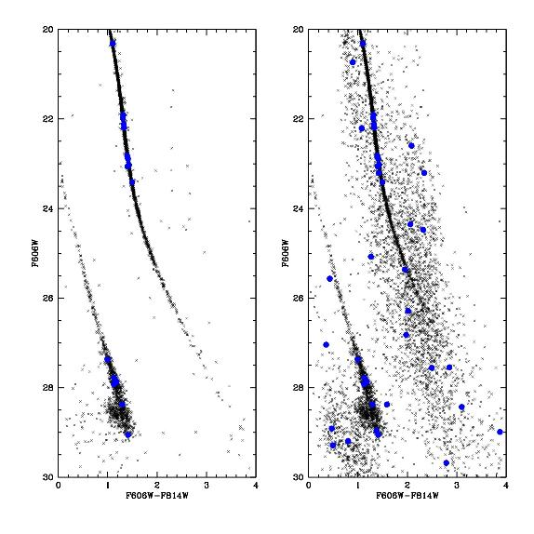
Proper motion cleaning, 5 years
baseline
NGC6397
PI-Rich, UCLA
BLINK

Slide 11
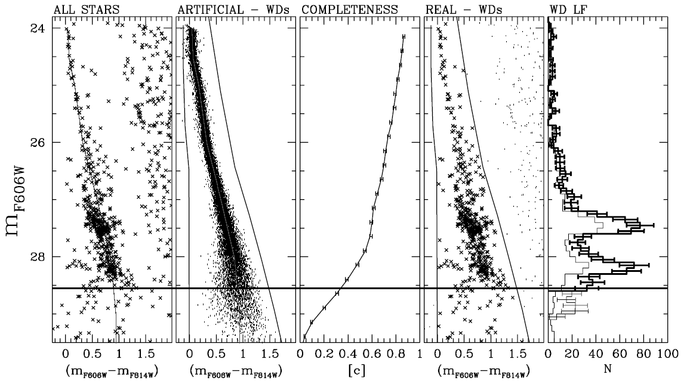
Pushing HST to the limits, sometimes you may get… surprises:
The double peaked WD cooling sequence in NGC 6791
Bedin et al. 2005, 2008a, 2008b

Slide 12
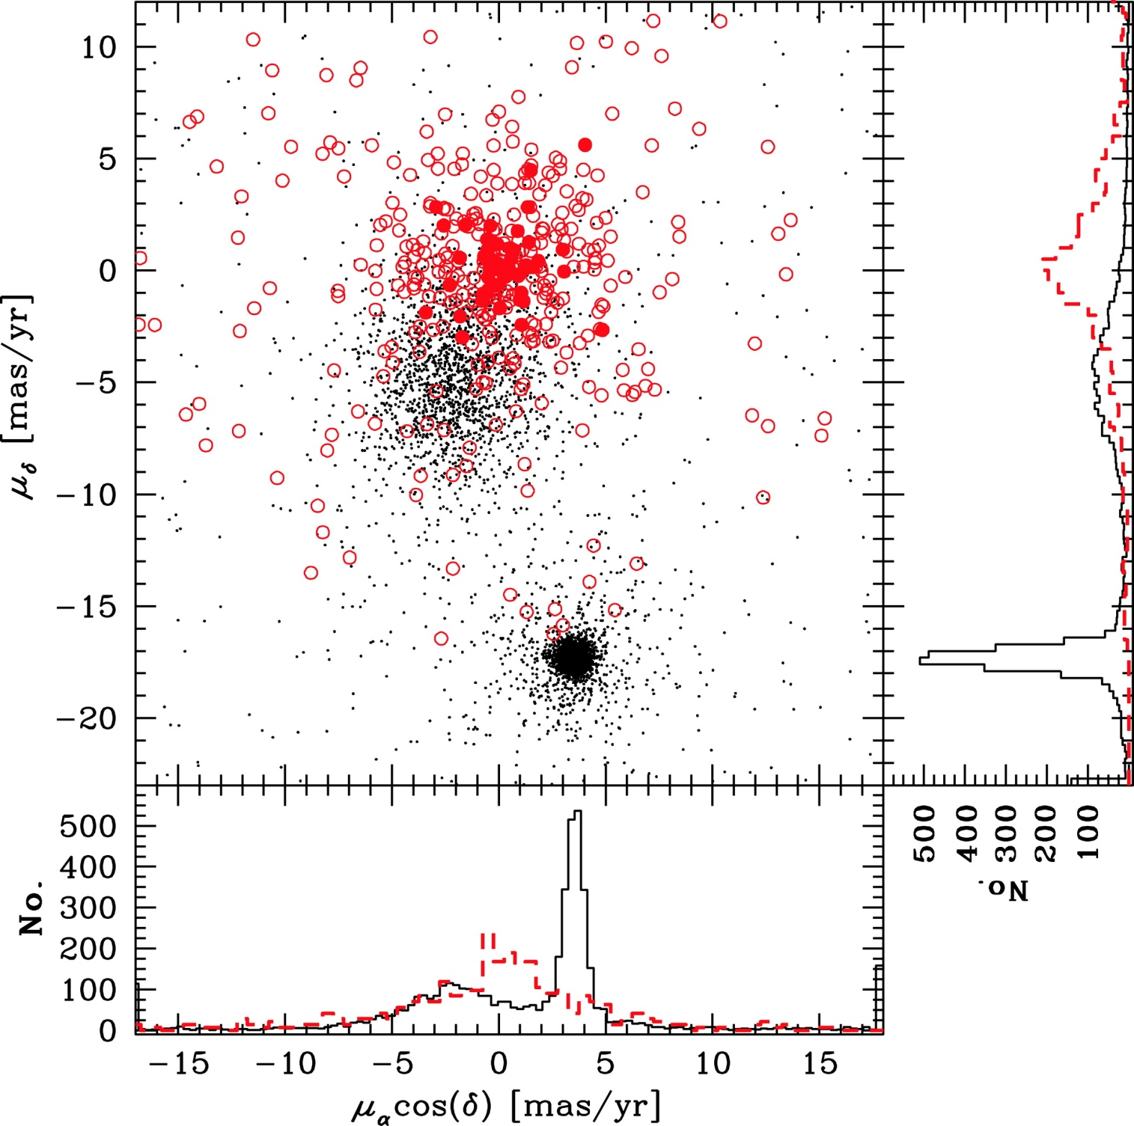
NGC 6397 III: Richer’s 126 HST orbits, 398 bk galaxies
250μas astrometric
precision on single brightest galaxies;
10yr baseline,
40μas/yr in absolute proper motion error!
The “problem” with proper motions is that…they become better and better with time!
Kalirai et al. (2007)

Slide 13
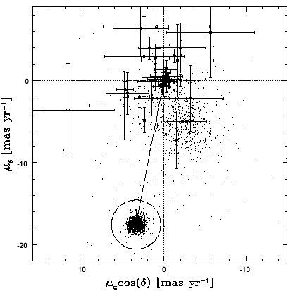
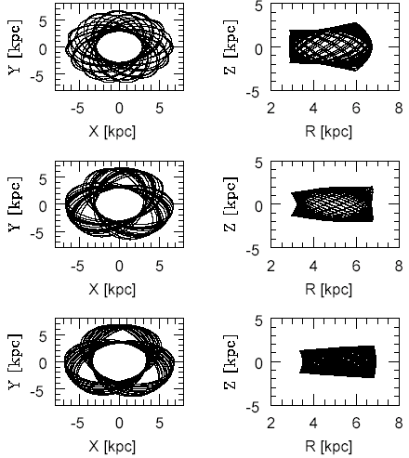
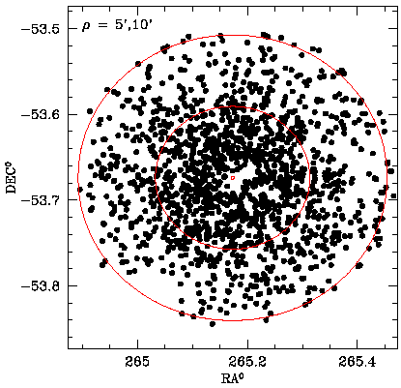
proper motion
3D absolute motions: the orbits of NGC 6397
background
galaxies
field
stars
d=2000pc
NGC6397
d=2200pc
d=2400pc
radial velocity
cluster orbit
Milone et al. 2006, A&A 460, L27

Slide 14
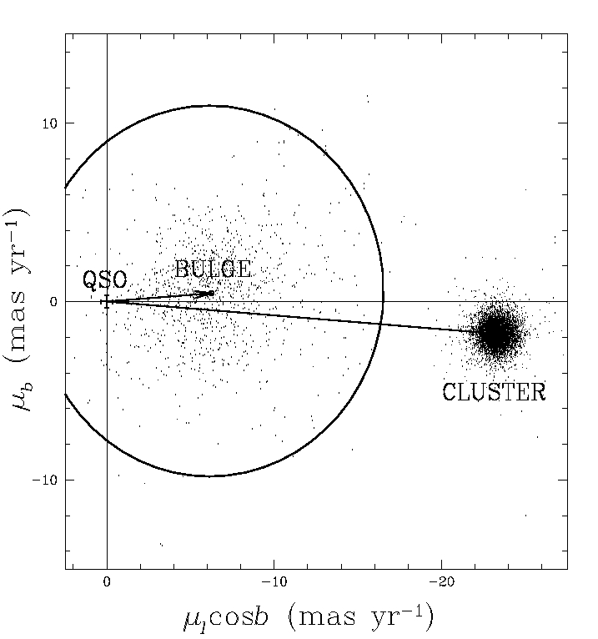
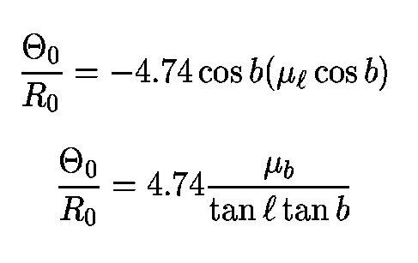
Bedin, Piotto, King, Anderson 2003, AJ, 126, 247
Field stars
may be as
useful as
cluster
stars!!!!
Measurement of the Galactic constant:
(A-B)_{Oort}=Θ₀/R₀=
27.6±1.7 km/s/Kpc

Slide 15
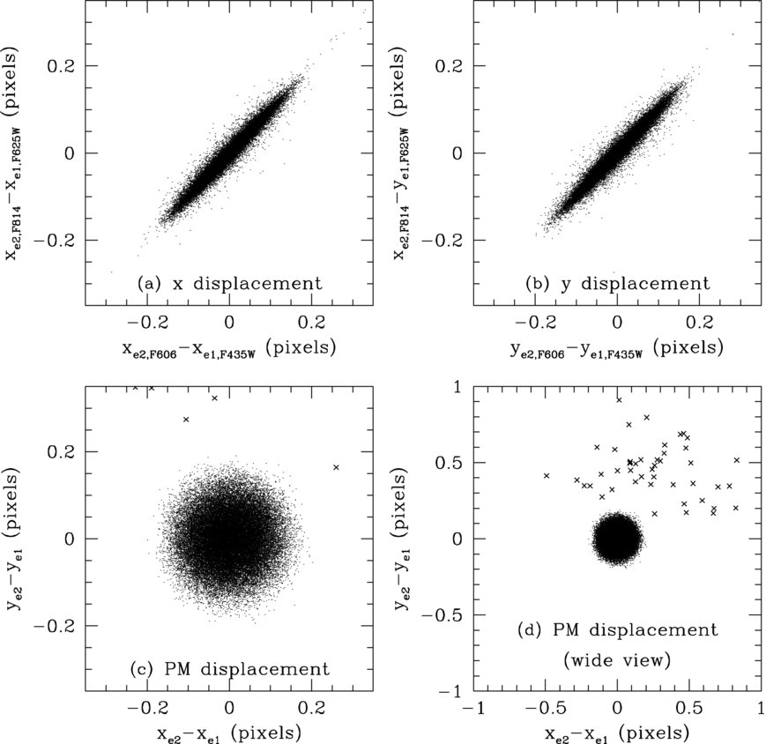
Geometrical distance of ωCen
2-dimensional proper motion dispersion:
σ_{x} = 833 ± 59 µas/yr
σ_{y} = 835 ± 71 µas/yr
Comparing proper motion dispersion (an angular) quantity with the radial velocity dispersion (a linear quantity), we get the distance:
D = 4.70 ± 0.06 kpc
Anderson and van der Marel (2010)
Van der Marel and Andersono (2010)

Slide 16
Geometrical distance of ωCen
2-dimensional proper motion dispersion:
σ_{x} = 833 ± 59 µas/yr
σ_{y} = 835 ± 71 µas/yr
4 year time baseline
Comparing proper motion dispersion (an angular) quantity with the radial velocity dispersion (a linear quantity), we get the distance:
D = 4.70 ± 0.06 kpc
p.m.
error
Proper motion dispersion
Anderson and van der Marel (2010)
Van der Marel and Andersono (2010)

Slide 17
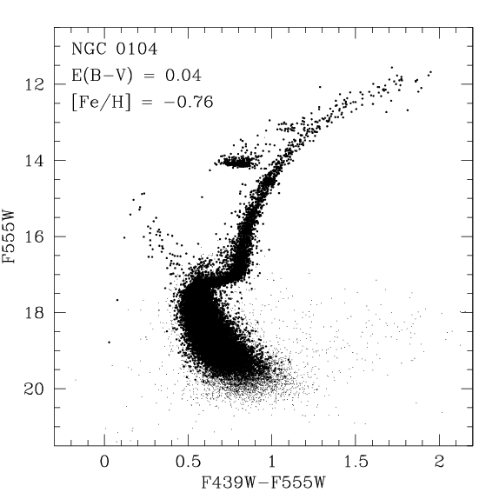
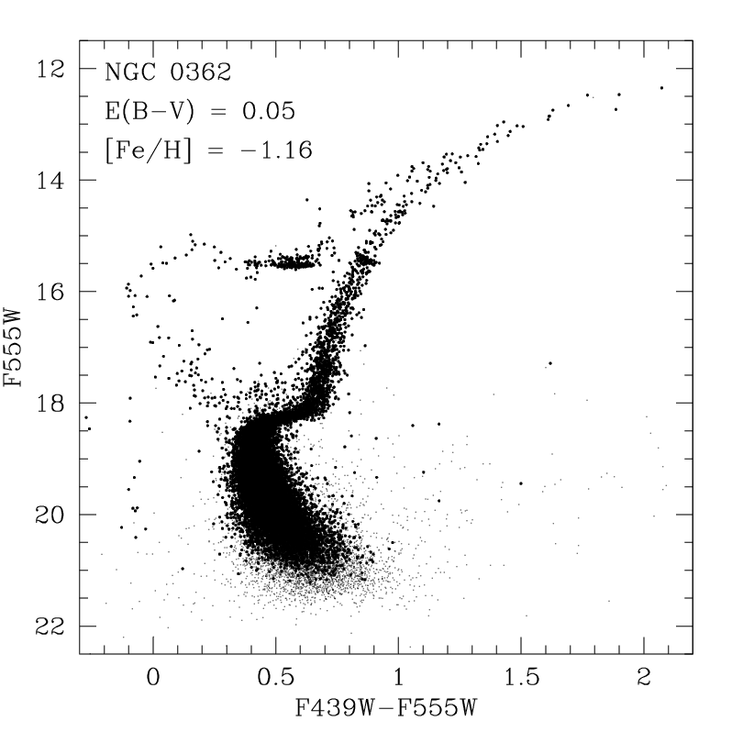
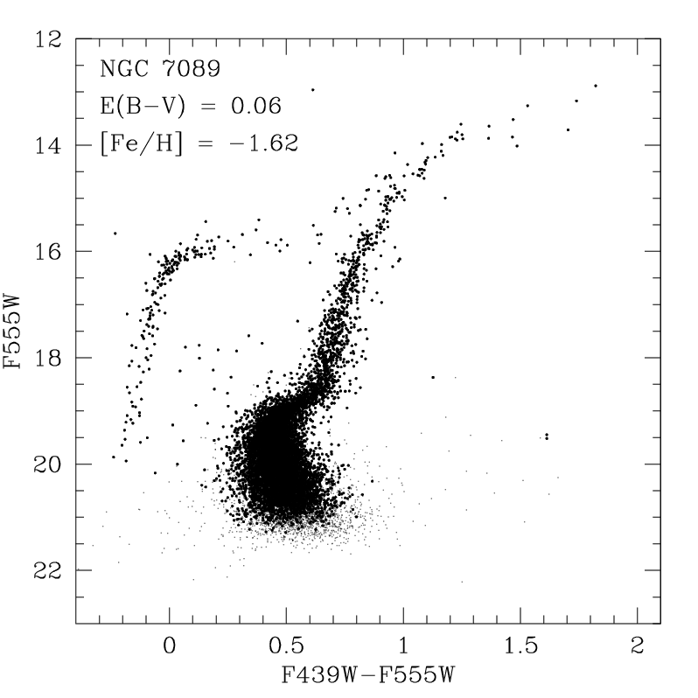
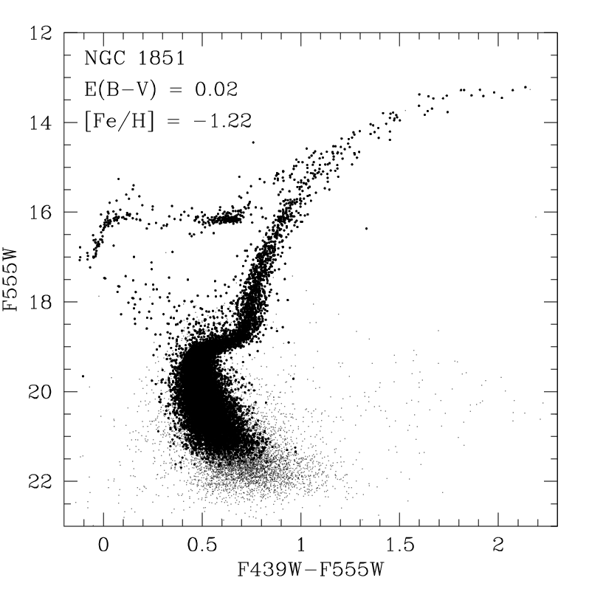
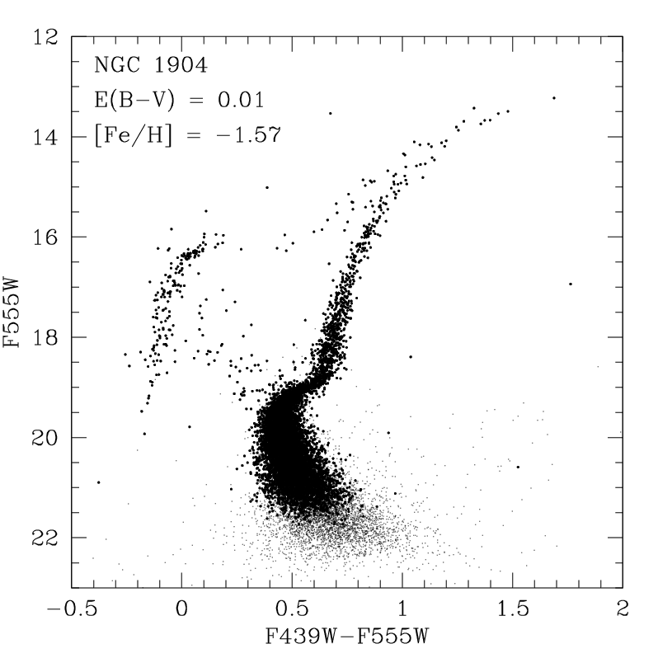
High precision astrometry means high precision PSFs and therefore:
High precision photometry
First photometric survey
HST SNAPSHOT PROJECT:
(Piotto et al. 2002, A&A, 391,945)
74 GC cores observed with the WFPC2 in the F439W and F555W band [all clusters with (m-M)B<18];
More than 150 papers based on this data base;
1st epoch for proper motion measurements;
Data available on: http://dipastro.pd.astro.it/globulars/databases/snapshot/snapshot.html

Slide 18
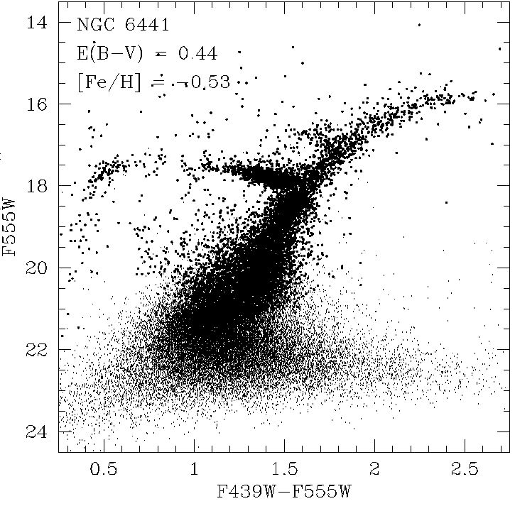
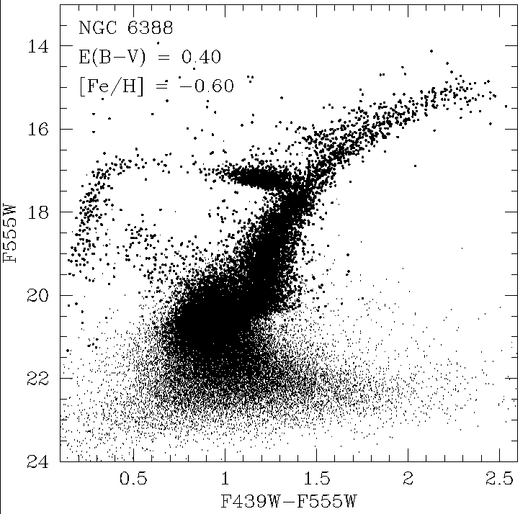
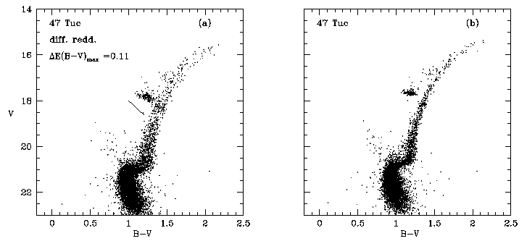
The most surprising discovery from the HST WFPC2 snaposhot survey
[Fe/H]=-0.7
Blue horizontal branches in metal rich globular clusters
Rich et al. 1997

Slide 19
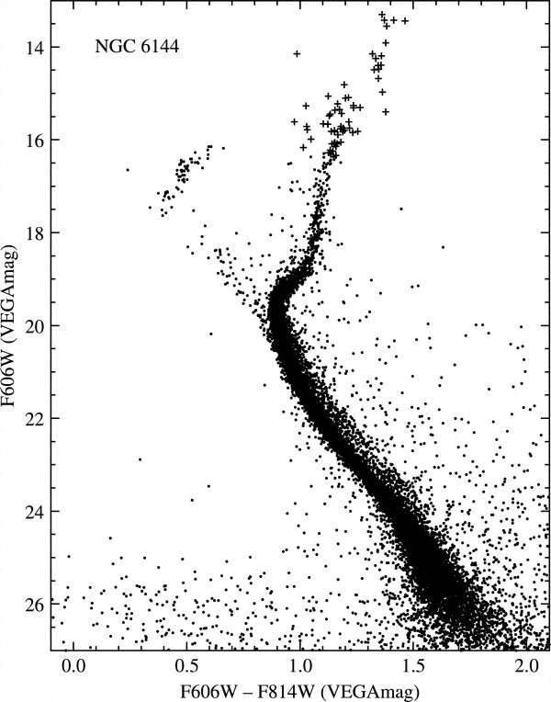
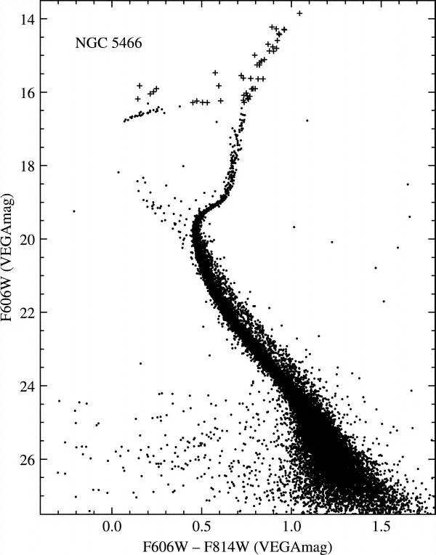
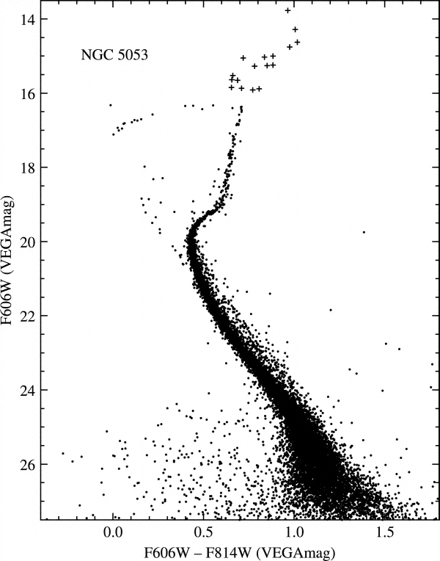
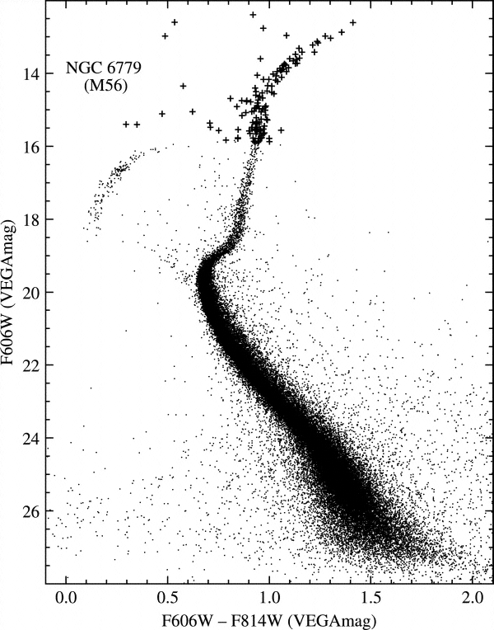
Globular Cluster Treasury project PI: A. Sarajedini
Anderson et al. 2008, AJ, 2008, 135, 2055
ACS/HST survey of 66 Galactic Globular Clusters
Target: down to 0.2 solar masses with S/N>10; highest S/N at the TO
Data available on: http://www.astro.ufl.edu/~ata/public_hstgc/databases.html

Slide 20
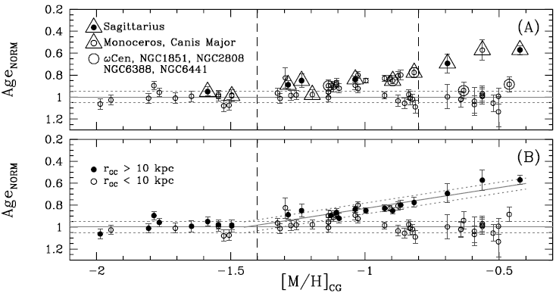
Globular Cluster relative ages
Marin-French et al. 2009

Slide 21
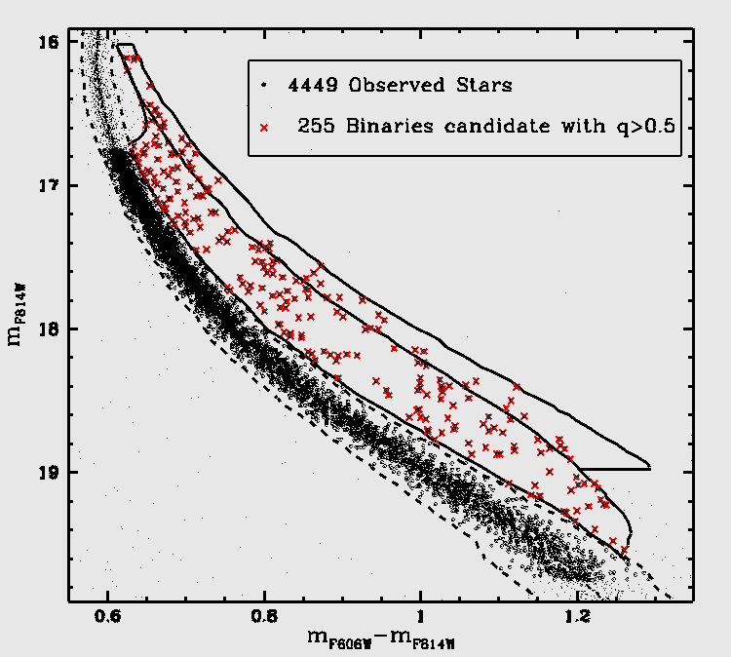
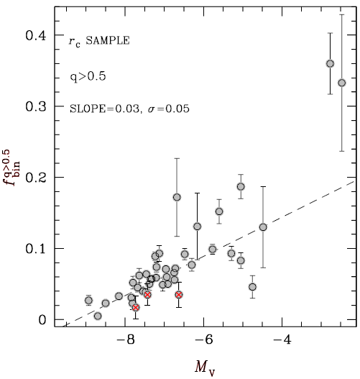
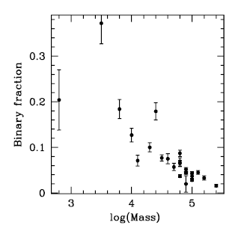
Photometric binaries in 54 Globular Clusters.
Milone et al. 2010, in prep.
Significant anti-correlation between the fraction of binaries in a cluster and its absolute luminosity (mass)

Slide 22
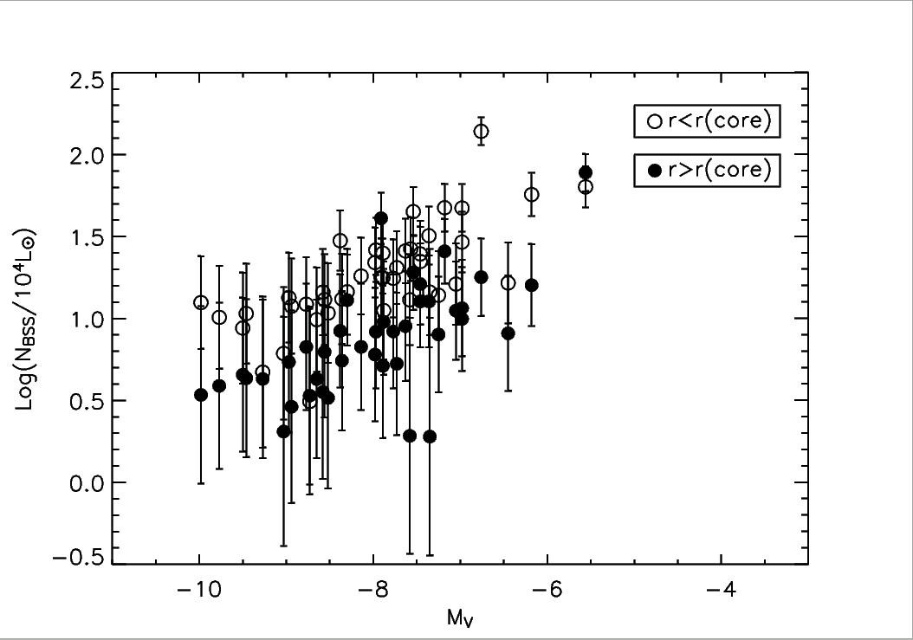
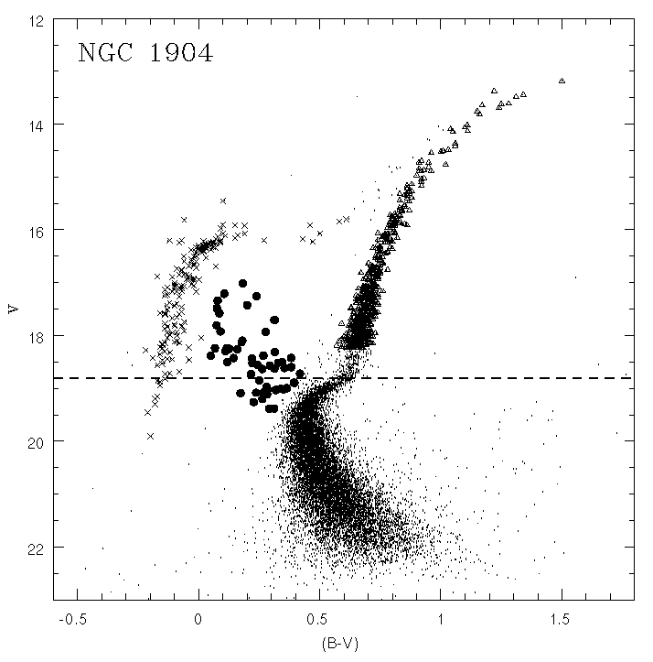
Piotto et al. (2003)
From HST snapshot survey
Blue stragglers frequency anticorrelates with cluster total luminosity (total mass). This fact has been interpreted as an evidence of the dynamical evolution of binaries.
Moretti et al. (2008), Davies et al. (2005) Piotto et al. (2004),

Slide 23
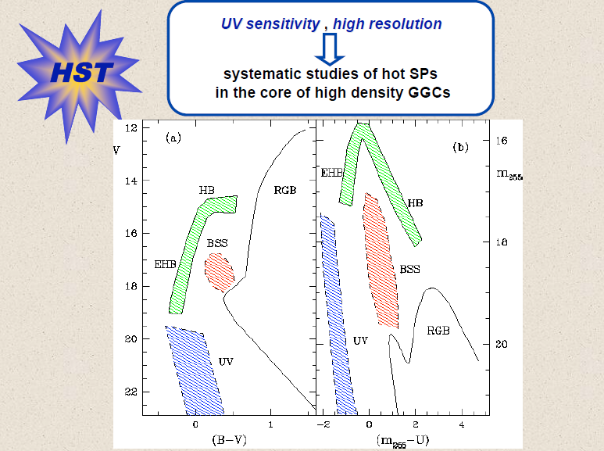
Courtesy of F. Ferraro

Slide 24
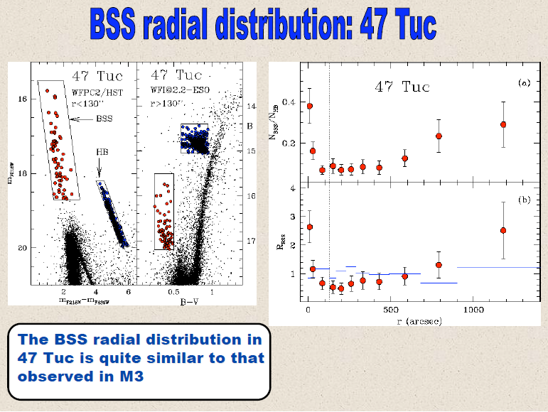
Mapelli et al. (2004)

Slide 25
Globular Clusters as
Simple Stellar Populations?
“A Simple Stellar Population (SSP) is defined as
an assembly of coeval, initially chemically
homogeneous, single stars.
Four main parameters are required to describe
a SSP, namely its age, composition (Y, Z) and
initial mass function.
In nature, the best examples of SSP’s are the
star clusters….” Renzini and Buzzoni (1986)
For this reason, star clusters have been – so far - a fundamental benchmark for testing stellar evolution models and for Population Synthesis Models

Slide 26
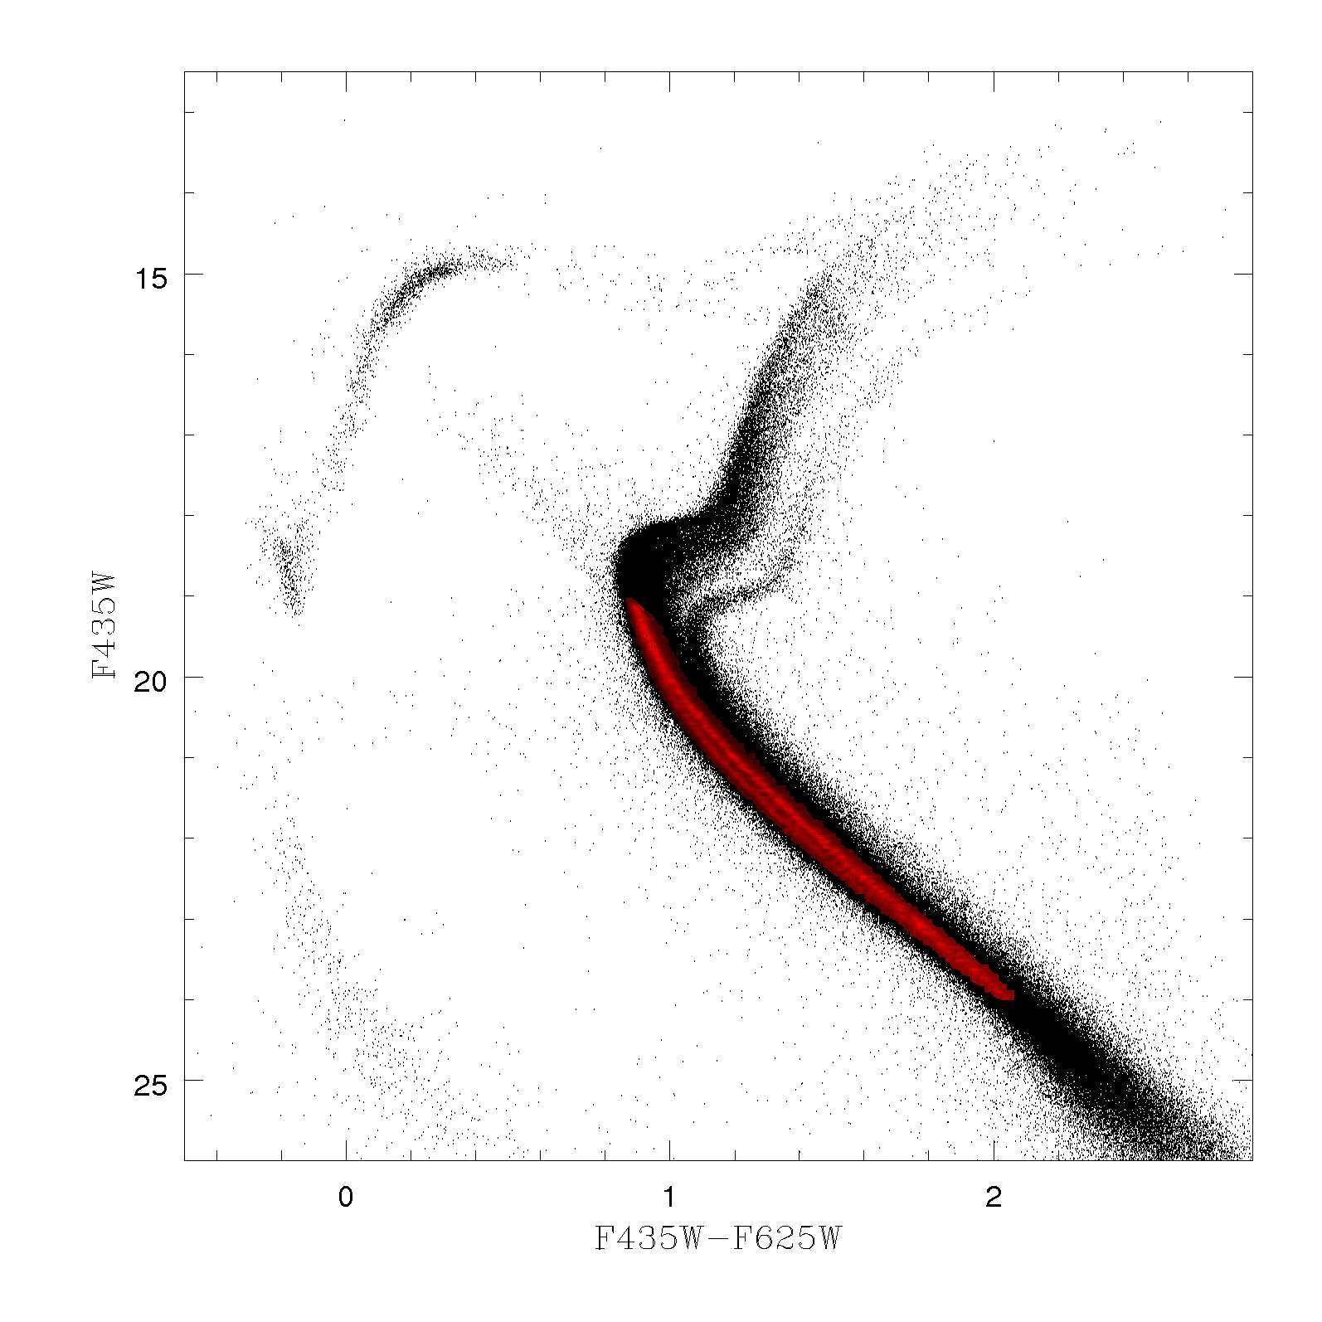
The scenario abruptly changed
“special” case:
Omega Centauri
Most massive
Galactic
“globular cluster”
(present day mass: ~4 million solar masses).
Well known
(since the ’70s)
spread in
metallicity
among RGB
stars.
Omega Centauri
Multiple RGBs
Lee et al. 1999
Pancino et al. 2000
Extended HB
Multiple MSs
Bedin et al. (2004)

Slide 27
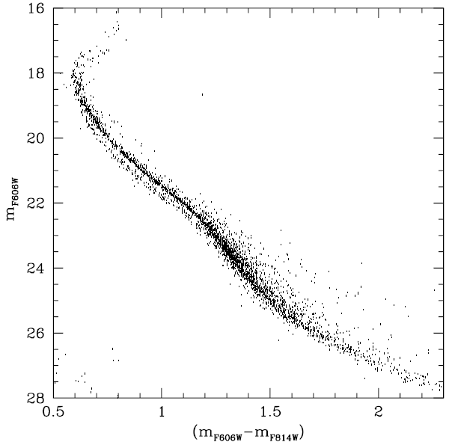
Omega Centauri multiple sequences
The discussion revitalized thanks to an exceptional HST (WFPC2 and ACS) discovery
The main sequence
of Omega Centauri
is split into two, distinct “main” main sequences
(Anderson, 1997, PhD thesis, Bedin et al. 2004, ApJ, 605,
L125).
A new era in globular cluster research opened

Slide 28
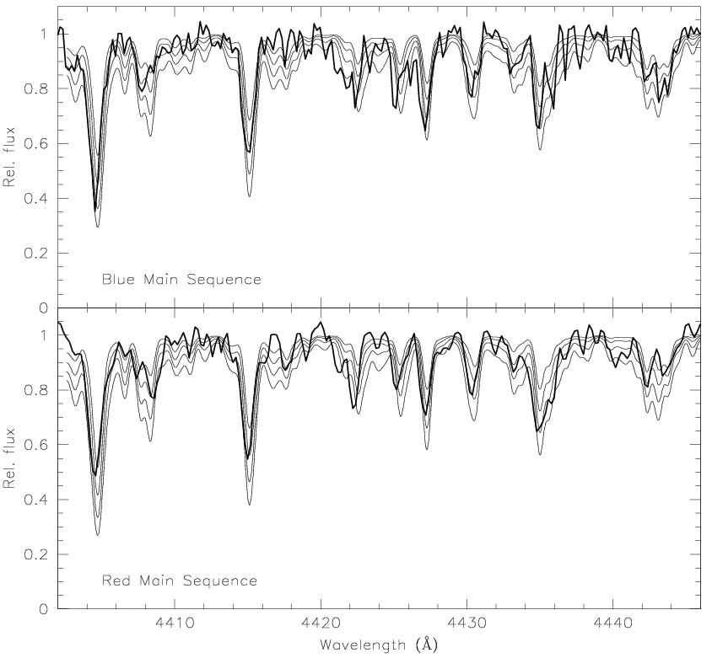
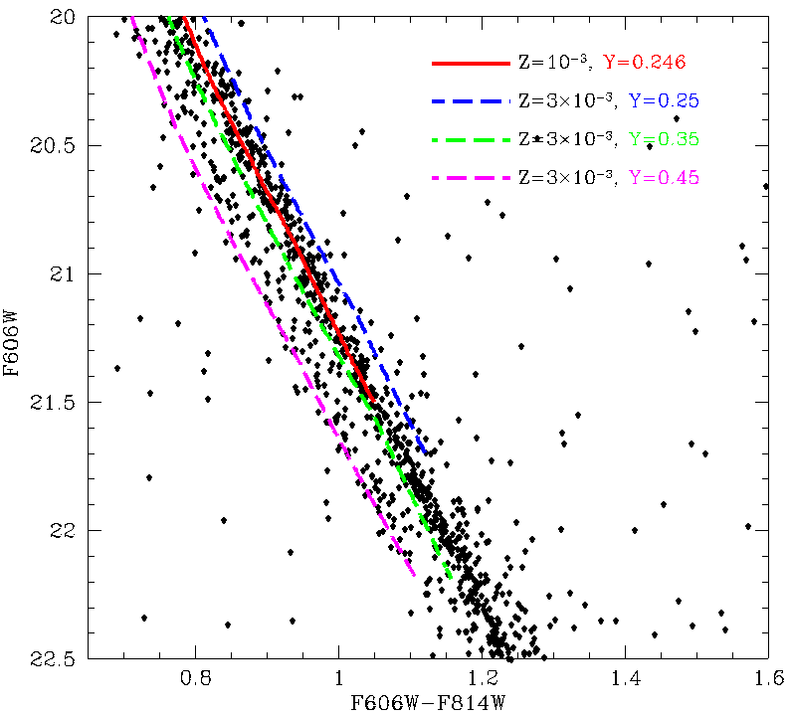
The most surprising discovery
The bluer sequence is
MORE METAL RICH
Piotto et al. (2005, ApJ, 621,777)
BlueMS: [Fe/H]=-1.27
17x12=204 hours
of VLT integration time
RedMS: [Fe/H]=-1.56
Apparently, only
an overabundance of
Helium (Y~0.40)
can reproduce both the photometric and spectroscopic observations

Slide 29
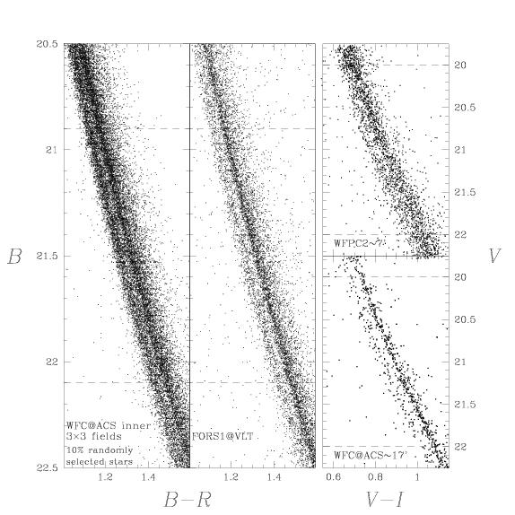
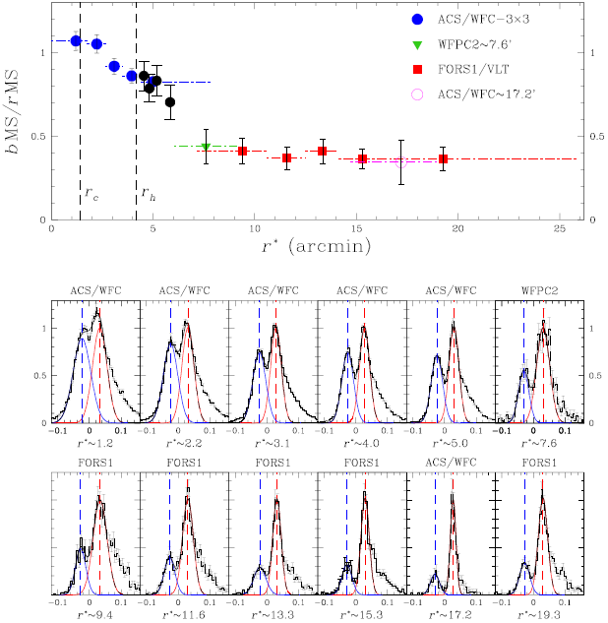
Omega Centauri: Radial distribution of main sequence stars
Bellini et al. 2009, A&A, 507, 1393
The double
MS is present all over the cluster, from the inner core to the outer envelope, but….
…the two MSs have different radial distributions: the blue, more metal rich MS is more concentrated

Slide 30
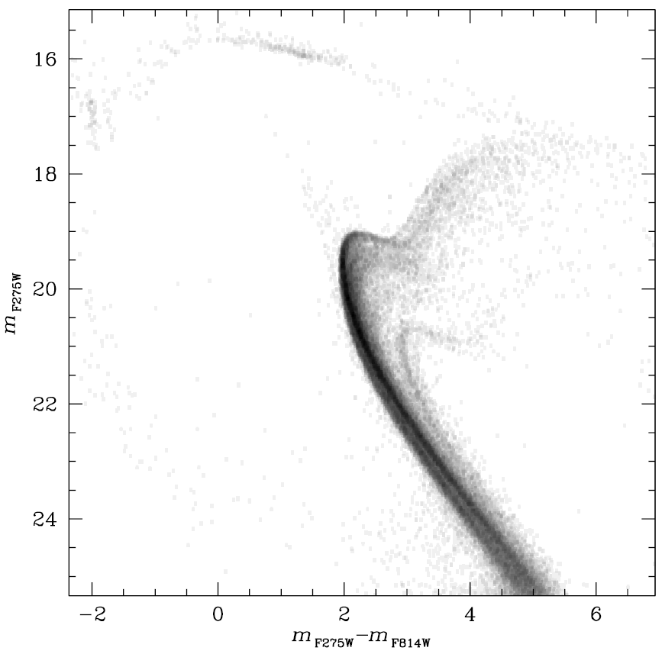
The complexity increases!
New spectacular
UV data from the new WFC3 camera onboard HST
Amazing perspectives with WFC3!!!
.
Bellini et al., 2010, AJ, 140,631

Slide 31
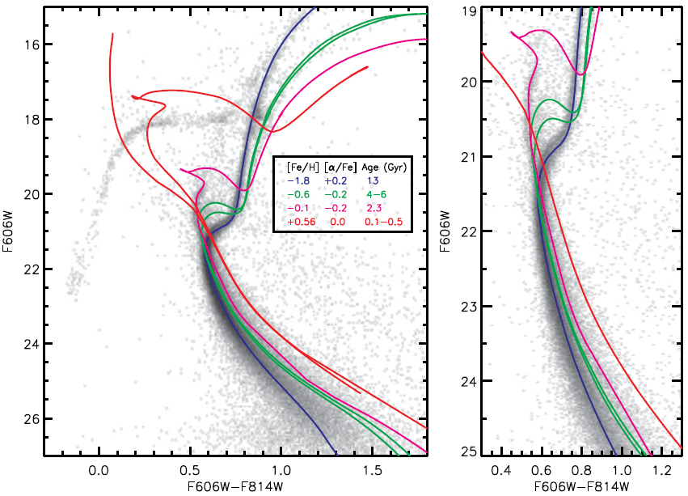
NGC 6715 (M54)
Siegel et al. (2007)
Multiple MSs, SGBs, RGBs ….

Slide 32
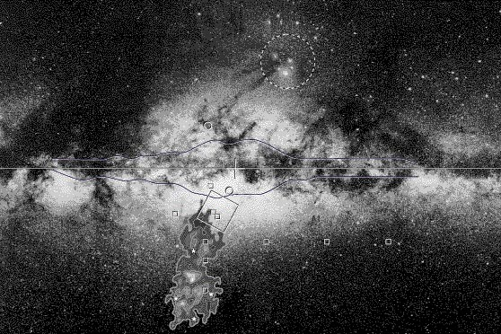
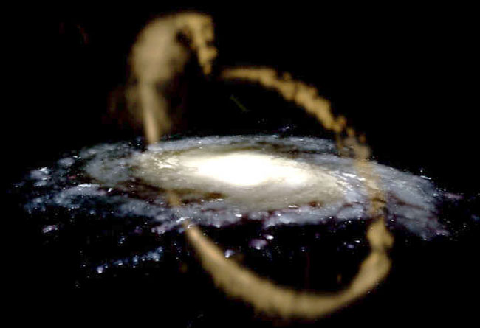
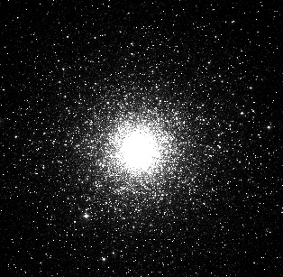
M54 coincides with the nucleus of the Sagittarius dwarf galaxy . It might be born in the nucleus or, more likely, it might be ended into the nucleus via dynamical friction
(see, Bellazzini et al. 2008), but the important fact is that, today:
The massive globular cluster M54 is part of the nucleus of a disaggregating dwarf galaxy.

Slide 33
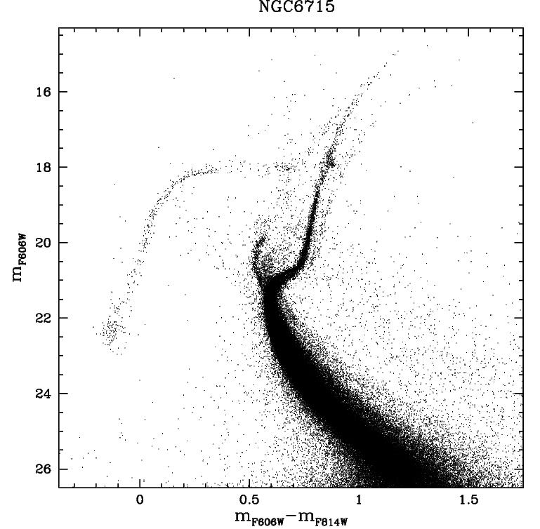
M54
The CMDs of M54
and Omega Centauri are
astonishingly similar!
Omega Centauri
It is very likely that M54 and the Sagittarius nucleus show us what Omega Centauri was a few billion years ago: the central part of a dwarf galaxy, now disrupted by the Galactic tidal field. But, where is the tidal tail of Omega Centauri (see Da Costa et al. 2008)?
Is this true for all globular clusters?

Slide 34
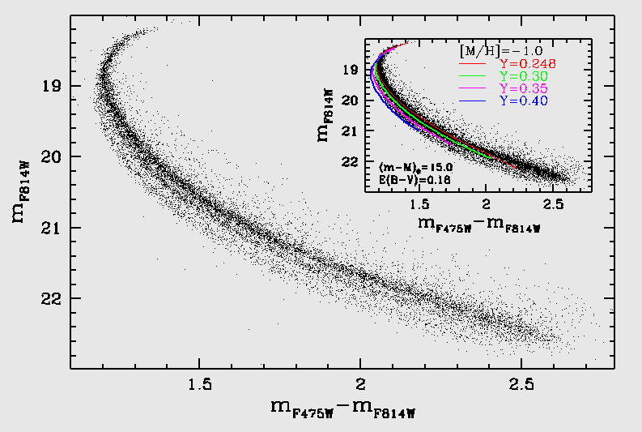
The triple main sequence in NGC 2808
The MS of NGC 2808 splits into three separate branches
Overabundances of helium (Y~0.30, Y~0.40) can reproduce the two bluest main sequences.
The TO-SGB regions are so narrow that any difference in age between the three groups must be significantly smaller than 1 Gyr
TO
Piotto et al. 2007, ApJ, 661, L35

Slide 35



NaO anticorrelation (Carretta et al. 2006)
Besides a bulk of O-normal stars with the typical composition of field halo stars, NGC2808 seems to host two other groups of O-poor and super O-poor stars
NGC2808 has a very complex and very extended HB (as ω Cen). The distribution of stars along the HB is multimodal, with at least three significant gaps and four HB groups (Sosin et al 1997, Bedin et al 2000)

Slide 36


In summary, in NGC 2808,
it is tempting to link together:
the multiple MS,
the multiple HB,
and the three oxygen groups,
as indicated in the table below
(see Piotto et al. 2007 for details).
1.4x10⁴ and 2.7x10⁴ solar masses of fresh Helium are embedded in the 2nd and 3rd generations of stars
Observations properly fit a scenario in which a 2nd and 3rd stellar generations formed from material polluted by intermediate mass AGB stars of a 1st generation

Slide 37



NGC 6752: very extended EHB, but with
a mass of 1.6x10⁵ M⊙
Example of a not massive cluster showing clear evidence of multiple populations
Milone et al. 2010, ApJ, 709, 1183

Slide 38

…47Tuc MS is also intrinsically spreaded
If the spread in color is due to a spread in Fe, it implies a Δ([Fe/H])=0.001; if it is helium, it implies a ΔY=0.03

Slide 39

A problem: star to star variations of light elements are present in all GCs
Most clusters have constant [Fe/H], but large star to star variations in light elements.
Some elements define correlations like the NaO anticorrelation, or the
MgAl anticorrelation.
These anticorrelations are present in all clusters analyzed so far.
Carretta et al. 2010

Slide 40

The Double Subgiant Branch of
NGC 1851
Milone et al. 2008, ApJ, 673, 241
The SGB of NGC 1851 splits into two well defined sequences.
If interpreted only in terms of an age spread, the split implies an age difference of about 1Gyr.

Slide 41

Radial
distribution of the two SGBs in NGC 1851
The double SGB is present all over the cluster,
also in the envelope
There is no radial gradient
Log t_{rh} = 8.9
Milone et al. (2009) in prep

Slide 42


Cassisi et al. (2007, ApJ, 672, 115, Ventura et al. 2009) suggested that the two SGBs can be reproduced by assuming that the fainter SGB is populated by a strongly CNONa enhanced population.
In such hypothesis, the age difference between the two groups may be very small (10⁷-10⁸ years). But….
Villanova et al. 2010, ApJL, in press, arXiv1008.4372

Slide 43

NGC 6656 (M22) double SGB
Piotto et al. (2009),
in preparation

Slide 44

Double SGBs are present in many Globular Clusters: e.g. NGC 6388
New WFC3 data acquired; reduction in progress
Piotto (2009, IAUS, 258, 233)

Slide 45

In order to reproduce the
anomalous HB, Caloi and
D’Antona (2007) propose
an even more complicate
scenario with 3 distinct
populations:
a normal population (Y~0.25);
a polluted pop. (0.27<Y<0.33);
A strongly He enhanced pop. (Y~0.4)
Three He populations
in NGC 6388 and
NGC 6441, as in
NGC 2808 and
perhaps ωCen?
NGC 6441
Caloi and D’Antona, 2007, A&A, 463, 949

Slide 46

LMC clusters
We used ACS/HST archive data to construct the CMDs of 46 LMC clusters.
We investigated the CMD morphology of 16 intermediate age clusters, with ages between 1 and 3 Gyr.
Milone et al. (2008)

Slide 47











Eleven out of 16 (2/3) of the intermediate age clusters show either a double or an extended TO! Milone et al 2009, A&A, 497, 755).

Slide 48

47 Tucanae
shows a spreaded
SGB, plus
a secondary
SGB
Example of cluster
with not extended HB showing evidence of multiple populations
Anderson et al. 2009, ApJ, 697, L58

Slide 49
…47Tuc MS is also intrinsically spreaded
If the spread in color is due to a spread in Fe, it implies a Δ([Fe/H])=0.001; if it is helium, it implies a ΔY=0.03

Slide 50
Multipopulation zoo
Multipopulations may be ubiquitous: NaO anticorrelation found in all clusters searched so far.
Clusters with discrete multiple main sequences, apparently implying extreme He enrichment, up to Y=0.40 (e.g., ωCentauri, NGC2808)
Clusters with broadened or splitted MS (as NGC6752 and 47Tuc)
Complex objects like M54 (= Omega Cen?)
Intermediate objects like Ter 5, M22 (=M54, ωCen?)
Clusters with double SGB or RGB (e.g., NGC 1851, NGC6388, NGC 5286, M4, and many others)
The LMC/SMC intermediate age clusters with double TO/SGB.
Young massive clusters in external galaxies.
Are all of them part of the same story?

Slide 51

Proposed scenario (1)
Ejecta (10-20 km/s) from intermediate mass AGB stars (4-6 solar masses) could produce the observed abundance spread (D’Antona et al (2002, A&A, 395, 69). These ejecta must also be He, Na, CN, Mg) rich, and could explain the NaO and MgAl anticorrelations, the CN anomalies, and the He enhancement.
Globular cluster stars with He enhancement could help explaining the anomalous multiple MSs, and the extended horizontal branches.

Slide 52

Alternative explanation (2)
Pollution from fast rotating
massive stars (Decressin et al.
2007, A&A, 475, 859).
The material ejected in the disk has two important properties:
It is rich in CNO cycle products, transported to the surface by the rotational mixing, and therefore it can explain the abundance anomalies;
It is released into the circumstellar environment with a very low velocity, and therefore it can be easily retained by the shallow potential well of the globular clusters.

Slide 53
Conclusions
Thanks to HST we are now looking at globular cluster (and
cluster in general) stellar populations with new eyes. De
facto, a new era on globular cluster research is started:
Multiple stellar generations seems ubiquitous. Many serious problems remain unsolved, and we still have a rather incoherent picture. The new WFC3/HST will play a major role. In helping us understanding their origin.
For the first time, we might have the key to solve a number of problems, like the abundance “anomalies” and possibly the second parameter problem (which have been there for decades), as well as the newly discovered multiple sequences in the CMD.
Finally, we should never forget that what we will learn on the origin and on the properties of multiple populations in star clusters has a deep impact on our understanding of the early phases of the photometric and chemical evolution of galaxies.

