Slide 1
Hubble’s Exploration of the
Solar System
Hal Weaver
Johns Hopkins University Applied Physics Laboratory

Slide 2
Outline
Minor Bodies, including Dwarf Planets
  Comets, Asteroids, TNOs, Pluto System
Transient Events
  Comet breakups, Asteroid collision, Jupiter impacts
Giant Planet Atmospheres
  Weather and Auroral processes
Galilean Satellites
  Atmospheres
Ring systems
  Uranus
Mars
  Global imaging
Notes:
The Solar System is a diverse place, and Hubble has investigated a wide range of planetary objects over the past two decades. I’ve selected highlights from six different areas of Solar System research: Minor Bodies, Transient Events, Giant Planet Atmospheres, Galilean Satellites, Ring Systems, and Mars. I apologize to my planetary colleagues if I’ve left out their particular favorite Hubble research result, but I simply can’t cover every significant Hubble Solar System result in the limited time available here.

Slide 3
Minor Bodies
Comet nucleus sizes and D/H
Resolved imaging of Asteroids
TNOs: Eris and Haumea
TNO binaries
Pluto system
Notes:
Hubble has made many important contributions to the study of the Minor Bodies in the Solar System. These are the particular topics covered in this presentation.

Slide 4
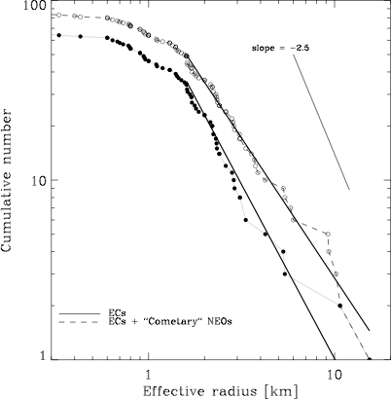
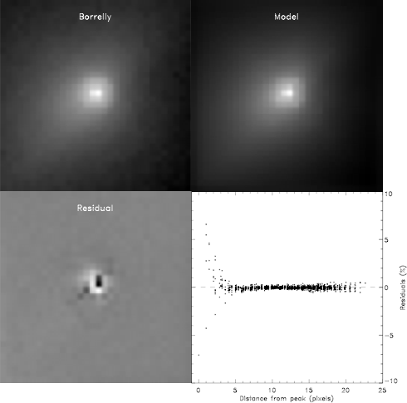
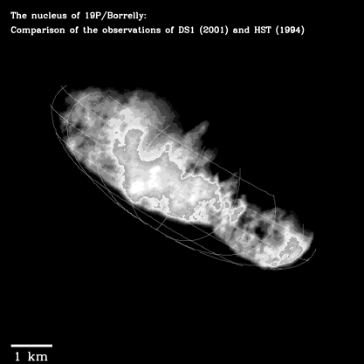
Sizes of Cometary Nuclei
Collisionally relaxed case
Comet CSD is −1.9 ± 0.3
“Photometrically resolved” cometary nuclei
Size distribution deviates substantially from “collisionally relaxed” population
Confirmation that Hubble
technique works!
Lamy et al.
Notes:
Since 1993, Hubble has been measuring the sizes of cometary nuclei using a new technique in which the high spatial resolution of Hubble is used to “photometrically resolve” the nucleus (Lamy et al.). The size distribution obtained from ~63 short-period comets, with ~3 dozen coming from Hubble measurements, appears to deviate substantially from a “collisionally relaxed” population. However, more observations are needed, particularly for the smaller nuclei for which Hubble excels.

Slide 5
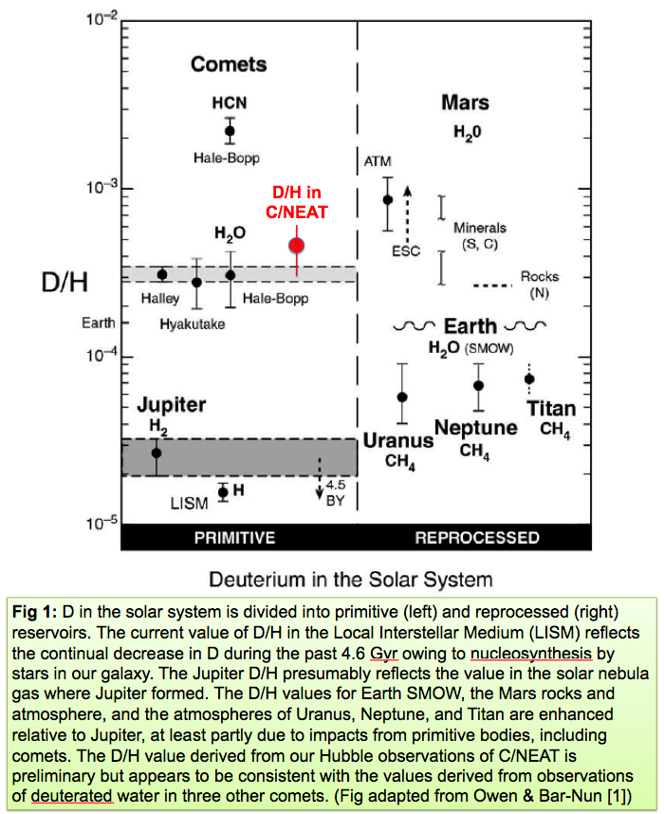
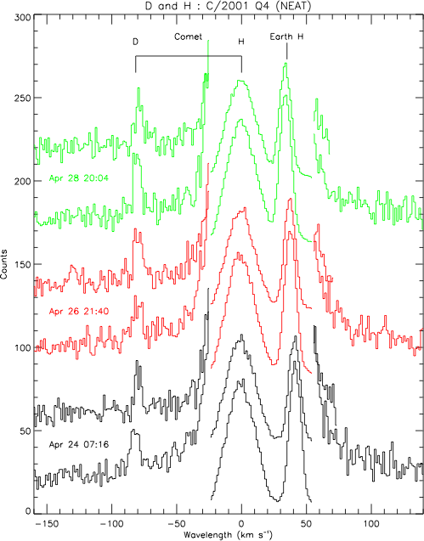
D/H in Comets
STIS/E140H (Weaver et al.)
Did Comets deliver Earth’s water?
Notes:
High spectral resolution observations of bright comet C/2001 Q4 (NEAT) in April 2004 resulted in the first discovery of deuterium emission from a comet. The figure to the left shows clear detection of the D Lyman-alpha line on 3 different dates, and in two different E140H orders each day. Assuming all of the D is coming from the photodissociation of deuterated water (HDO), the D/H ratio is consistent with the values measured in three other Oort cloud comets, all of which are ~2x the value in Earth’s water. The apparent implication is that comets did not supply the bulk of Earth’s water, but that’s not so certain for at least two reasons: (1) maybe comets are needed to raise Earth’s value from its original protosolar value, and (2) perhaps the D/H value in short-period comets is different. Needless to say, this is a complicated issue.

Slide 6
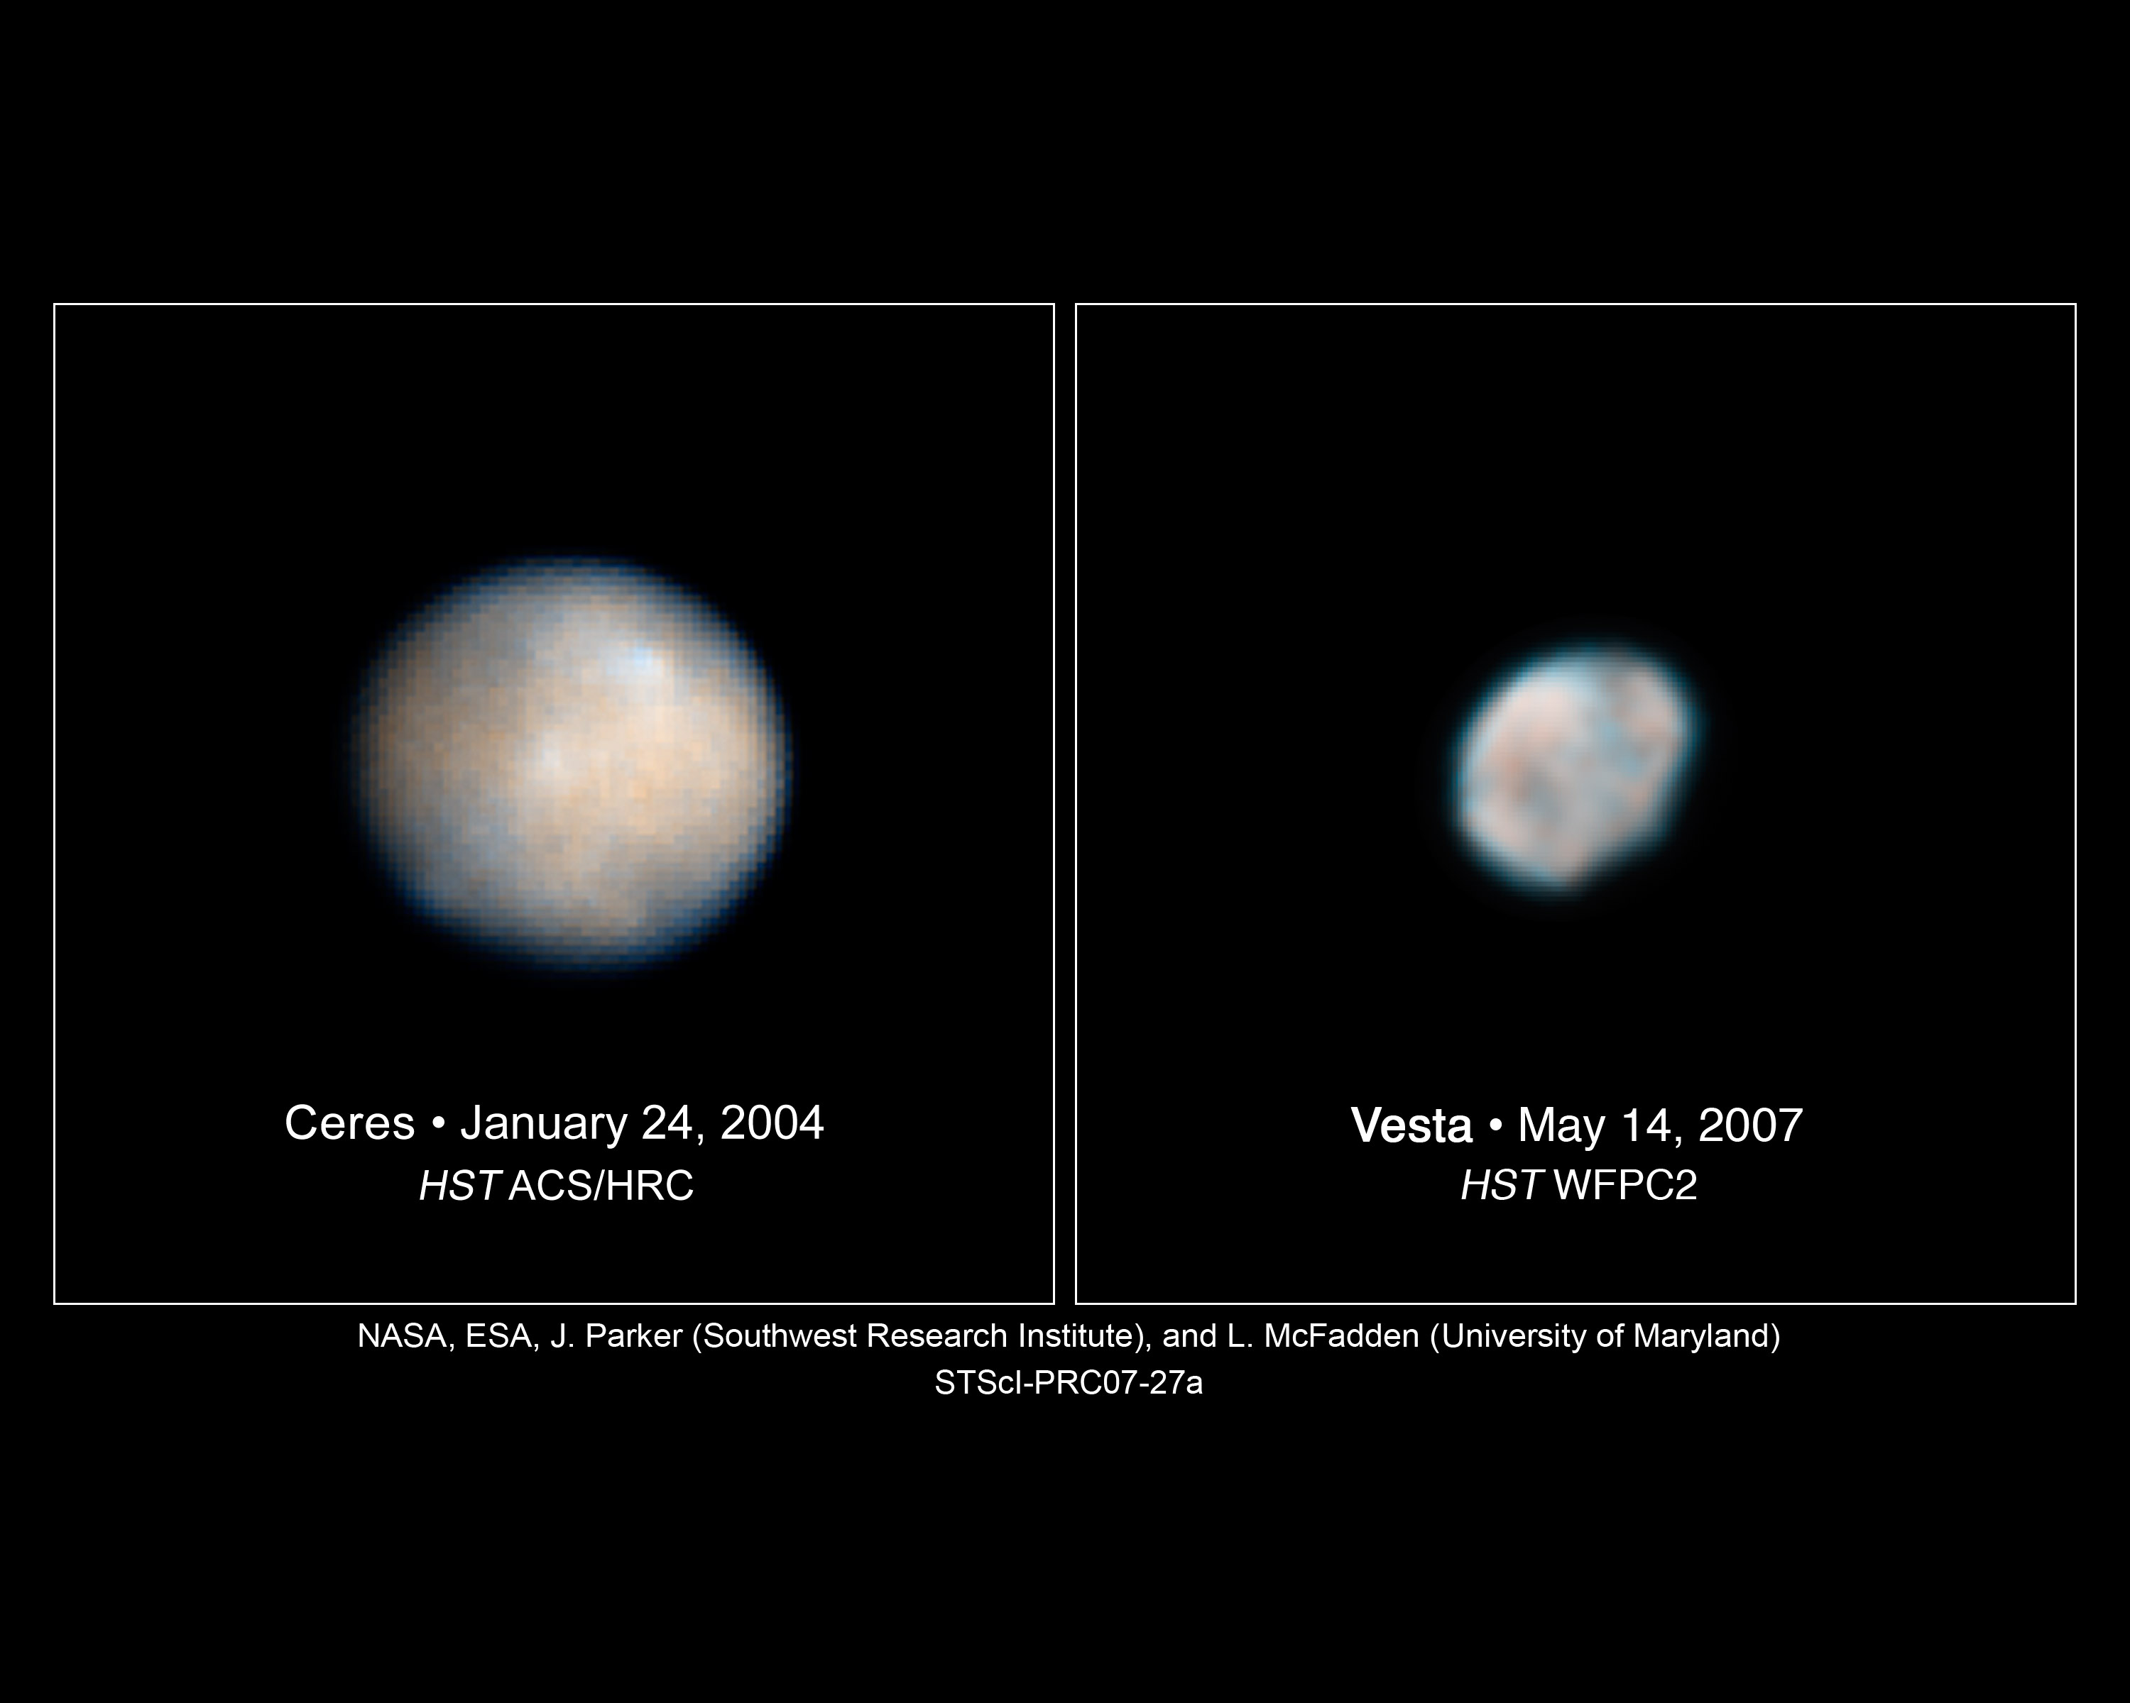
Resolved Asteroids
Dwarf Planet
Wannabe Dwarf Planet
Parker, McFadden, Thomas, et al.
Notes:
Asteroids are no longer pinpoints of light! Hubble permits spatially resolving, color imaging of the largest asteroids.

Slide 7
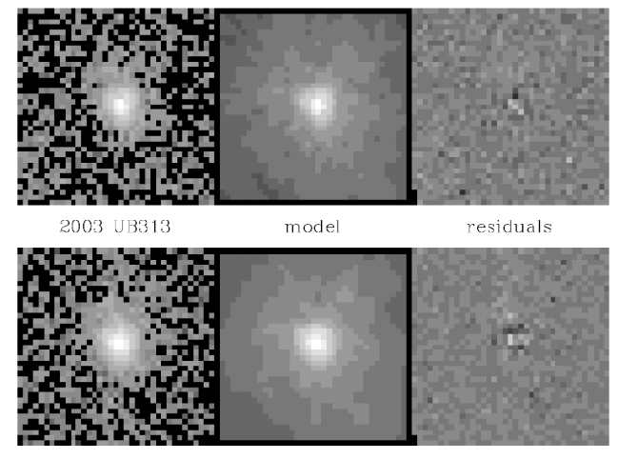
Eris : Pluto Killer
background star model residuals
Eris model residuals
ACS/HRC Images : Dec 2005
Brown et al.
Notes:
Brown et al. used the TinyTim s/w package to carefully model the PSF of the background star and then used that PSF to forward-model the disk of Eris. Combining the results from 28 individual images gives a size of 2400 +/- 100 km, about 5% bigger than Pluto. These are ACS/HRC images taken in December 2005.

Slide 8
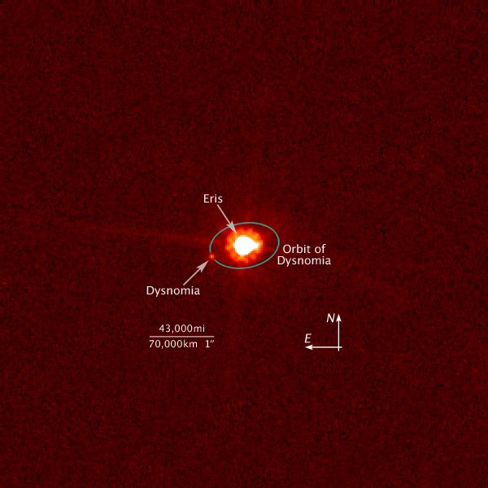
Dysnomia: Moon of Eris
2006 Aug 30
Eris is ~5% larger and ~30% more massive than Pluto
Brown et al.
Notes:
Hubble measurements of Eris ignited a major controversy on the definition of “planet”. Eris is ~5% larger than Pluto, prompting calls for the “demotion” of Pluto and, more generally, a discussion of what constitutes a planet. This issue continues to divide the planetary community, even though the IAU weighed-in with a new definition for “planet” and the official recognition of a new category of objects called “dwarf planets”. The use of “Dwarf Planets” seems to be catching on, with Pluto and Eric being the prototypes.
Dysnomia has a 15.7 day period, which gives a mass of 1.28 +/- 0.02 times larger than Pluto’s.

Slide 9
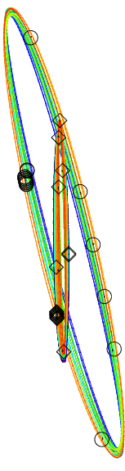
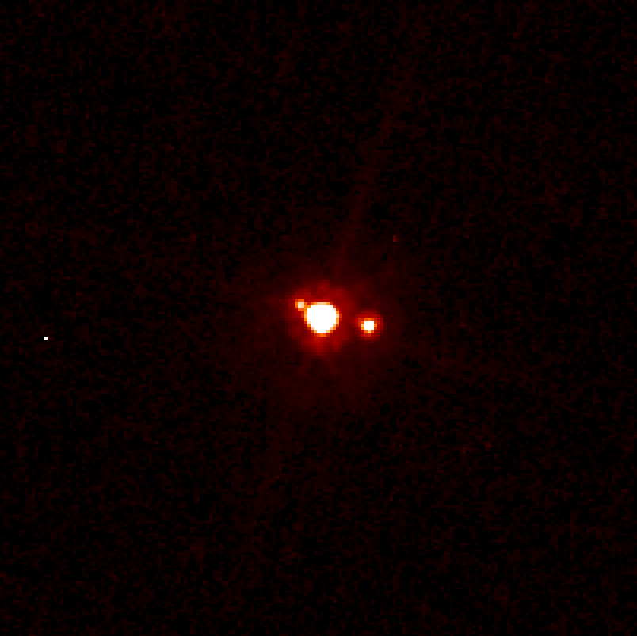
TNO Transits and Mutual Occultations
Hiʻiaka
Haumea
Namaka
Mutual Event season for Haumea and Namaka!
Brown et al.
Notes:
When we **did** finally solve for the full orbits, we found that Namaka, the smaller inner satellite, was actually undergoing mutual events with Haumea. The event season is going to last another few years; we got our first detection of a transit in July with WFC3. Transits and occultations of satellite systems – like exo-planet transits – are rich in information about object sizes, dynamics, and surface characteristics. Over the next few years we should be able to map ~dozens of these transit and learn an astounding amount about the shape, size, interior structure, and surface of Haumea.

Slide 10
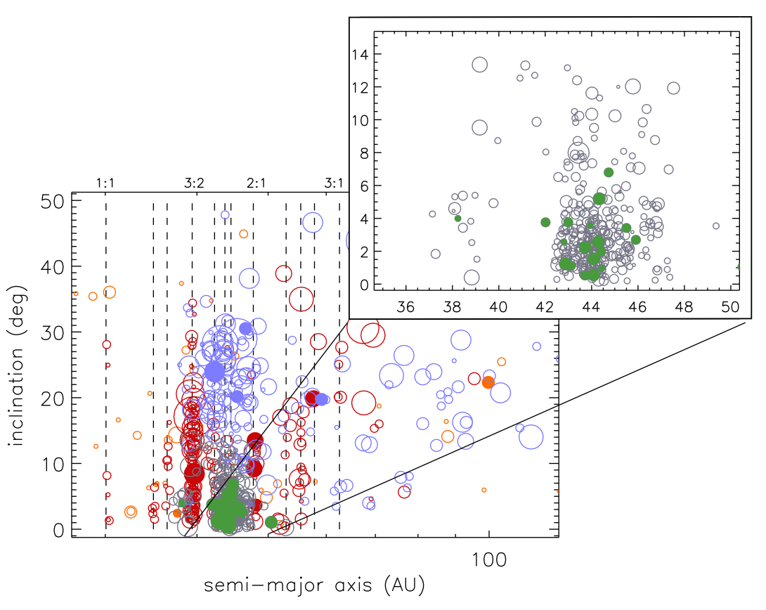
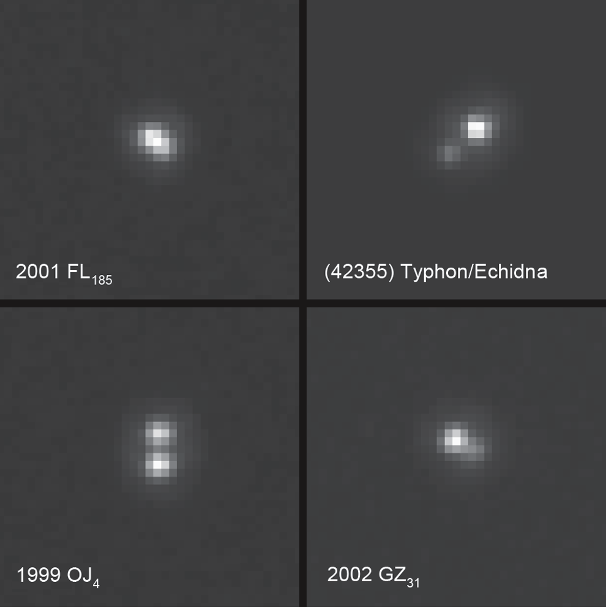
TNO binaries
~80% found by Hubble
Each image to left is 1” on a side.
Binary fraction for resonant + scattered TNOs is ~6%.
But “cold classical” binary fraction is larger.
Noll, Benecchi, Stephens, et al.
Notes:
A significant fraction of TNOs are binaries, and ~80% of those have been discovered by Hubble. Hubble is the best available facility for probing these systems because they’re usually such compact systems (see fig in upper left). Measurements of the period and the semi-major axis permits determination of the system mass.

Slide 11
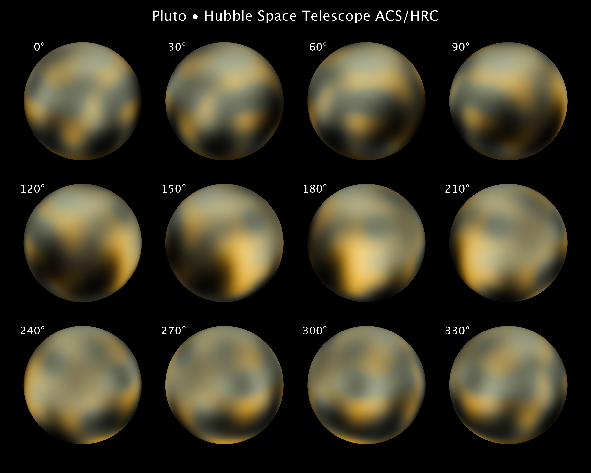
Hubble Color Images of Pluto
Buie et al.
Notes:
Hubble “true color” images of Pluto. Is this really what Pluto looks like? The New Horizons mission will say definitively during its Pluto flyby in July 2015. In the meantime, Hubble provides our best guess.

Slide 12
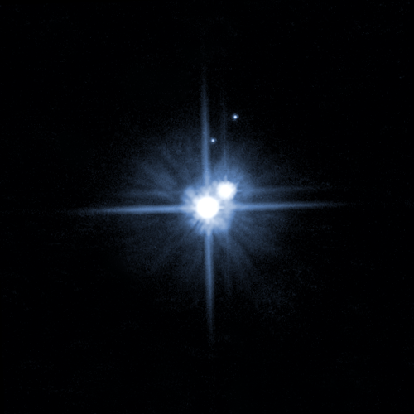
Pluto is a Quadruple System!
286,000 km
Hydra
Nix
12.5"
Charon
Pluto
ACS/HRC Image: 2006 Feb 15.6 UT
Weaver et al.
Notes:
In May 2005, Hubble was used to discover that Pluto is a quadruple system: two small satellites, Nix and Hydra, were discovered. Charon was previously discovered in 1978. (Pluto itself was discovered in 1930). Nix and Hydra are coplanar with Pluto and Charon, suggesting that all four objects formed during the collision of two Pluto-sized bodies ~4.6 Gyr ago. This discovery has caused a modification to the observing plan for the New Horizons mission, to allow spatially resolved imaging and spectroscopy of the two newly-discovered moons.

Slide 13
Transient Events
Comet breakups
Collisions in asteroid belt
Jupiter impacts
Notes:
“Stuff Happens” in the Solar System, and Hubble is usually there to investigate.

Slide 14
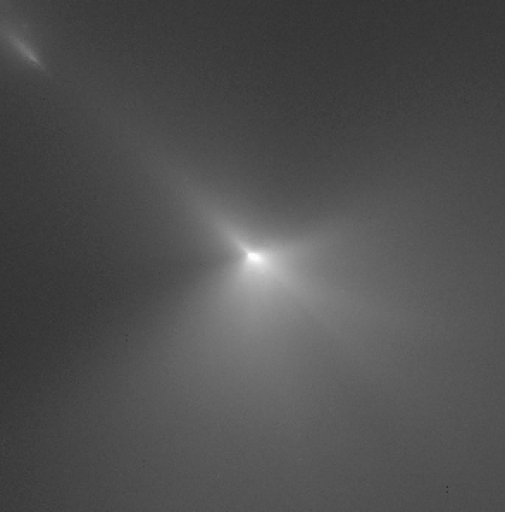
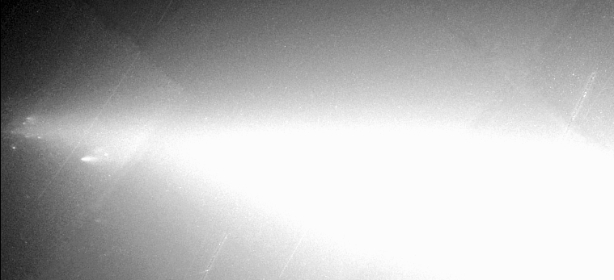
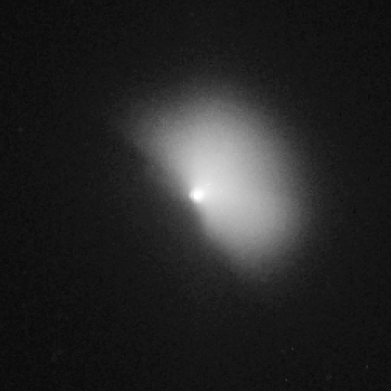
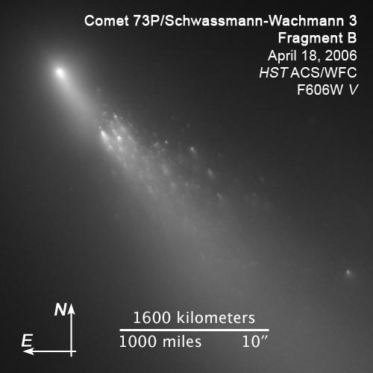
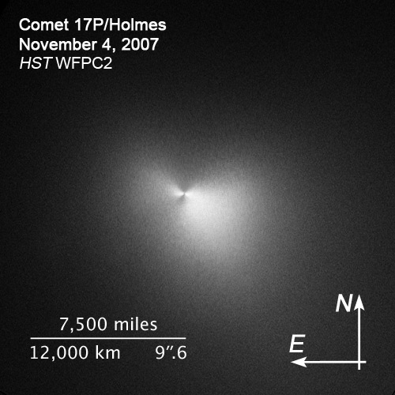
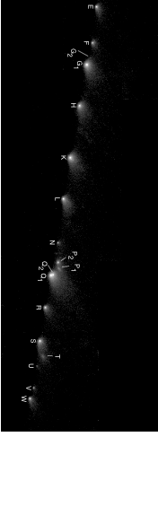
Comet Breakups : Natural and Not
Shoemaker-Levy 9 : String of Pearls
WFPC2, January 1994
C/Hyakutake : 1996 Mar 26
C/1999 S4 (LINEAR) : 2000 Aug 5
9P/Tempel 1 : 2005 Jul 4
Deep Impact Projectile-Induced
Notes:
Some pretty spectacular comet breakups have occurred during the past two decades, and Hubble has captured them. SL9 was the most famous because the fragments plunged into Jupiter’s atmosphere in July 1994 producing Earth-sized scars. Hubble also observed house-sized chunks being released from C/Hyakutake, the complete destruction of C/1999 S4 (only Hubble and the VLT could see multiple fragments near the “tip”). Hubble also witnessed the release of material following the Deep Impact delivery of a projectile to the nucleus of 9P/Tempel 1, the breakup of multiple fragments of 73P/SW3 (with over 60 named fragments), and the explosion of 17P/Holmes (which brightened by a factor of ~1 million). All of these events illustrate the extraordinary fragility of cometary nuclei, which are the original building blocks of all the bodies in the outer Solar System.

Slide 15
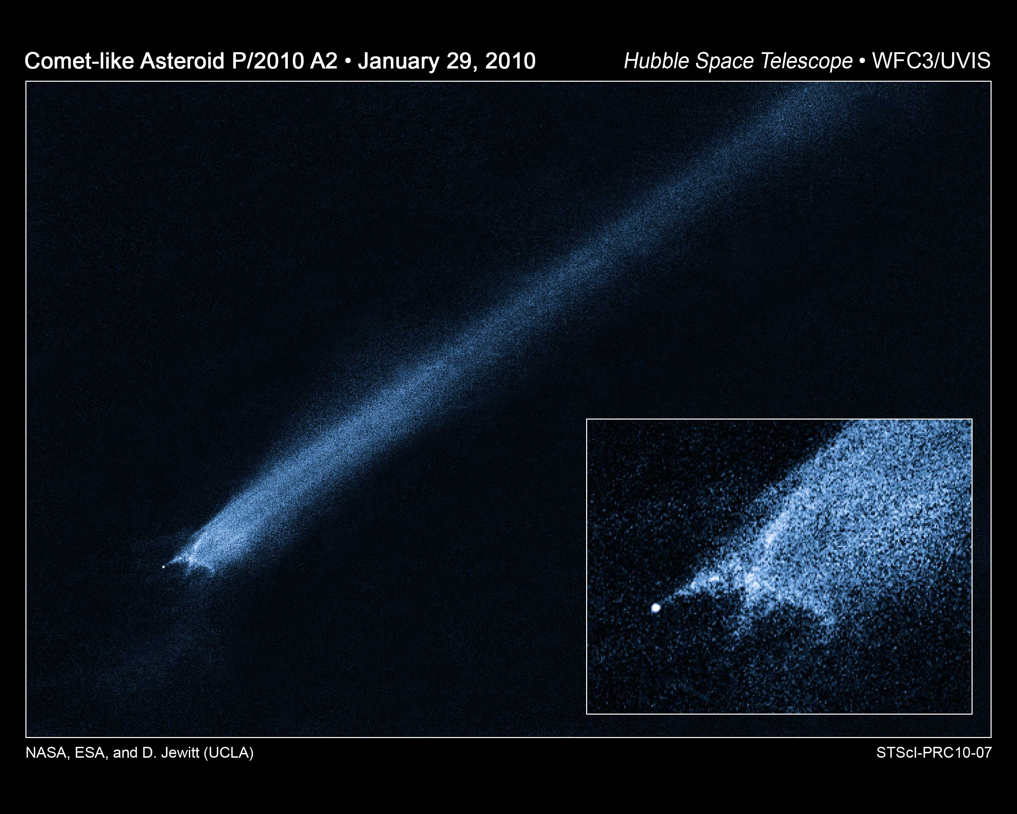
Asteroid Collision
Jewitt et al.
Notes:
In January 2010 Hubble bore witness to the first known example of a collisional event in the asteroid belt. Originally, it was presumed that another “Main Belt Comet (MBC)” had been discovered. But Hubble imaging showed P/2010 A2 to be a very different beast. There was no evidence for ongoing cometary activity. Rather, the observed morphology is more likely explained by the collision of a meter-sized object with a small asteroid (~120 m in diameter). Events like this may occur approximately annually.

Slide 16
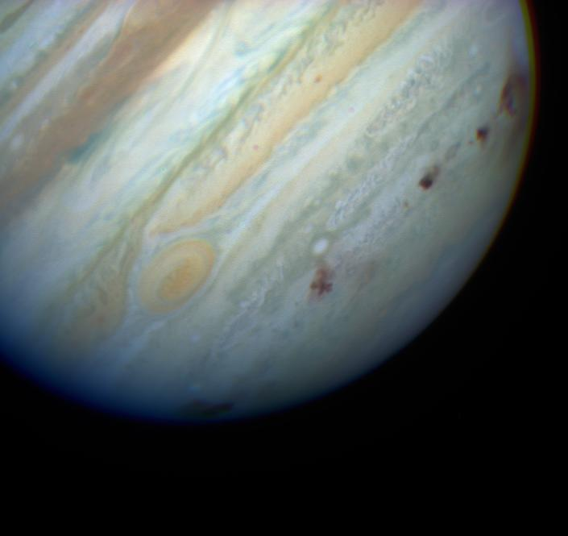
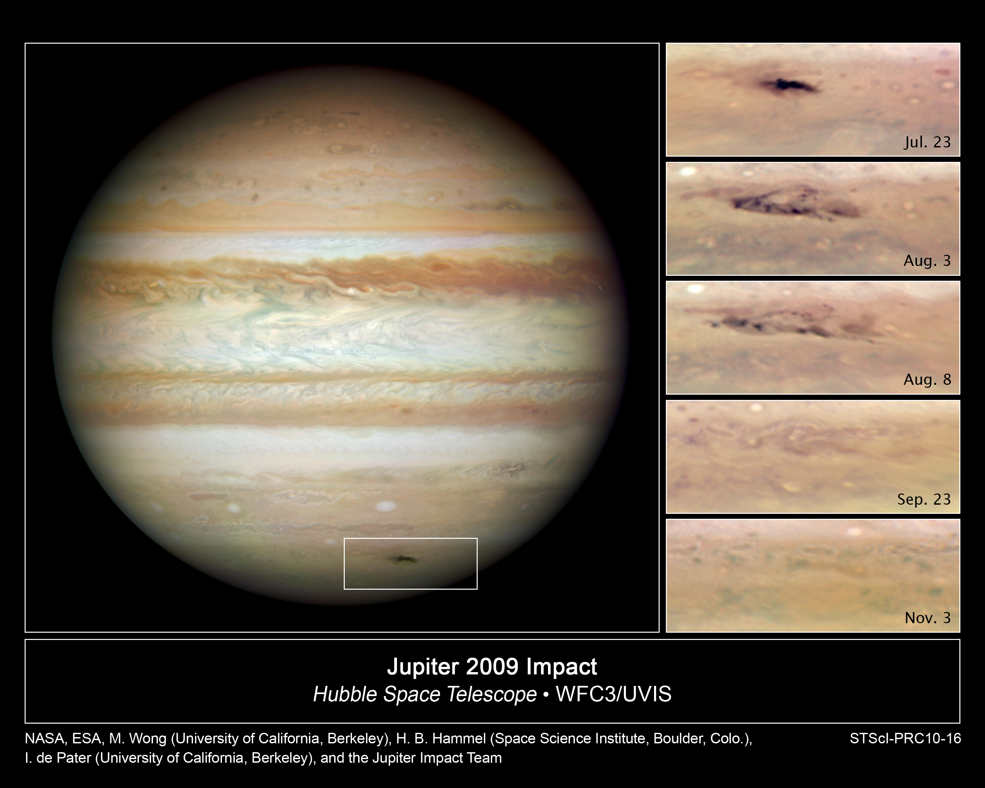
SL9-like Impacts on Jupiter
SL9 impacts in July 1994 showed effects of km and sub-km objects plunging into Jovian atmosphere
Frequency of events thought to be every ~300 years
Amateur observed new event in July 2009 and Hubble followed evolution
Wong, Hammel, de Pater, et al.
Notes:
Unique compared with SL9, because as singular event, there was no confusion in the debris field. First observations with WFC3 (taken during SMOV). Shallower impact angle, smaller impact, and from different direction than SL9 (unrelated to SL9). This is potentially a fertile new area of Hubble research because new events are now being discovered at least every year.

Slide 17
Giant Planet Atmospheres
Jovian weather, storms, and color changes
Rare major storm on Saturn
Aurorae on Jupiter and Saturn

Slide 18
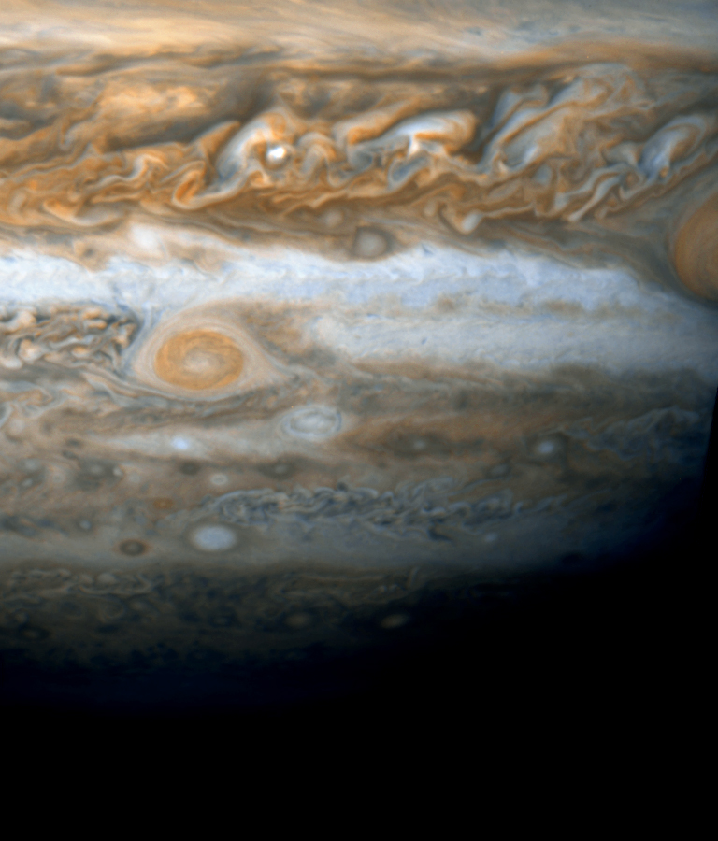
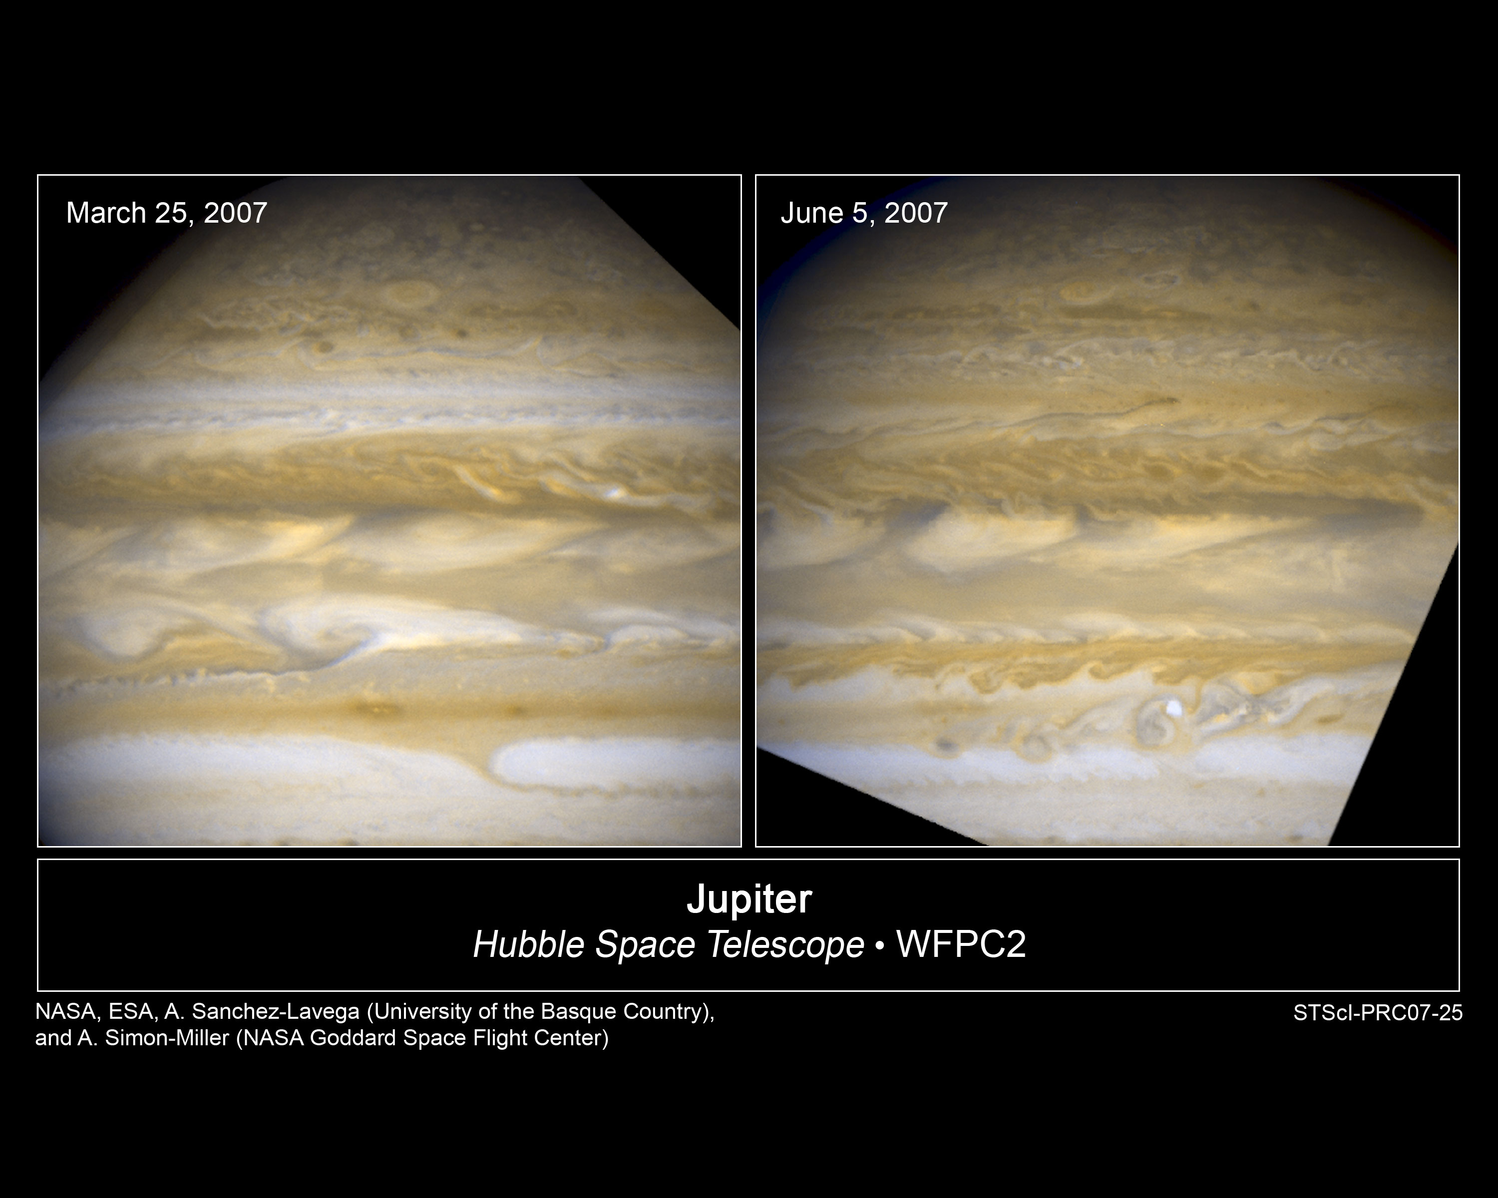
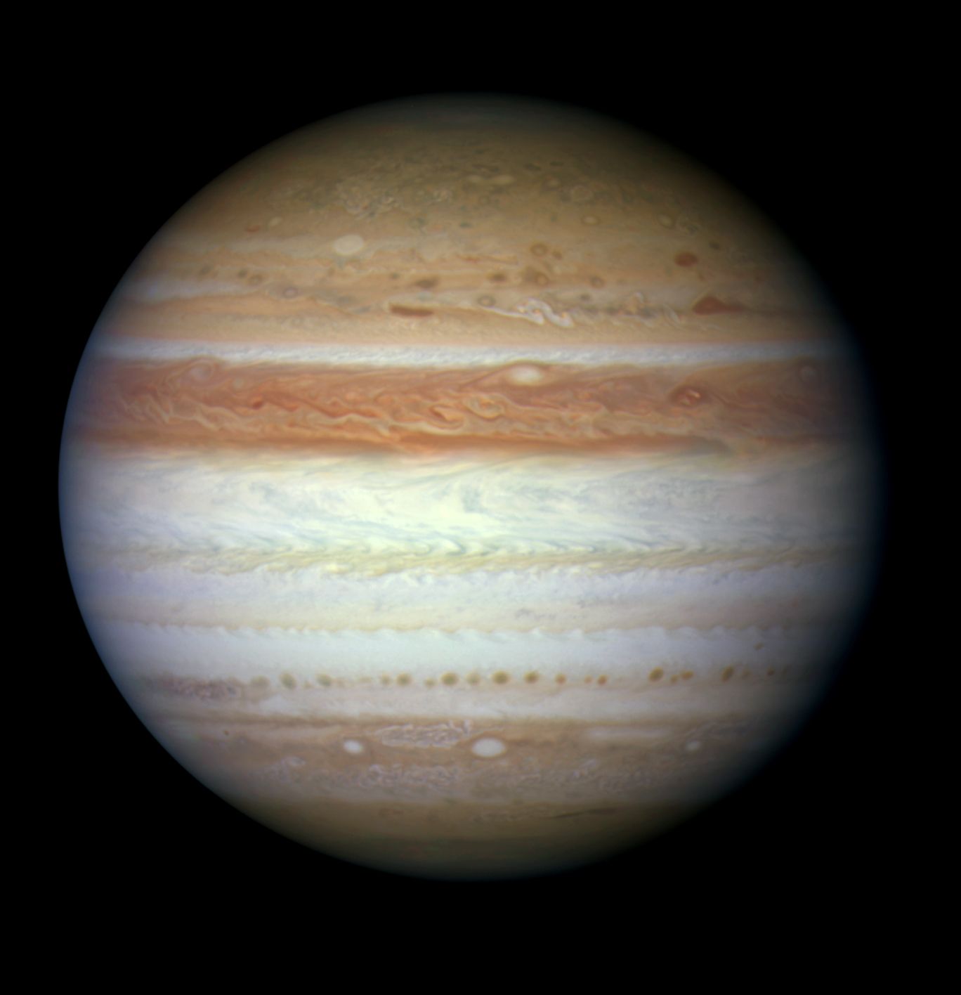
Jovian Weather
GRS
LRS
Oval BA (LRS) formed in 2002 from merger of three 65 yr old storms and turned red in 2006
Global Upheaval started in 2006 and continues to this day
<- 2010
Simon-Miller, de Pater, Sanchez-Lavega, et al.
Notes:
Spots & stripes changing color.
Spot: Anticyclonic (high pressure, counter-clockwise rotation in the south) Oval BA: formed from merger of 3 65-year old storms. A few years later, it appeared to strengthen and turn red. Hubble confirmed color change and higher wind speeds.
Stripes: various belt and zone color changes. Started just before New Horizons flyby in 2006/2007. Equator turned orange (clouds cleared), north temperate belt turned white, then red, south equator belt was disrupted. Part of a series of changes called a global upheaval. Unclear why it happens. Continued in 2010 with fully white south Equatorial belt.

Slide 19
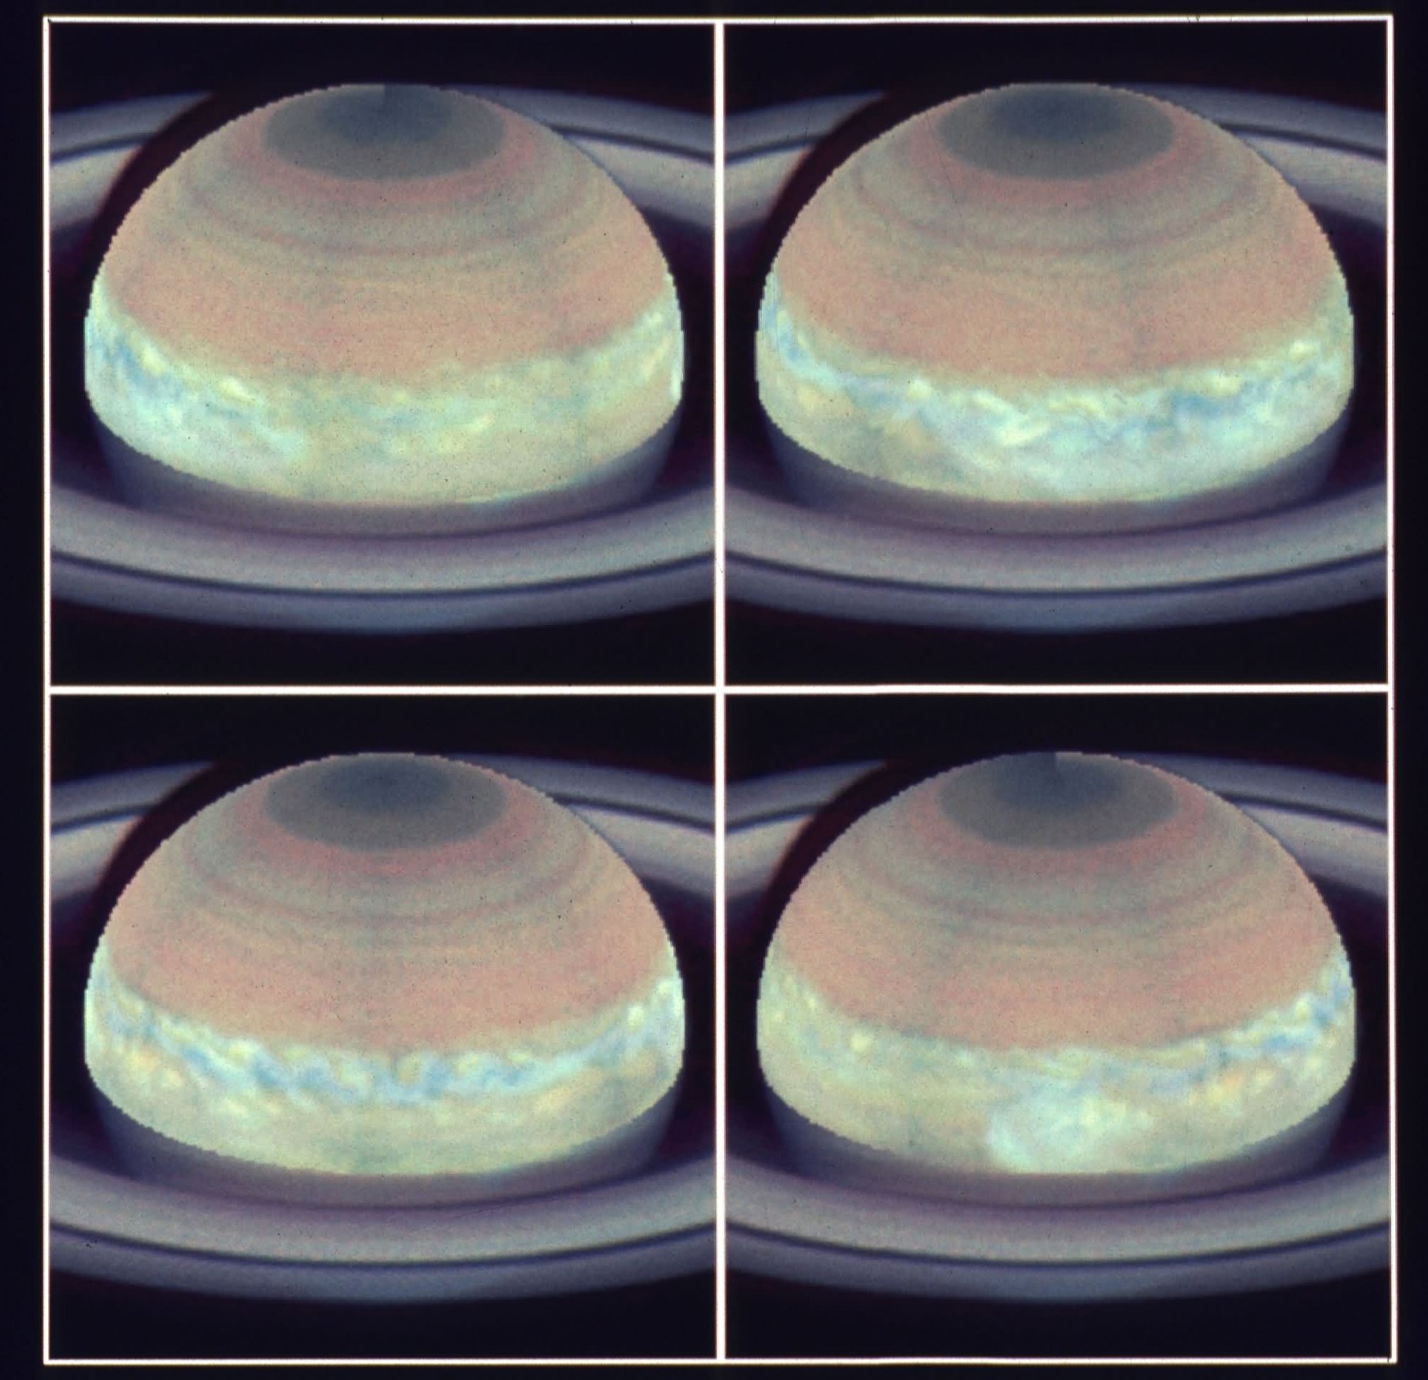
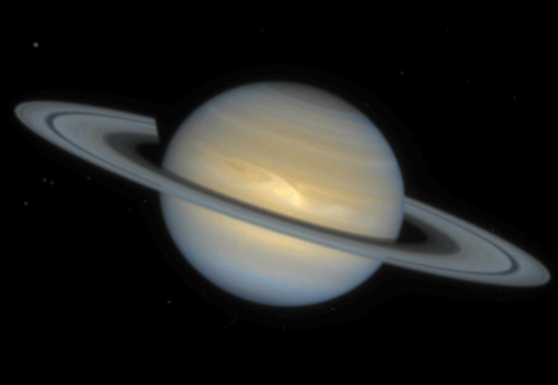
Major Storm on Saturn
Hubble captured major storm outbreak on Saturn
Rare, roughly every two Saturn years (last was 1933)
Cassini will not see this
1991
1994
Notes:
1990/1991 – Major storm outbreak on Saturn. Occurs every ~2 Saturn years (57 years since previous one in 1933!), starts as a small storm, fills entire equatorial region
Will not see anything like this from Cassini. Smaller storms are more frequent, like in 1994, but still rare.

Slide 20
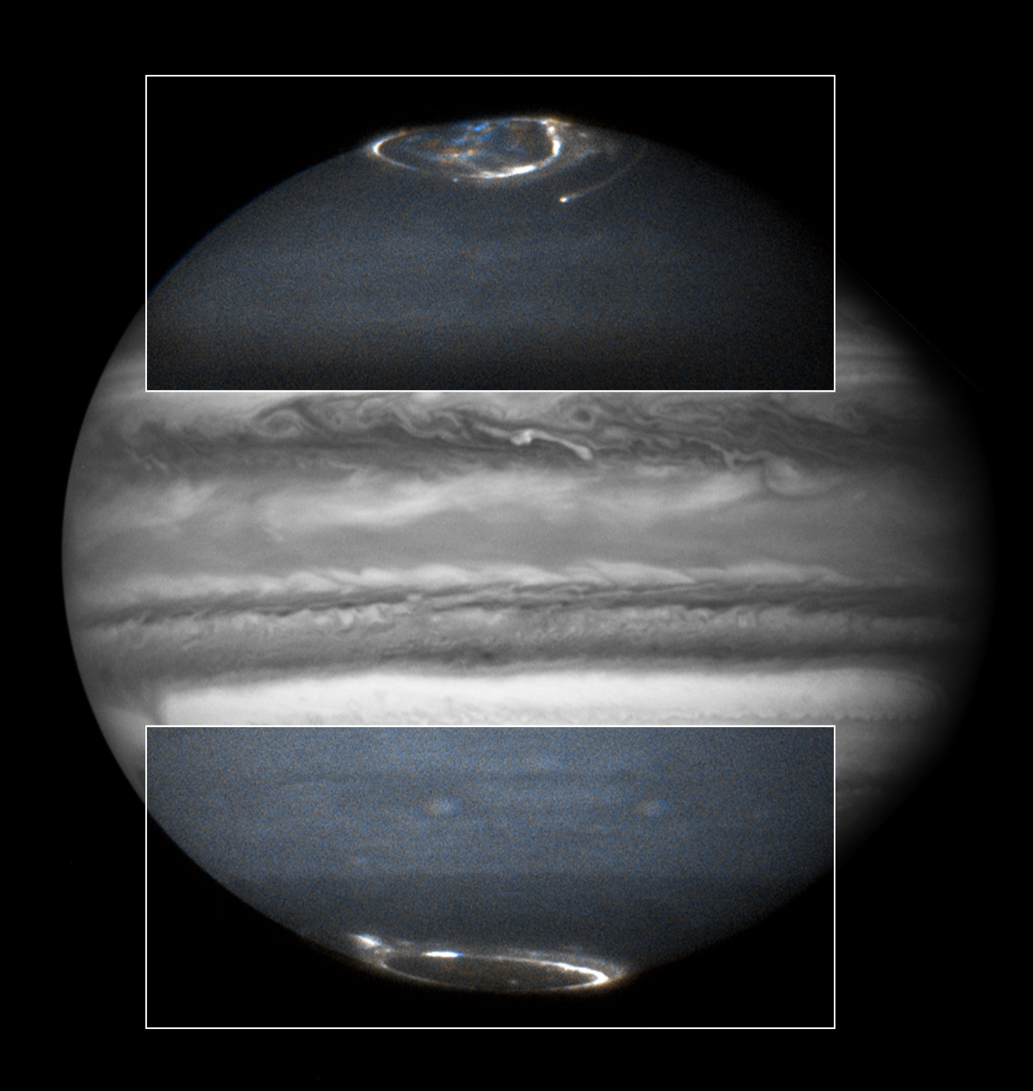
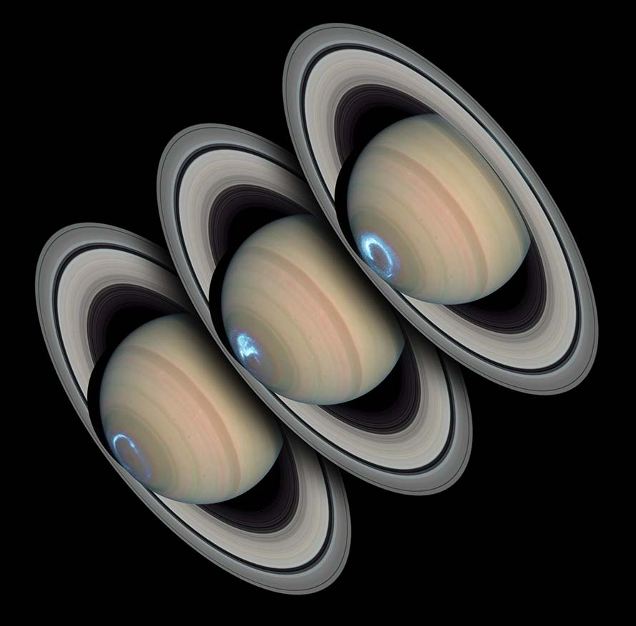
Hubble Observations of UV Auroral Emissions
Clarke et al.
Observations made with every camera and UV spectrograph on Hubble
Large programs to study Jupiter during New Horizons flyby (2007) and Saturn during Cassini campaign (2007-2008)
Emission energy, morphology, and variations : changes with solar wind
Improved understanding of internal magnetic fields and magnetospheric interactions : apply to exoplanets
Notes:
Jupiter and Saturn have huge magnetospheres. Ions captured in these magnetospheres plunge into the upper atmospheres producing spectacular, temporally variable auroral displays. The Hubble programs have resulted in over 100 publications. The Jupiter image is from ACS/SBC, and the Saturn image is from 2004 STIS/SBC.

Slide 21
Galilean Satellites
UV emissions from atmospheres
Notes:
Unfortunately, there isn’t enough time to cover these areas: UV absorption spectroscopy of atmospheres and UV spectroscopy of surfaces.

Slide 22
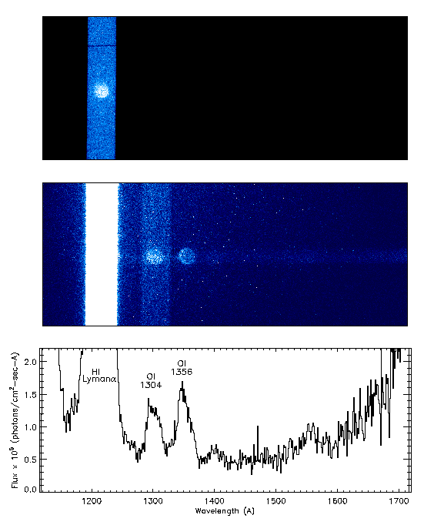
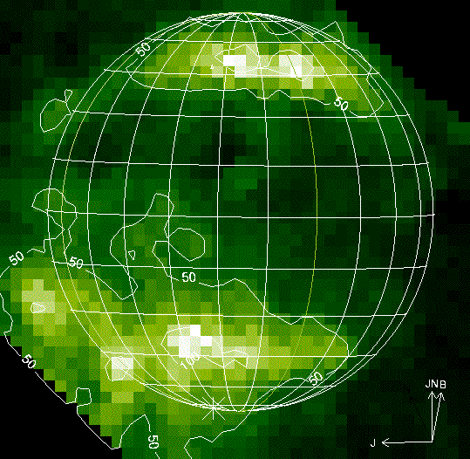
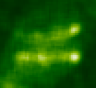
STIS/MAMA Spectral Imaging of Satellites
Europa
Both icy satellites have O₂ atmospheres. Ganymede has aurorae + surface O₃.
Ganymede
Trailing hemisphere
Feldman, McGrath, et al.
Leading hemisphere
Notes:
Both Europa and Ganymede have thin O2 atmospheres. Ganymede additionally shows auroral activity. Spectra of Ganymede’s surface at NUV wavelengths show ozone absorption (Noll et al., Science 1996).

Slide 23
Ring Systems
Rings and small satellites of Uranus
Notes:
No time to discuss Saturn, which has the most spectacular ring system in the Solar System. But recent results from Uranus are particularly exciting. (Plus, Cassini is currently performing wonderfully detailed investigations of Saturn’s rings.)

Slide 24
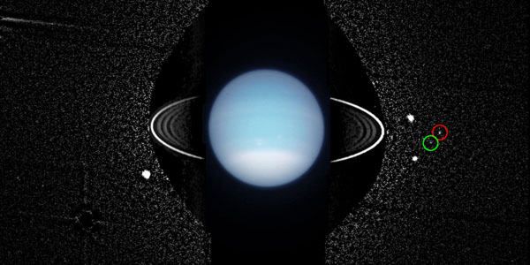
Rings of Uranus
Perdita: Detected by Voyager 2 but unconfirmed until HST
Cupid: ~ 9 km radius, only 850 km interior to Belinda
Mab: ~ 12 km radius, isolated between Puck and Miranda
Showalter et al.
Notes:
Movie obtained from first extended observations of Uranus in August 2003. 8 frames per orbit, three orbits. ACS/HRC images. Uranus was 50x over-exposed; an image from shorter exposures has been overlaid for context. Circles mark the three discovered/recovered moons. By the way, Cupid and Belinda are the closest pair of moons in the solar system that are not in the same orbit. Integrations of Cupid’s orbit suggest it to be highly unstable.

Slide 25
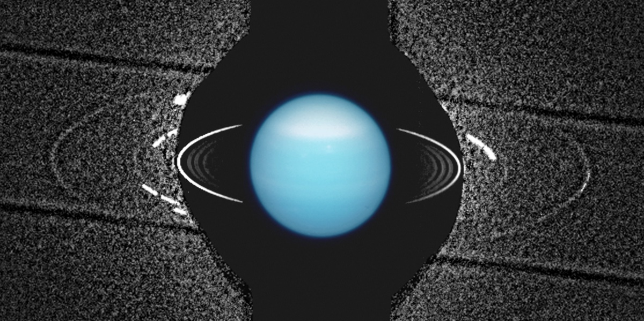
Rings of Uranus
Ring ν
Mab
Ring µ
Further enhancement and co-adding of these images reveals two faint, dusty, outer rings
Mab is clearly associated with Ring µ, and it’s probably the primary source
Ring ν orbits between Portia and Rosalind but is not associated with any known moons
Showalter et al.
Notes:
Images from the previous visit, filtered and co-added. Moons are moving so they make streaks. The two outer rings, mu and nu, come into view. Mab is clearly embedded in ring mu.

Slide 26
Mars
High resolution, global color imaging

Slide 27
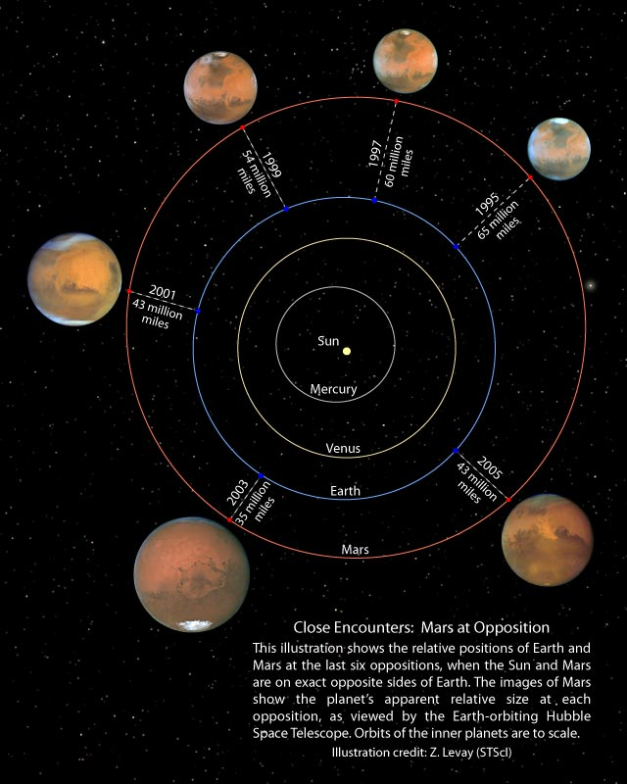
Mars
Major Hubble target since earliest days
Unique global color imaging during all oppositions from 1995-2005
Bell et al.
Notes:
Hubble provided unique global color imaging of Mars during 1995-2005. The figure above shows Hubble images during each of the six opposition periods, showing the relative locations of Earth and Mars and the correct apparent sizes of Mars each time.

Slide 28
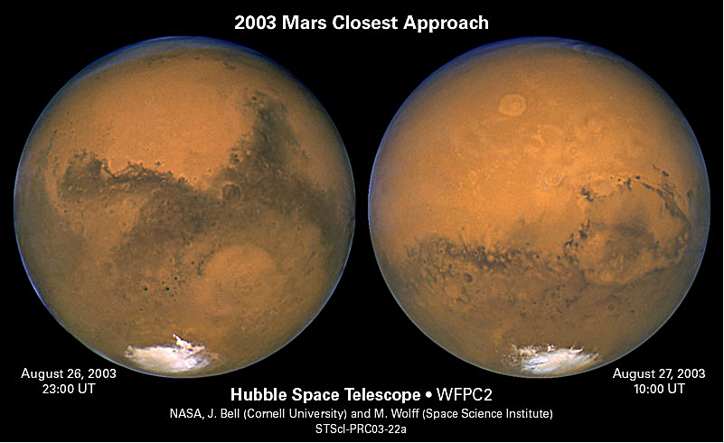
Closest Mars-Earth View in 60,000 years
Bell, Wolf, et al.
Notes:
Hubble performed hires color imaging during August 2003, which is the closest approach by Earth in 60,000 years.

Slide 29
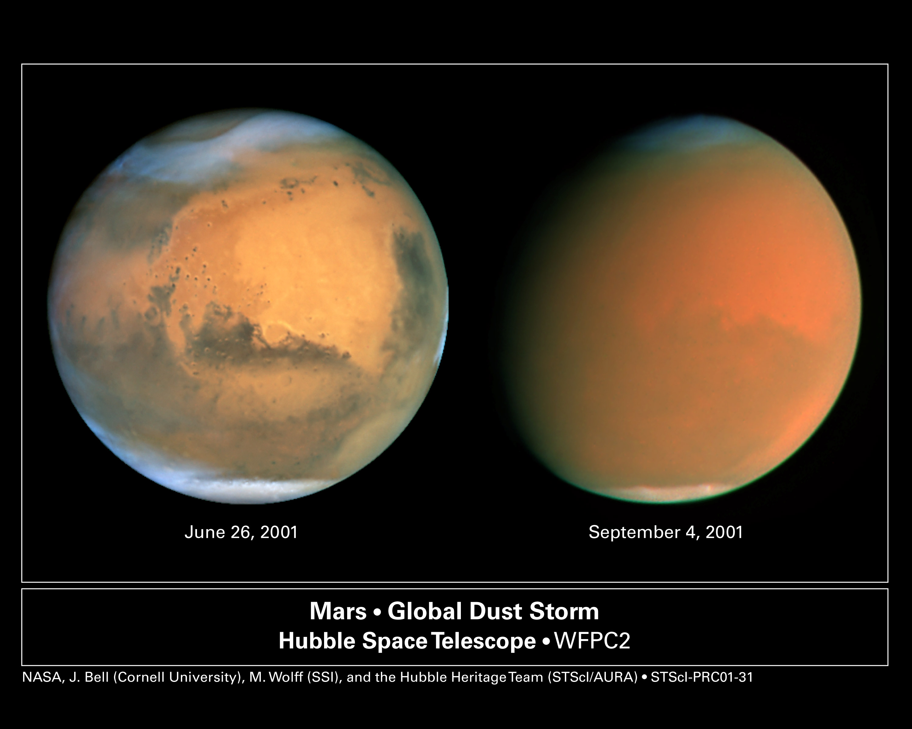
Hubble View of 2001 Dust Storm
Bell, Wolf, et al.
Notes:
A global storm in 2001 covered Mars with fine dust, obscuring its surface from view. Hubble monitored the development of this storm.

Slide 30
Mission Support
Hubble has provide valuable support to multiple NASA planetary missions
  Galileo (Jupiter)
  Deep Space 1 (Comet 19P/Borrelly)
  Cassini (Saturn)
  Rosetta (Comet 67P/Cheryumov-Gerasimenko, Asteroid 21 Lutetia)
  Deep Impact (Comets 9P/Tempel 1 and 103P/Hartley 2)
  New Horizons (Jupiter and Pluto)
  Dawn (Asteroids Vesta and Ceres)
Notes:
Hubble has frequently been called upon to support NASA’s planetary missions.

Slide 31
Acknowledgements
Colleagues who have contributed to this presentation:
  M. Brown (Caltech), J. Bell (Cornell), S. Benecchi (Carnegie), J. Clarke (Boston U), P. Feldman (JHU), H. Hammel (SSI), P. Lamy (LAS/Marseille), M. McGrath (NASA/MSFC), K. Noll (STScI), M. Showalter (SETI), A. Simon-Miller (NASA/GSFC)
Hubble’s Moving Target support:
  Lockheed-Martin’s accurate pointing & control system
  NAIF/JPL Moving Object Support System (MOSS)
  STScI MT development and MT Ops support:
    J. Isaacs, A. Lubenow (deceased), M. Buie, K. Noll, T. Roman, A. Vick, M. Reinhart, T. Ellis
Bob Fosbury and Antonella Nota for inviting me to give this presentation

Slide 32
Backup

Slide 33
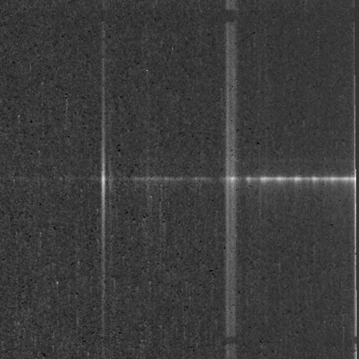
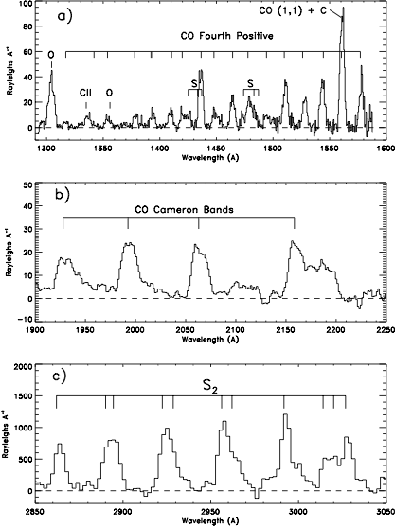
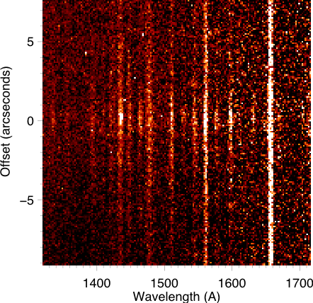
Comet Composition
STIS G140L
153P/Ikeya-Zhang
CO 4PG
C I
Parent Species CO, CO₂, S₂
Plus OH,CS,H,O,C,S
C/Hyakutake (1996 B2)
GHRS
Lupu et al.
FOS
STIS G230LB
2002 Apr 23
153P/Ikeya-Zhang
OH
FOS
CS
S₂
Weaver
Weaver et al.
Notes:
Hubble can be used to probe the composition of comets. Hubble measures emissions from parent species CO and S₂ and indirectly measures CO₂ via forbidden CO Cameron bands (excited via photodissociative excitation of CO₂). Hubble measurements also allow determination of H₂O and CS₂ production rates, via emissions from OH and CS, respectively. Hubble also measures atomic emissions from H, O, C, and S. The spectra of C/Hyakutake on the left were taken with the first generation Hubble instruments (GHRS and FOS). The addition of STIS permits spatial mapping of emissions to determine source of emissions (e.g., direct sublimation from the nucleus vs “extended source” production in the coma). In the figures to the right, the OH and C I emissions are very extended, the CS emission is more concentrated (its parent, CS₂, has a short lifetime), and the S₂ emission is only seen very close to the nucleus (direct sublimation and short lifetime of ~500 sec).

Slide 34
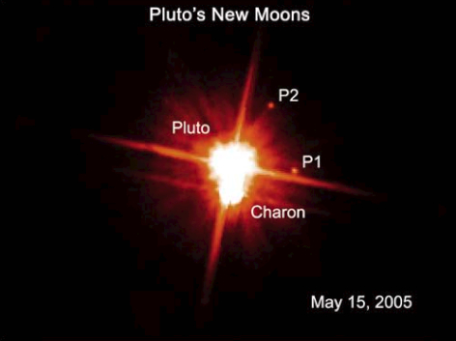
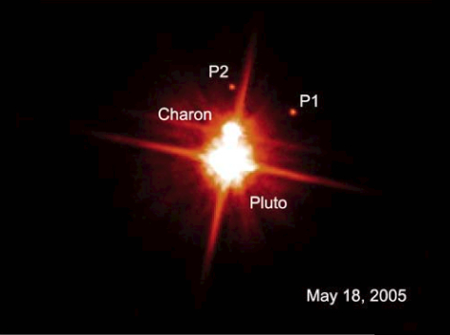
Pluto has two new satellites!
ACS/WFC Images of Pluto System
12.8"
279,000 km
Combination of 4 Images
Combination of 4 Images
Provisional Names : S/2005 P 1 and S/2005 P 2

Slide 35
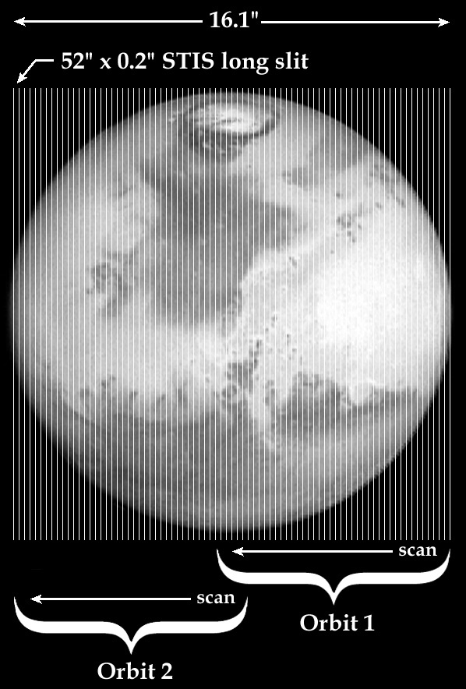
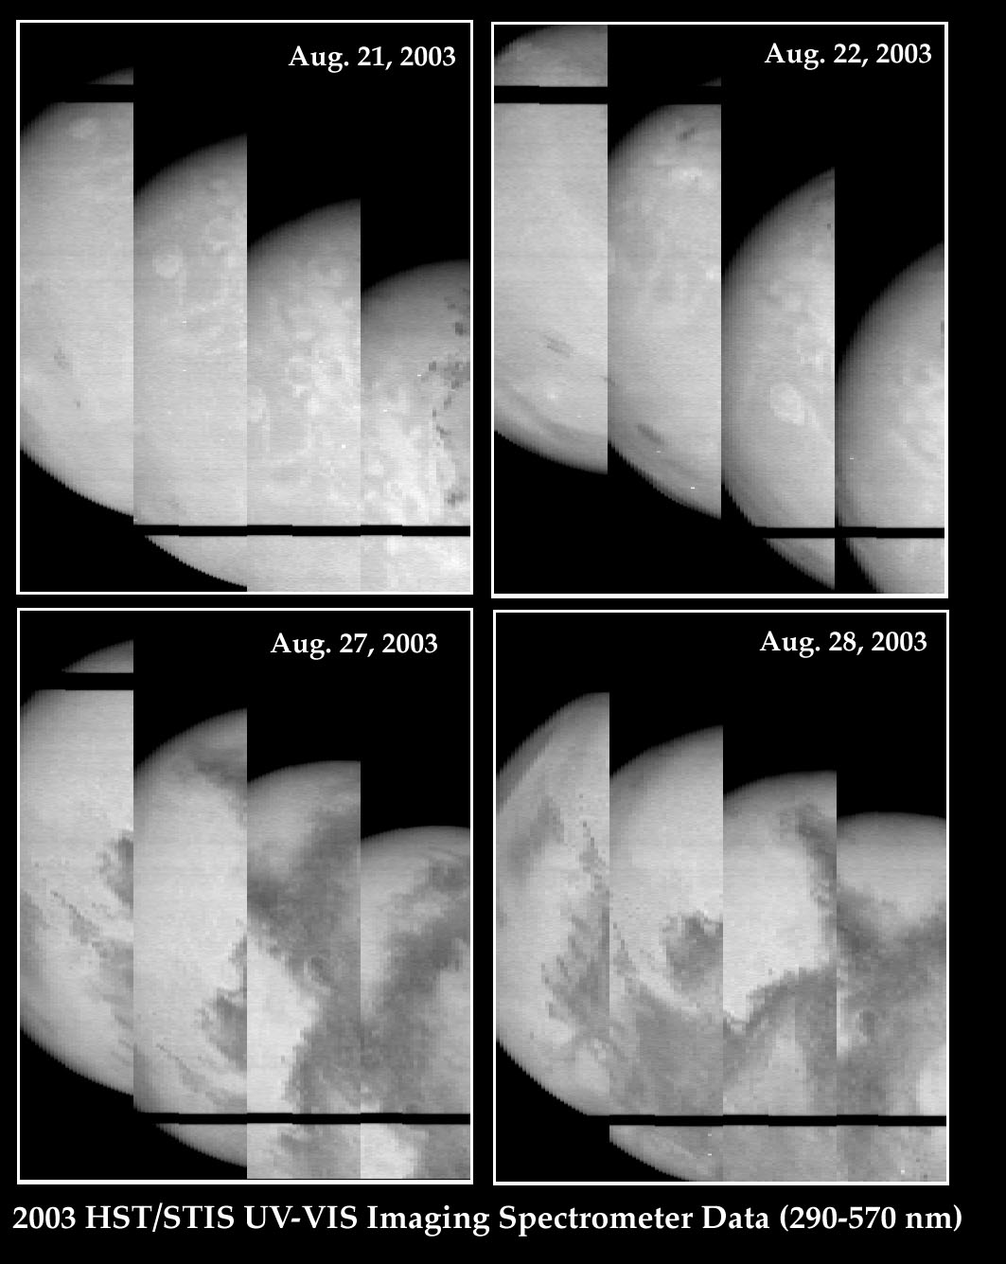
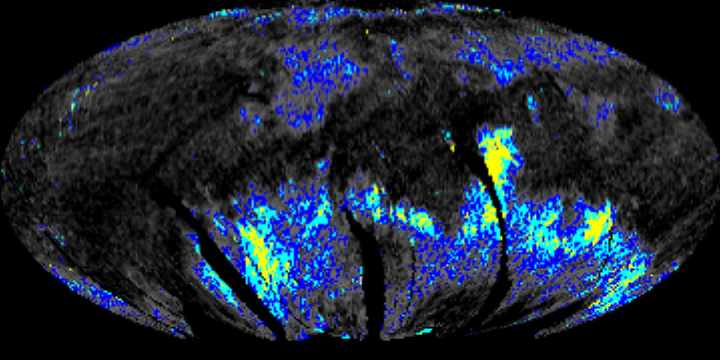
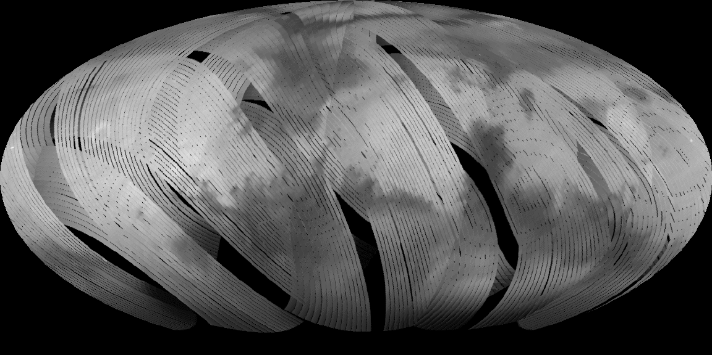
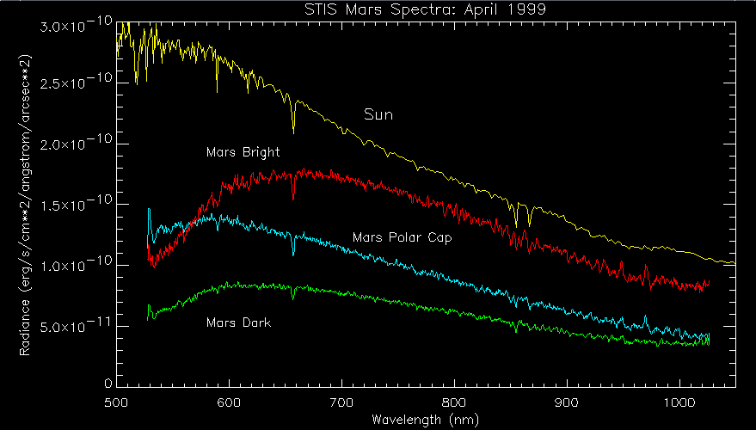
HST/STIS
VIS-NIR Imaging Spectroscopy...
Bell & Ansty, Icarus, 191, 581, 2007

