Slide 1
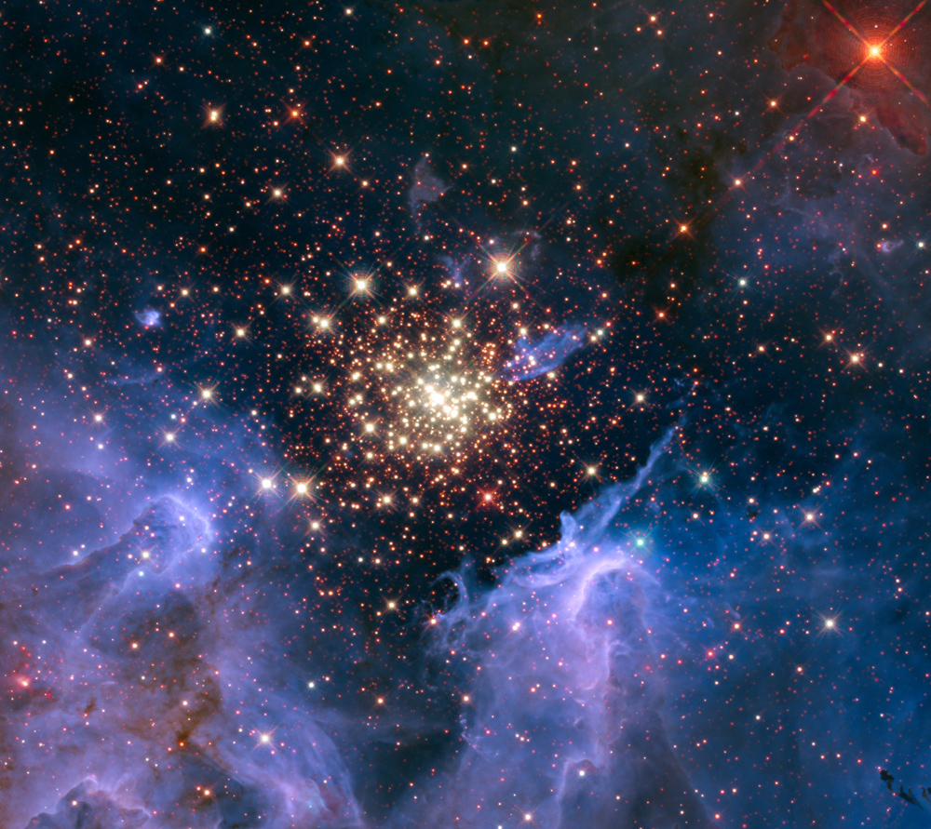

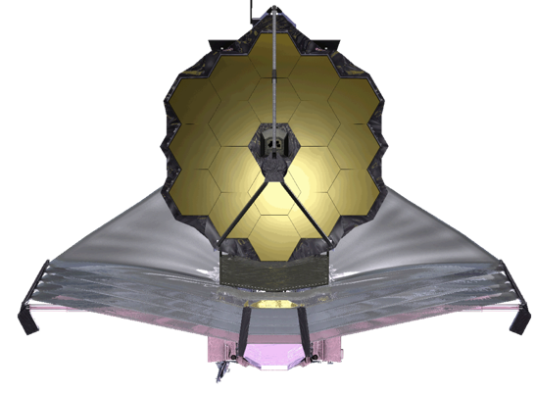
HST, JWST, and the Future
John Mather
JWST Senior Project Scientist
Goddard Space Flight Center

Slide 2
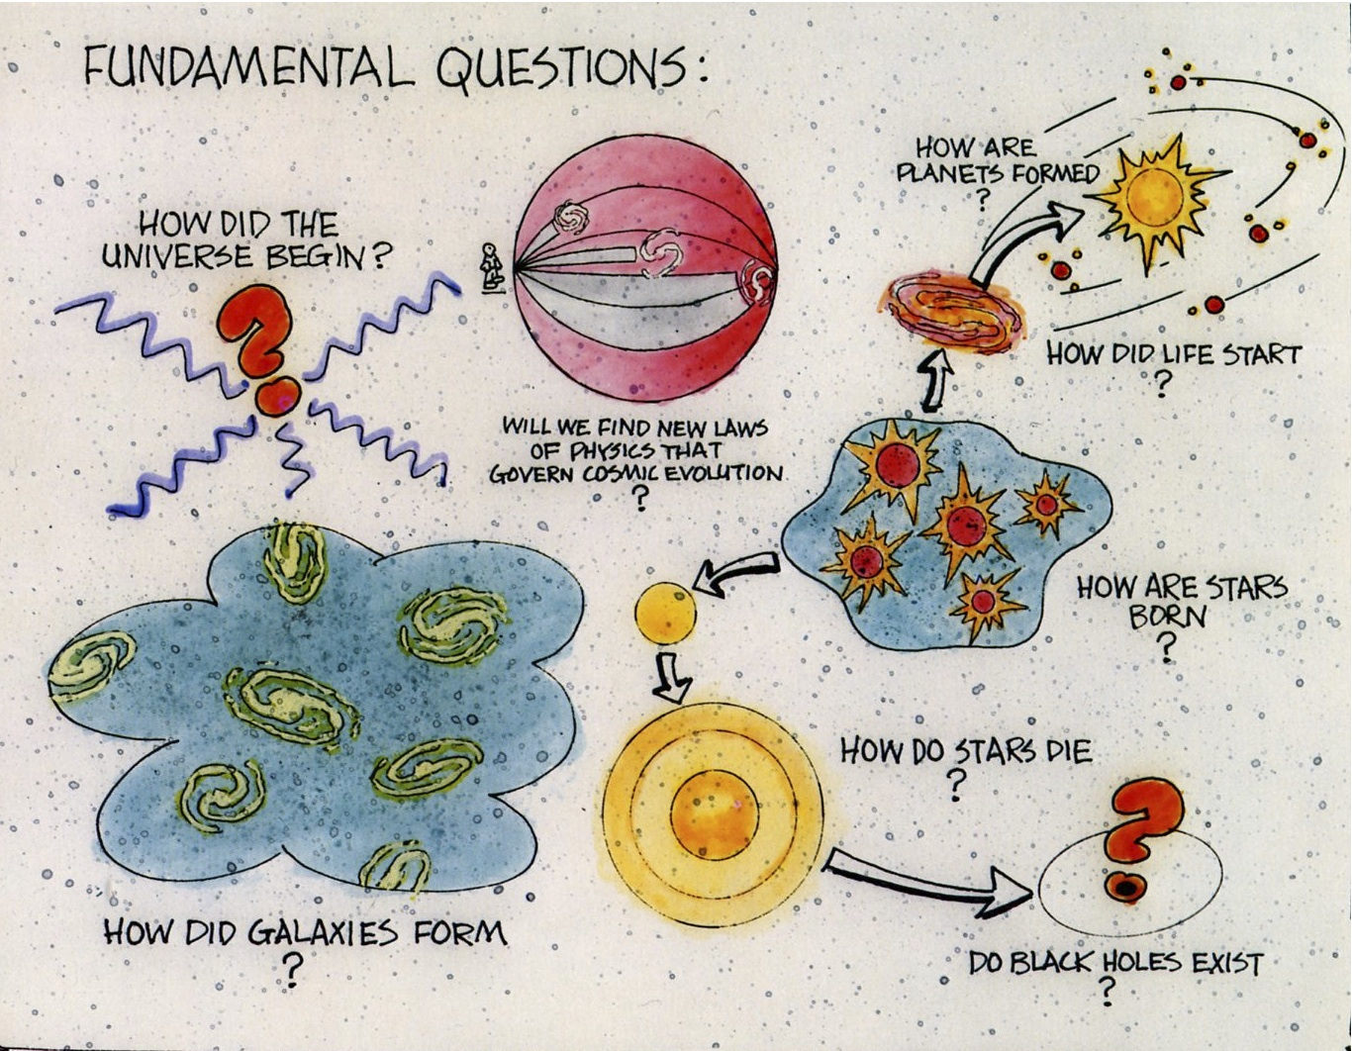

Slide 3


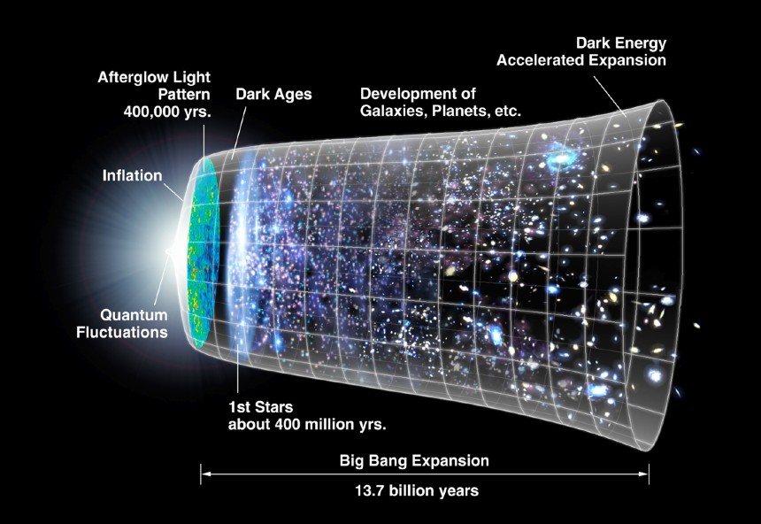
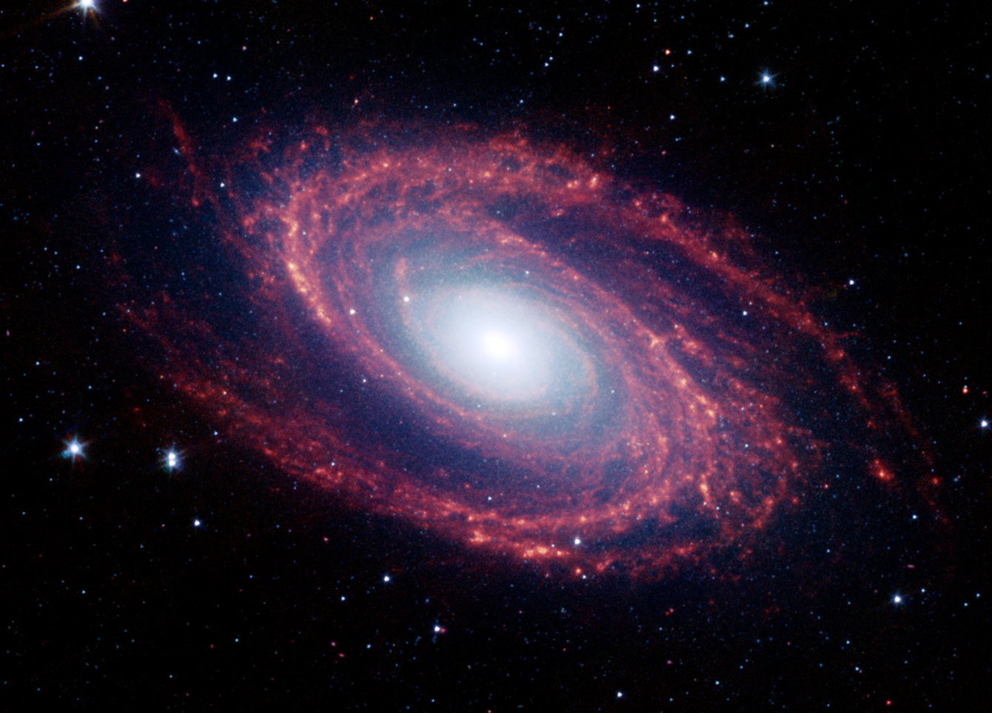
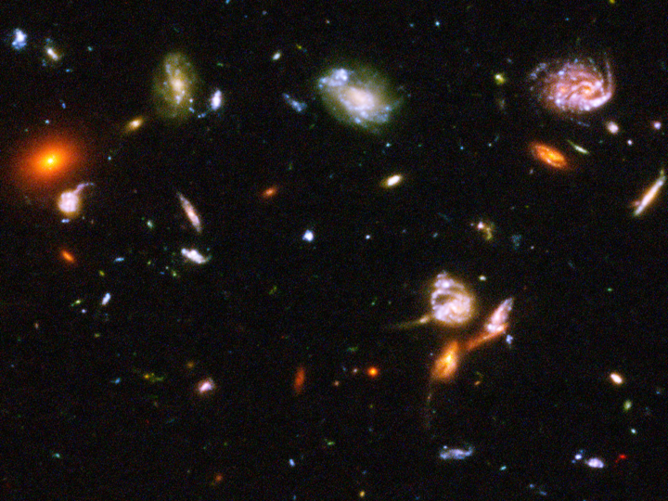
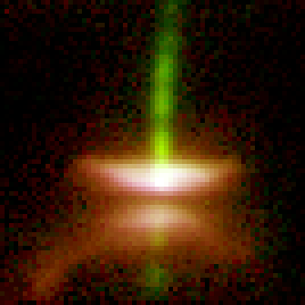
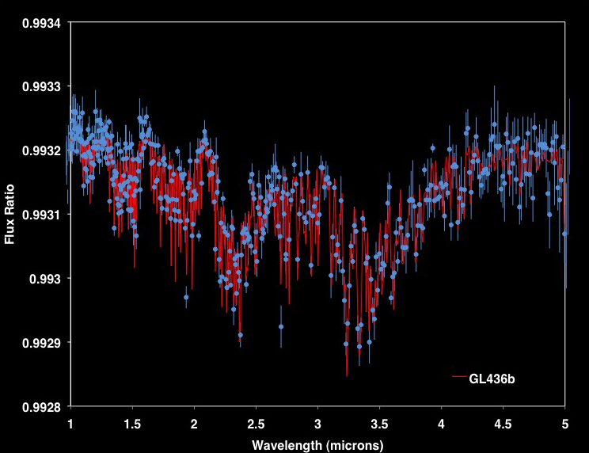
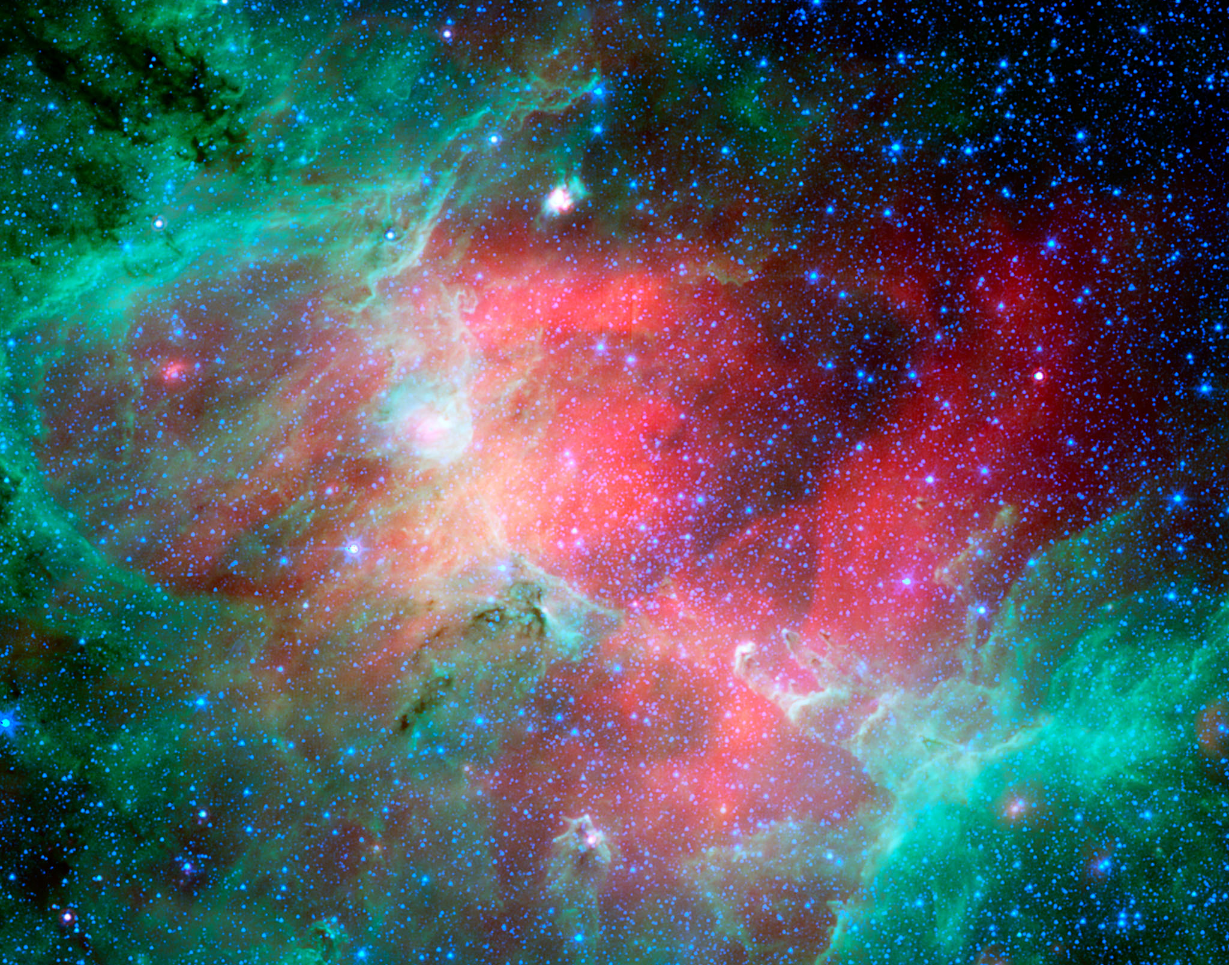
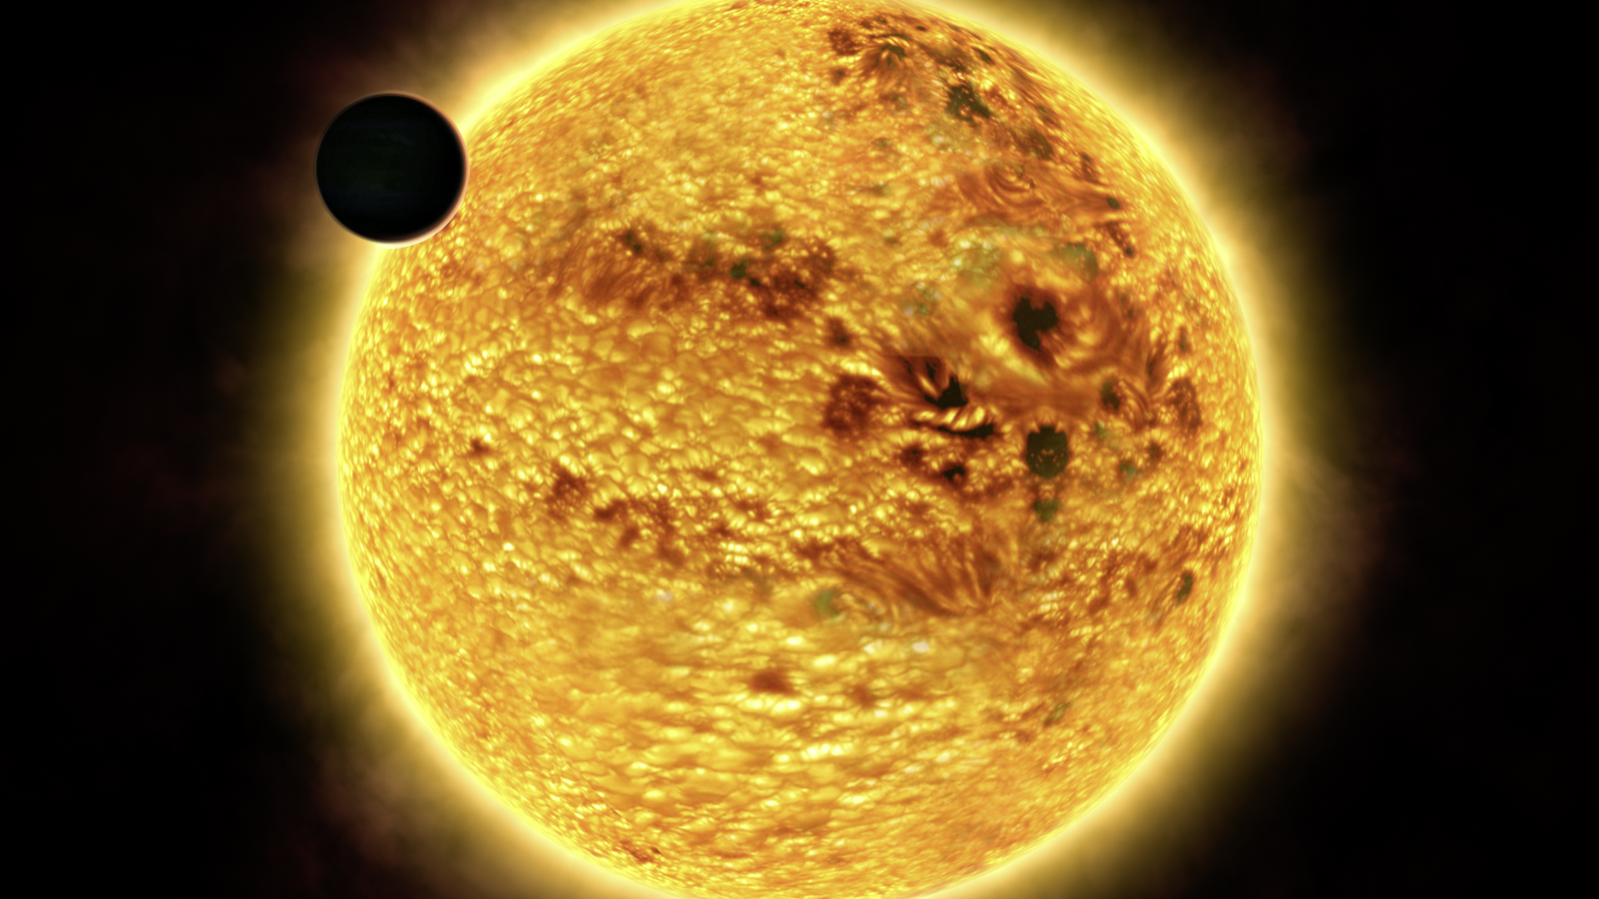
JWST Science
M81
HST-UDF
First Light and Re-Ionization
Assembly of Galaxies
HH-30
GL146
M-16
Birth of stars and
proto-planetary systems
Planetary systems and the
origin of life

Slide 4
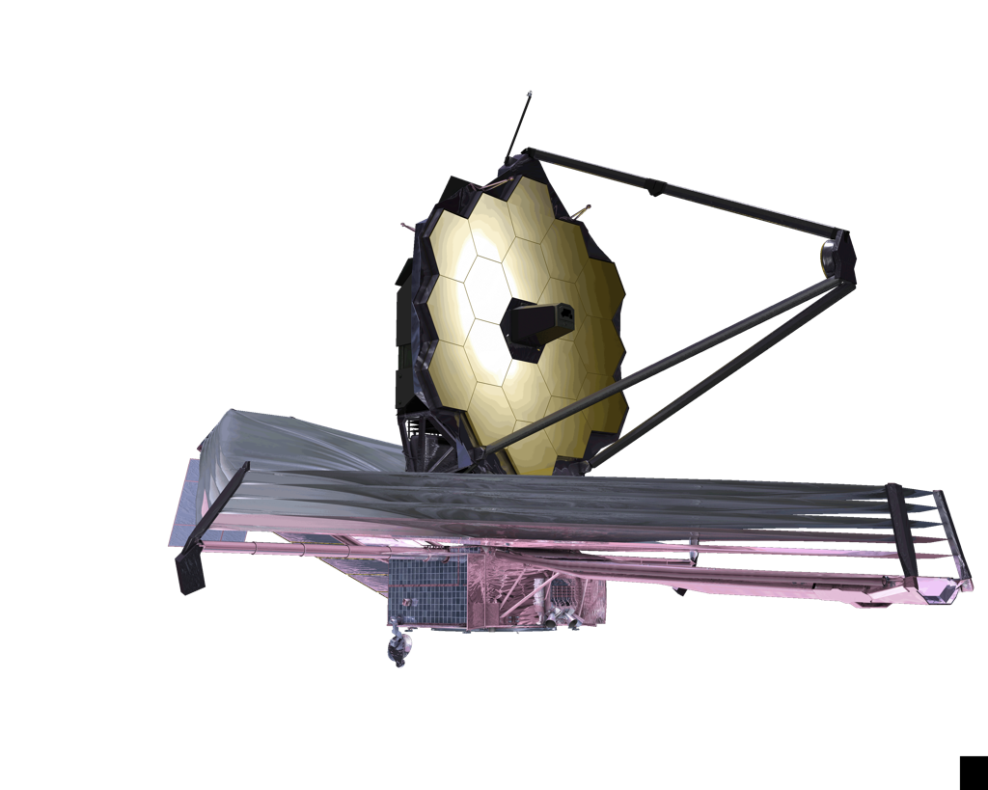
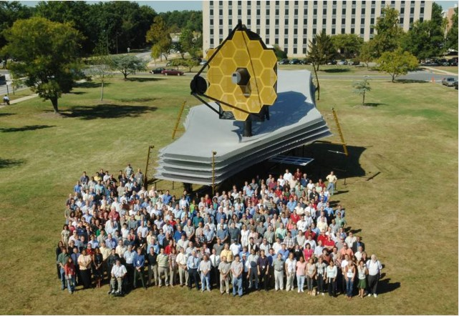

James Webb Space Telescope
Organization
Mission Lead: Goddard Space Flight Center
Senior Project Scientist: Dr John Mather
International collaboration: ESA & CSA
Prime Contractor: Northrop Grumman Aerospace Systems
Instruments:
Near Infrared Camera (NIRCam) – Univ. of Arizona
Near Infrared Spectrograph (NIRSpec) – ESA
Mid-Infrared Instrument (MIRI) – JPL/ESA
Fine Guidance Sensor (FGS) & Tunable Filter
  Imager – CSA
Operations: Space Telescope Science Institute
Description
Deployable infrared telescope with 6.5 meter diameter segmented adjustable primary mirror
Cryogenic temperature telescope and instruments for infrared performance
Launch on an ESA-supplied Ariane 5 rocket to Sun-Earth L2
5-year science mission requirement (10-year propellant lifetime)

Slide 5
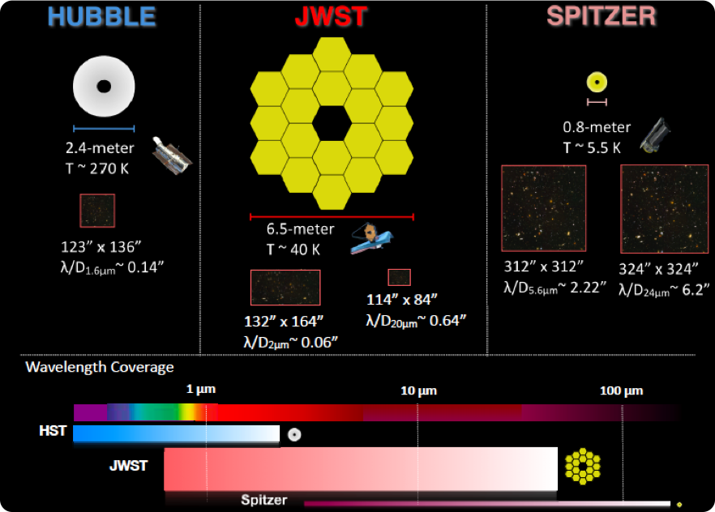
JWST and its Precursors

Slide 6
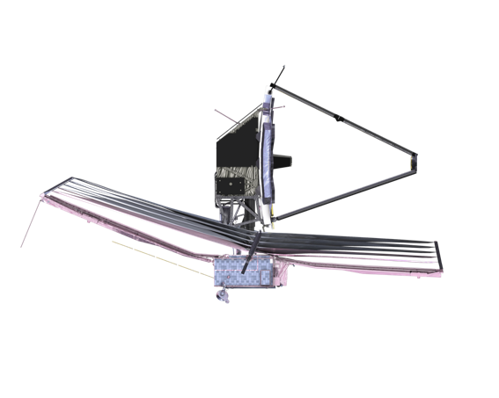
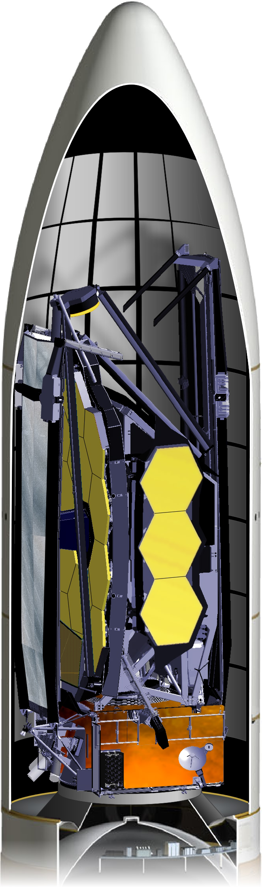
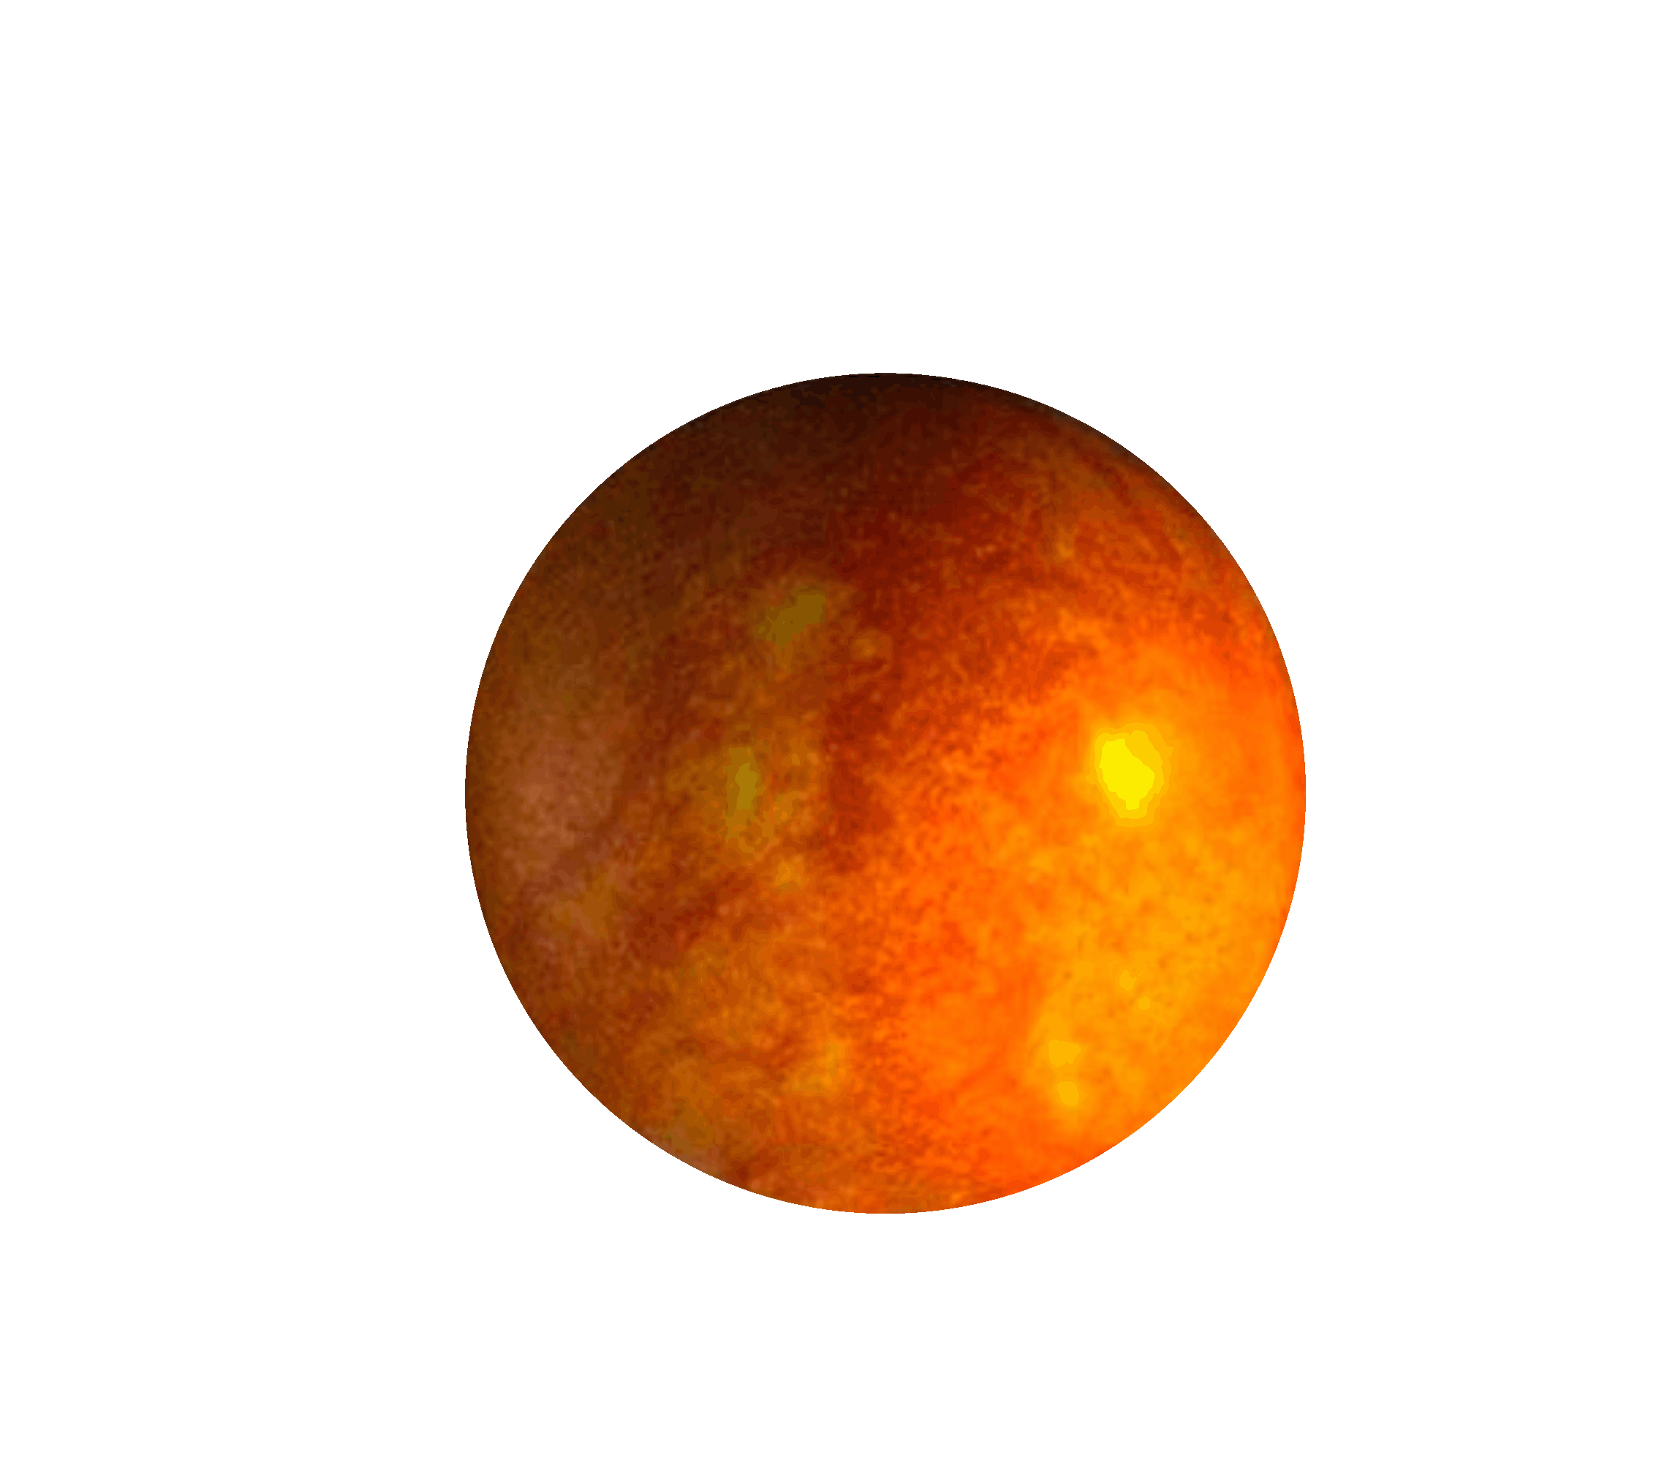
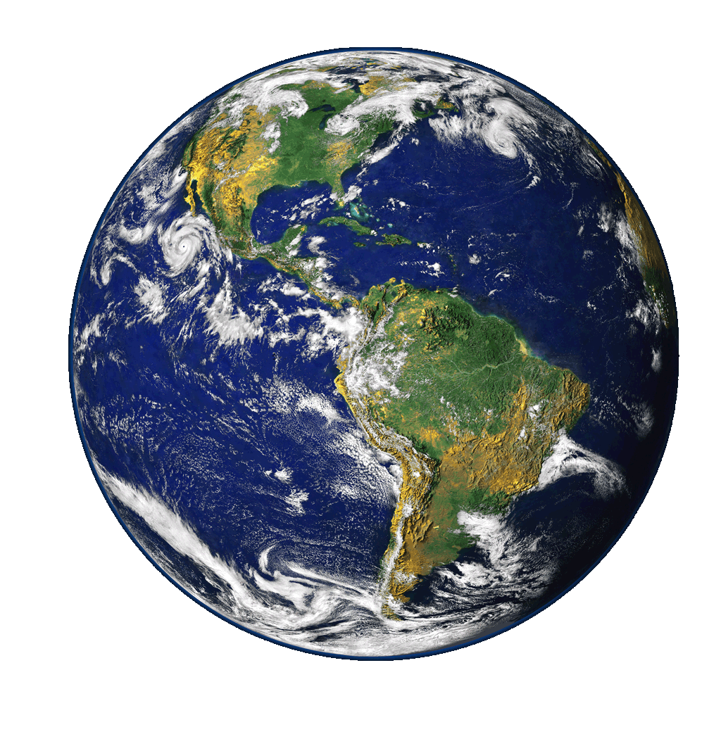
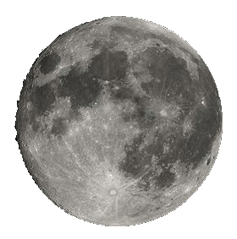
HOW JWST WORKS
Integrated Science
Instrument Module (ISIM)
Cold Side: ~40K
Primary Mirror
JWST is folded
and stowed for launch
5 Layer
Sunshield
Observatory is deployed after launch
Solar Array
Secondary
Mirror
Spacecraft Bus
Sun
Hot Side
JWST Orbits the 2nd Lagrange Point (L2)
239,000 miles (384,000km)
930,000 miles (1.5 million km)
Earth
Moon
L2

Slide 7
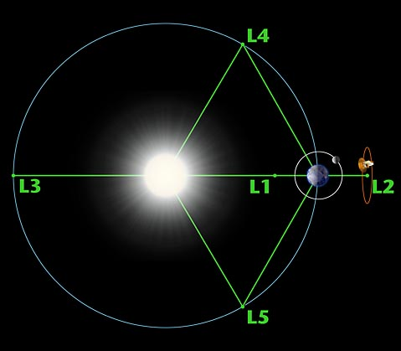
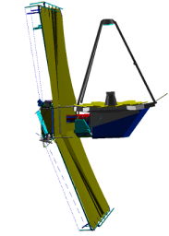
JWST science objectives require the largest cryogenic telescope ever constructed
An L2 point orbit was selected for JWST to enable passive cryogenic cooling
  Station keeping thrusters fire ~ every 3 weeks to maintain this orbit
  Propellant sized for 11 years (delta-v ~ 93 m/s)
North
Ecliptic
Pole
Continuous
Coverage
Zone North
5°
45°
The JWST can observe the whole sky while remaining continuously in the shadow of its sunshield
  Field of Regard is an annulus covering 35% of the sky
  The whole sky is covered each year with small continuous viewing zones at the Ecliptic poles
Toward
the Sun
360°
Continuous
Coverage
Zone South

Slide 8

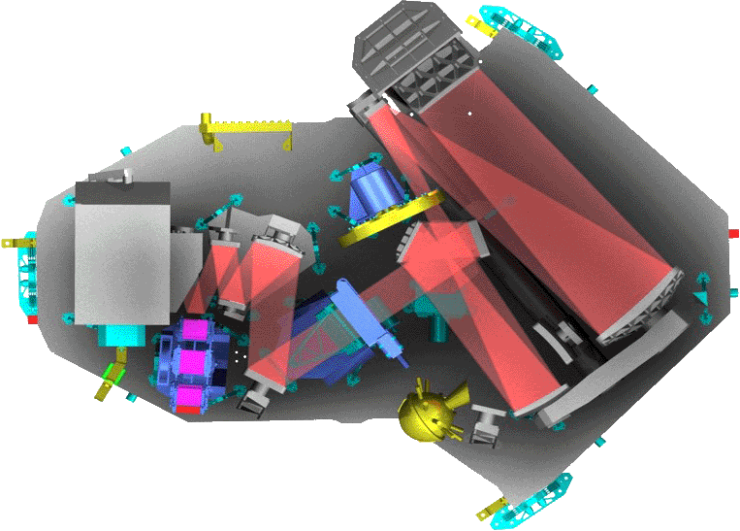
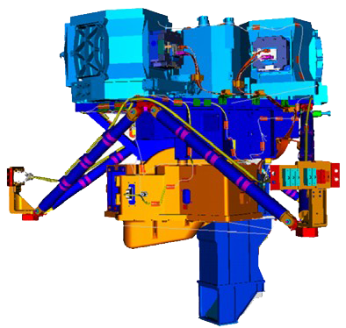
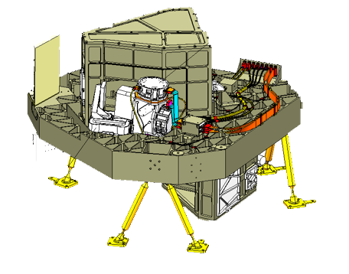
JWST Instrumentation
Instrument | Science Requirement | Capability
NIRCam Univ. Az/LMATC | Wide field, deep imaging 0.6 μm - 2.3 μm (SW) 2.4 μm - 5.0 μm (LW) | Two 2.2’ x 2.2’ SW Two 2.2’ x 2.2’ LW Coronagraph
NIRSpec ESA/Astrium | Multi-object spectroscopy 0.6 μm - 5.0 μm | 9.7 Sq arcmin Ω + IFU + slits 100 selectable targets: MSA R=100, 1000, 3000
MIRI ESA/UKATC/JPL | Mid-infrared imaging 5 μm - 27 μm Mid-infrared spectroscopy 4.9 μm - 28.8 μm | 1.9’ x1.4’ with coronagraph 3.7”x3.7” – 7.1”x7.7” IFU R=3000 - 2250
FGS/TFI CSA | Fine Guidance Sensor 0.8 μm - 5.0 μm Tunable Filter Imager 1.6 μm - 4.9 μm | Two 2.3’ x 2.3’ 2.2’ x 2.2’ R=100 with coronagraph

Slide 9
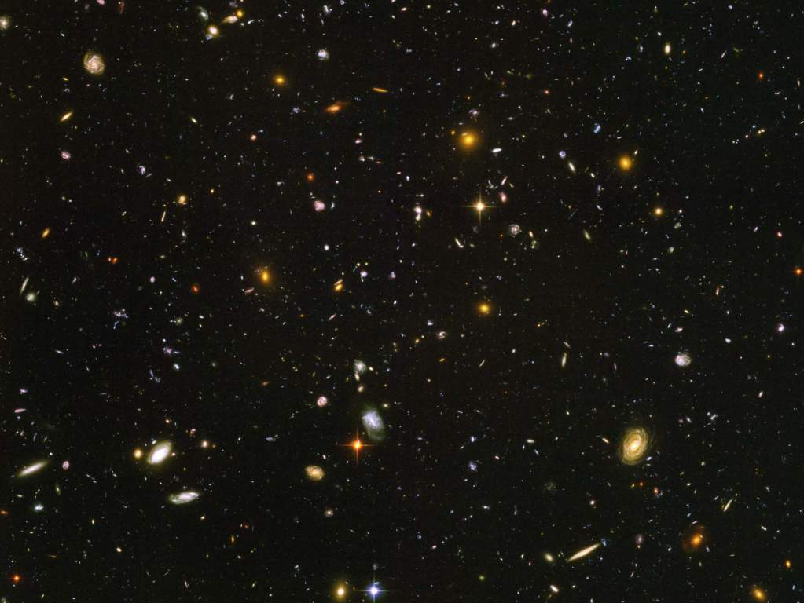

End of the dark ages: first light and reionization
… to identify the first luminous sources to form and to determine the ionization history of the early universe.
Hubble Ultra Deep Field

Slide 10
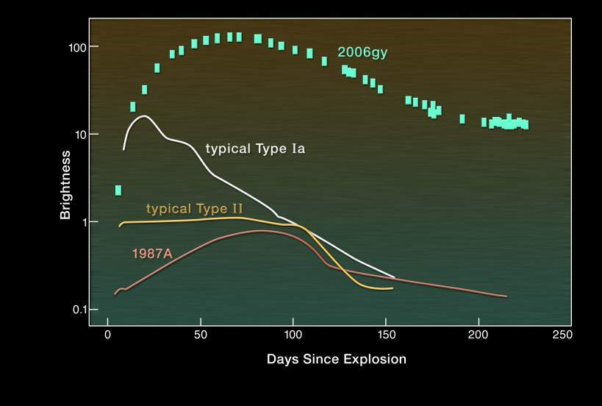
Pair-production SNe as First Stars
Good news: JWST can easily detect these when stars first formed (but not as transients).
Interesting news: pair-production instability doesn’t necessarily require primordial composition.

Slide 11
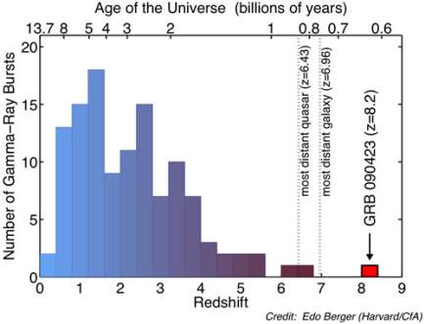
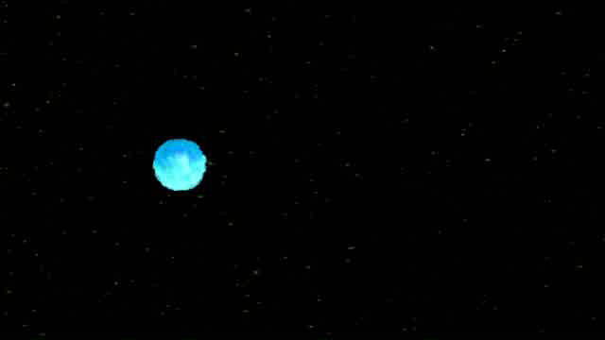
Gamma Ray Burst 4/23/09 was one of the most distant objects yet found
(z = 8.2) – supernova jet aimed at us!
JANUS GRB (SMEX) search proposed, could see to z = 12
Notes:
A sign of the most distant universe – gamma ray burst from an exploding star pointing its jet right at us. Discovered originally by satellites we launched to catch the Soviet Union cheating on nuclear bomb tests. A mystery for 40 years. Now, a probe of our own history – the most distant object ever seen.

Slide 12
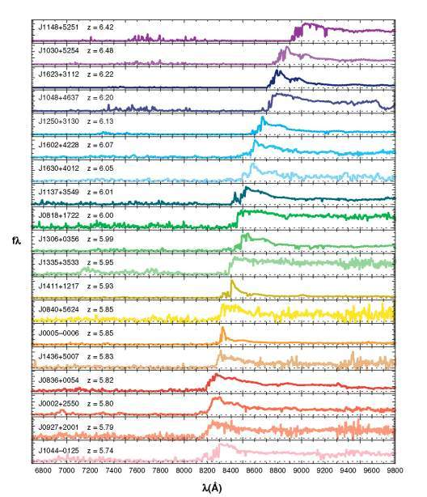
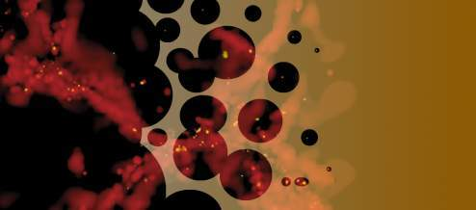
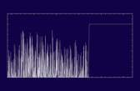
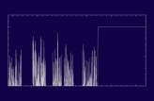
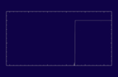
When was re-ionization?
6.42
6.00
Redshift
Neutral IGM
z~z_{i}
z>z_{i}
.
z<z_{i}
Wavelength
Wavelength
Wavelength
5.74
Lyman Forest Absorption
Patchy Absorption
Black Gunn-Peterson trough
Fan, Carilli & Keating 2006, ARAA, 44, 415
Notes:
We see evidence for re-ionization at z~6. (And by the way, the presence of massive, bright quasars at z~6 indicate that they started accreting much earlier).

Slide 13

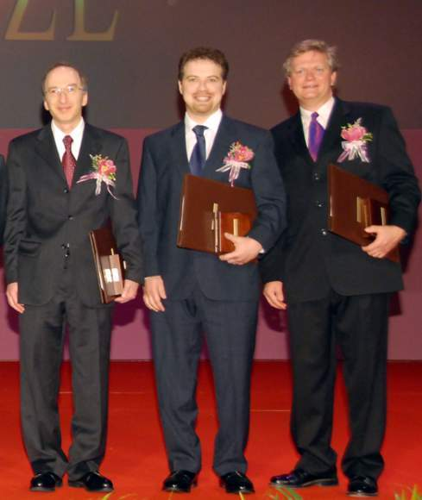
Dark Energy!
MacArthur Fellow 2008 - Adam Riess
S. Perlmutter, A. Riess, B. Schmidt

Slide 14
JWST, Dark Energy, Dark Matter
Problem: determine acceleration parameter now and in the past
Multiple techniques required due to likely systematic errors
JDEM/IDECS wide-field surveys will find targets for JWST
JWST contributes by
  Measuring very distant supernovae (standard candles?)
  SNe rest-frame IR light curves – maybe better standard candles?
  Measuring effects of dark matter too (distorted images of distant objects, masses of galaxies and clusters out to high redshift, rotation curves, etc.)
  Cosmic archeology at high redshift (prior to acceleration, formation of galaxies and clusters)
  Measuring Cepheids in galaxies with maser distances

Slide 15
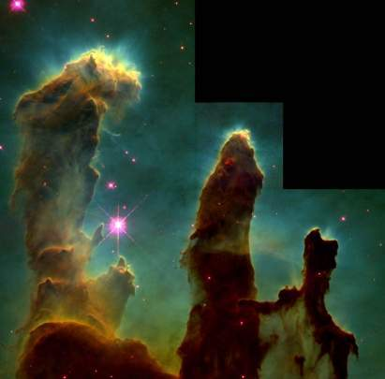
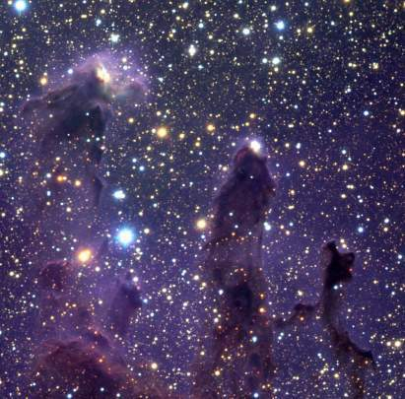
How does environment affect star-formation and vice-versa?
What is the sub-stellar initial mass function?
Massive stars produce winds and radiation
  Either disrupt star formation, or causes it.
The boundary between the smallest brown dwarf stars and planets is unknown
  Different processes? Or continuum?
Observations:
  Survey dark clouds, “elephant trunks” and star-forming regions
The Eagle Nebula
as seen in the infrared
The Eagle Nebula as seen by HST

Slide 16
Exoplanets
  As of Sept. 9, 2010, 490 total:
    Radial velocity: 459 planets, 45 multiple planet systems
    Transiting: 101 planets, including 6 multiples (most good JWST targets)
    Microlensing: 10 planets, 1 multiple system
    Imaging: 13 planets, 1 system (a triple) (JWST has 3 coronagraphs)
    Timing: 8 planets, 2 multiple planet systems
    + predictions from dust disk structures
Kepler launched Mar. 6, 2009, monitors ~ 100,000 stars, to find handful of Earths, thousands of others
TESS (Transiting Exoplanet Survey Satellite), proposed SMEX, would survey nearest stars, best candidates for detailed follow-up with JWST
JWST Transits Working Group established – M. Clampin

Slide 17
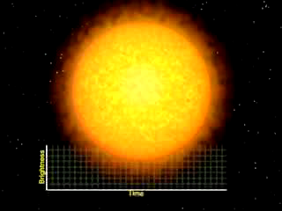
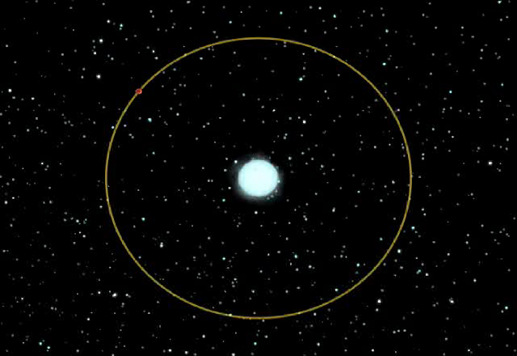
Primary
Secondary
Planet blocks light from star
Visible/NIR light (Hubble/JWST)
Radius of planet/star
Absorption spectroscopy of planet’s atmosphere
JWST: Look for moons (by timing), constituents of atmosphere, Earth-like planets with water, weather
Star blocks light from planet
Mid-Infrared light (Spitzer/JWST)
Direct detection of photons from planet
Temperature of planet
Emission from surface
JWST: Atmospheric characteristics, constituents of atmosphere, map planets

Slide 18
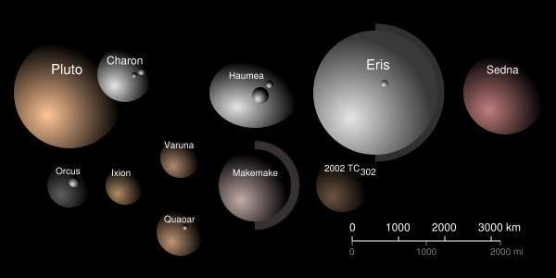
Dwarf Planets and Plutoids
May be 2000 more when whole sky is surveyed
With moving object tracking JWST is perfect tool

Slide 19

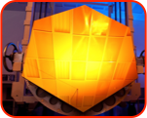
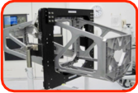
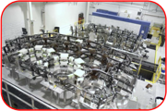
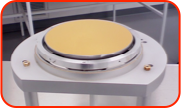
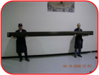
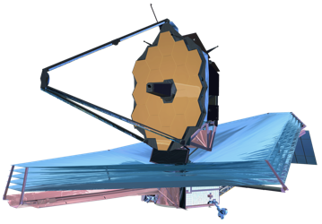
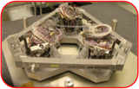
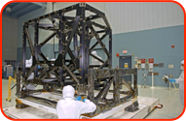
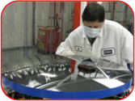
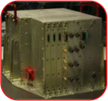
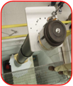
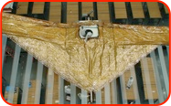

JWST: Under Construction
Primary Mirror Segment
Aft Optics System
PM Flight Backplane
Tertiary Mirror
SMSS Pathfinder Strut
Fine Steering Mirror
ISIM Flight Bench
SM Hexapod
Secondary Mirror Segment
IC&DH unit ETU
Mid-boom Test
Membrane Mgmt
Pathfinder Membrane

Slide 20








JWST Mirror Fabrication
Raw Be billet (two mirrors)
JWST Mirrors made of beryllium
Lightweight and stable at 40 K
Brush-Wellman
Primary mirror segment
Secondary mirror
Tertiary mirror
Machined & lightweighted by Axsys
92% material is removed
Mirrors polished at Tinsley Segment cryo-figure: 20 nm
Actuators & Strongback
Gold Coating
JWST

Slide 21

Flight Mirror Cryogenic Testing

Slide 22




First Flight Mirrors Complete
Mid Frequency: RMS 12.1nm, P-V 56nm
High Frequency: RMS 5.4nm, P-V 121nm
EDU
Mid Frequency: RMS 8.2nm, P-V 49nm
High Frequency: RMS 3.2nm, P-V 153nm
A4

Slide 23






Secondary Mirror
SM flight spare meets requirements
22K SMA SFE
SMA 22K ROC = 1778.83mm
SMA 22K Conic Constant = -1.65998
22K SMA SFE Cycle-Cycle Stability

Slide 24



JWST Telescope Aft Optics
Aft optics and Aft optics bench complete

Slide 25


JWST Telescope Optics
Tertiary Mirror
58 nm RMS
(-Tilt, -Power)

Slide 26



JWST Telescope Optics
Fine Steering Mirror
2.3 nm RMS

Slide 27




Predicted Image Quality
Log scale
Linear scale
2 μm
2.0” x 2.0”
1 μm
2.0” x 2.0”
Log scale: 2.0” x 2.0”
Linear scale: 2.0” x 2.0”

Slide 28


The NIRCam instrument will image large portions of the sky identifying primeval galaxy targets for the other instruments
Developed by the University of Arizona with Lockheed Martin ATC
  Operating wavelength: 0.6 – 5.0 microns
  Spectral resolution: 4, 10, 100
  Field of view: 2.2 x 4.4 arc minutes
  Angular resolution (1 pixel): 32 mas < 2.3 microns, 65 mas > 2.4 microns
  Detector type: HgCdTe, 2048 x 2048 pixel format, 10 detectors, 40 K passive cooling
  Refractive optics, Beryllium structure
  Simple coronagraph with choice of Lyot masks in wheel
Supports OTE wavefront sensing

Slide 29











Wavefront Sensing and Control Setup Sequence
OTE Deployment / First Light (Image Mosaic)
SM Focus Sweep
Segment Identification
NIRCam First Light
After Segment-Image Array
After Global Alignment
Segment Search
Segment-Image Array
DHS (20 edges)
Global Alignment
Commissioning
After Image Stacking
Image Stacking
After Coarse Phasing
Coarse Phasing (DHS)
Single Field Fine Phasing
After SF Fine Phasing
Pupil Imaging
Multi-Field Fine Phasing
Wavefront Monitoring & Maintenance

Slide 30
NIRSpec Schematic
0.6-5.0 µm, R = 100, 1000, 3000
Micro-Shutter
Array
Grating/Prism
Wheel
Detector
Array
Filter
Wheel
Pick-off
Optics
Fore optics
Collimator
Camera

Slide 31


NIRSpec: ESA & Astrium
> 100 Objects Simultaneously
10 square arcminute FOV
Implementation:
  3.4’ Large FOV Imaging Spectrograph
  4 x 175 x 384 element Micro-Shutter Array
    250,000 pixels, 203 x 463 mas, pitch 267 x 528 mas
  2 x 2k x 2k HgCdTe Detector Arrays
  Fixed slits and IFU for backup, contrast
  SiC optical bench & optics

Slide 32





250,000 pixel cryogenic microshutter array system
Human Hair 90 um Dia.
203 x 463 mas shutter pixel clear aperture, 267 x 528 mas pitch, 4 x 171 x 365 array

Slide 33

Engineering Test Units Instruments at GSFC
NIRSpec
MIRI
NIRCam
OSIM
http://www.jwst.nasa.gov/webcam.html

Slide 34

ISIM Structure Cryoset Test

Slide 35













ISIM Test Configuration
SES
chamber
LN2 Shroud
He shroud
ISIM
OSIM
Vibration Isolation Supports
GHe shroud instillation and test completed July 09
Fold Mirror 3 Tip/Tilt
Gimbal Assembly
Alignment Diagnostic Module
OSIM Primary Mirror

Slide 36


Optical End-to-End Test @ JSC
Vibration isolation
system for suspension
system. Six minor
intrusions thru the
chamber
Cryo-Position
Metrology provided
by photogrammetry
with cameras mounted
on windmills to
provide conical
scanning
Goals of Test
Verify Optical alignment
Verify workmanship
Thermal balance
Suspension system
which holds the OTE
support structure,
CoCI, and ACFs
Test sources mounted on the AOS
entrance. Inward sources sample the Tertiary Mirror.
Outward sources make a pass and a half thru the
OTE optics.
JWST

Slide 37




Sunshield Development
JWST’s sunshield is the key element that allows passive cooling to 40K
The size of a tennis court, the five-layer sunshield is deployed after launch
Key sunshield technical challenges have been addressed using pathfinders
Membrane shape
Packaging for launch
Membrane folding strategy
Membrane covers
Deployment
JWST

Slide 38


Membrane Deployment
NGAS have developed a managed approach to sunshield deployment
Full scale models validate deployment approach, membrane folding and deployment boom performance
Folded membrane
Deploying membrane
Mid-Boom
JWST

Slide 39



Backplane/Sunshield Mockup
Sunshield systems testing
1/3rd scale Sunshield thermal performance test

Slide 40







Spacecraft Bus Engineering Model Hardware
Successfully Completed Spacecraft Preliminary Design Review (PDR) in 2009
Successfully completed & delivered SC Sim 1A
Spacecraft Critical Design Audit: June 2012
Completed HGA STM
CTP in Lab testing FSW Release 1.x
SC Sim 1A upgrade
Transponder Transmitter Slice
(in progress)
JWST Flight SCAT at Test Site
Software Development Lab CTP EM
Transponder Receiver Slice

Slide 41


Slide 42

SPICA
Japanese 3.5 m 4.5 K actively cooled telescope, launched on H-II rocket to L₂
Cooling design mature
5-200 µm with cameras and spectrometers
Seeking international partnership

Slide 43

Con-X + XEUS → IXO

Slide 44

Advanced Technology Large Space Telescope
Study started at STScI/JHU in preparation for Decadal Survey
UV/optical successor for HST
  Supernovae
  Lensing
  Clustering
Reveal cosmic web: intergalactic medium
  Lyman α absorption against distant objects
  Hope: direct imaging of IGM

Slide 45



Single Aperture Far IR Telescope
20 - 500 microns wavelength, cooled to ~ 4 K, operating at L2, 8 - 10 m aperture

Slide 46


TPF-Interferometer

Slide 47

IR Coronagraph Design Concept
28-m Telescope
28-meter filled aperture telescope
  Three-mirror anastigmat
  36 segments, 4-meter flat-flat
  Composite replica optics
  Gold mirror coatings
Multi-layer sunshade
  Passive cooling to ~30K
IR Coronagraph for planetary detection/characterization
  10⁷ contrast at 100 mas
IR camera and spectrograph for general imaging/spectroscopy
  2 x 2 arcmin FOV
Launched with EELV heavy to L2
  On-orbit assembly option
6-DOF Secondary
35 x 50-m Sunshield
(Tennis court = 11 x 24 m)

Slide 48


Slide 49

Why astronomy doesn’t pay for everything

Slide 50

Summary
JWST is making excellent technical progress
JWST will be the dominant astronomical facility for a decade, and will undertake a broad range of investigations by the astronomical community
JWST remains the brilliant advance recommended by the 2000 Decadal Survey
  JWST science underpins the science recommended by the 2010 Decadal Survey
  JWST has the capability to address new observing opportunities such as exoplanet characterization......
  JWST has the capability to address new observing opportunities such as exoplanet characterization......

Slide 51


SN 2006 gy – brightest supernova
Could be the first observation of a pair-production instability, from the death of a very massive star.
  Stars are normally held up by the balance of light pressure and gravity
  Gamma rays producing electron/positron pairs scatters light, reducing pressure. Instability creates runaway collapse.
A nearby analog for the first stars in the Universe.
γ → e– + e⁺ → γ
Progenitor was similar to Eta Carina.
Hubble Image of Eta Carina
Notes:
γ

Slide 52

The Laser Interferometer Space Antenna (LISA)
New branch of astronomy!
Space-based gravitational wave detector
3 spacecraft in 5,000,000 km equilateral triangle
Laser interferometer senses changes of 1/100 size of an atom

Slide 53
Sensitivity & Resolution
Cameras and R ~ 100 spectroscopy background limited at all wavelengths
  6.5 m mirror much larger than HST, Spitzer - big gains
  Background dominated by zodi light, and at > 12 µm from thermal emission from sunshield
  Other stray light from galaxy, sometimes Earth or Moon
NIRSpec sensitivity detector limited at R ~ 1000
Image quality
  Diffraction limited (λ/14 rms wavefront) at 2 µm (better than ground AO in Strehl and much better Field of View)
  0.032 arcsec pixels in NIRCam short band (Nyquist @ 2 µm)
  0.065 arcsec in NIRCam long band and .068 in Fine Guider
  0.2 x 0.45 arcsec shutters for NIRSpec
  0.11 arcsec pixels for MIRI camera
  0.19 - 0.28 arcsec pixels for MIRI image slicer integral field unit

Slide 54


30 – 300 m Wavelength Radio Telescope on Far Side of Moon
Low frequency radio observations require only lightweight dipoles
Ionosphere blocks access from Earth surface

Slide 55


SPIRIT and SPECS
SPIRIT
SPECS
Space Infrared Interferometric Telescope
Submillimeter Probe of the Evolution of Cosmic Structure
~30 m
1 km
SPIRIT - deployed boom linear array, rotating to fill (u,v) plane
SPECS - separated spacecraft array, with tethers for faster rotation

Slide 56

Where they are

