Slide 1
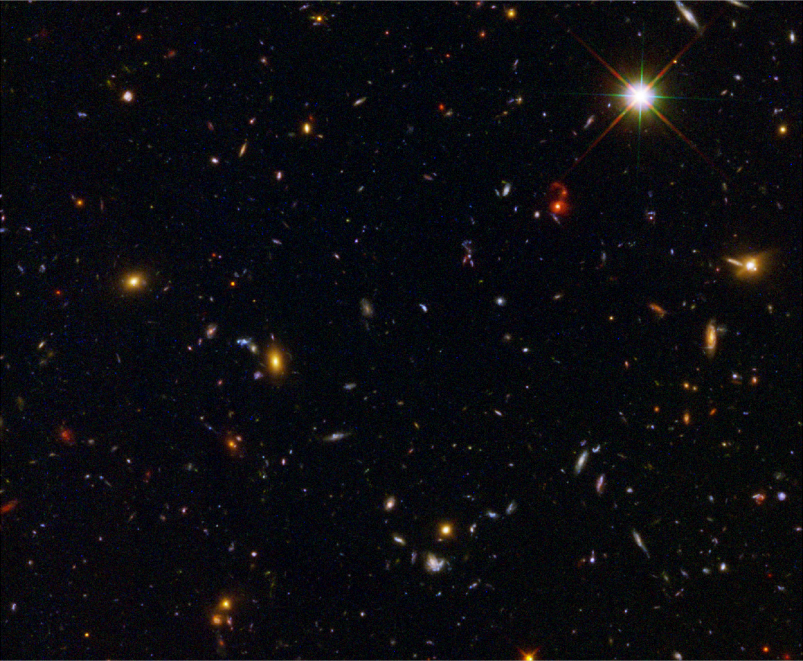


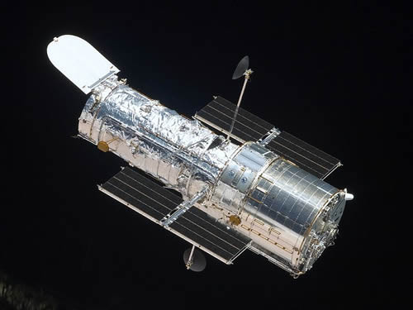
HST WFC3 Early Release Science: Emission–Line Galaxies from IR Grism Observations
Amber N. Straughn
NASA Postdoctoral Program Fellow
NASA’s Goddard Space Flight Center
Collaborators: H. Kuntschner, M. Kümmel, J. R. Walsh, S. H. Cohen, J.P. Gardner, R. A. Windhorst, R. W. O’Connell, N. Pirzkal, G. Meurer, P.J. McCarthy, N. P. Hathi, S. Malhotra, J. Rhoads, M. Mutchler, & the WFC3 SOC
14 October 2010` Science with the Hubble Space Telescope III Venice, Italy

Slide 2
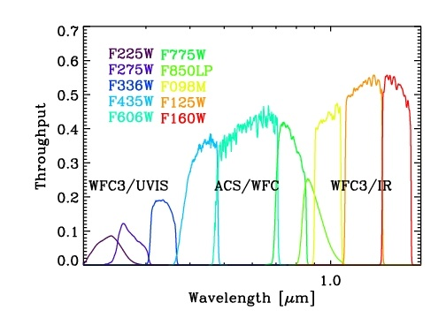
WFC3 Early Release Science II Program
Eight pointings with UVIS channel
  F225W, F275W, and F336W
Ten pointings with IR channel
  F098M, F125W, F160W
  4.65 arcmin² FOV; 0.13 arcsec/pix
One grism field
  G102 (R~210) & G141 (R~130): 2 orbits each
Windhorst et al. 2010

Slide 3
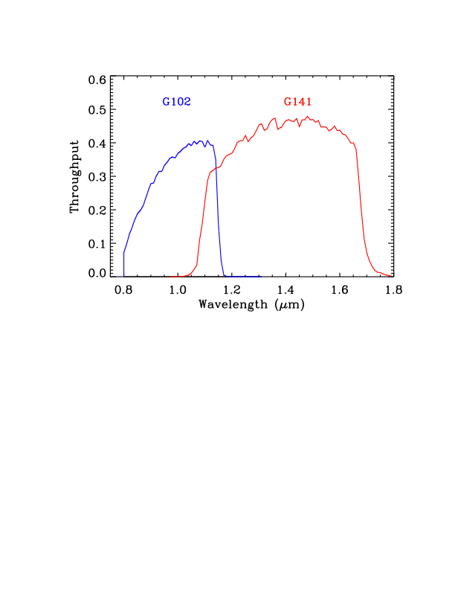
WFC3 Early Release Science II Program
Eight pointings with UVIS channel
  F225W, F275W, and F336W
Ten pointings with IR channel
  F098M, F125W, F160W
  4.65 arcmin² FOV; 0.13 arcsec/pix
One grism field
  G102 (R~210) & G141 (R~130): 2 orbits each
Windhorst et al. 2010

Slide 4
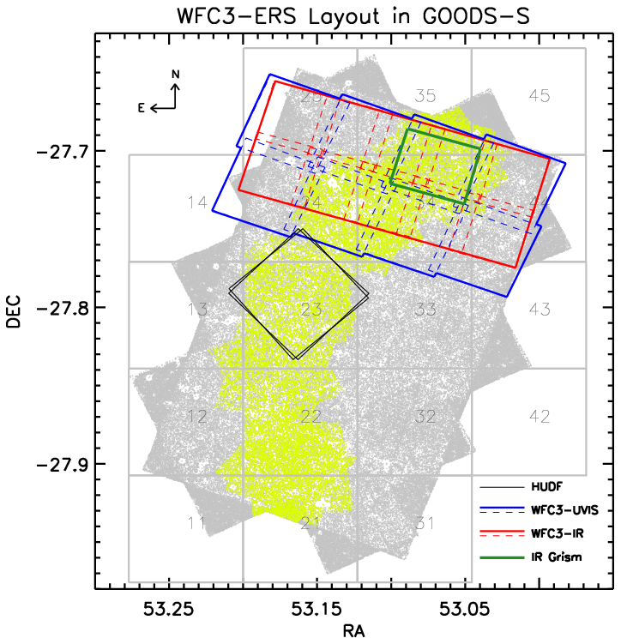
WFC3 Early Release Science II Program
Eight pointings with UVIS channel
  F225W, F275W, and F336W
Ten pointings with IR channel
  F098M, F125W, F160W
  4.65 arcmin² FOV; 0.13 arcsec/pix
One grism field
  G102 (R~210) & G141 (R~130): 2 orbits each
Windhorst et al. 2010

Slide 5
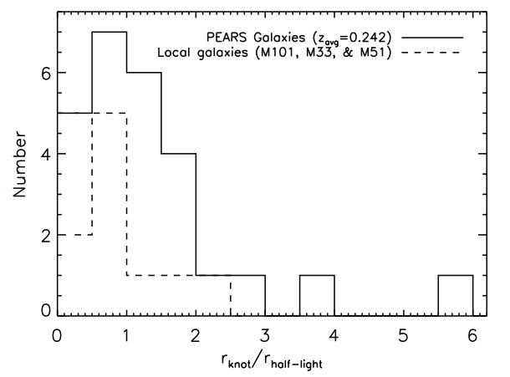
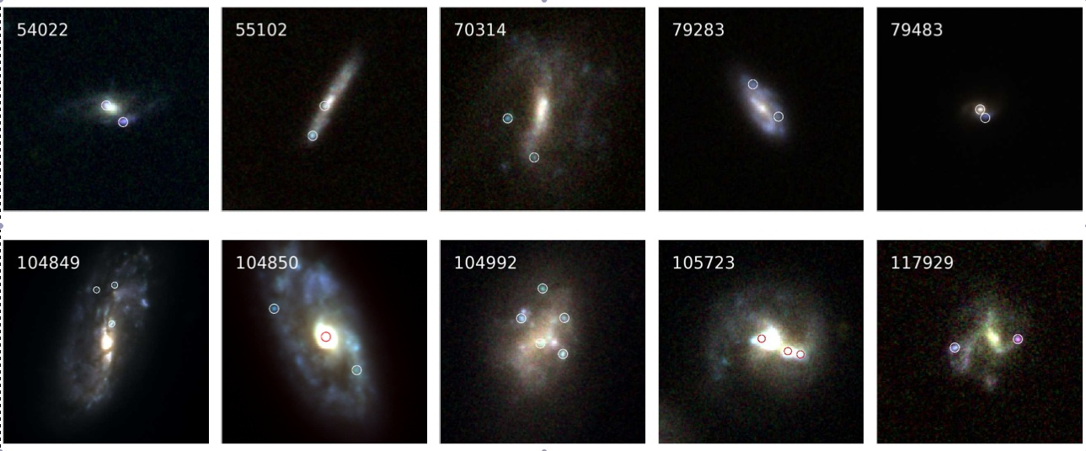
Background: The Probing Evolution And Reionization Spectroscopically (PEARS) ACS Grism Survey
Sample of ~200 faint emission-line galaxies in GOODS-South (Straughn et al. 2008, 2009)
HST/ACS G800L grism (6000-9500 Å; R~100)
Majority of sources have a single line; line ID & grism redshift determination possible with photz

Slide 7
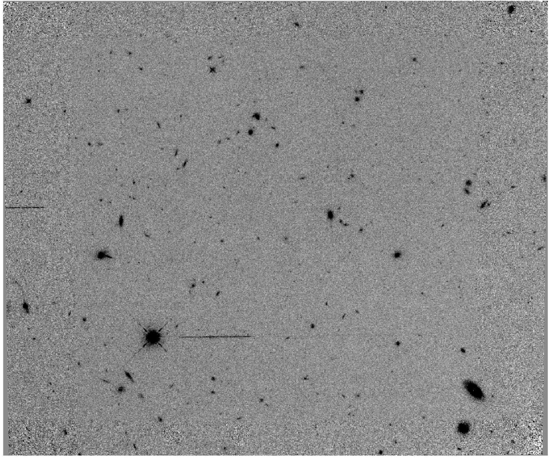
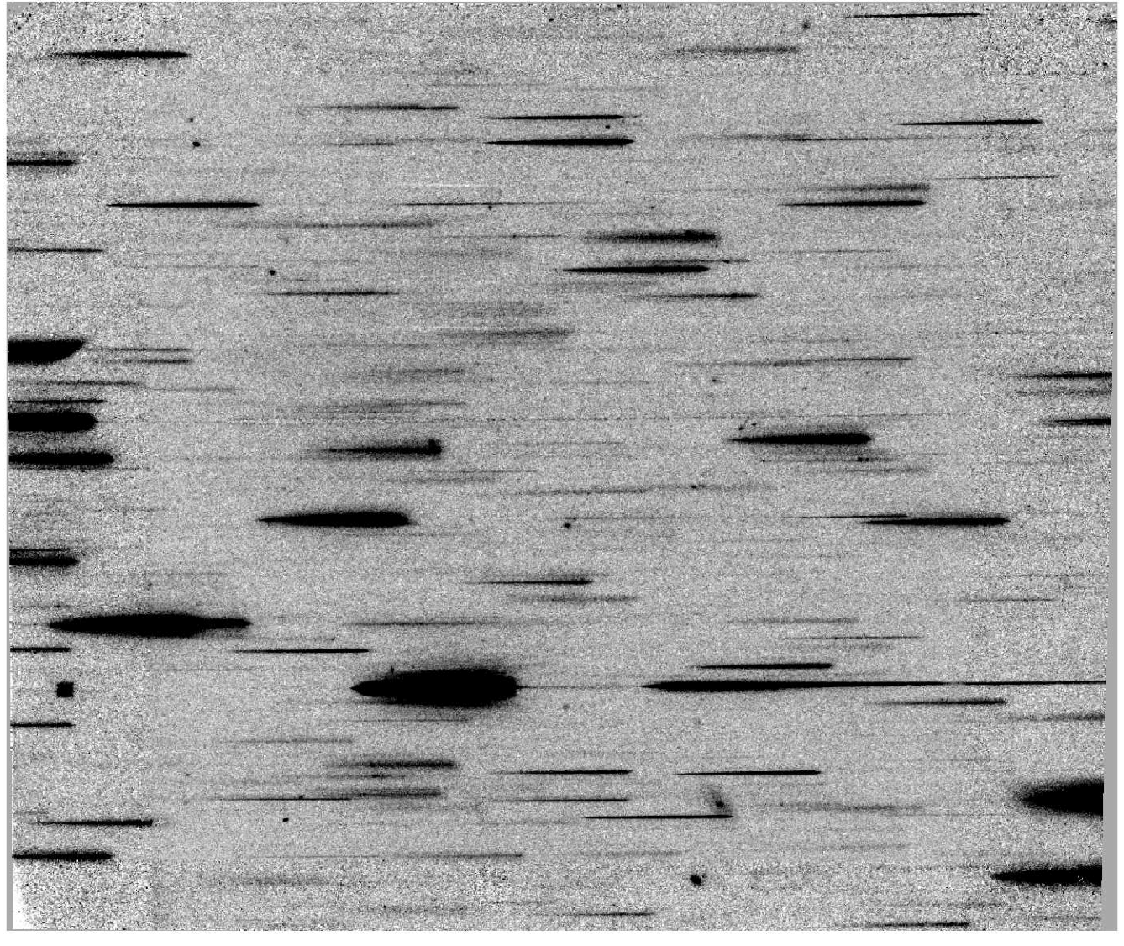
F098M + G102 (2 orbits)

Slide 8
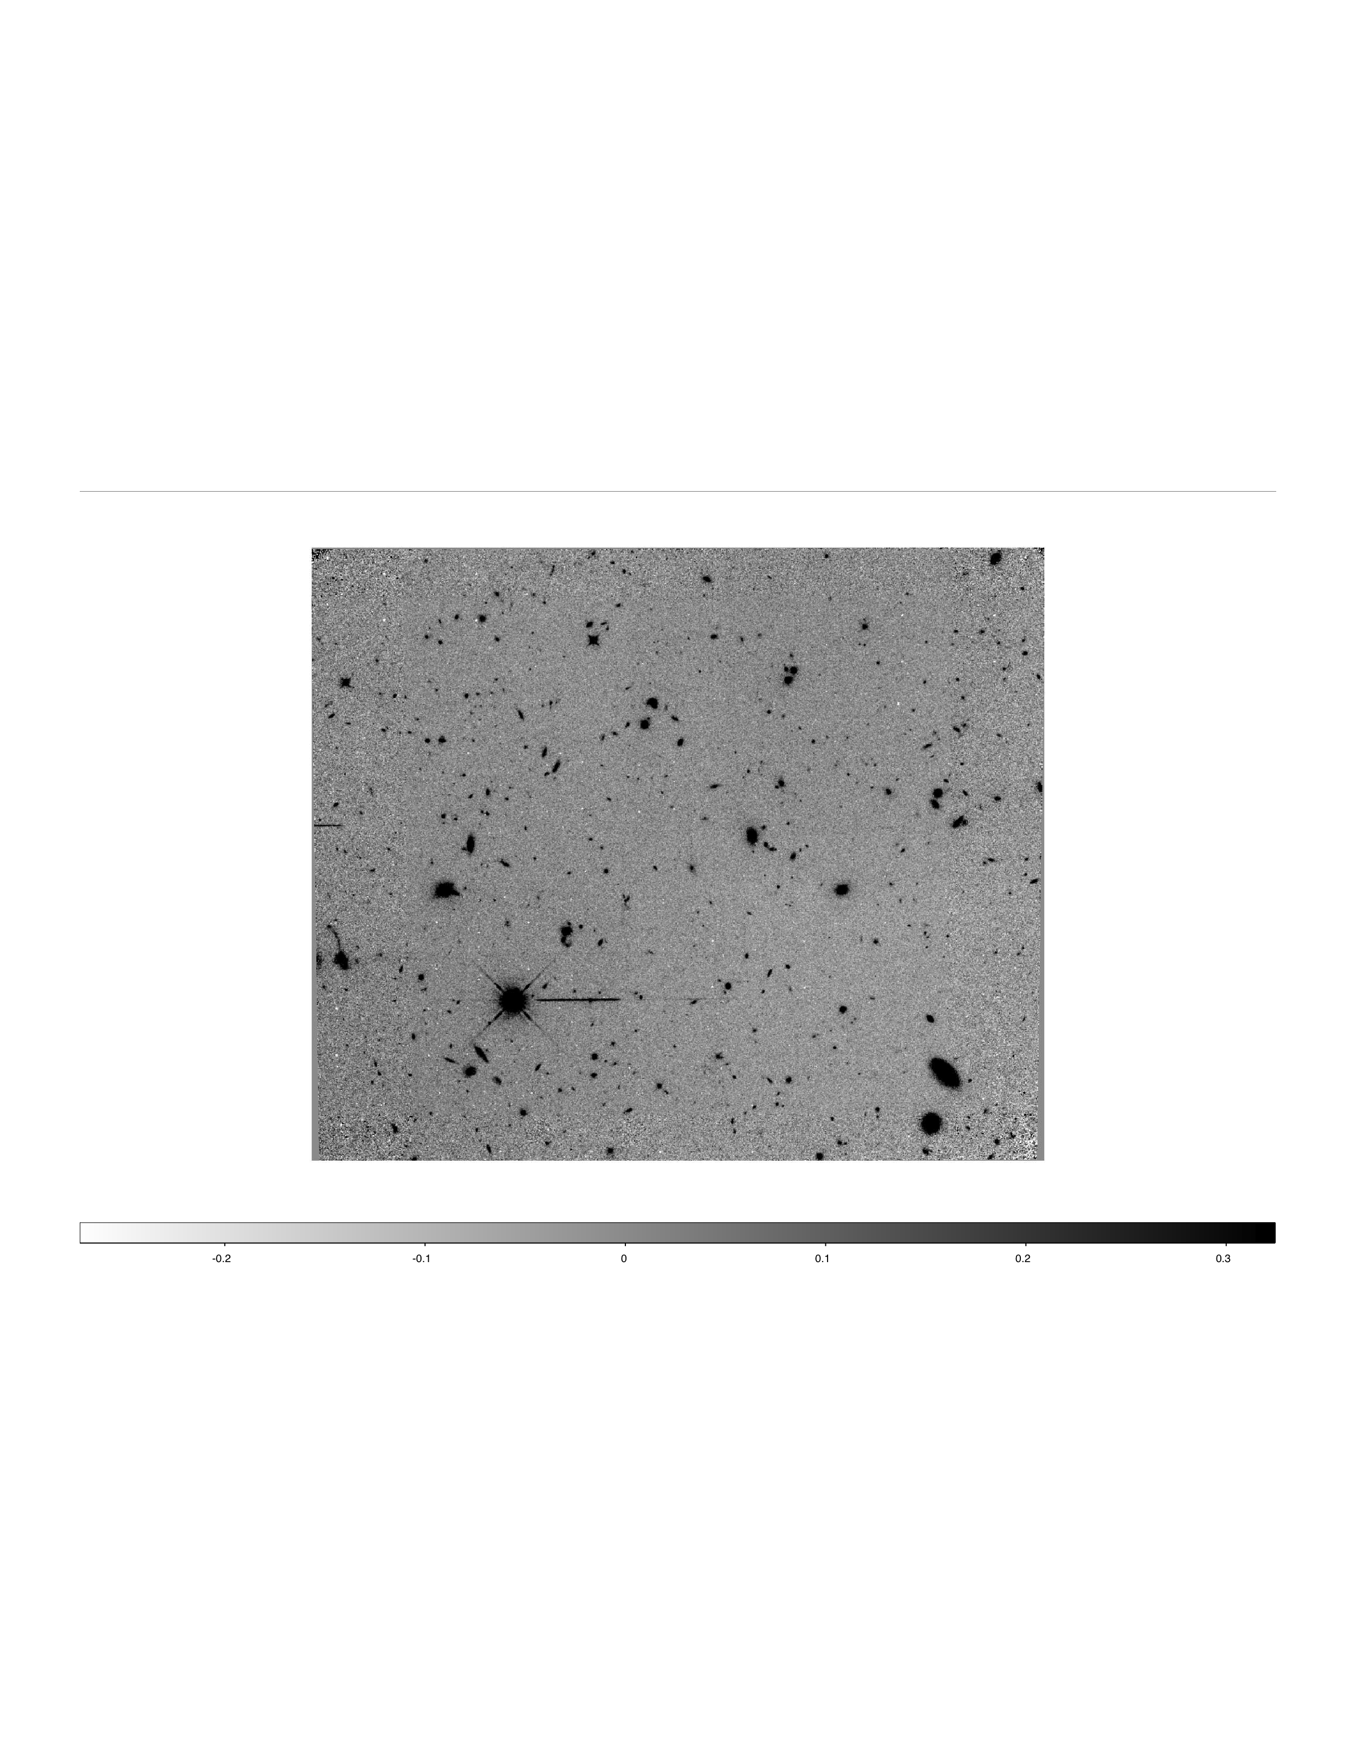
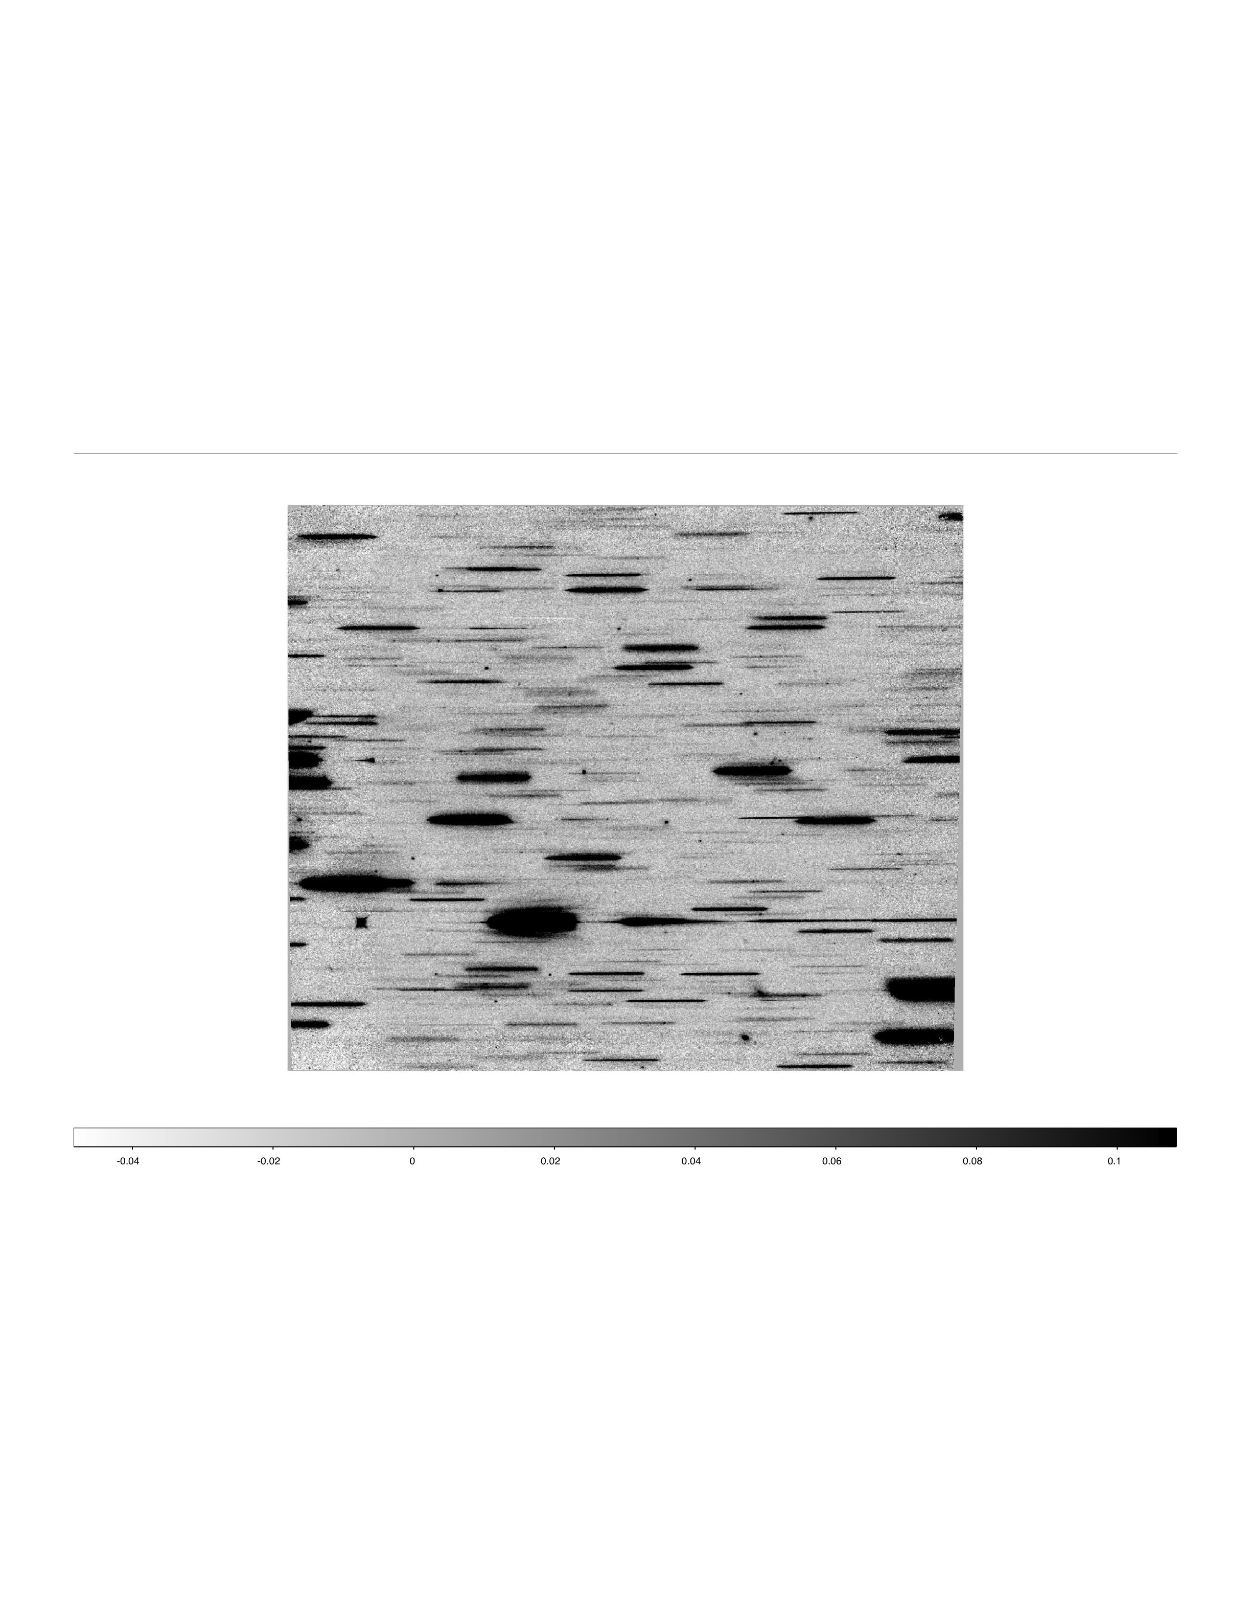
F140W + G141 (2 orbits)

Slide 11
Summary of ELG Detections
WFC3 IR grism spectra augment previous optical ACS grism PEARS data in the ERS field, yielding spectra of galaxies from 0.6-1.6 μm
48 galaxies with 73 emission lines
  29 Hα, 27 [OIII], 6 [OII], 2 [SII], 2 [SIII]λ9069, 2 [SIII]λ9532, 5 unidentified
  Hα: 0.2<z<1.4; [OIII]: 1.2<z<2.2; [OII]: 2.0<z<3.3
Average redshift: z=1.200; 0.227<z<2.315
  18 new grism-spectroscopic redshifts for GOODS-S galaxies
Average F098M magnitude: m=23.7 mag; 18.7 < m < 26.9 (!)

Slide 12
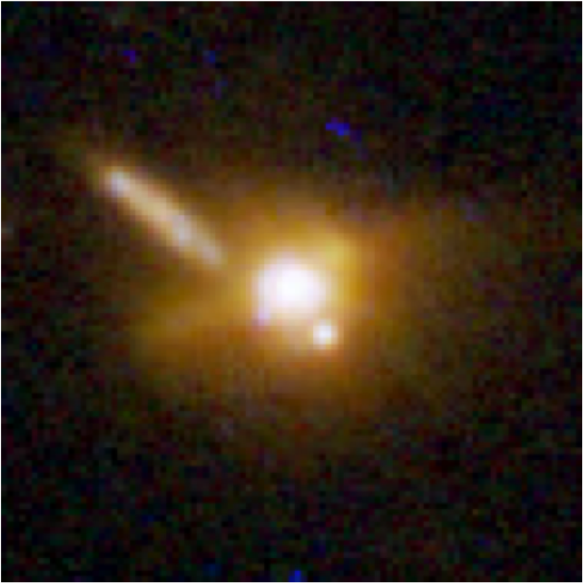
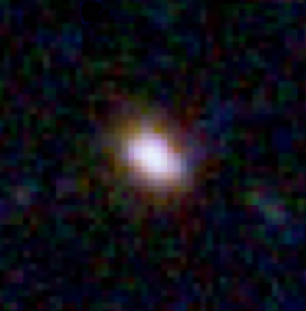
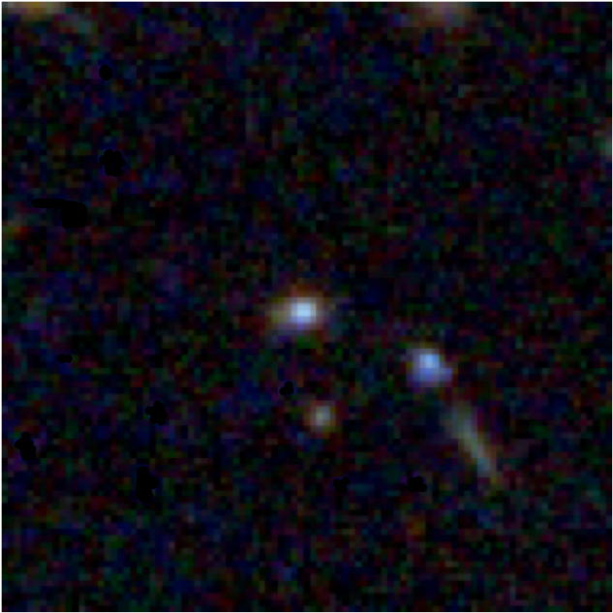
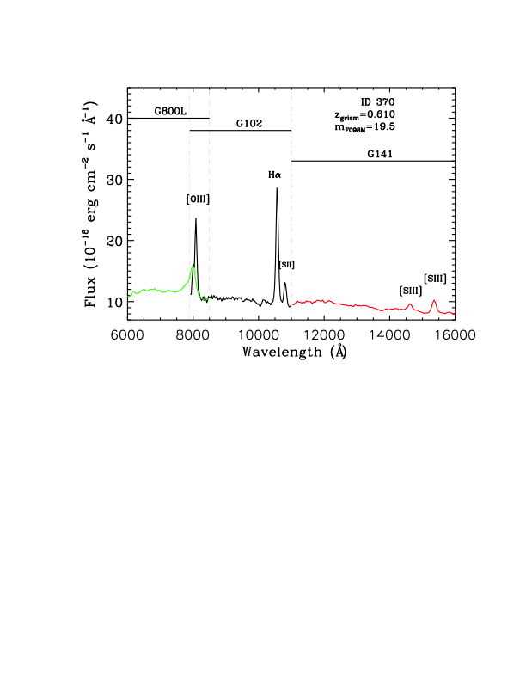
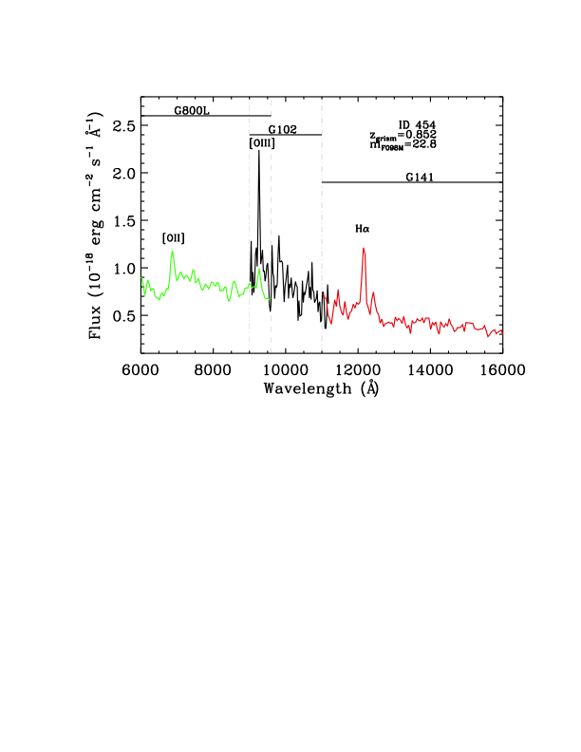
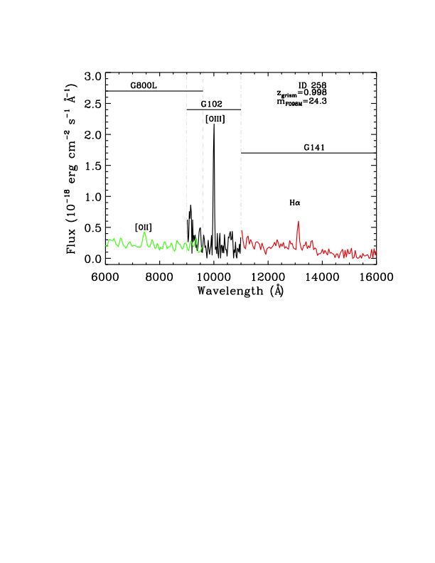
Emission-line Galaxies with
ACS + WFC3 spectra (0.6 – 1.6 μm)
13 ACS/PEARS ELGs with lines in IR
(Straughn et al. 2010, submitted)

Slide 13
Emission-line Galaxies with
ACS + WFC3 spectra (0.6 – 1.6 μm)

Slide 14
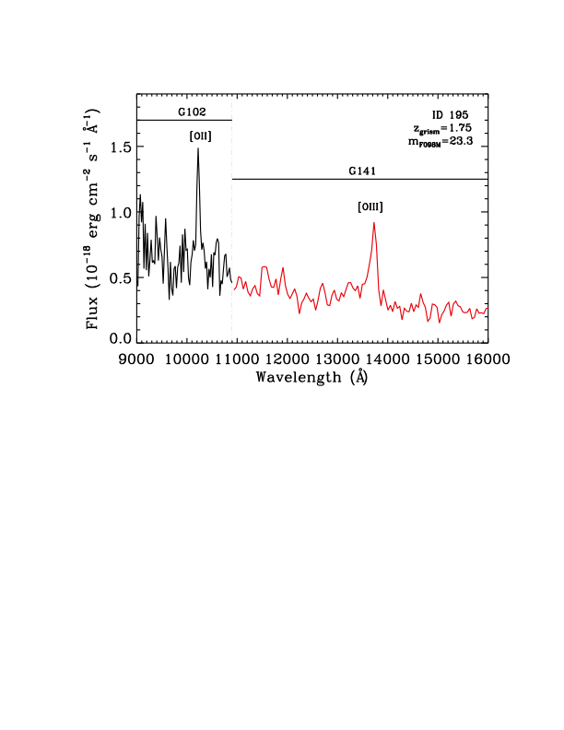
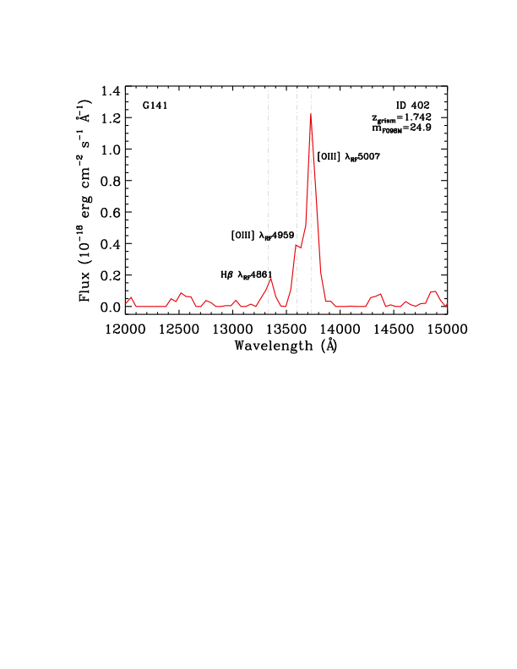
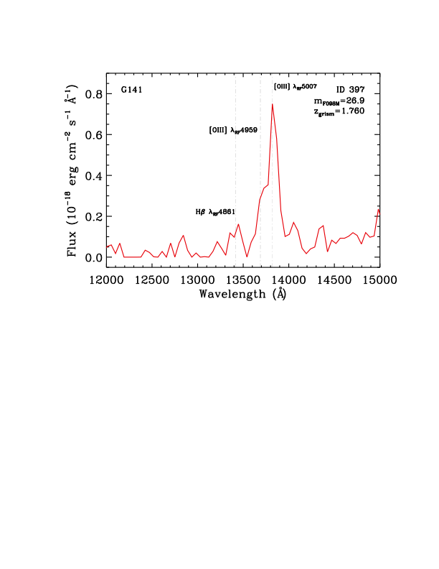
New WFC3 ELGs
m_{F098M}=26.9 !
35 new WFC3 ELGs
[OIII] at λ4959, λ5007 marginally
resolved

Slide 15
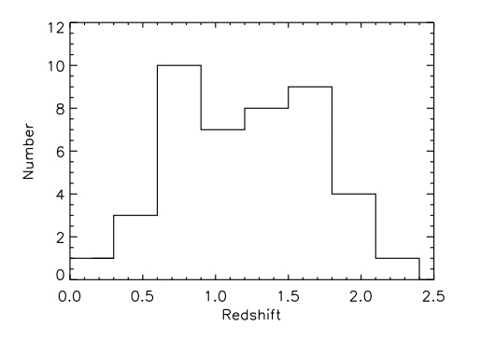
Redshifts of WFC3 ELGs
Hα: 0.2<z<1.4
[OIII]: 1.2<z<2.2
[OII]: 2.0<z<3.3

Slide 16
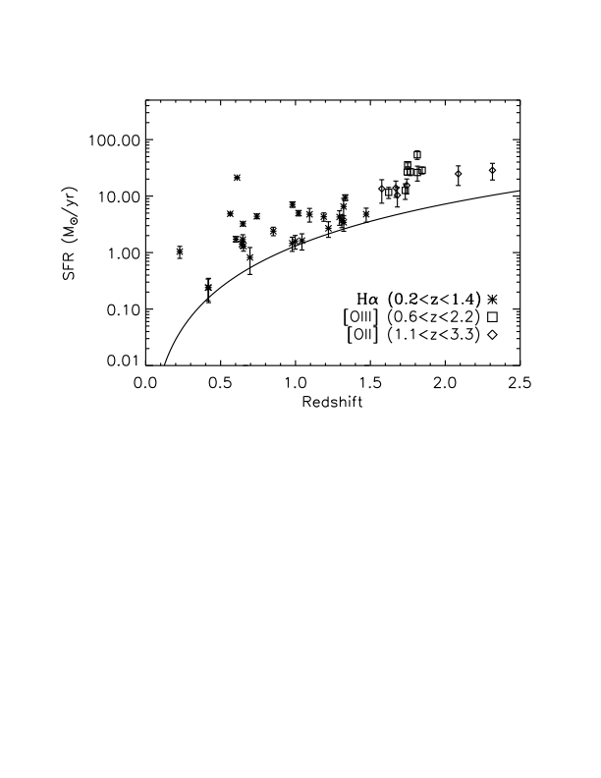
Star Formation Rates of ELGs
SFRs calculated using Hα, [OII], & [OIII] line fluxes
Compare SFR_{EL} to SFR_{SED}
Lowest SFR_{EL}:SFR_{SED} galaxies generally redder; highest are blue and compact
Straughn et al. 2010, in press

Slide 17
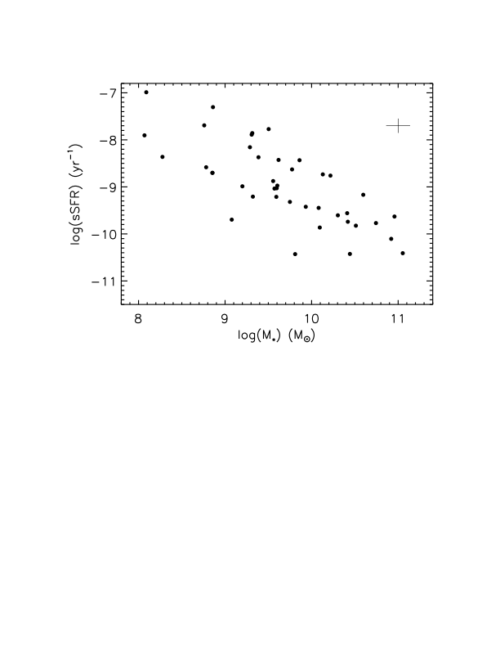
Specific Star Formation Rates of ELGs
SFRs calculated using Hα, [OII], & [OIII] line fluxes
Masses calculated by fitting ACS+WFC3 (0.2-1.7 μm) SEDs to BC03 models
Result consistent with general negative trend observed in previous studies
Straughn et al. 2010, in press

Slide 18
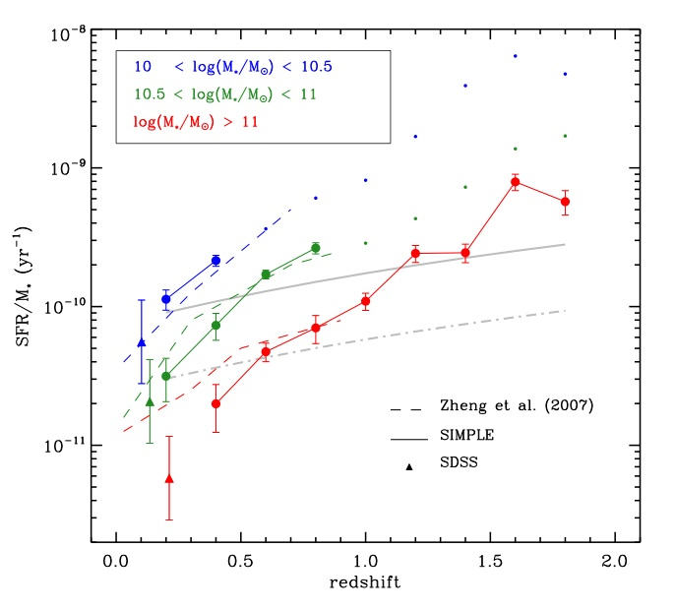
Specific Star-formation Rate of ELGs
Previous studies of SSFR vs. z have used very large galaxy samples (e.g., GOODS, COMBO-17, SIMPLE etc.)
  Damen+09, Zheng+07, Martin+07, Perez-Gonzalez+08
Find lower SSFR for higher mass galaxies
Damen et al. 2009, ApJ, 690, 937

Slide 19
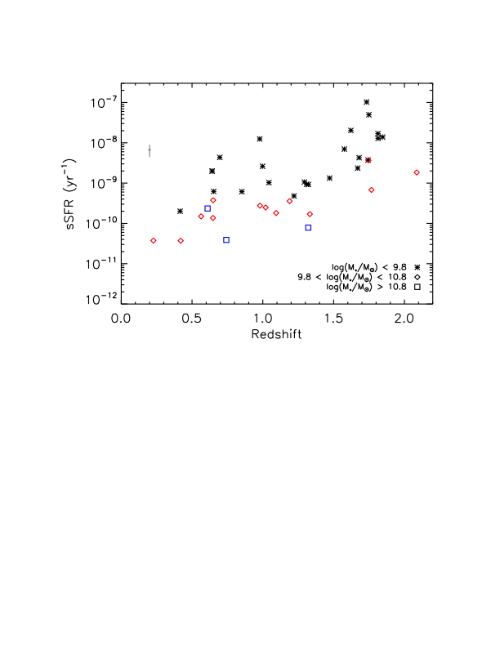
Specific Star-formation Rate of ELGs
Previous studies of SSFR vs. z have used very large galaxy samples (e.g., GOODS, COMBO-17, SIMPLE etc.)
  Damen+09, Zheng+07, Martin+07, Perez-Gonzalez+08
Find lower SSFR for higher mass galaxies
Straughn et al. 2010, in press
We detect this general trend with just two orbits of HST time.

Slide 20

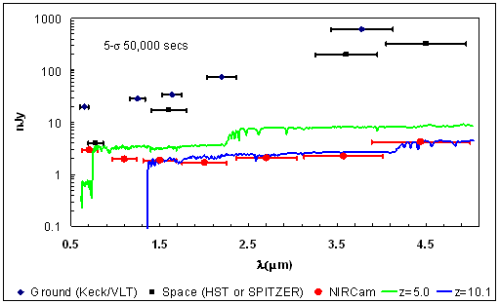
The Future
More to do with ERS grism data!
CANDELS
JWST NIRCam Grisms

Slide 21
Summary
WFC3 IR grism spectra augment previous optical ACS grism PEARS data in the ERS field, yielding spectra of galaxies from 0.6-1.6 μm
48 galaxies with 73 emission lines
  29 Hα, 27 [OIII], 6 [OII], 2 [SII], 2 [SIII]λ9069, 2 [SIII]λ9532, 5 unidentified
  Hα: 0.2<z<1.4; [OIII]: 1.2<z<2.2; [OII]: 2.0<z<3.3
Average redshift: z=1.200; 0.227<z<2.315
  18 new grism-spectroscopic redshifts for GOODS-S galaxies
Average F098M magnitude: m=23.7 mag; 18.7 < m < 26.9 (!)
Our results are consistent with previous studies showing that the sSFRs of the most massive SF galaxies are generally lower than their lower mass counterparts as a function of redshift
These data demonstrate the efficiency of the WFC3 grisms in detecting faint SF galaxies at z≈0.2-2.5. This work sets the stage for larger area and deeper studies of star–forming galaxies with WFC3 in the future.

Slide 23
The next era: NIRCam grisms
Two identical long wavelength grisms
Used for coarse phasing
Also science applications (see, eg., Greene et al. 2007 for detailed discussion on exoplanets)
Some advantages over NIRSpec for particular science objectives:
  Higher spatial resolution spectroscopic obs.
  No slit losses
  Ability to dither slitless spectra: better flat-fielding
  Sample entire NIRCam FOV
Emission lines to much higher redshifts

Slide 24
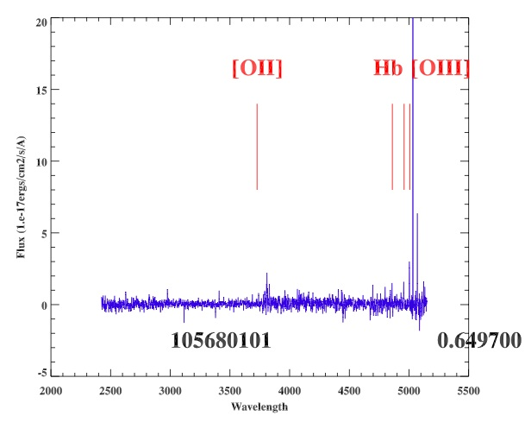
ELGs with JWST & ELTs
General strategy:
Imaging
Grism
Ground-based spectroscopy

Slide 25
The next era: NIRCam grisms

