Slide 1
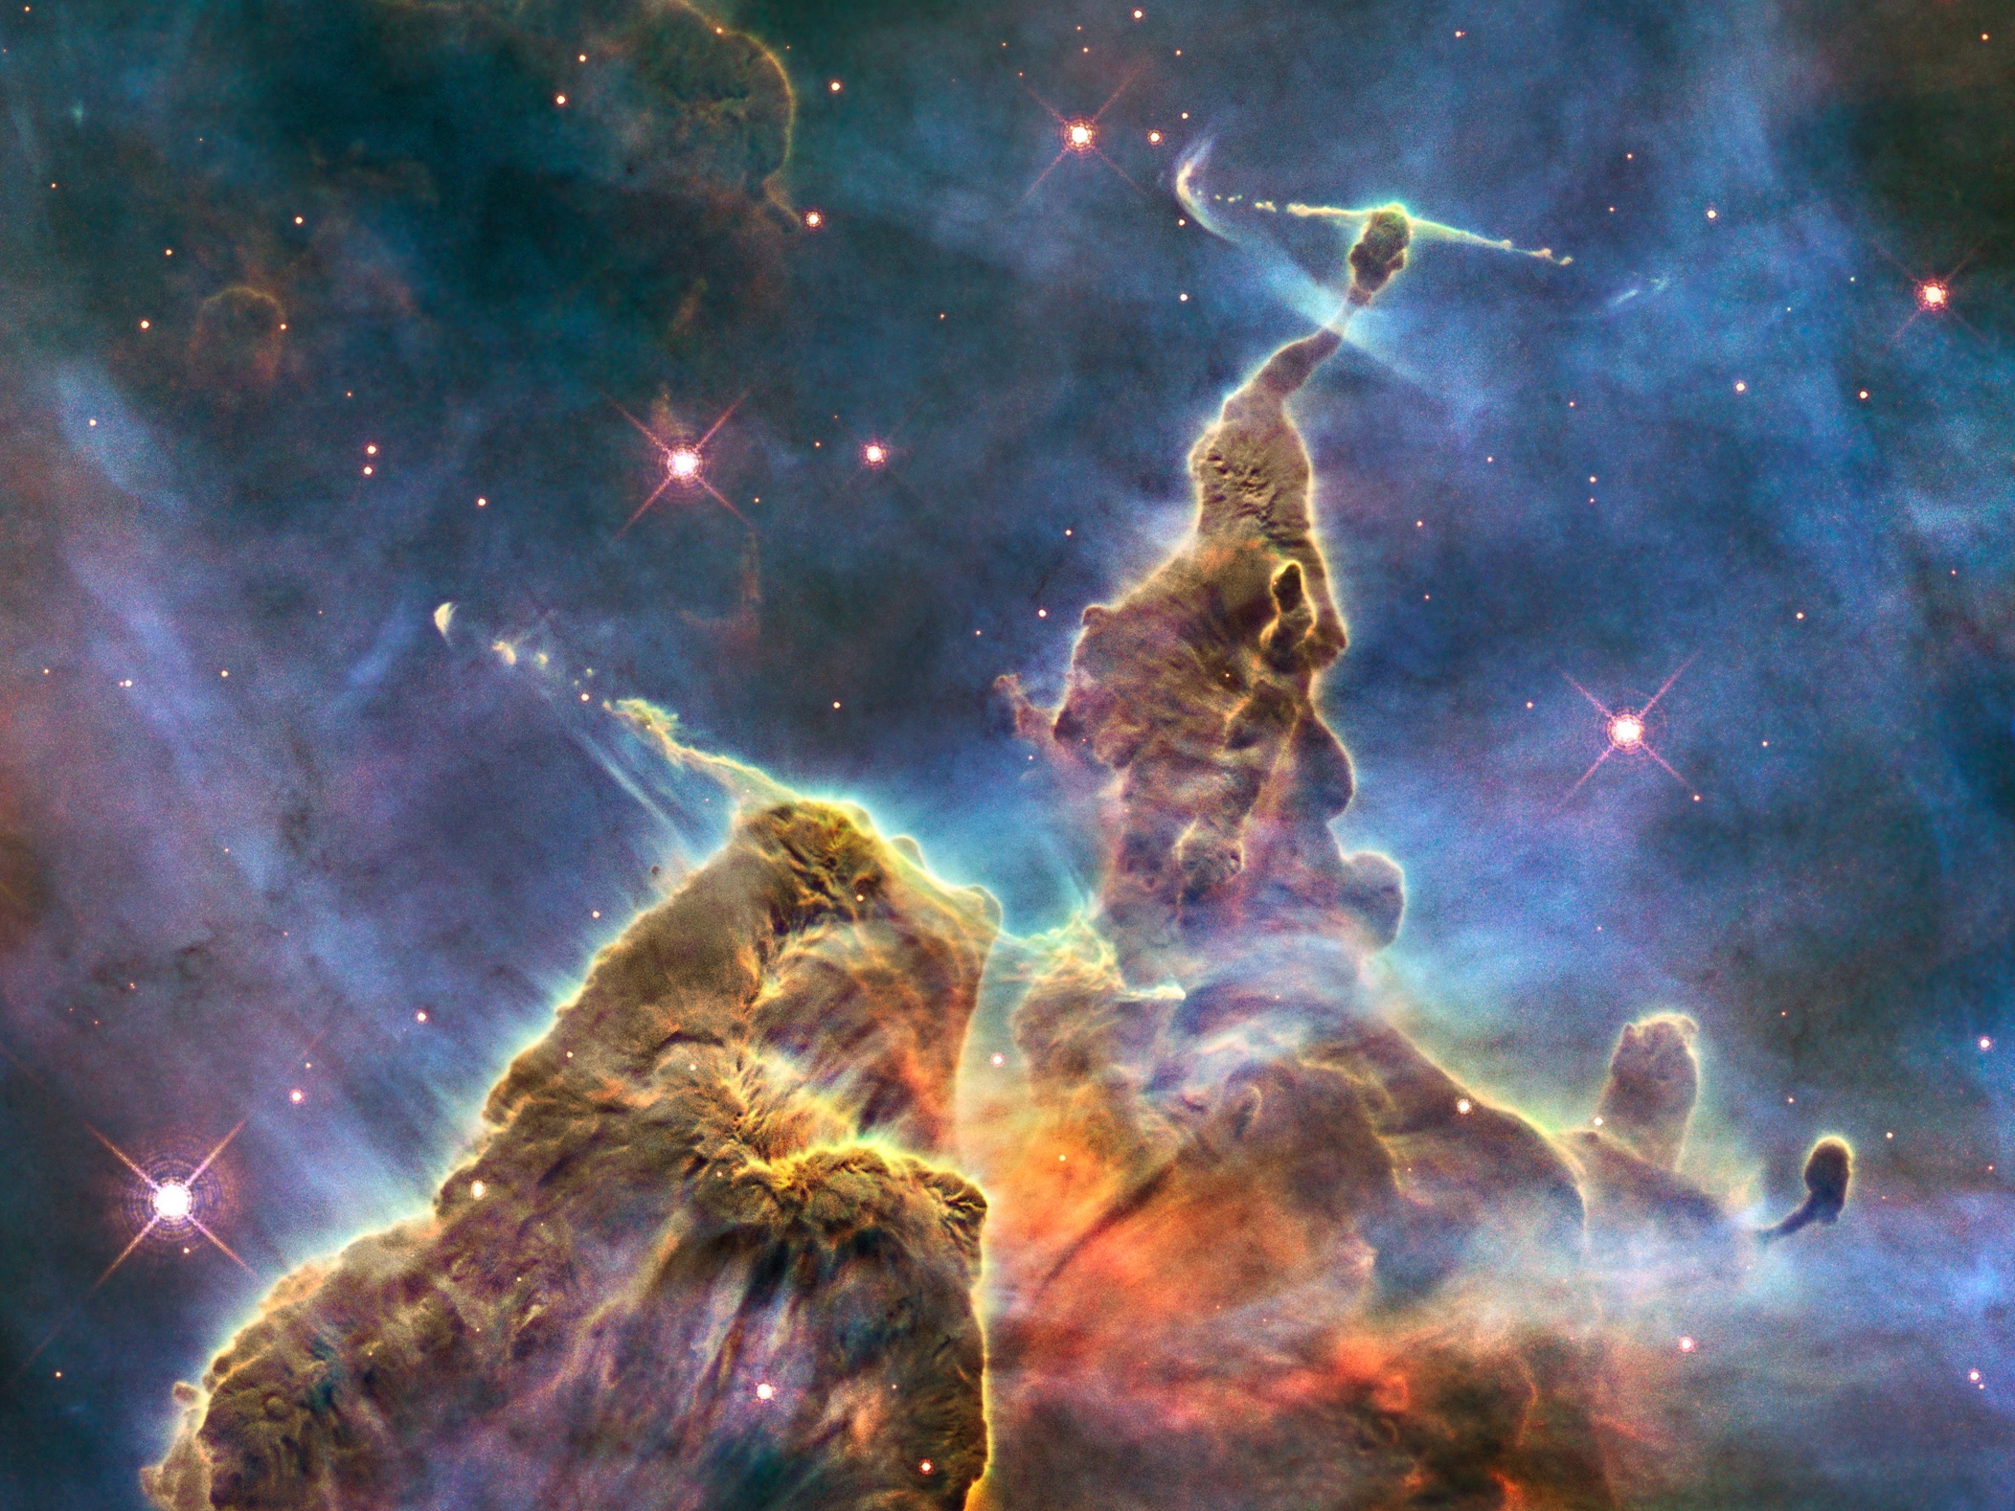
In-Flight Performance
of
Wide Field Camera 3
Randy Kimble
NASA/Goddard Space Flight Center

Slide 2
Origins/Purpose of WFC3
WFC3 originated in 1997/1998 when HST’s planned observing lifetime was first extended from 2005 to 2010: conceived for installation during Servicing Mission 4, to extend and enhance HST’s imaging capability
General purpose “panchromatic” imager (200-1700 nm), developed as a facility instrument by HST Project
  Ball Aerospace was principal outside partner; much of the work in-house at Goddard Space Flight Center
  Additional key contributions from e2v, Teledyne, Barr, Moog
  Day-to-day science oversight from GSFC and STScI
  External Scientific Oversight Committee, chaired by Bob O’Connell of U. of Virginia

Slide 3
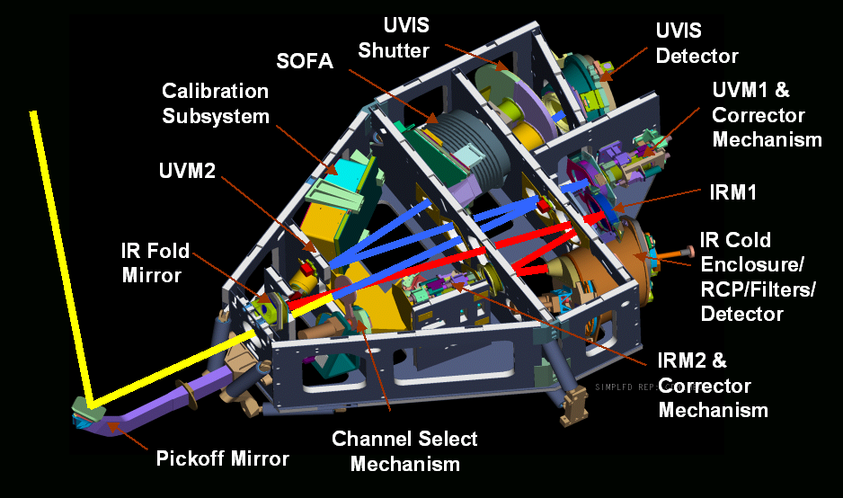
WFC3 Interior Configuration

Slide 4
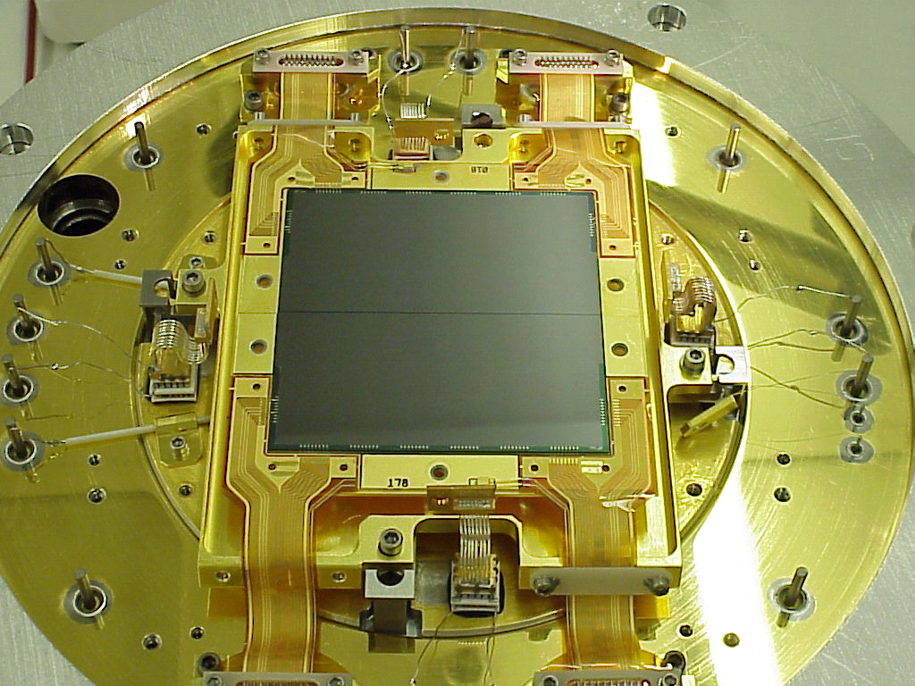
CCD Detectors
4K x 4K, low-noise, UV-optimized CCDs from e2v
Camera heads built by Ball Aerospace

Slide 5
UV/Visible Channel Format
Comparison of HST Imagers
Channel | Pixel Format | Pixel Scale (arcsec) | FOV (arcsec) | FOV/ WFC3
WFC3/UVIS | 4102×4096 | 0.039 | 162×162 | 1.00
ACS/WFC | 4096×4096 | 0.049 | 202×202 | 1.56
ARC/HRC | 1024×1024 | 0.026 | 26×29 | 0.029
WFPC2/WF | 800×800 (×3) | 0.100 | 80×80 (×3) | 0.73
WFPC2/PC | 800×800 | 0.0455 | 36×36 | 0.051
FOV (to scale) of HST
UV/Visible Imagers
WFC3/UVIS ACS/WFC WFPC2 ACS/HRC STIS

Slide 6
WFC3 Interior Configuration

Slide 7
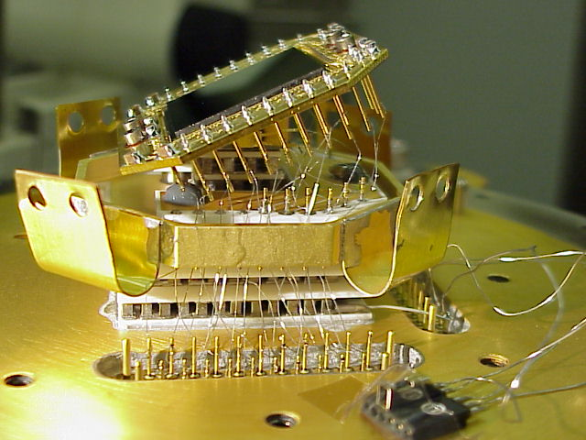
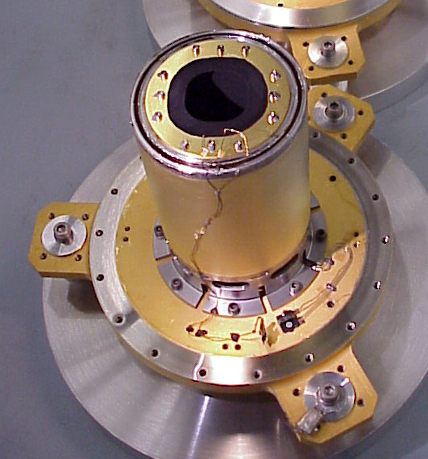
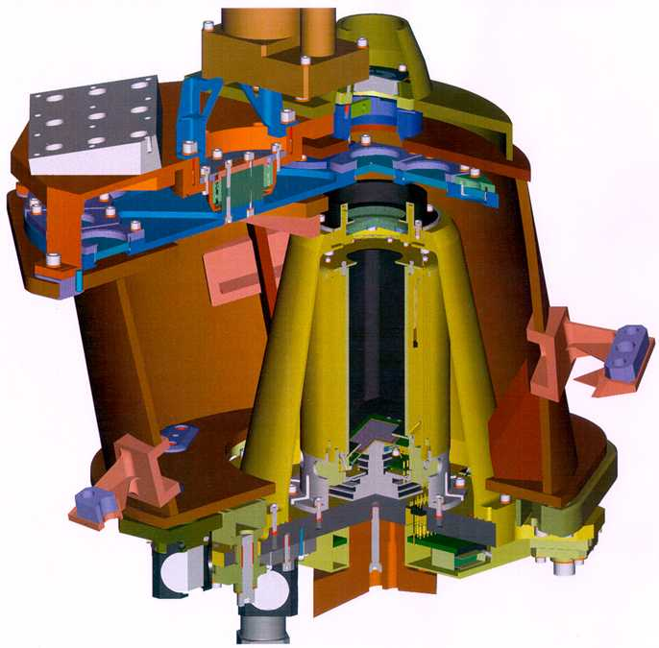
IR Detectors
The novel 1.7 micron cutoff wavelength of the IR array (left), developed by Teledyne Imaging Sensors (formerly Rockwell Scientific), permits low-dark-current operation at a temperature of 145 K, achievable with thermo-electric cooling alone.
The development program was WFC3’s biggest technical challenge, but in the end yielded a few “just in time” gems.

Slide 8
Infrared Channel Format
Comparison of HST Imagers
Channel | Pixel Format | Pixel Scale (arcsec) | FOV (arcsec) | FOV/ WFC3
WFC3/IR | 1014×1014 | 0.13 | 123×136 | 1.00
NICMOS/NIC3 | 256×256 | 0.200 | 51×51 | 0.155
NICMOS/NIC2 | 256×256 | 0.075 | 19×19 | 0.022
FOV (to scale) of HST NIR Imagers
WFC3/UVIS WFC3/IR NIC3 NIC2 NIC1

Slide 9
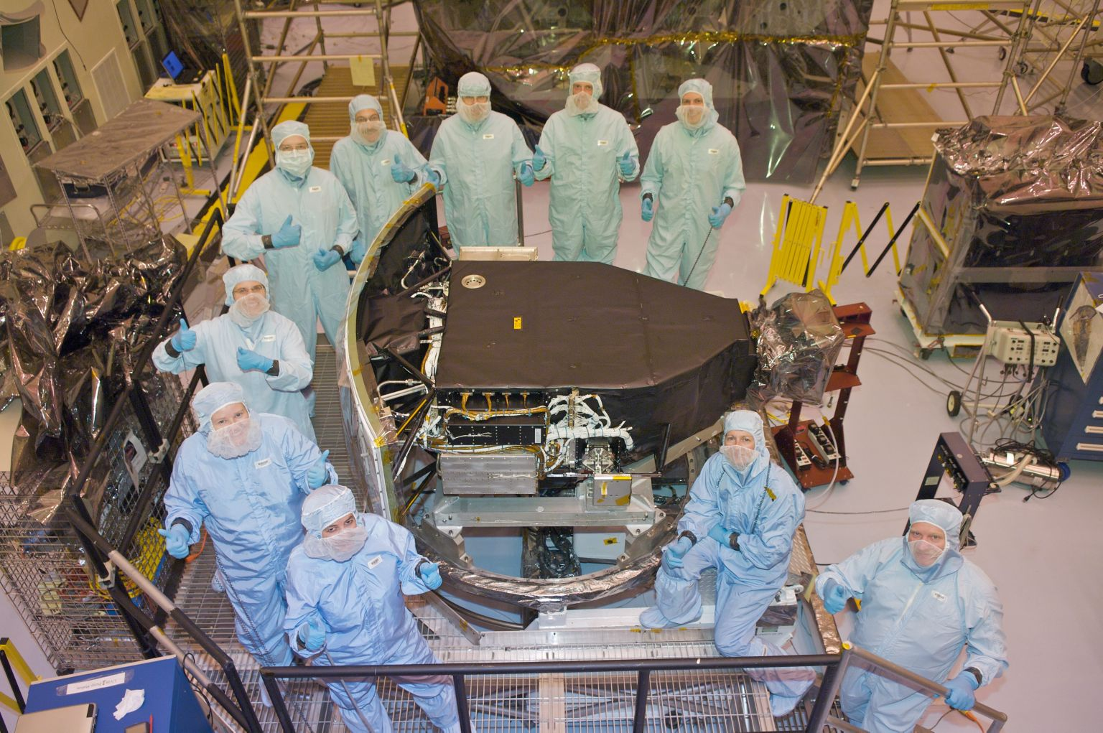
Ready to Go

Slide 10
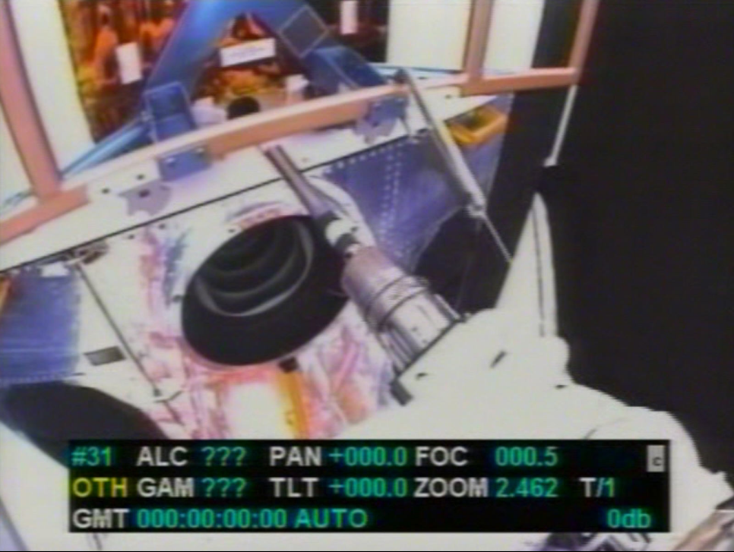

Slide 11

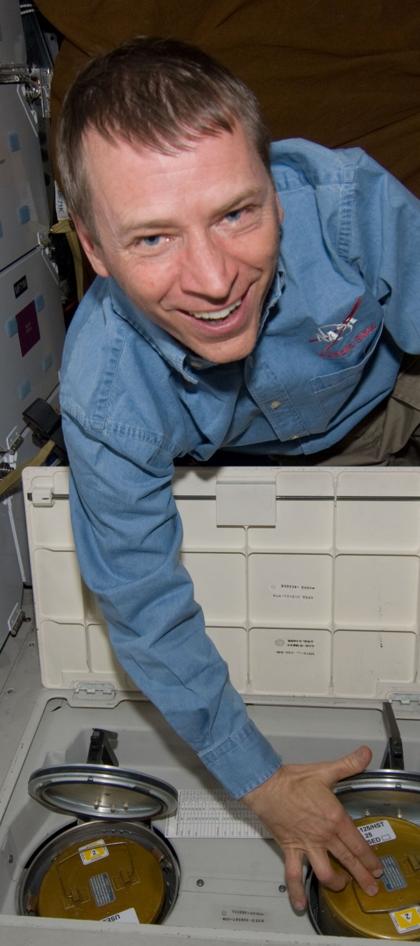

Slide 12
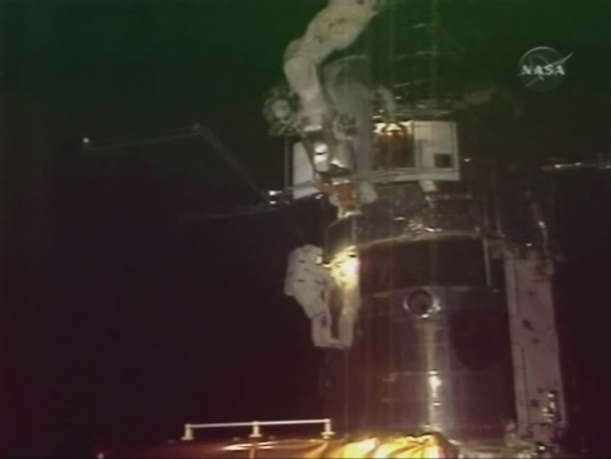
WFC3 Heading In

Slide 13
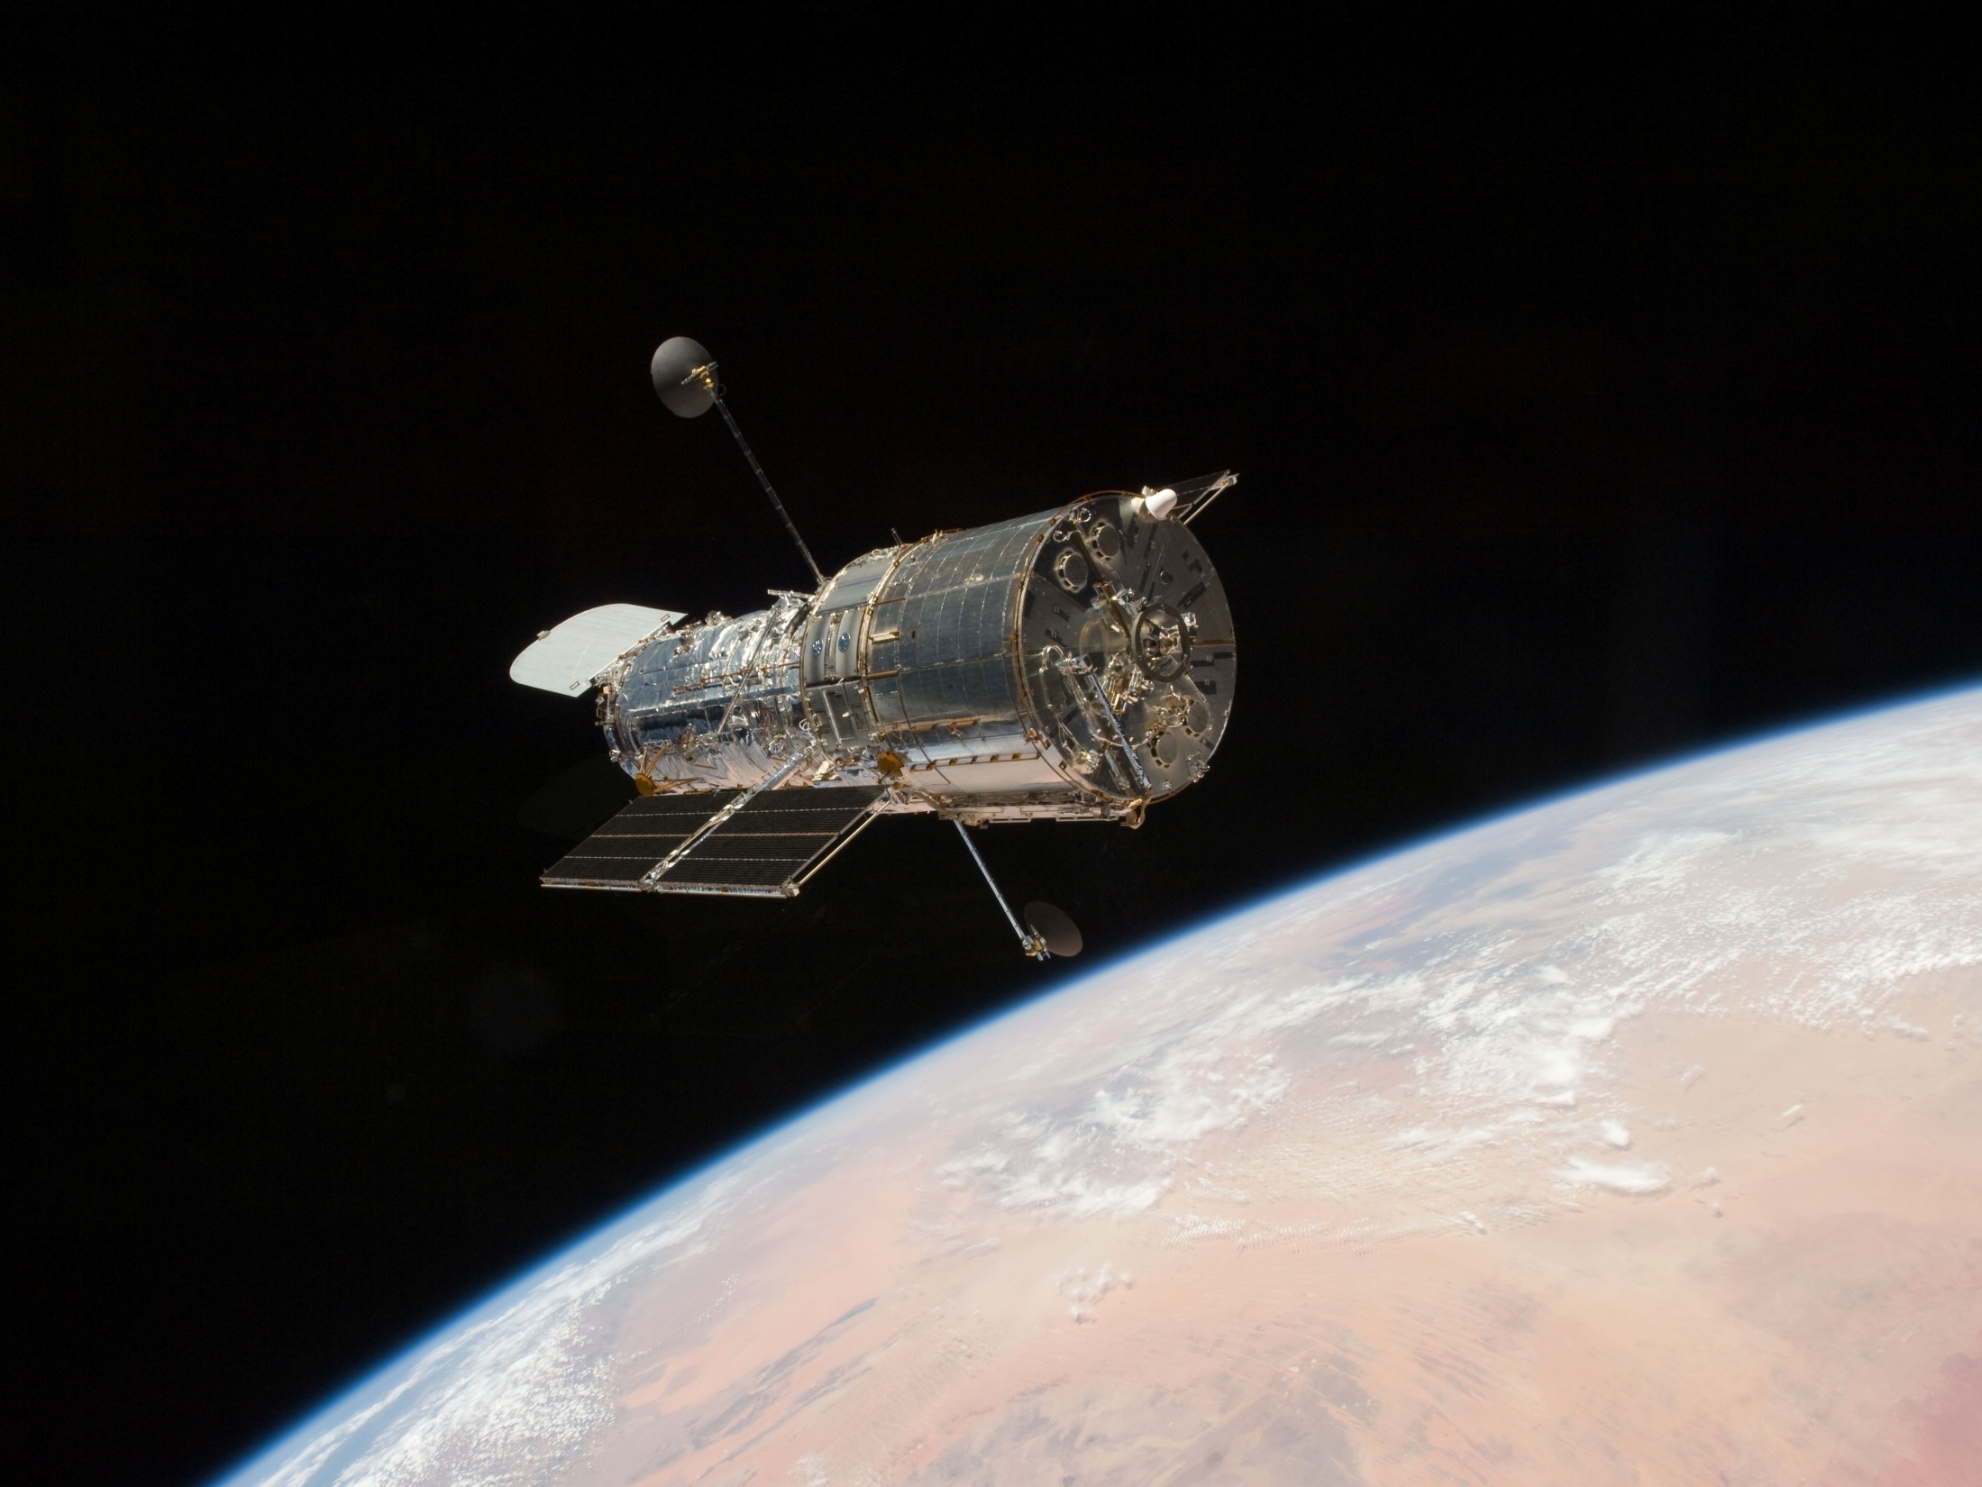
13

Slide 14
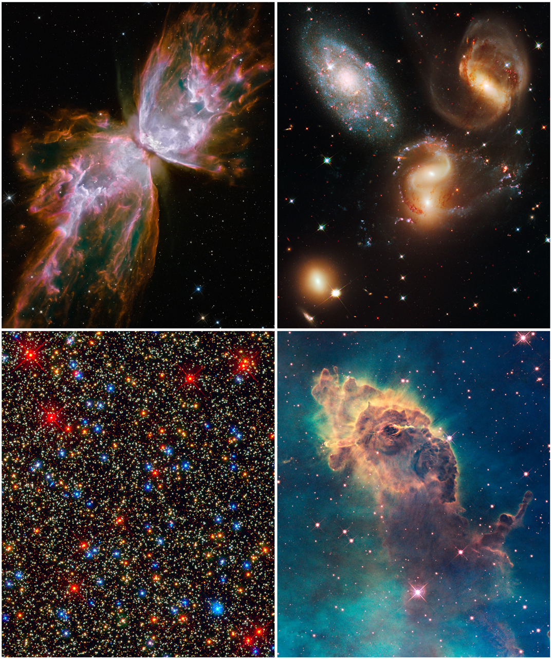
Early Release Observations
Notes:
Jet in Carina HH 666
HST WFC3/UVIS

Slide 15
SMOV Results in a Nutshell
Instrument operating completely nominally (mechanisms, electronics, thermal control) – all redundant systems on primary side
Image quality excellent, in good agreement with ground test
Detectors performing very well
Throughput 5-15% higher than ground test predictions

Slide 16
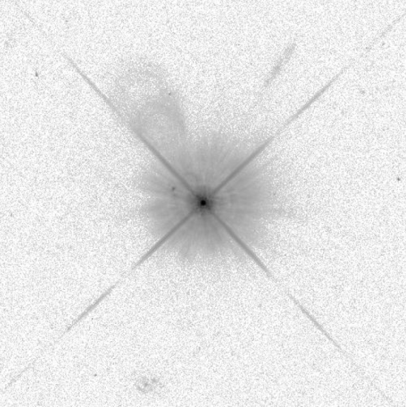
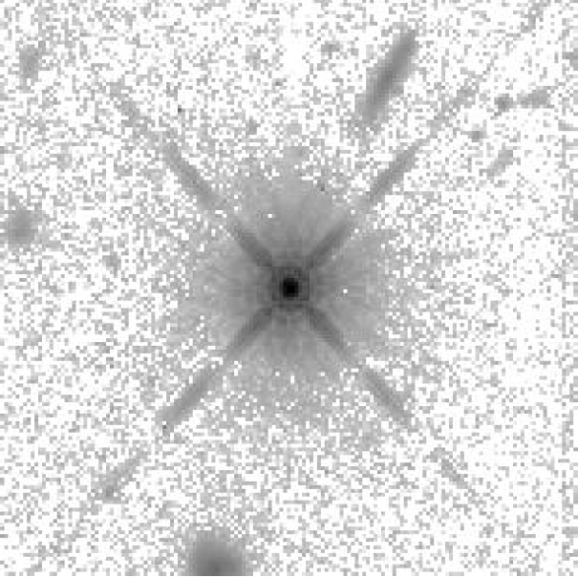
Image Quality
Encircled energy appropriate to an HST imager
UVIS:
~79% in 0.25 arcsec diam at 633nm
Same in UV (finer diffraction limit; more scatter)
IR:
56% in 0.25 arcsec diam at 1.0
46% in 0.25 arcsec diam at 1.6
F625W, ~20x20 arcsec, 6 dex log stretch
F160W, ~20x20 arcsec, 6 dex log stretch

Slide 17
UVIS Detector Has Low Read Noise and Dark Current
Read noise is ~3.1 e- rms for all four readout amps
Median dark current <3 e-/pixel/hr
  Higher than ground test and slowly growing, but still negligible
  Hot pixel tail slowly growing with radiation damage
These low values are particularly valuable for WFC3 with its fine sampling (0.039”/pixel) and its emphasis on UV and narrowband observing → low sky counts

Slide 18
IR Dark Current and Read Noise Slightly Improved vs. Ground Test
Median dark rate ~0.05 e/pix/s, only 0.6% of pixels above spec of 0.4
Effective noise reading up the ramp is actually a bit lower in flight than in thermal-vac for long exposures: (average of the 4 quadrants shown)
Combining read noise with excellent dark current, very well satisfies goal of being zodiacal-background-limited for long exposures in broad bands (zodi rates from a few tenths to >1 e-/pix/s)
~2.5% pixels flagged as “bad” – low QE, high dark, unstable, open
# of Reads | 3 | 8 | 15
Effective noise (e- rms; SMOV) | 19.6 | 16.0 | 12.4 | Flight
Effective noise (e- rms; thermal-vac) | 20.8 | 17.8 | 14.6 | Ground

Slide 19
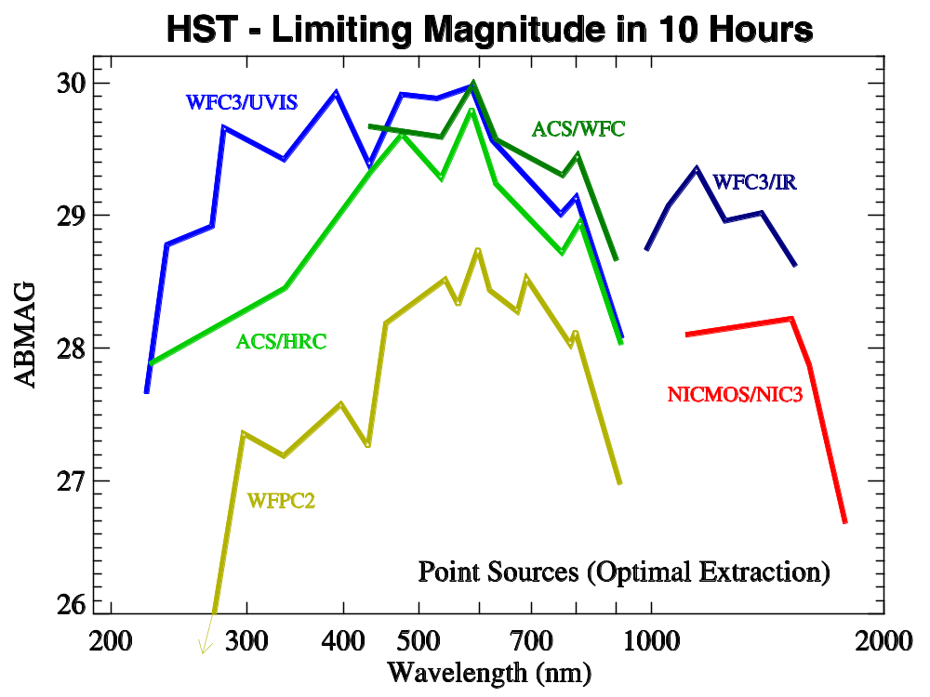
Performance Metrics vs. Other HST Imagers

Slide 20
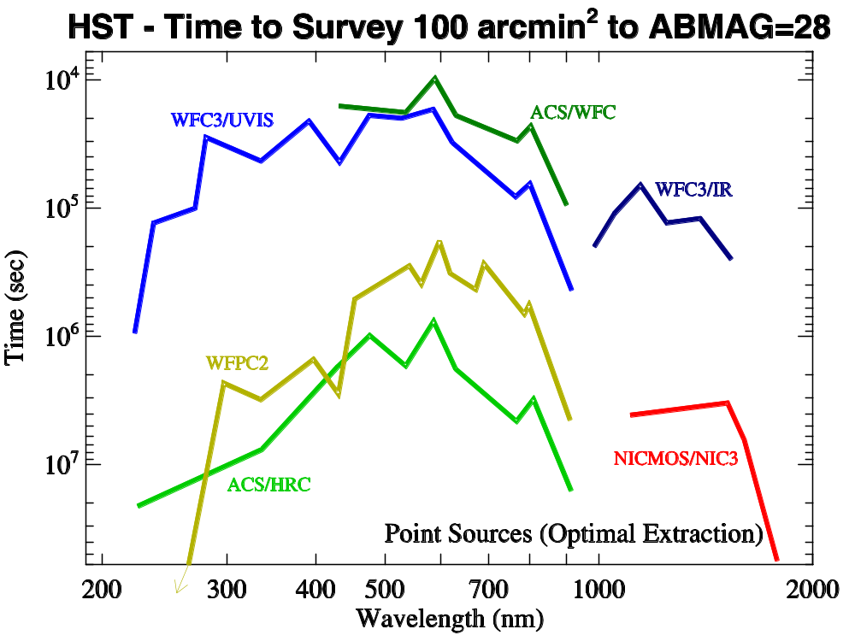
Performance Metrics vs. Other HST Imagers (2)

Slide 21
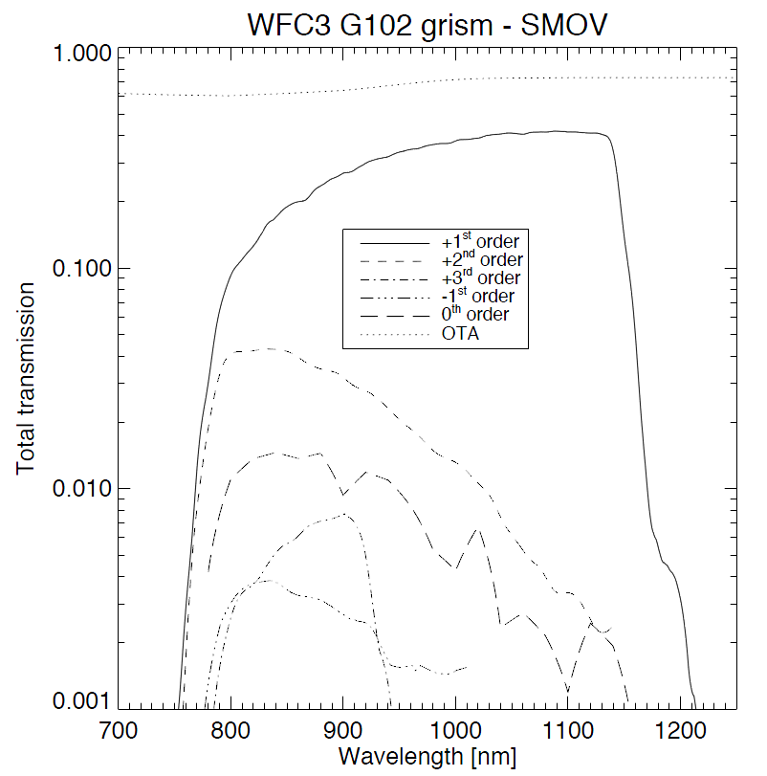
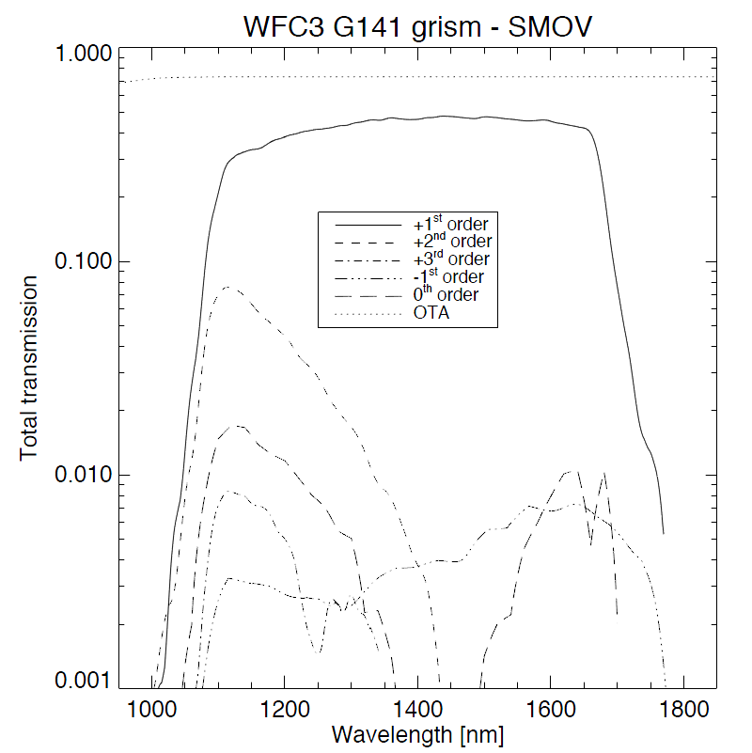
Very Exciting Capability –
Slitless Spectroscopy with WFC3’s IR Grisms
G102 (0.8 – 1.1μm; R ~ 210) Very high end-to-end
G141 (1.1 – 1.6μm; R ~ 130) throughput

Slide 22
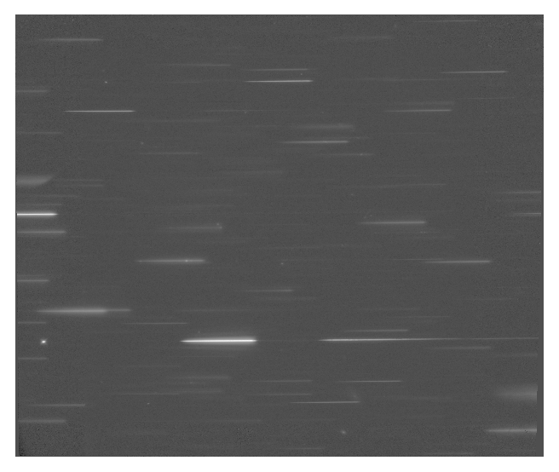
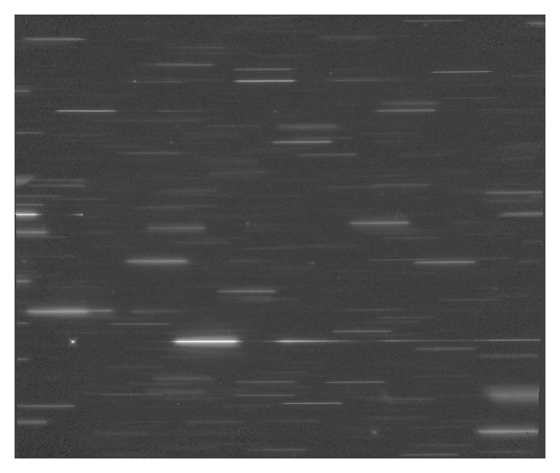
IR Grism Images from GOODS Field
SOC did a very nice demonstration project in ERS program
  Two orbits in each grism
Straughn et al. showed a number of emission-line galaxies
G102 G141
Community has definitely noticed this capability
20% of prime GO orbits in Cycle 18 selection to IR grisms

Slide 23
Photometric Stability
Photometric stability has been excellent
UVIS: ~0.3% rms on bright standard stars over 15 months
IR: ~0.5% rms in similar monitoring
No discernible trend in either channel
Few % QEH issue intrinsic to these CCDs completely controlled in flight using lamp flash protocol developed in lab test in the year before launch

Slide 24
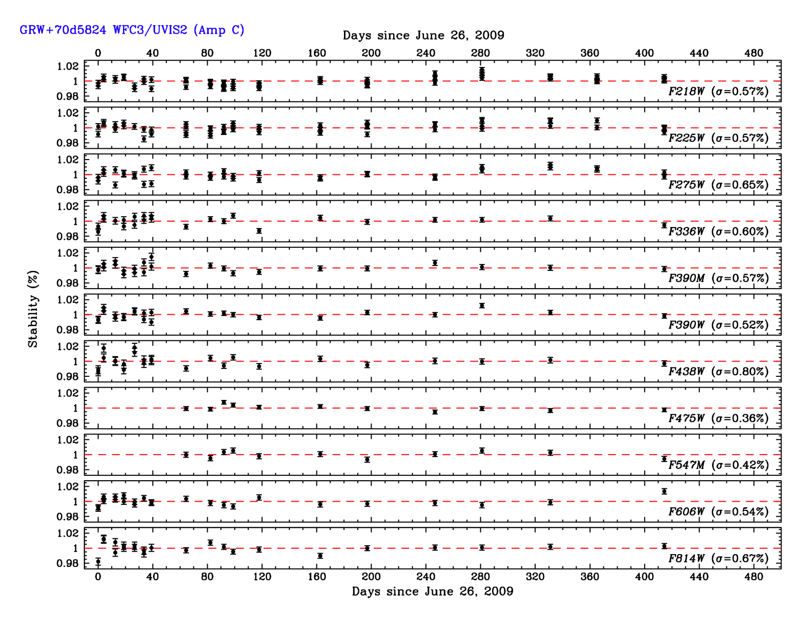
Photometric Stability – UVIS

Slide 25
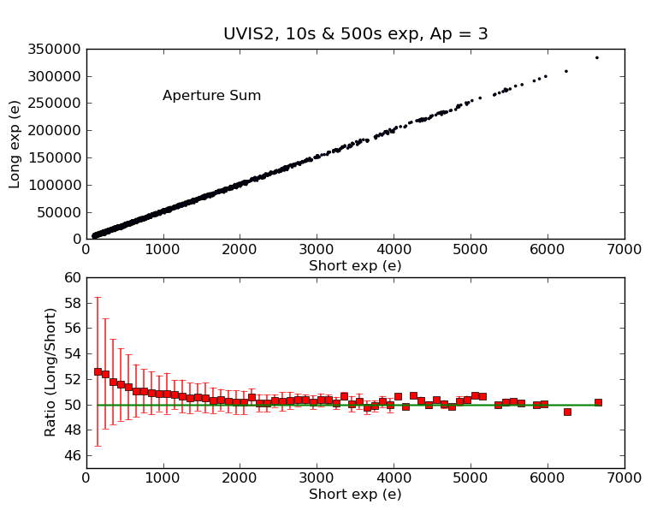
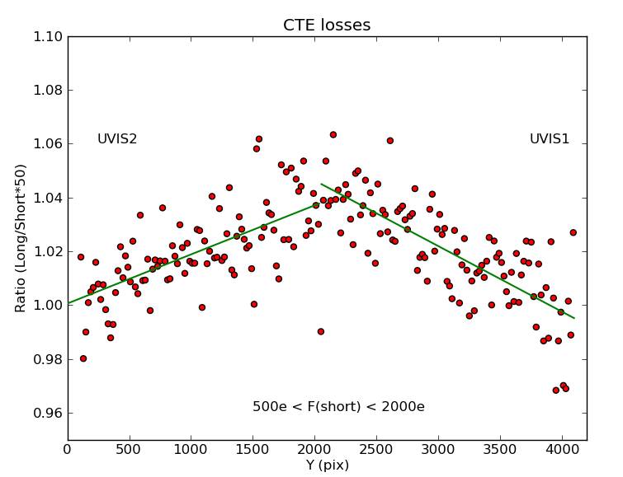
CTE Degradation
Compare signal levels in long vs. short exposures (left)
Deficit in short exposures tracks linearly with rows from readout – classic signature of parallel CTE loss

Slide 26
CTE Degradation (2)
Expected effect, but strength 2-3x stronger than ACS loss at same point in mission – expected comparable
Probable contributor is greater strength of SAA at solar minimum when SM4 occurred vs. solar max of SM3B
  STScI examining HST CCD histories to look for such modulation
  Recent preprint by Massey suggests ACS CTE degradation also has been worse recently
  Rate of degradation should slow as solar activity picks up
What to do about it?
WFC3 offers a potentially useful charge injection capability; being evaluated as part of Cycle 18 cal program
  >10,000 e- of “fat zero” at the cost of 15 e- rms noise
  Periodic line injection option may provide significant benefit
Pixel-based correction algorithms (e.g. Anderson, Massey) have also shown significant promise

Slide 27
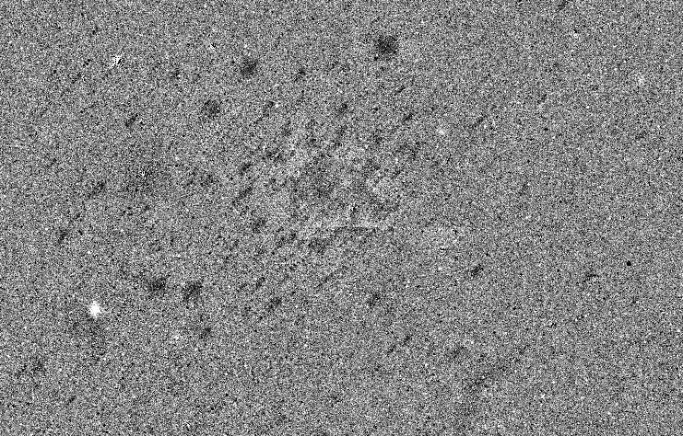
IR Persistence
Image persistence is a well known feature of HgCdTe arrays
<1/2 x full well, very small, essentially gone by next orbit
Strongly saturated sources can linger for hours
STScI taking manual scheduling steps to avoid worst such situations
Developing tools to enable removal
Be alert to this issue
Deep field exposure following bright star cluster

Slide 28
IR Rate-Dependent Response
“Reciprocity failure”, “count-rate non-linearity”, “Bohlin effect”: fewer counts out per photon in at low input rates
Smaller effect than for NICMOS (which showed 3-6%/dex), but still present
Lab measurements on flight spares: 0.3 – 1.0% /dex
In-flight measurements comparing cluster observations with ACS, NICMOS:
  1.1% /dex (ISR WFC3 2010-07, A. Riess)
Attempting WFC3-only determination using varying Earth limb background

Slide 29
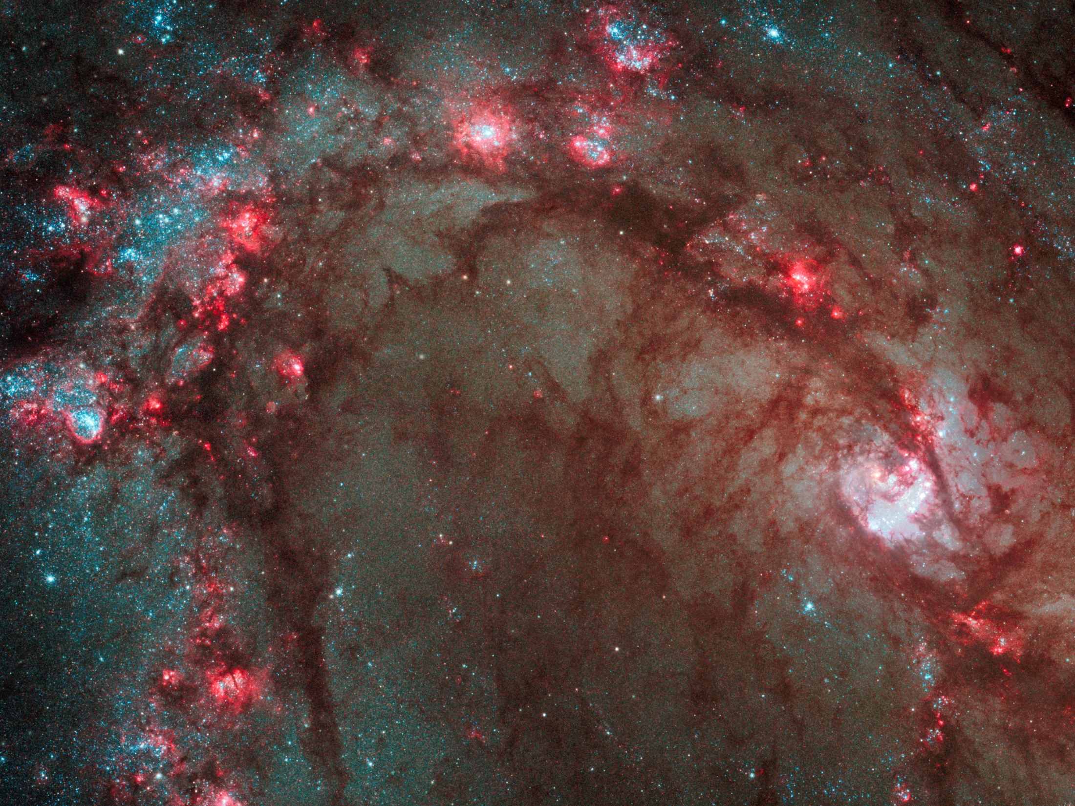
Information Resources
At STScI WFC3 site: www.stsci.edu/hst/wfc3
WFC3 Instrument Handbook, v. 2.1
WFC3 Data Handbook
Instrument Science Reports
Happy observing!

Slide 30
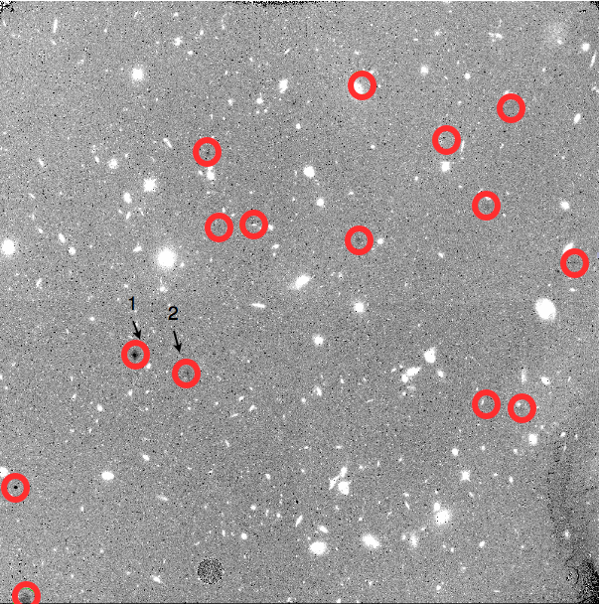
Scare from IR Spots
First few months after launch, dark spots appeared in IR sky
Found to be on Channel Select Mechanism fold mirror, not detector
Large particles, localized coating problem?
Fortunately, appears to have stopped – no new obvious features since January, 2010

