Slide 1
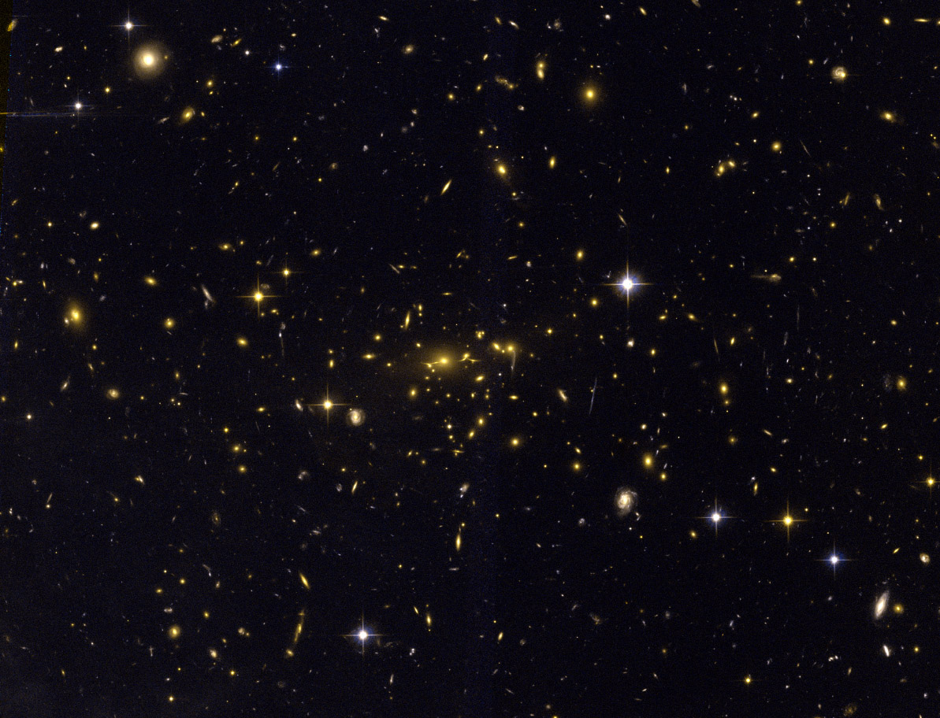
Through a Lens, Darkly:
An Innovative Multi-cycle Hubble Treasury Program to Study the Dark Universe
Marc Postman
Space Telescope Science Institute
Science with HST III, Venice, Italy
October 2010
MACS 2129-0741 z = 0.57 HST/ACS image (Ebeling et al.)
Notes:
The universe presents us with mysteries that provide fundamental challenges to both theoretical physics and observational cosmology. Since the early 70s, when solid astronomical evidence for dark matter was discovered, the search to identify the particle or particles that comprise 20% of the mass density of the universe has been underway. In the late 90s we saw the perhaps even more remarkable initial evidence for an accelerating universe and the campaign to understand how this can be and to verify it further has engaged many of us. Clusters of galaxies, by virtue of their position at the high end of the cosmic mass power spectrum, play a direct and fundamental role in testing cosmological models and in constraining the properties of dark matter (DM), providing unique and independent tests of any viable cosmology and structure formation scenario, and possible modifications of the laws of gravity. A key ingredient of such cluster-based cosmological tests is the mass distribution of clusters, both on (sub) Mpc scales and across the range of populations. In this context, the current paradigm of lambda cold dark matter (LCDM) cosmology provides testable predictions of how the shape of a cluster’s DM potential depends on its mass and redshift, how the baryons distribute within the gravitational potential wells of clusters, how the number of clusters of a given mass should increase with time, and how the growth rate depends on DM and dark energy (DE). Precise mass measurements in a galaxy cluster are then essential to make direct constraints on DM and to calibrate clusters as precision tools for cosmology.

Slide 2
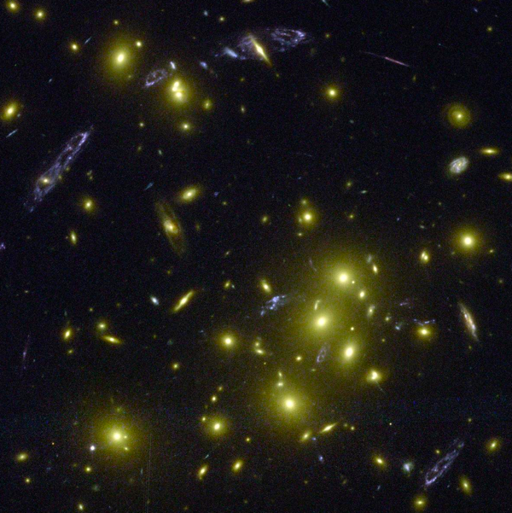
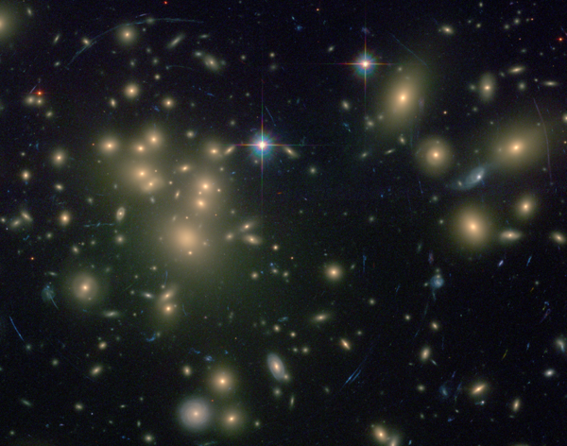
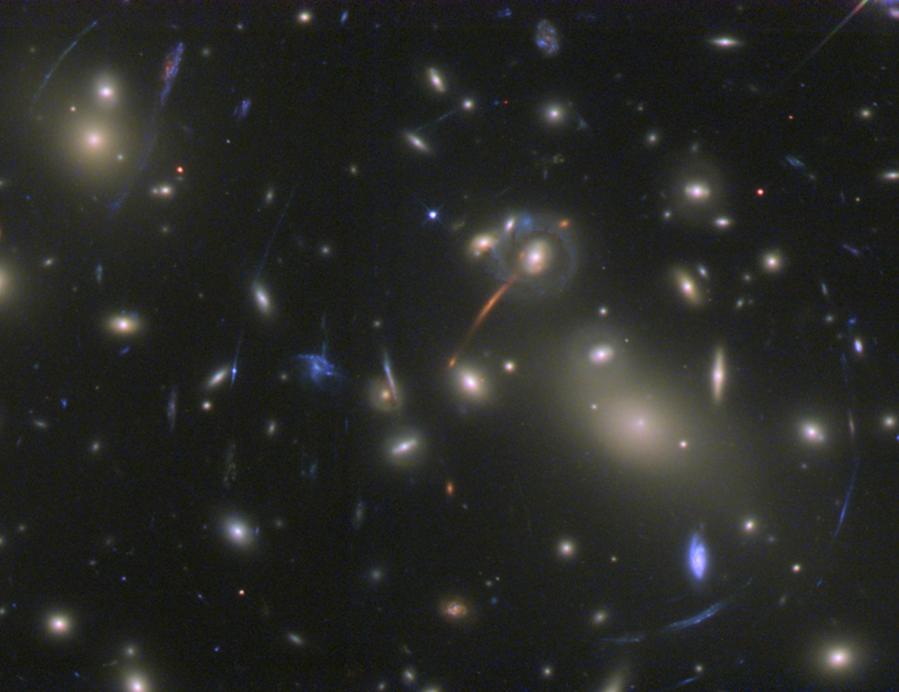
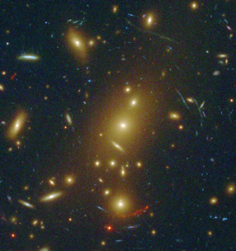
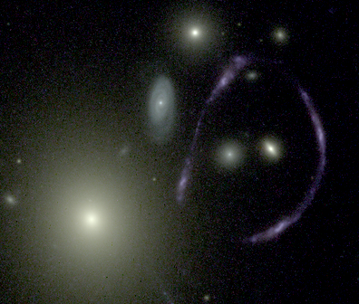
CLASH:
Cluster Lensing And Supernova survey with Hubble
An HST Multi-Cycle Treasury Program designed to place new constraints on the fundamental components of the cosmos: dark matter, dark energy, and baryons.
To accomplish this, we will use galaxy clusters as cosmic lenses to reveal dark matter and magnify distant galaxies.
  Multiple observation epochs enable a z > 1 SN search in the surrounding field (where lensing magnification is low). This allows us to improve the constraints on both the time dependence of the dark energy equation of state and on the amplitude of systematic errors in cosmological parameters.
CL0024
A1689
A2218
MS1358
A1703

Slide 3
































The CLASH Science Team:
Marc Postman, P.I.
Matthias Bartelmann
Narciso “Txitxo” Benitez
Rychard Bouwens
Larry Bradley
Thomas Broadhurst
Dan Coe
Megan Donahue
Rosa González-Delgado
Holland Ford, co-P.I.
Genevieve Graves
Øle Host
Leopoldo Infante
Stéphanie Jouvel
Daniel Kelson
Ofer Lahav
Ruth Lazkoz
Doron Lemze
Dan Maoz
Elinor Medezinski
Peter Melchior
Massimo Meneghetti
Julian Merten
Leonidas Moustakas
Enikö Regös
Adam Riess
Piero Rosati
Stella Seitz
Keiichi Umetsu
Arjen van der Wel
Wei Zheng
Adi Zitrin
Space Telescope Science Institute (STScI)
Universität Heidelberg
Instituto de Astrofisica de Andalucia (IAA)
Leiden University
STScI
University of the Basque Country
Jet Propulsion Laboratory (JPL) / Caltech
Michigan State University
IAA
The Johns Hopkins University (JHU)
University of California, Berkeley
University College London (UCL)
Universidad Católica de Chile
UCL
Carnegie Institute of Washington
UCL
University of the Basque Country
JHU
Tel Aviv University (TAU)
JHU
Universität Heidelberg
INAF / Osservatorio Astronomico di Bologna
Universität Heidelberg
JPL/Caltech
European Laboratory for Particle Physics (CERN)
STScI / JHU
European Southern Observatory
Universitas Sternwarte München
Academia Sinica, Institute of Astronomy & Astrophysics
Max Planck Institüt für Astronomie
JHU
TAU
Post-doctoral fellow
Graduate student

Slide 4
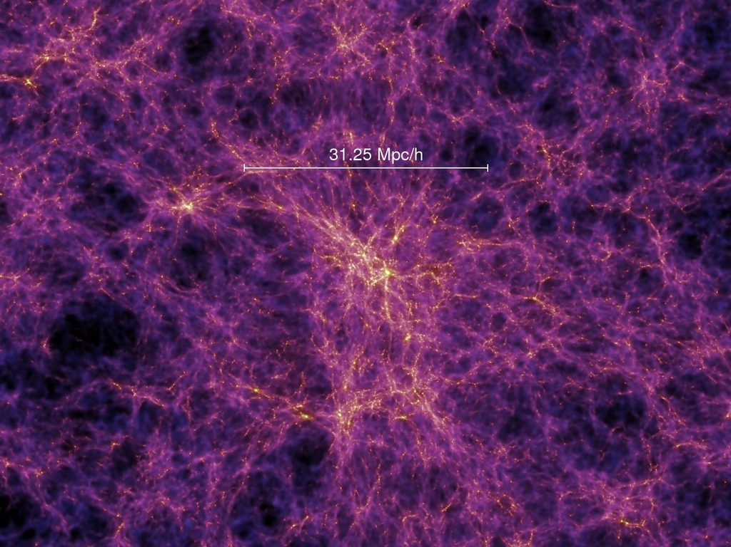
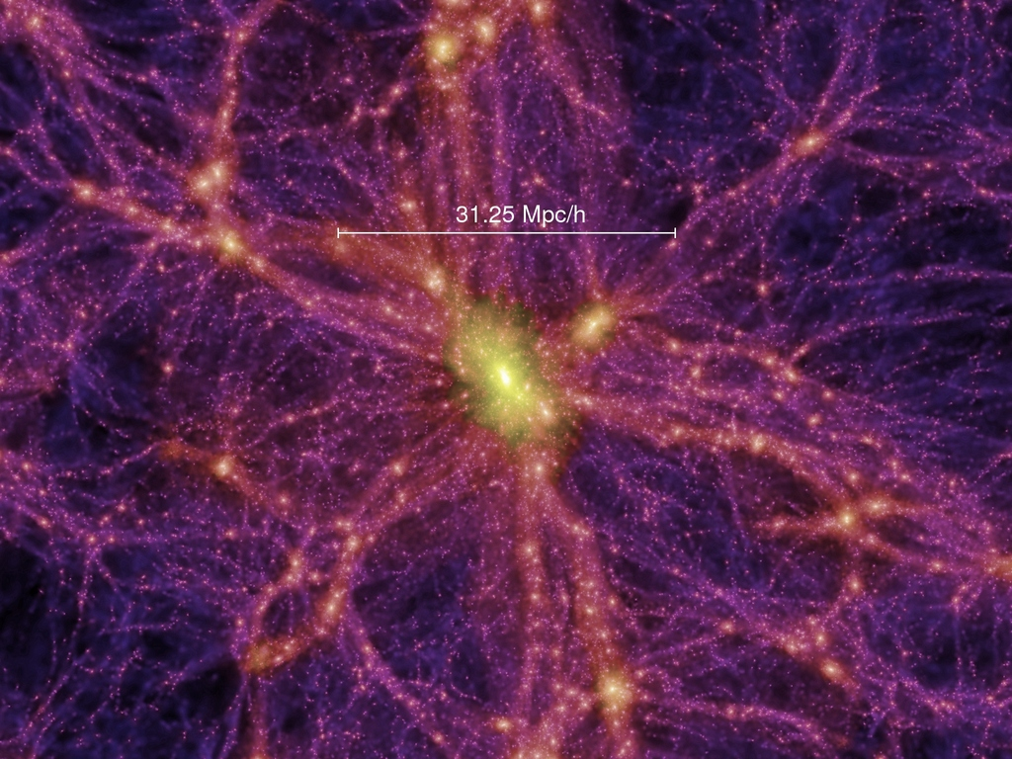
Fundamental Questions That Remain Unanswered or Unverified
130 Mpc
How is dark matter distributed in cluster & massive galaxy halos?
  How centrally concentrated is the DM? Implications for epoch of formation.
  What degree of substructure exists? And on what scales?
  How does the DM distribution evolve with time?
  What is the characteristic shape of a typical cluster DM halo?
12.5 Gyr
“Millennium” simulation of DM
Springel et al. 2005
Notes:
Duffy et al. 2008: A number of semi-empirical prescriptions (i.e. theoretically motivated
fitting functions) have been proposed to predict the c(M, z)
relation for arbitrary cosmologies. The basic premise of each is that
the concentration of a halo reflects the background density of the
universe at the formation time of the halo. The prescriptions differ
mainly in the definition of this formation time.

Slide 5
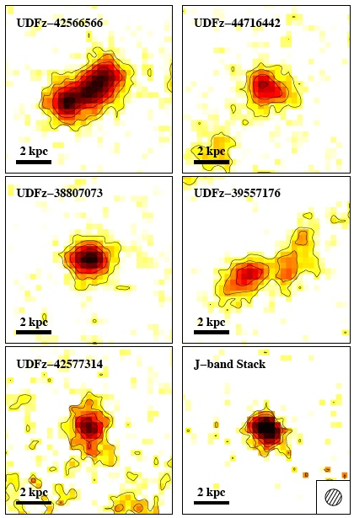
Fundamental Questions That Remain Unanswered or Unverified
When was the epoch of first galaxy formation?
  What are the characteristics (mass, “metal” abundance, star formation rates, global structure) of the most distant galaxies in the universe (t_{U} < 800 Myr)?
  What was their role in ionizing the intergalactic medium?
Young galaxies (z ~ 7)
Oesch et al. 2010

Slide 6
Fundamental Questions That Remain Unanswered or Unverified
w = P / ρc²
w = -1 (cosmo constant)
w ≠ constant; scalar field e.g. Quintessence, k-essence
Is w a f(z)?
w(z) = w_{o} + w_{a} z/(1+z)
(e.g., Linder 2003)
Why is the expansion of the universe accelerating?
  Is it something other than Λ?
  What are the parameters of the dark energy equation of state?
  What is the time derivative of the equation of state?
  How standard are our “standard” candles (cosmic distance indicators)? Need better measurements of systematic effects at large lookback times.
w
1 + z
Notes:
While w=-1 cosmological constant is consistent with observations, it runs into severe difficulties theoretically, namely, the fine-tuning problem (energy scale of lambda too low by at least 10^54 and may be as much as 10^120) and the coincidence problem (why now – why are lambda and omega-matter so close?).
K-essence models are scalar field cosmological models where the scalar field Lagrangian, L, has the distinctive feature that one allows for a dependence on higher-order powers of the kinetic term.
In order to alleviate the coincidence problem quintessence [2] and k-essence [3] have been proposed. In these models a scalar field has the property that at early times, in the radiation dominated universe, its energy density ’tracks’ the one of the cosmic fluid and therefore naturally provides a sizeable fraction of the energy density of the universe. Quintessence also tracks the matter energy density during matter domination, but the mechanism which leads to the domination of quintessence today is not clearly identified. In the case of k-essence the situation is different. Within a certain range of initial conditions, the energy density sharply drops after the beginning of the matter dominated era and assumes an equation of state P ≃ −rho (de Sitter phase). Afterwards its contribution can either rise to dominate the energy density with an equation of state of wk = constant < 0, or become comparable to that of matter and start to ’track’ the matter. The radiation tracker, de Sitter phase and k-essence domination (or matter tracker) are all attractor solutions of the k-essence evolution equation.
The idea that non-standard (i.e. non-quadratic), kinetic terms in the scalar field Lagrangian might be of interest to inflation was pointed out by C. Armend´ariz-Pic´on, T. Damour and V. Mukhanov in [1] and is string inspired.

Slide 7
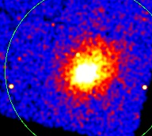
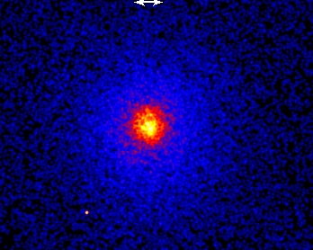
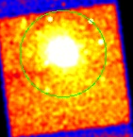
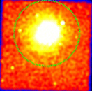
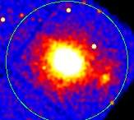
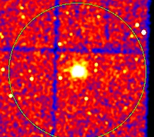
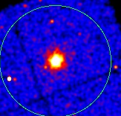
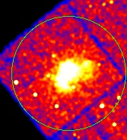
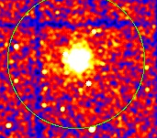
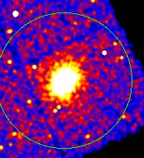
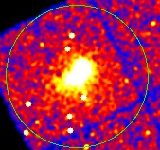
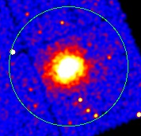
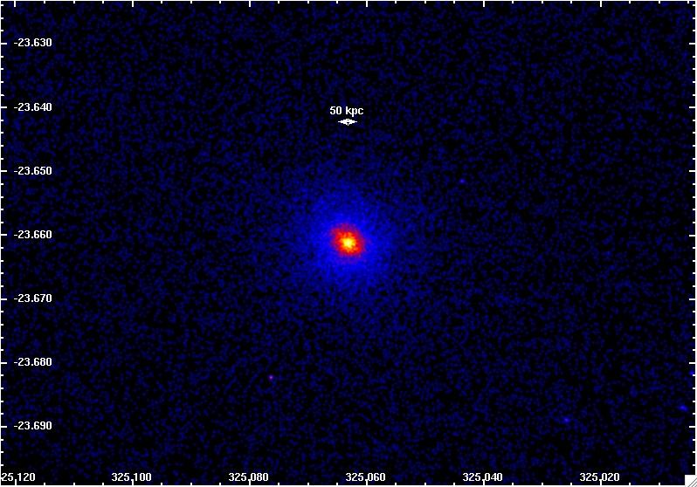
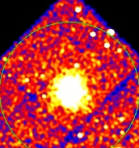
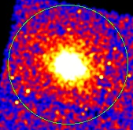
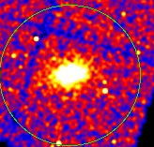
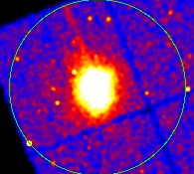
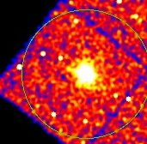
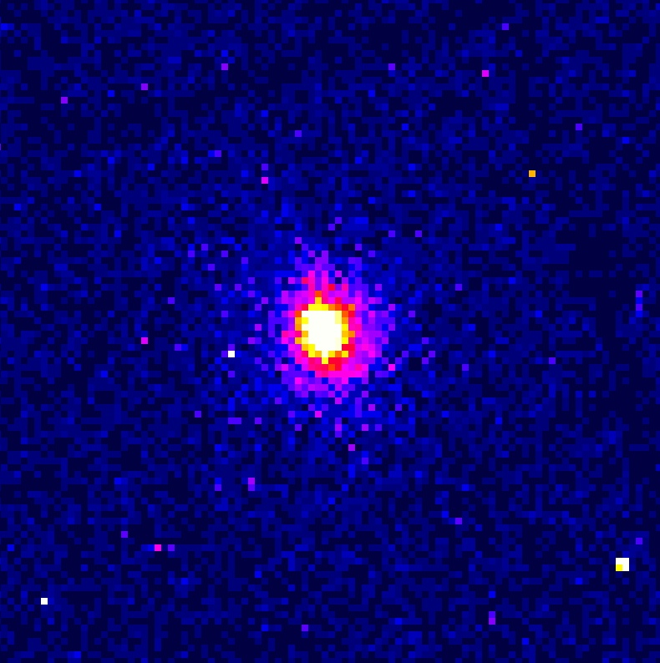
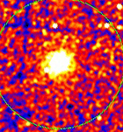
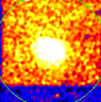
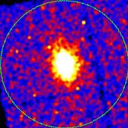
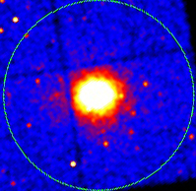
Abell 209
Abell 383 core
Abell 611
Abell 963
Abell 2261
CLJ1226+3332
MACS 0329-0211
MACS 0717+3745
MACS 0744+3927
MACS 1115+0129
MACS 1149+2223
MACS 1206-0847
RXJ 0647+7015
RXJ 1347-1145
RXJ 1423+2404
MS-2137 core
RXJ 1720+3536
RXJ 2129+0005
All clusters have
T_{x} > 5 keV
z_med ~ 0.4
MACS 0429-0253
MACS 1311-0310
RXJ 1532+3020
MACS 1931-2634
RXJ 2248-4431
Cutouts of x-ray images of 23 of the 25 CLASH clusters from Chandra Observatory
Notes:
20 clusters is the minimum required to be able to measure, at the 99% conf level, 15% deviations of the DM concentration from theoretical predictions. X-ray data essential to get a) estimate of baryonic mass (85% of baryonic mass is in ICM) and b) get alternative estimate of mass and c) calibrate x-ray scaling relations using GL-derived mass. Clusters selected on basis of “relaxed” x-ray SB distn, high kinetic gas temp. 20 of 25 Not selected for lensing characteristics. 5 are selected based on large Ein rad to aid in search of hi-z gals. Two others not shown are MACS0416-24 and MACS2129-07.

Slide 8
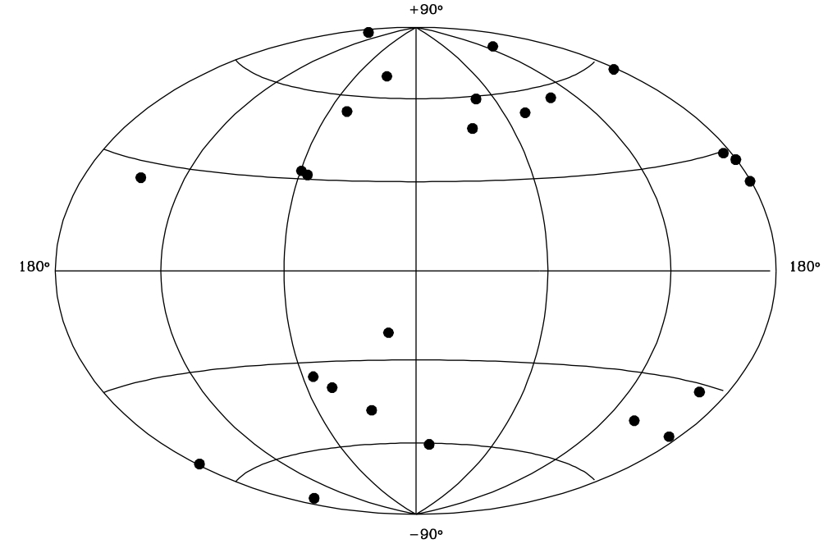
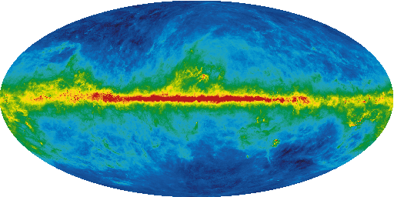
CLJ1226+3332
MACS1149+2223
MACS1423+2404
MACS1311-0310
Abell 963
MACS1115+0129
MACS1532+3021
MACS1206-0847
RXJ1347-1145
Abell 611
MACS1720+3536
MACS0744+3927
Abell 2261
MACS0717+3745
MACS0647+7015
Cluster distribution on sky
120º
60º
0º
300º
240º
MACS1931-2635
RXJ2129+0005
MACS0429-0253
MACS2129-0741
MACS0416-2403
MS2137-2353
Abell 383
MACS0329-0211
Median z=0.39
RXJ2248-4431
Abell 209
CLASH CLUSTER SAMPLE
(Galactic Coordinates)
Redshift
Background: Schlegel et al. Galactic Extinction Map
Notes:
Map position = 0.17, 0.32
Map size = 6.57, 9.66
Bkgd Dust map from http://spider.ipac.caltech.edu/staff/jarrett/irsa/dust.html

Slide 9
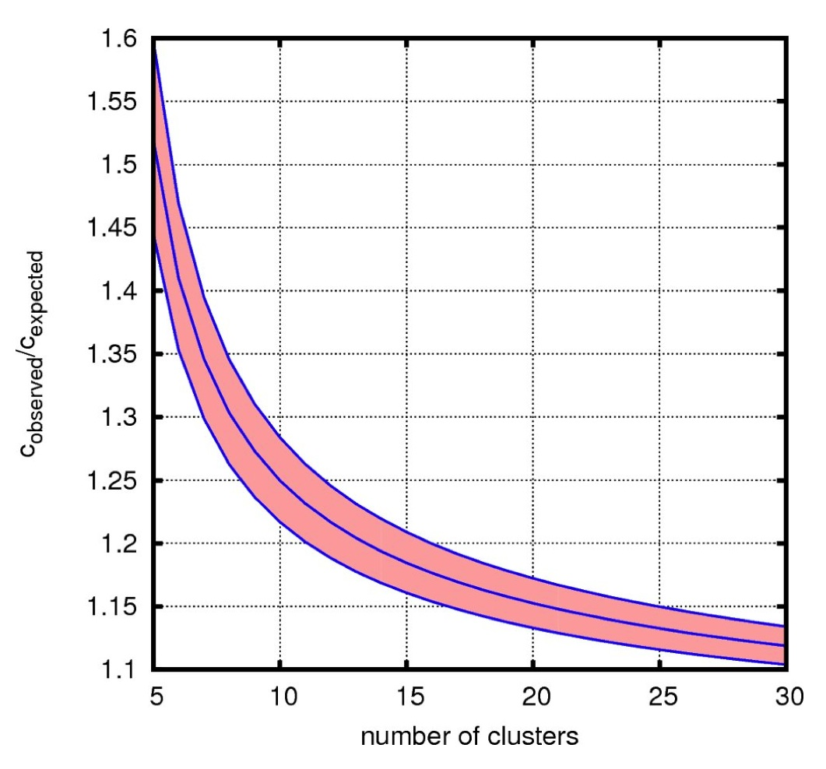
Cluster Sample Size Justification
Observational
Theoretical
Want to measure mean “concentration” of DM profile to ~10% accuracy:
N_{CL} ≈ ( σ_{tot} / f )²
f = 0.10
σ_{tot}² = σ_{LSS}² + σ_{int}² + σ_{Meas}²
σ_{LSS} = 0.13 (e.g., Hoekstra et al. 2003)
σ_{int} = 0.30 (e.g., Neto et al. 2007)
σ_{Meas} = 0.22 ( N_{arc, CL0024} / N_{arc})^{½} (Umetsu et al. 2010)
N_{CL} = 24
N-body simulations show DM profile concentration distns are log-normal with σ~ 0.25±0.03 (e.g., Jing 2000; Meneghetti et al. 2009).
Ratio needed to reject hypothesis that observed DM concentrations follow the LCDM predictions at 99% C.L. given a sample with the indicated # clusters.
Notes:
The σ_{Tot}² = σ_{LSS}² + σ_{Int}² + σ_{Meas}² where σ_{LSS} = 0.13 (Hoekstra 2002) and σ_{Int} = 0.30 (Neto et al. 2007) are, respectively, the scatter from intervening large-scale structure and intrinsic variation (including the effects of orientation averaging of triaxial halo shapes). The measurement error, σ_{Meas}, for each cluster can be scaled from that for CL0024+1654 as σ_{Meas} = σ_{CL0024}/sqrt(<w>) where σ_{CL0024} = 0.22 (see Figure 1), <w> = N_{arc} / N_{arc}(CL0024), and N_{arc} is the number of strongly lensed objects for a given observing depth.

Slide 10

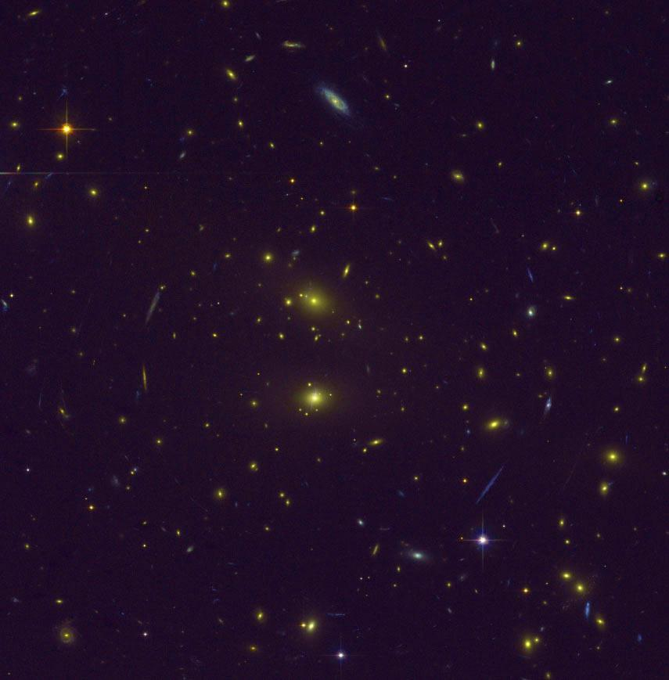
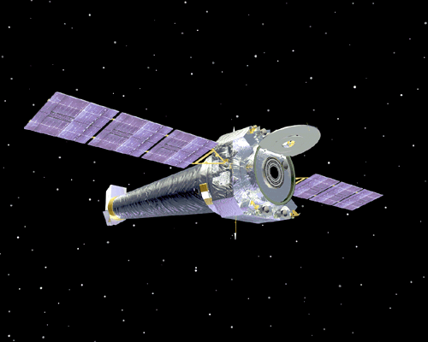
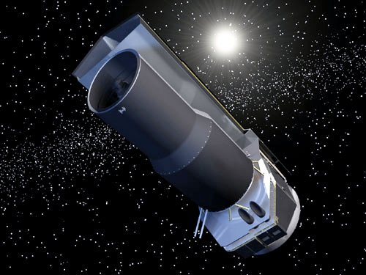
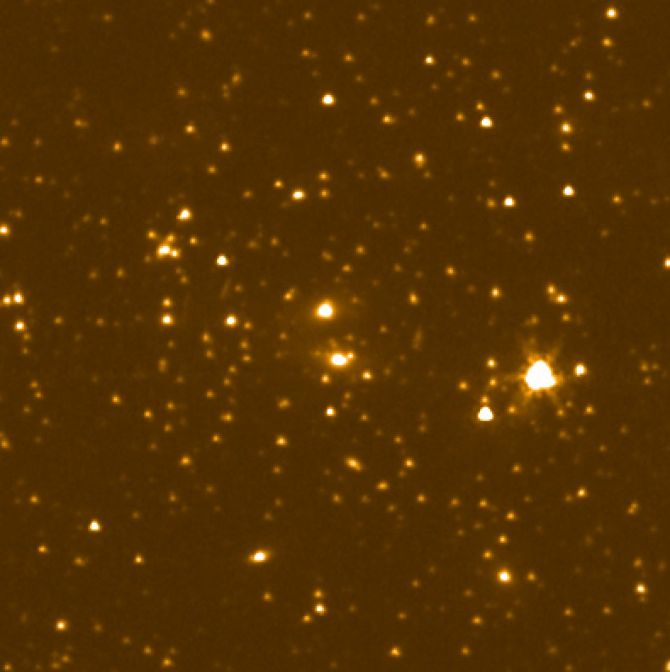
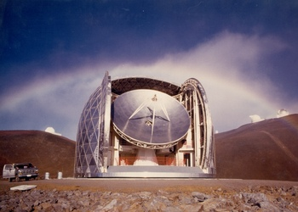
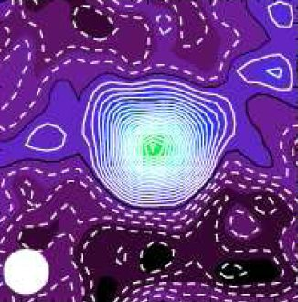
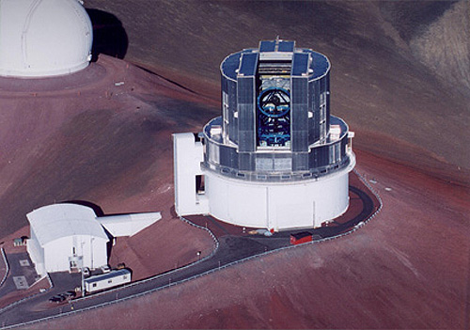
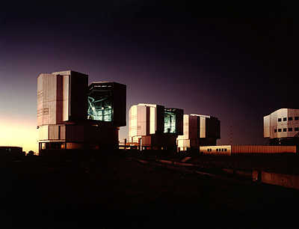
Comprehensive Multi-wavelength Coverage
HST 524 orbits: 25 clusters, each imaged in 16 passbands. (0.23 – 1.6 μm) ~20 orbits per cluster.
Chandra x-ray Observatory archival data (0.5 – 7 keV)
Spitzer IR Space Telescope archival data (3.6, 4.5 μm)
SZE observations (Bolocam, Mustang) to augment existing data (sub-mm)
Subaru wide-field imaging (0.4 – 0.9 μm)
VLT, Magellan Spectroscopy

Slide 11
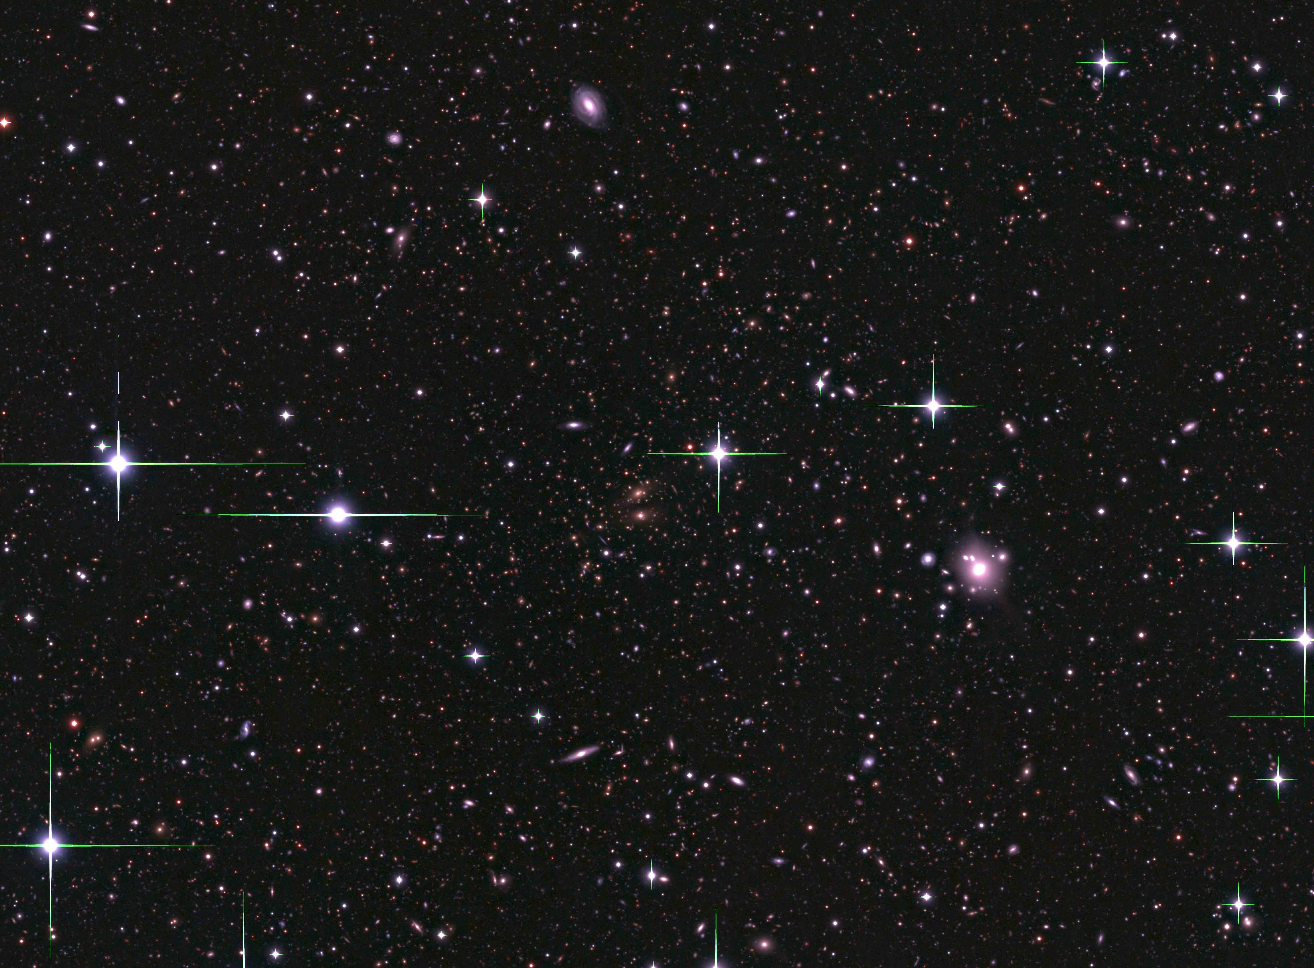

CLASH: An HST Multi-Cycle Treasury Program
WFC3 Parallels
Cluster Pointings
ACS Parallels
6 arcmin. = 2.2 Mpc @ z=0.5
SN search cadence:
10d-14d, 4 epochs per orient
Footprints of HST Cameras: ACS FOV in yellow,
WFC3/IR FOV in red, WFC3/UVIS in blue.
Footprint of our 2 ORIENT survey: The area of the complete 16-band coverage in the cluster center is 4.07 square arcminutes (88% of the WFC3/IR FOV).
Image: Subaru Suprime Cam
Lensing amplification small at these radii
Notes:
Supernova parallel fields don’t get 16 filters. ACS parallel fields have only i775 and z850. WFC3 parallel fields have only F160W (H-band) and F350LP (blue long pass). Hence galactic hosts for supernova will require redshift measurements either from photoz based on Subaru images or photoz from followup HST data or from grism spectroscopy with HST.

Slide 12
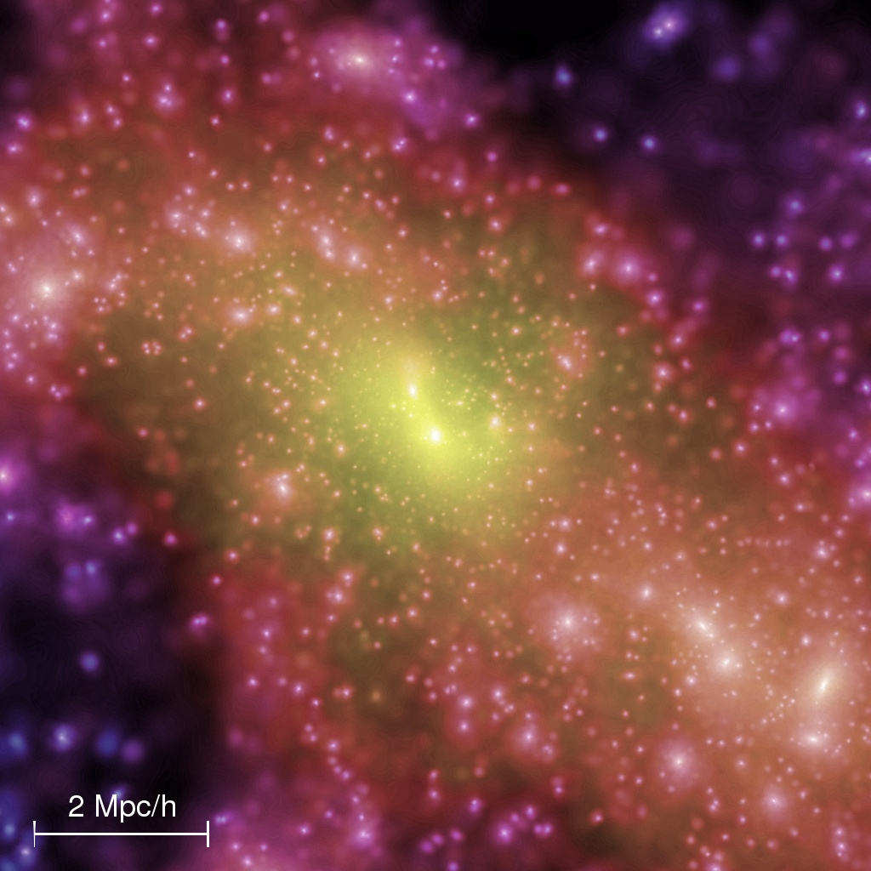
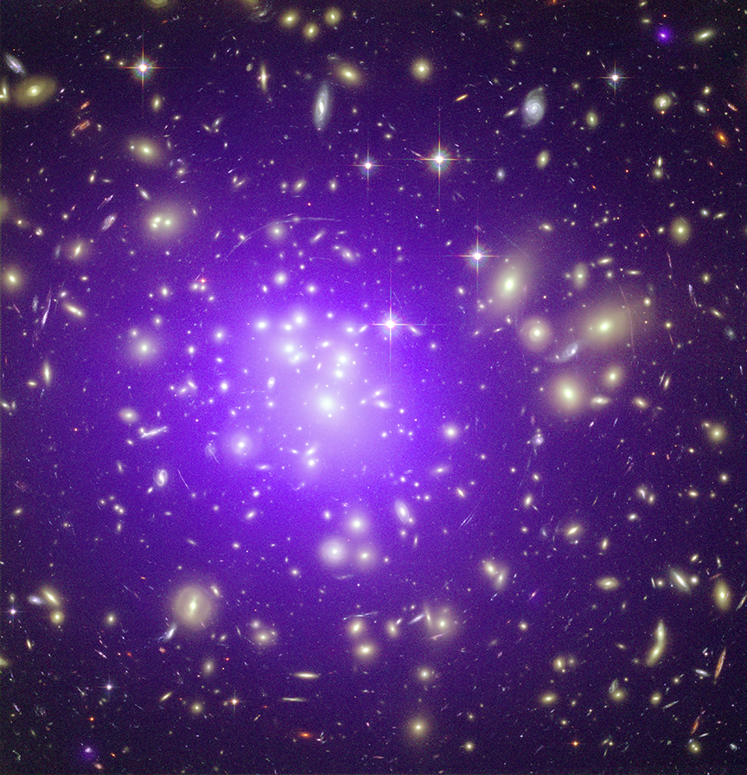
CLASH: An HST Multi-Cycle Treasury Program
Deep HST image of massive cluster
θ_{Einstein}
R ∝
N_{Arcs}
WHERE R IS THE RESULTING SPATIAL RESOLUTION OF THE DARK MATTER MAP
(6.5 Million Light Years)
Simulation of dark matter around a forming cluster (Springel et al. 2005)
Notes:
12

Slide 13
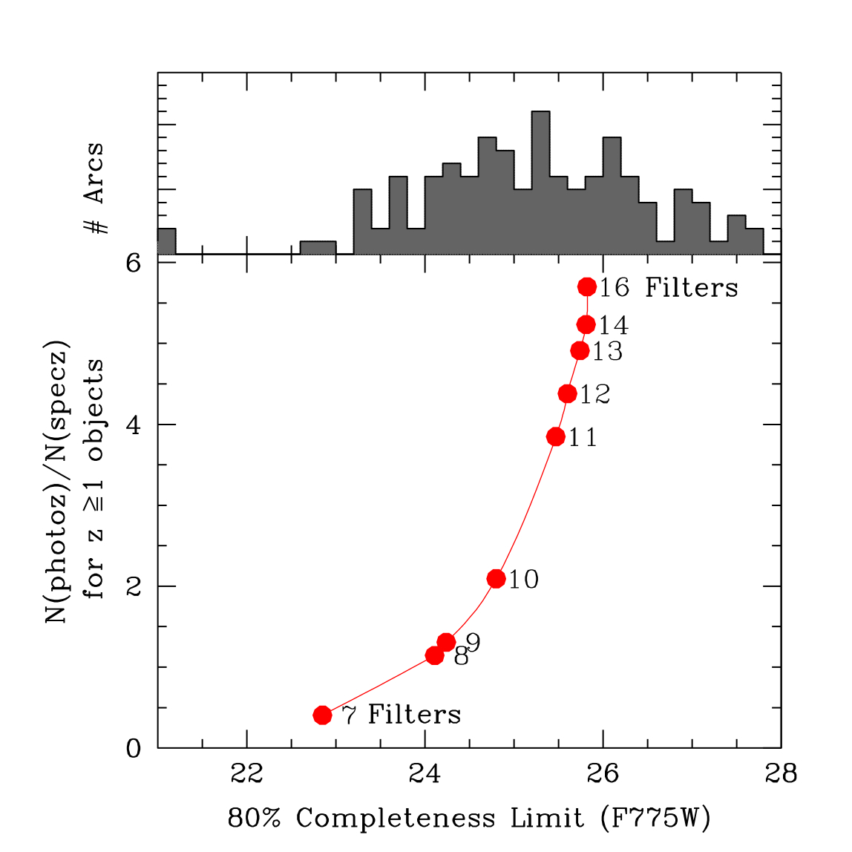
CLASH: An HST Multi-Cycle Treasury Program
Why 16 filters?
Spectroscopic
redshifts
Photometric
redshifts
  F225W … 1.5 orbits WFC3/UVIS
  F275W … 1.5 orbits WFC3/UVIS
  F336W … 1.0 orbit WFC3/UVIS
  F390W … 1.0 orbit WFC3/UVIS
  F435W … 1.0 orbit ACS/WFC
  F475W … 1.0 orbit ACS/WFC
  F606W … 1.0 orbit ACS/WFC
  F625W … 1.0 orbit ACS/WFC
  F775W … 1.0 orbit ACS/WFC
  F814W … 2.0 orbits ACS/WFC
  F850LP … 2.0 orbits ACS/WFC
  F105W … 1.0 orbit WFC3/IR
  F110W … 1.0 orbit WFC3/IR
  F125W … 1.0 orbit WFC3/IR
  F140W … 1.0 orbit WFC3/IR
  F160W … 2.0 orbits WFC3/IR
Mag distn of multiply lensed arcs in A1689 and CL0024
Arcs in A1689 and CL0024
Will yield photometric redshifts with rms error of
~2% x (1 + z) for sources down to ~26 AB mag.
Notes:
Strong gravitational lensing (SL) is of great significance as a cosmological probe, providing model-free masses of galaxies and clusters interior to the Einstein radius and useful constraints on their inner mass profiles. The mass density in the central regions of distant clusters typically exceeds the critical value required for lensing, generating multiple images of background objects.

Slide 14
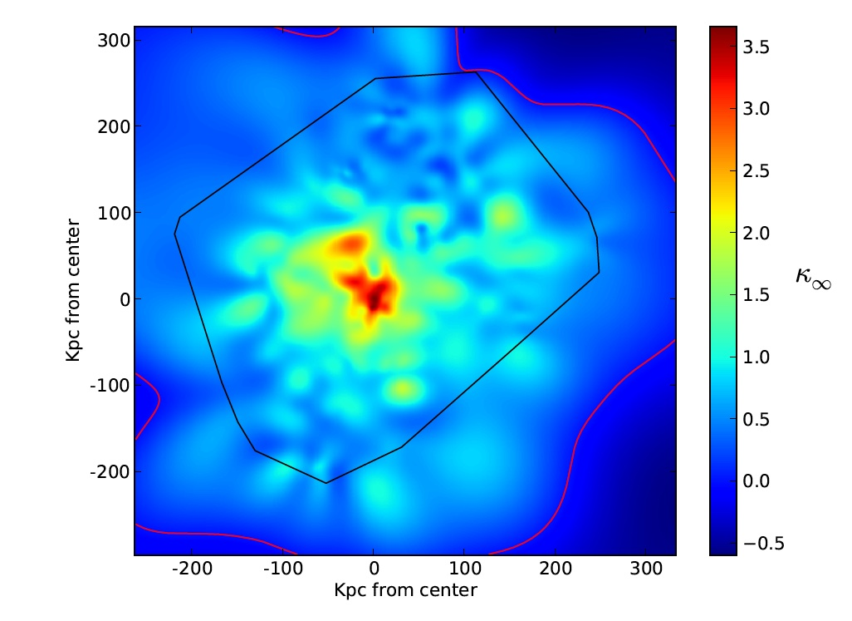
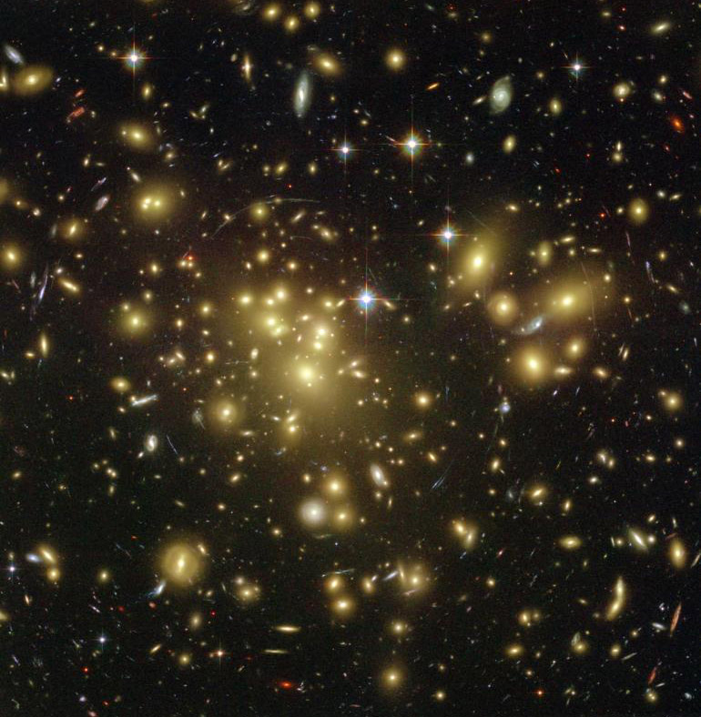
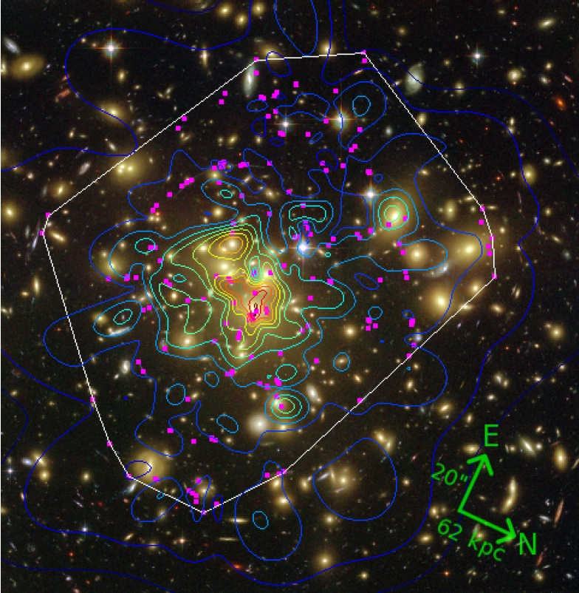
Gravitational lensing analysis reveals dark matter substructure
HST Image of Cluster Reconstructed Mass Surface Density
Region of Reliable Reconstruction
Abell 1689 Coe et al. 2010
DM substructure resolution in this map is ~23 kpc. DM substructure resolution for typical CLASH cluster will be ~30 – 40 kpc.
Notes:
Mention that constraints on DM distn parameters (e.g., Einstein radius for z=2, concentration, etc.) are best constrained from integrated mass profile (mass within radius) rather than from surface mass profile.

Slide 15



Structure Formation History and DM properties are encoded in DM Halo profiles and shapes
Dark matter halos are predicted to have a roughly universal
density profile (NFW / Sersic / Einasto)
Density profile: flatter in core, steeper in outskirts
Observed
Concentration
Simulated
Abell 1689
Best fit to data shown here
lensing bias
The DM concentration is predicted to decline with increasing cluster mass because in the hierarchical model massive clusters collapse later, when the cosmological background density is lower.
predicted
Comerford & Natarajan 2007
Oguri et al. 2009
Notes:
the degree of mass concentration should decline with increasing cluster mass because in the hierarchical model massive clusters collapse later, when the cosmological background density is lower.

Slide 16


Both Strong & Weak Lensing Measurements Needed for Good Constraints
ΛCDM Theory
ΛCDM Theory
Umetsu et al. 2010
LCDM prediction from Duffy et al. 2008
CLASH will:
Use 3 independent lensing constraints: SL, WL, mag bias
Have a well-selected cluster sample with minimal lensing bias
Definitively derive the representative equilibrium mass profile shape
Robustly measure cluster DM concentrations and their dispersion as a function of cluster mass (and possibly their redshift evolution).
Provide excellent calibration of mass-observable relations for clusters

Slide 17

We expect to find tens of bright (m < 26.5 AB) z > 7 galaxies
CLASH Survey Limit
CLASH (predicted)
Field survey with
identical area
CLASH Survey
Lensing greatly enhances the ability to detect distant galaxies and provides an additional constraint on their redshifts, as the projected position of the lensed object is a function of the source redshift.

Slide 18



WFC3/IR z-band dropouts
Bradley et al. 2010 (in prep): Abell 1703
435 nm 475 nm 555 nm 625 nm
1 orbit each in WFC3/IR F125W (J) and F160W (H)
μ ~ 3 - 5
Brightest candidate: z ~ 6.9, H160 ~ 24.3 AB (brightest z ~ 7 candidate known)
Can reliably constrain SED
775 nm 850 nm 1.25 μm 1.6 μm
Highly Magnified z ~ 5 galaxies
Zitrin et al. 2010
Reconstruction of a z = 4.92 source lensed by the z = 0.33 cluster MS1358+62.
Best resolved high-z object: spatial resolution of ~50 pc (rest-frame UV)
Equivalent to 20-m space telescope resolution of a non-lensed z=5 galaxy!
z = 4.92 Galaxy
ACS PSF
0.2”
How object would look without cluster lensing

Slide 19

HST: 23 SNe Ia at z>1 Find Past Deceleration,
Confirms Dark Energy+Dark Matter Model
G
R
O
U
N
D
S
P
A
C
E
Riess et al. 2004, 2007
z>1 is a particularly important regime for testing “astrophysical contamination” of SN cosmology signal, such as dust or evolution. Also key for constraining dw/dz.
Notes:
19

Slide 20

HST & WFC3-IR, Gateway to SNe Ia at z>2
Assuming a mixed SN delay time distn (~50% prompt, ~50% 2-3 Gyr): expect CLASH to find 10 – 20 SNe at z>1; and ~6 with z > 1.5, doubling the known number of z > 1 SN
Two MCT HST programs (CLASH + CANDELS)
will detect SNe Ia at
1.0 < z < 2.5. They will provide a direct test
of the SN systematics in a matter-dominated universe
(e.g., Riess & Livio 2006).
Δ mag (vs. w_{o} = -1, w_{a} = 0)
MCT
MCT
CURRENT
HST LIFETIME
Notes:
positive dmag implies BRIGHTER SNe relative to w=-1, w’=0 model (i.e., Dlum is LOWER relative to reference wo=-1/wa=0 model). Also Universe is slightly younger in wo<-1 or wa>0 model. C/O evolution – if progenitor mass is increased (e.g., earlier formation epoch), then C/O ratio in WD before explosion is lower, resulting in a potential reduction in Ni56 mass. This would lower peak luminosity. However, other evolutionary scenarios could increase SN brightness at high z. This is because system lifetime is essentially set by lifetime of companion star. Younger companion → more mass companion → more mass transferred to WD → smaller WD mass required → higher Ni56 mass.

Slide 21
Concluding Comments
CLASH observations with HST to begin in November. 25 clusters will be observed over the course of cycles 18-20 (~3 years): 10, 10, 5.
Represents a major observational initiative to constrain the properties of DM, high-z galaxies, and advance our understanding of DE.
Immediate public access to all HST data.
High-level science products will be released on a regular schedule, including compilations of x-ray, IR, sub-mm, and spectroscopic data.
http://www.stsci.edu/~postman/CLASH

Slide 22

Current Schedule
MACS1206

