Slide 1
Exoplanets: What’s new and next for HST?
Jennifer Wiseman
NASA GSFC

Slide 2
Thoughts on Exoplanets with HST
Not an original goal for HST, but HST has become a major contributor to exoplanet studies, via transit spectroscopy, astrometry, and imaging.
Moving beyond simply detection (most exoplanets detected by radial velocity motions of the associated star), Hubble (in concert with other facilities like Spitzer) is now being used for beginning characterization of exoplanets (generally gas giants).
Astro2010 recommended WFIRST as the next flagship mission, which would enable exoplanet statistics using microlensing, complementing Kepler’s statistical study via distant transits. Neither allows followup spectroscopic study and characterization. JWST will allow IR studies of circumstellar disks and transit IR spectroscopy of mostly gas giants (and hopefully super-Earths). SO, in the meatime, important to maximize scientific use of unique HST capabilities for exoplanet characterization while we still can.

Slide 3
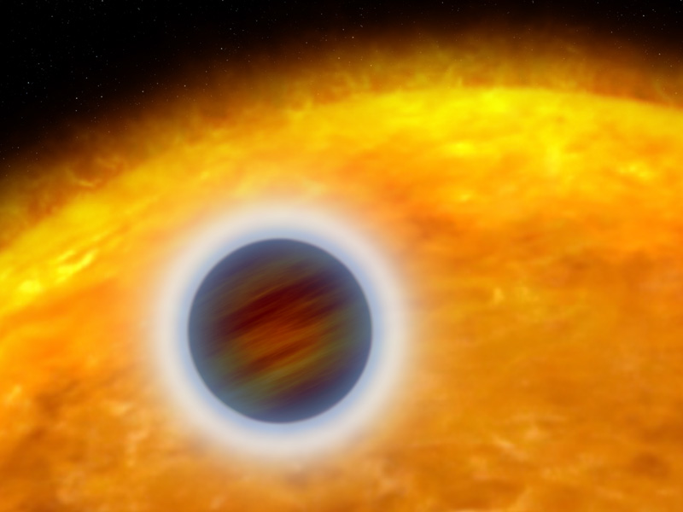
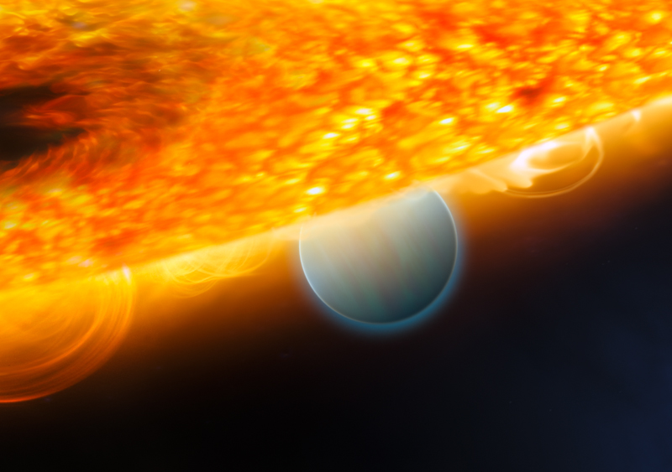
TRANSITING EXOPLANETS (“HOT JUPITERS”)
PRIMARY ECLIPSE –
Spectroscopy/Photometry probe terminator region in absorption
SECONDARY ECLIPSE –
Spectroscopy/Photometry probe dayside in emission/reflection
OBSERVATIONS WITH HUBBLE (NICMOS) AND SPITZER
Enable identification of atmospheric molecular and atomic constituents
Provide information about thermal profiles, dynamics of atmospheres
At least four “hot Jupiters” observed to date
Observed constituents include CH₄, H₂O, CO_{2,} CO
              e.g. G. Tinelli, M. Swain, et al.
Notes:
Giovanna Tinelli
Paul Kalas

Slide 4
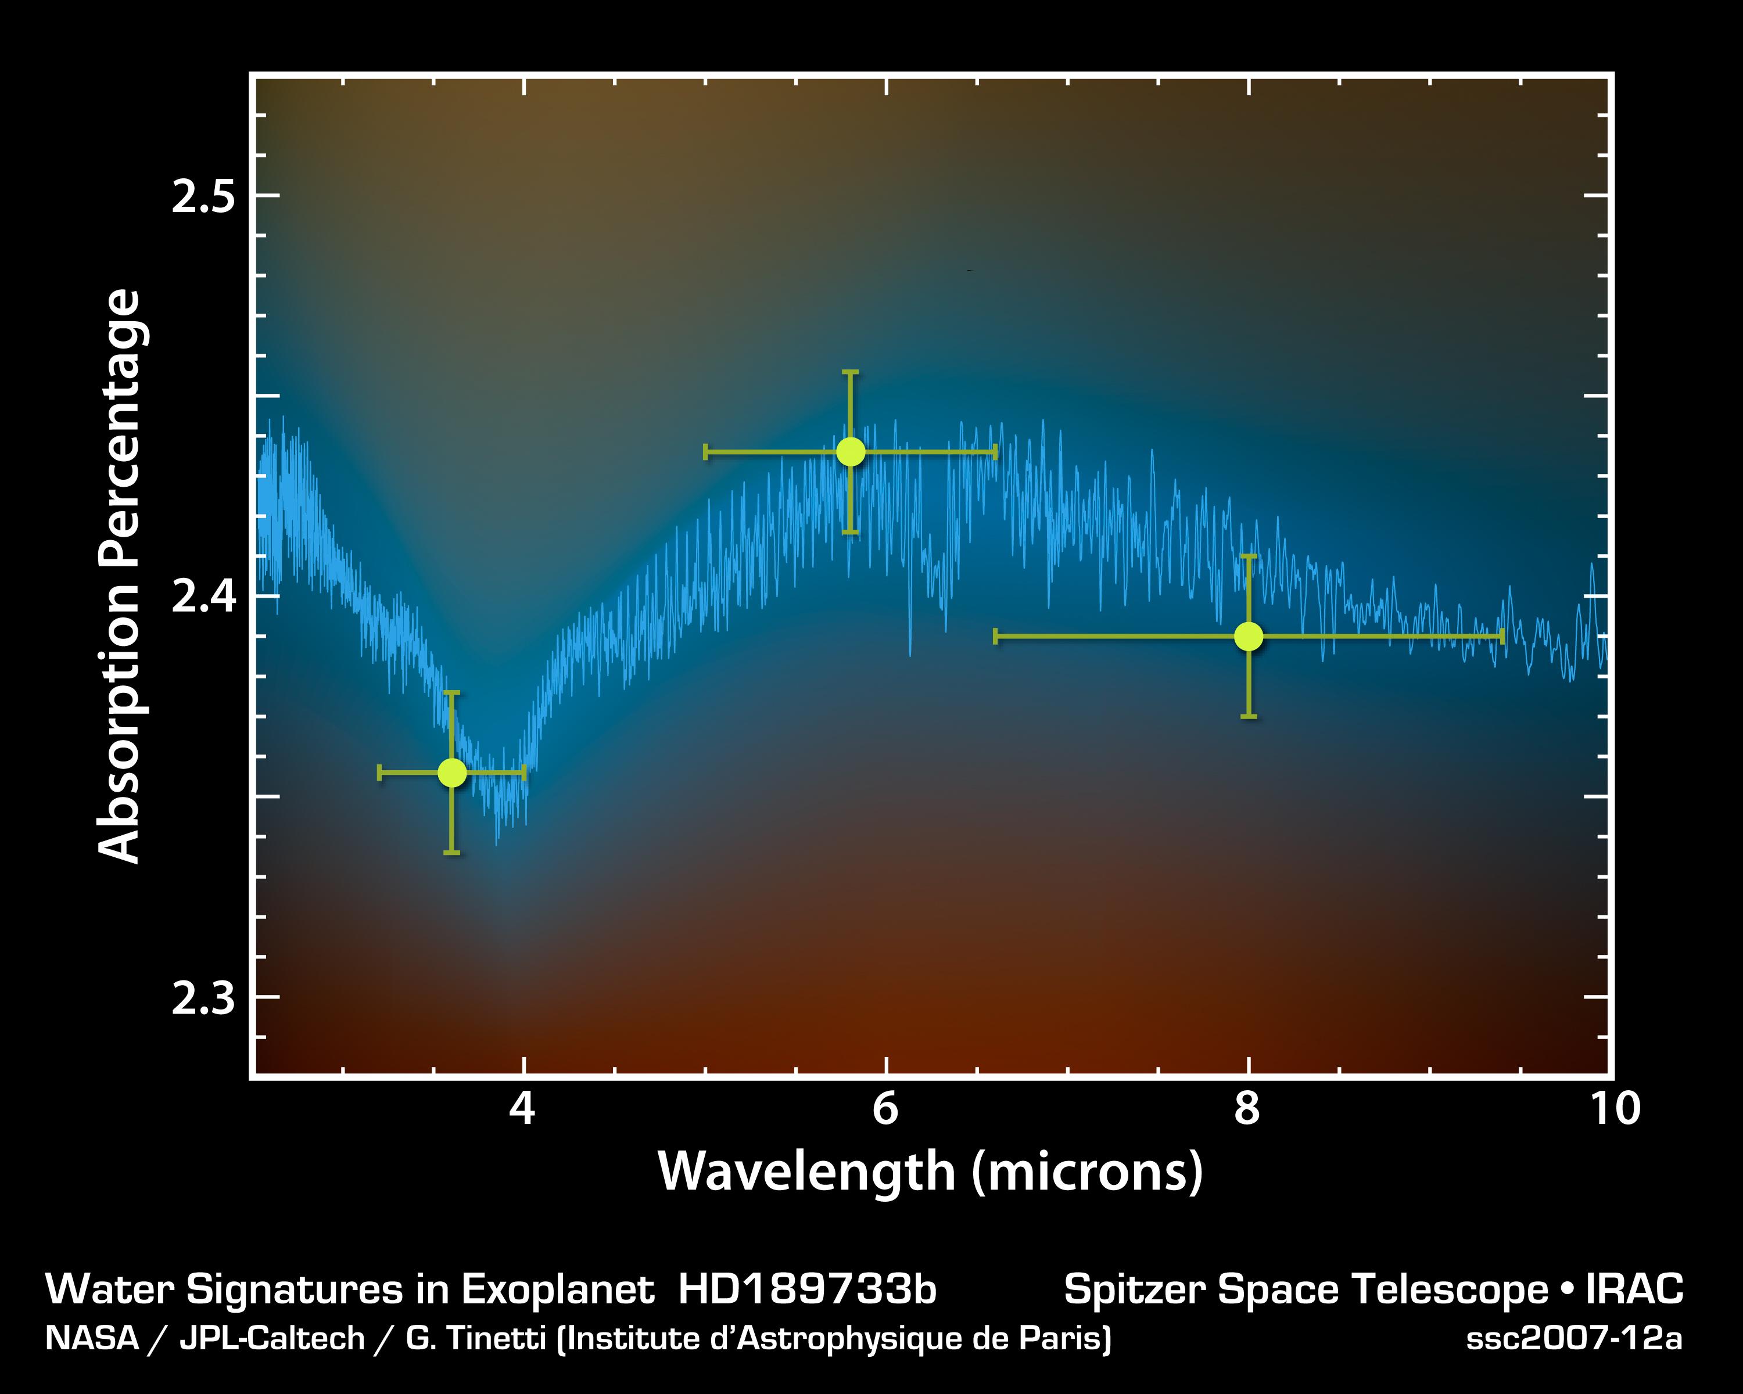
Notes:
First detection of water in the atmosphere of “hot Jupiter” HD189733b
Three bandpass filter photometry from Spitzer/IRAC
Blue plot is synthetic spectrum from model H2 atmosphere with small amount of H2O added
Broad absorption peak is produced by vibrational band of H2O at 6 μm

Slide 5
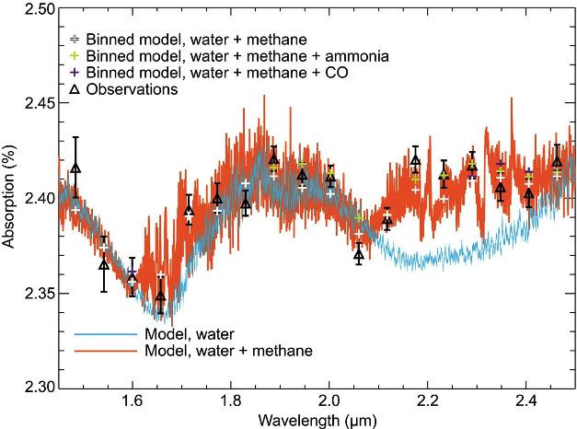
HUBBLE/NICMOS PRIMARY ECLIPSE SPECTROSCOPY OF HD189733b
M. Swain, G. Vasisht, G. Tinetti 2008, Nature, 452, pp. 329-331
Notes:
Full resolution Hubble/NICMOS grism spectrum of “Hot Jupiter” HD189733b in transit
Resolving power is λ/δλ=35 at 2.0 μm
Plotted with INCREASED absorption upward on the vertical scale
Red and blue plots are synthetic spectra from a model H2 atmosphere with small amounts of H20 and Methane added as indicated.
H20 absorption is insufficient to explain observations at 1.7-1.8 μm and 2.15-2.4 μm
Added absorption explained as primarily due to presence of CH4
Slightly better fit to data obtained by postulating additional constituents, e.g. CO or NH3

Slide 6
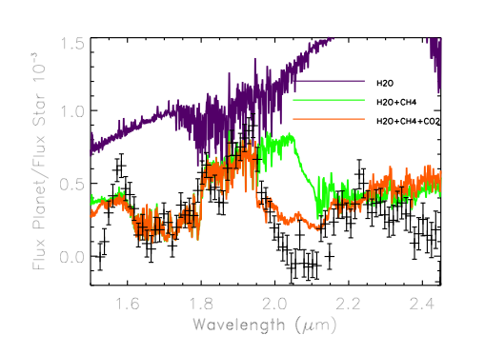
HUBBLE/NICMOS SECONDARY ECLIPSE SPECTROSCOPY OF HD209458b
M.R. Swain, et al. 2009, ApJ, 704, pp 1616-1621
Notes:
Hubble/NICMOS grism spectrum of “Hot Jupiter” HD209458b in secondary eclipse
Data points are smoothed with 5-point running boxcar
Vertical axis is ratio of flux from planet and flux from star – brighter is upward on vertical axis
Colored plots are synthetic spectra from H2 model atmosphere containing small amounts of H2O, CH4, CO2
Observed absorption in spectrum requires contributions form all three molecules.
Additional absorption is needed around 2.0 and 2.4 μm

Slide 7
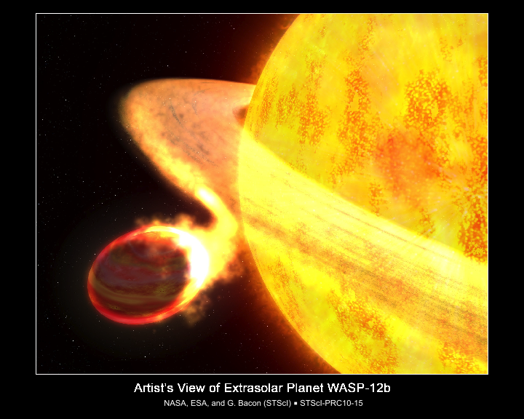
Notes:
UV transit dip begins before visible transit, indicating that outer atmosphere is being stripped tidally by star…
This is based on COS spectral transit observations. After Hubble, no UV capabilities, so we need to do as many of these UV observations as we can while we still have HST.

Slide 8
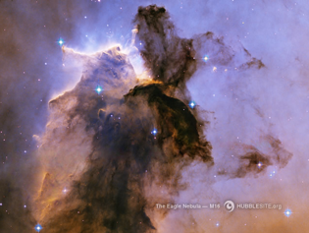
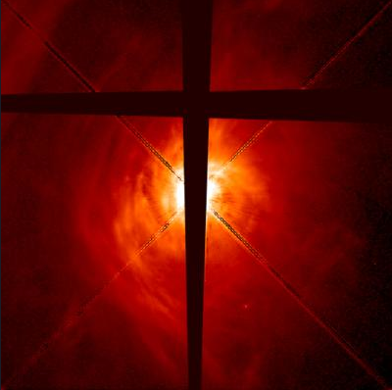
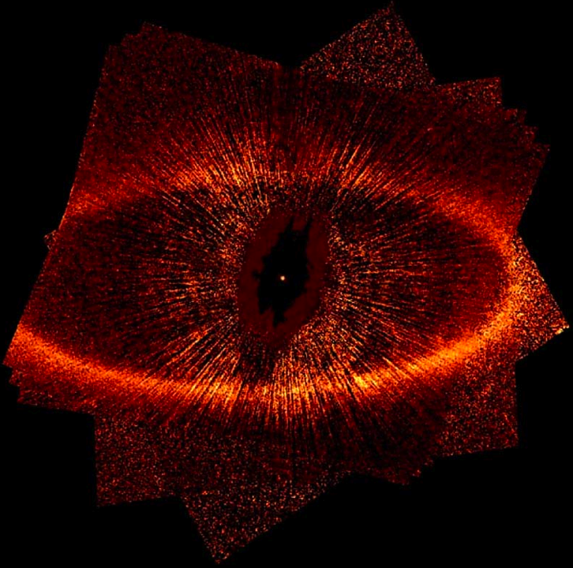
Planetary System Formation

Slide 9
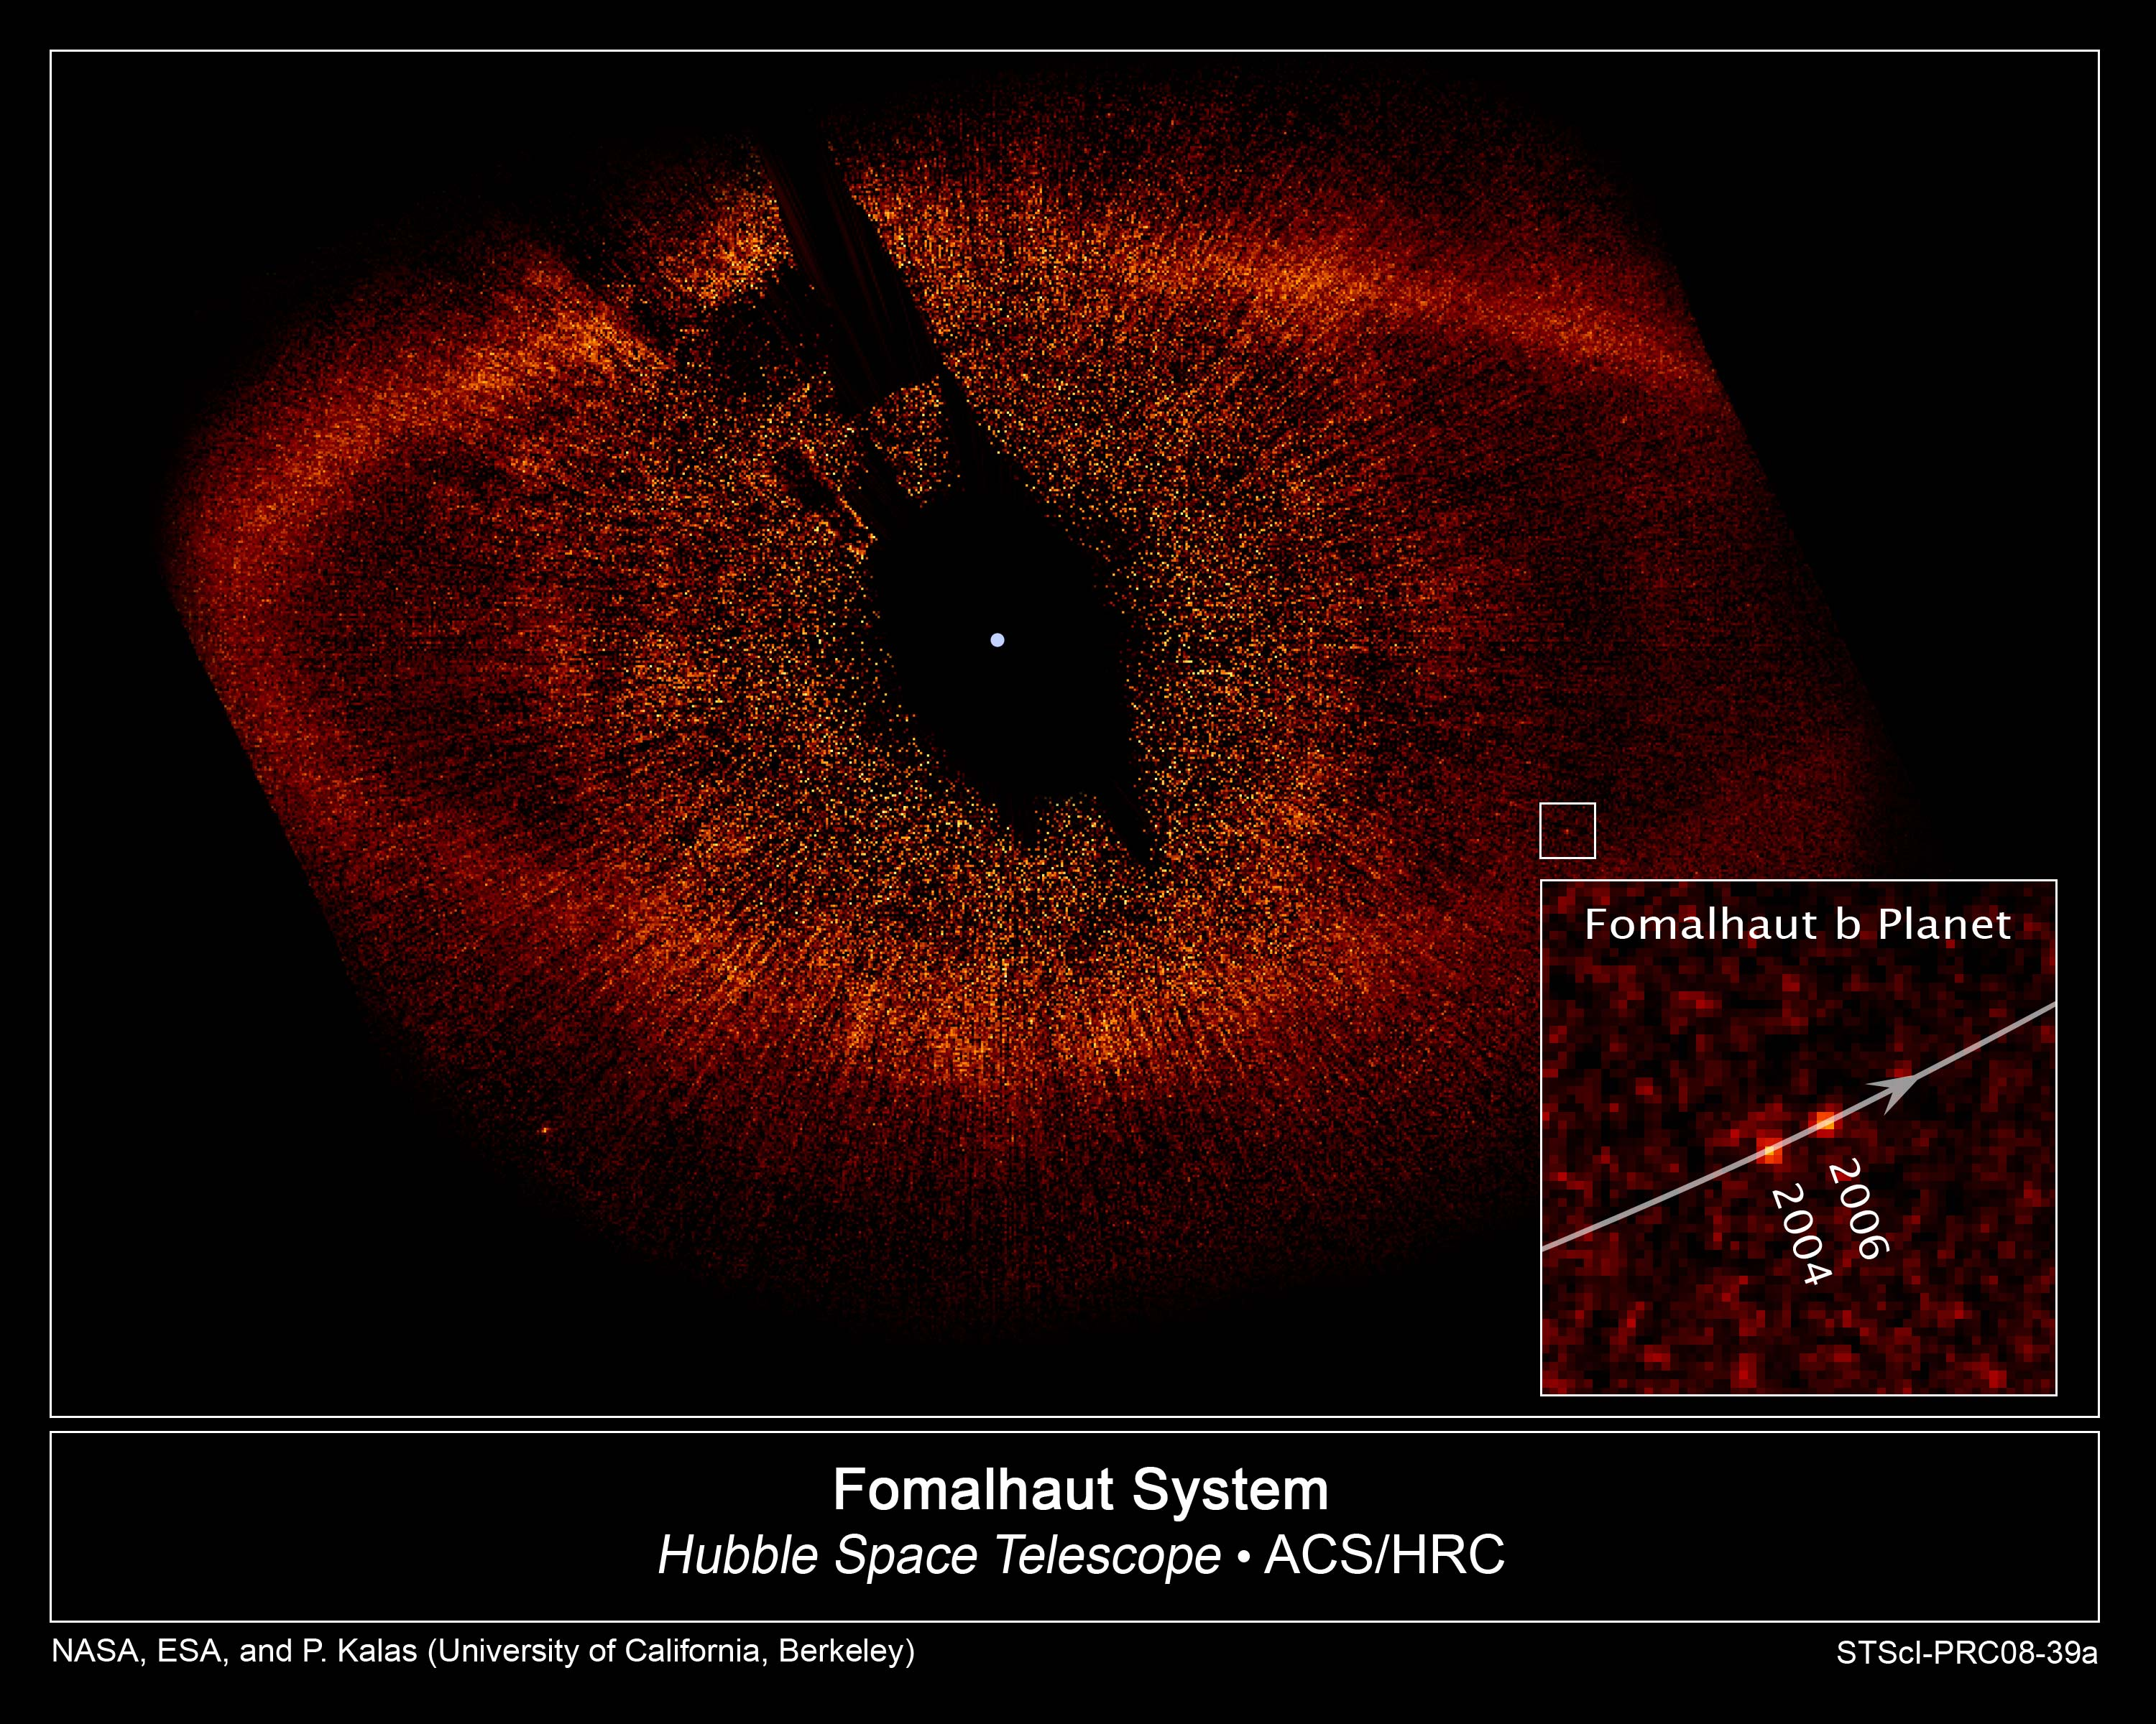
Notes:
With loss of ACS/HRC, was thought we couldn’t image Fomalhaut-B (or similar such exoplanets) again with Hubble. But now Paul Kalas team has been able to do this with STIS! Recovered the Fomalhaut-B planet. Perhaps can find others??

Slide 10
Thoughts on Exoplanets with HST, continued…
Maximize use HST’s unique spectral capabilities for studying exoplanet atmospheres via transit spectroscopy
  UV (COS, STIS) (e.g. tidal stripping of atmospheres; outer atmosphere component identification)
  NICMOS? (Reaches beyond the WFC3 1.7 micron limit) (atmospheric components like Methane)
Image circumstellar disks and exoplanets with STIS (e.g. Fomalhaut-B)
Many sources left to study: primary, secondary transits, imaging of disks (and associated exoplanets!)
  Pursue JWST / HST potential to study super-Earths around M dwarf stars

