Slide 1
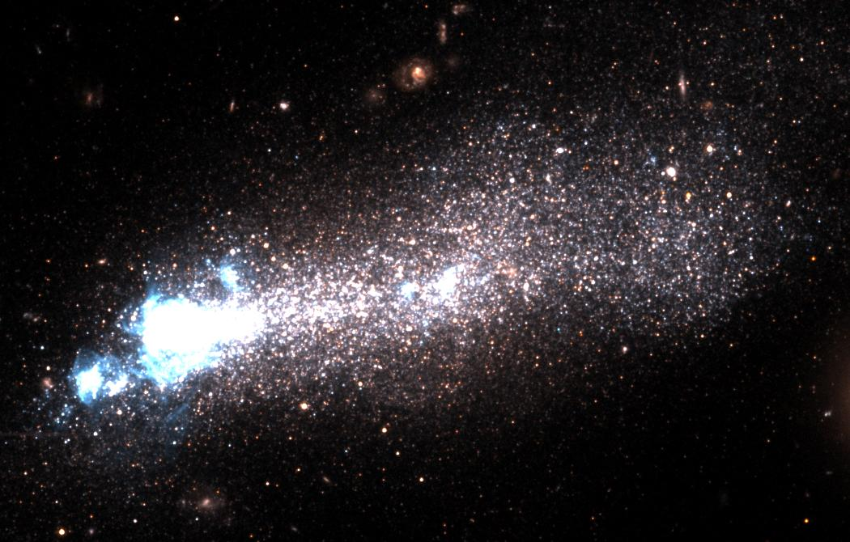
The Difference between Neutral- and Ionized-Gas Metal Abundances in Local Star-Forming Galaxies with COS
Alessandra Aloisi
(STScI)
Science with the Hubble Space Telescope – III
Venice – 13 October 2010

Slide 2
The Difference between Neutral- and Ionized-Gas Metal Abundances in Local Star-Forming Galaxies with COS
Alessandra Aloisi
(STScI)
In collaboration with:
B. James (STScI)
T. Heckman (JHU)
K. Sembach (STScI)
T. Sohn (STScI)
M. Tosi (INAF–OAB)
M. Wolfe (STScI)
Science with the Hubble Space Telescope – III
Venice – 13 October 2010

Slide 3
The Real Abundances of SFGs
Abundances in SFGs inferred from O in nebular (emission-line) spectra of HII regions. However:
  HII regions may suffer from self-enrichment (Kunth & Sargent 1986)
  Bulk of metals in SFGs may be in neutral gas (up to 90-95%)
Need to infer abundances in neutral ISM through absorption-line spectra !

Slide 4
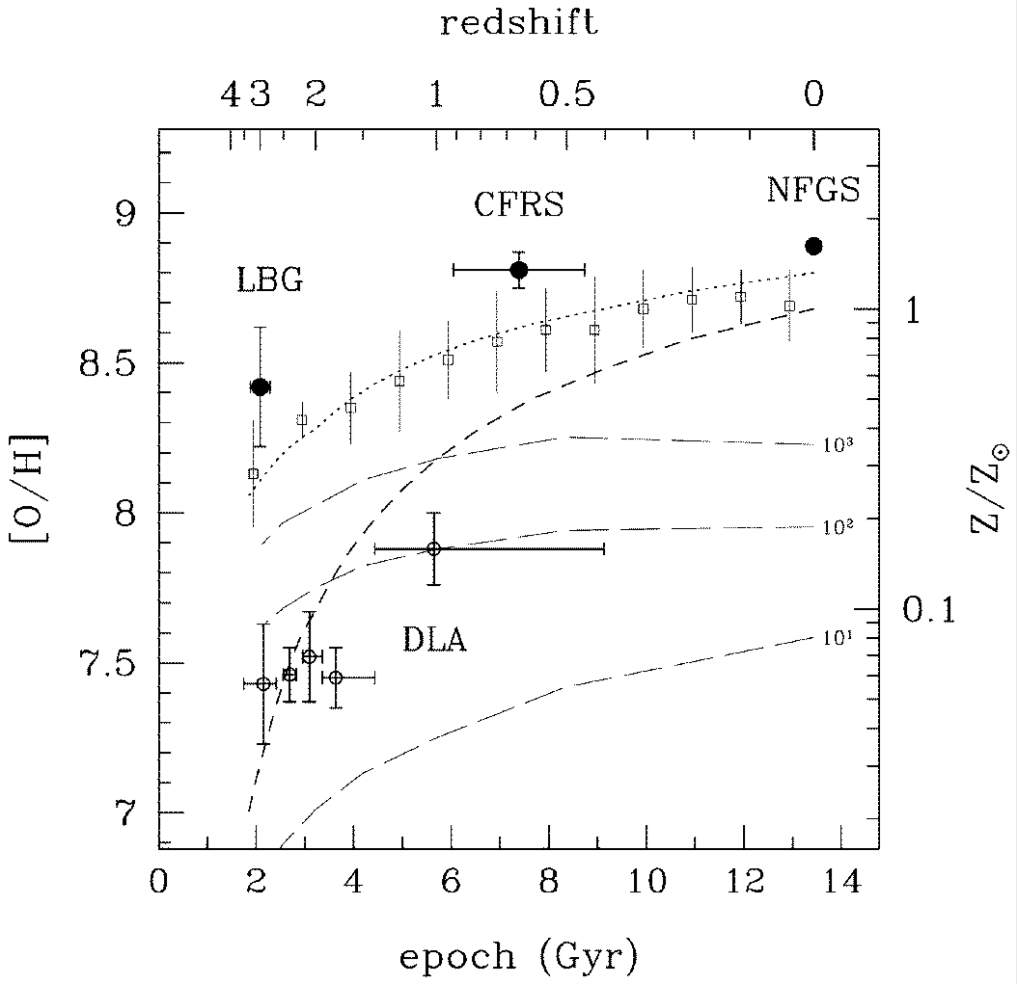
Importance of this Kind of Studies
Solid circles: [O/H] from em lines
Open circles: [Fe/H] from abs lines
Lines: various theoretical models
Clear Z offset at high-z between LBGs and DLAs
Lilly et al. (2003)
High-z difference due to techniques or samples ?
Similar offset at z = 0 ?

Slide 5
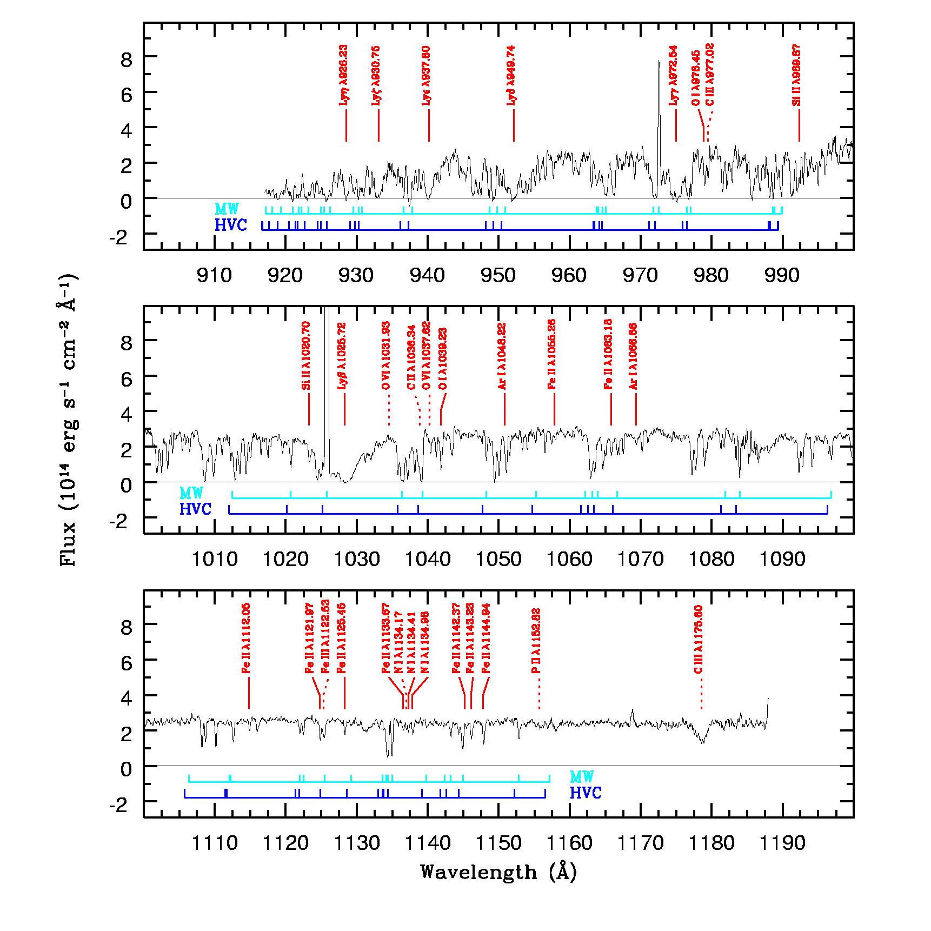
I Zw 18: an Example of
Neutral Gas Abundances with FUSE
FUSE suitable for most abundant species – HI, OI, Ar I, Si II, P II, C II, NI, Fe II
HI already enriched in heavy elements, i.e. not primordial
Existence of a metallicity offset between neutral and ionized gas, except for Fe
SF at least ~ 1 Gyr old required to explain Fe in ISM
Constraints to chemical evolution models
Aloisi et al. (2003)

Slide 6
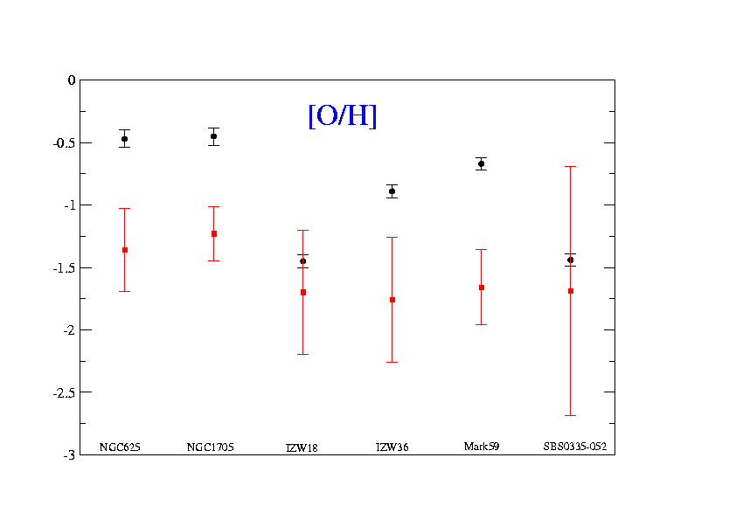
FUSE Results on Neutral Gas Abundances in Local SFGs
H II
H I
H I more metal-poor than H II ?
H II regions not fair tracer of the ISM metallicity ?

Slide 7
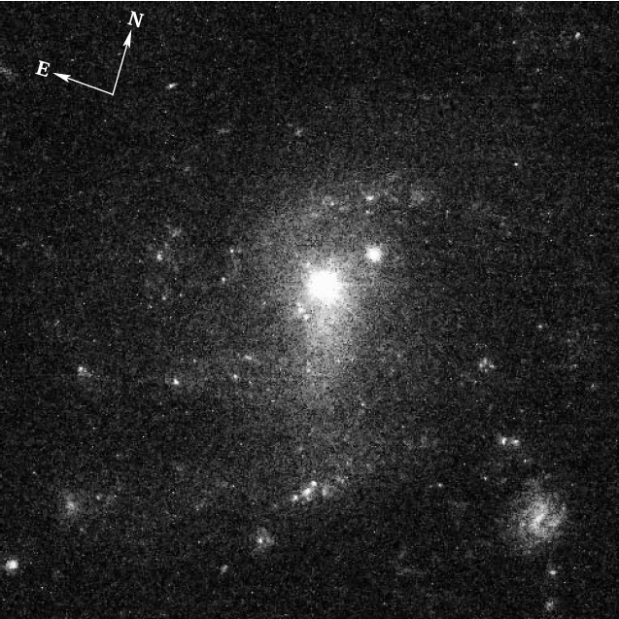
A Counterexample:
SBS 1543+593/HS 1543+5921
Schulte-Ladbeck et al. (2004, 2005)
STIS abundances of the damped Lyα system toward QSO HS 1543+5921
Emission-line abundances of the HII region in SBS 1543+593
Neutral & ionized gas abundances agree
However, measurements where not along the same sightline !
H I
HS 1543+5921
(background QSO)
H II
SBS 1543+593
(foreground galaxy)

Slide 8
Caveats on Neutral Gas Abundances from FUSE Studies
Saturation
• strong lines (e.g., O)
• unresolved multiple components due to large FUSE
aperture used
Ionization
• ionization corrections (only some ions may be present)
• intervening ionized gas (S, Si, Mg, P, C, Fe, Al)
• partially ionized gas (N & Ar)
Depletion
• alpha-elements Si & Mg more than O, Ar & S
• Fe-peak element Fe (Cr, Co, Ni) more than Zn or Mn
Need to move to COS/STIS wavelengths !

Slide 9
COS Survey of Local SFGs
34 HST orbits in Cycle 17 to target 9 galaxies (program 11579, PI: Aloisi)
8 orbits of ACS/SBC pre-imaging (archival data for SBS0335-052)
  F125LP filter used (longwards of Lyα)
  Data taken Jan-Mar 2009 (before SM4)
  Additional ACS/WFC, ACS/HRC, WFPC2 archival data used for read leak
26 orbits of COS/FUV spectroscopy
  one sightline in each galaxy of the sample
  second sightline in M83 and NGC5253
  COS spectra of 8/9 targets acquired Nov 2009 – Sep 2010
    Observations of NGC 4214 to be repeated due to a failure
    during TA
    Observations of IZw18 still to be executed (Jan 2011)

Slide 10
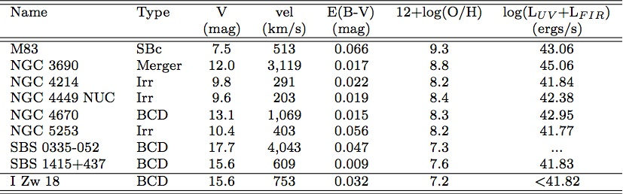
Properties of the COS SFG Sample
COS Sample of SFGs spans a wide range in Z, SFR, and type of galaxy, allowing to investigate the metallicity behavior of the neutral ISM as a function of the galaxy properties at z = 0

Slide 11
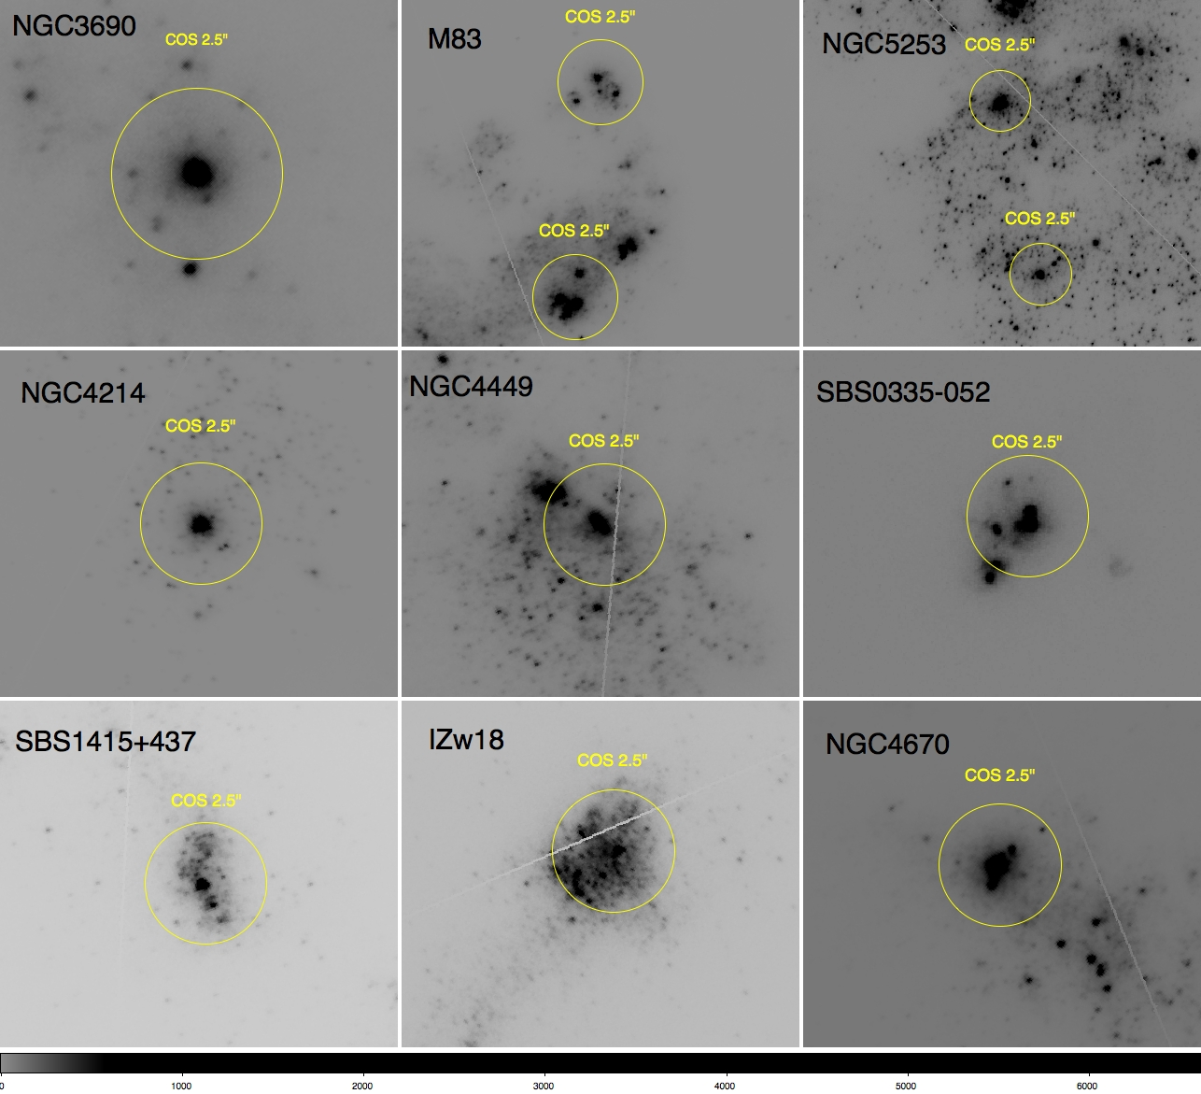
ACS/SBC Pre-Imaging of COS SFG Sample

Slide 12
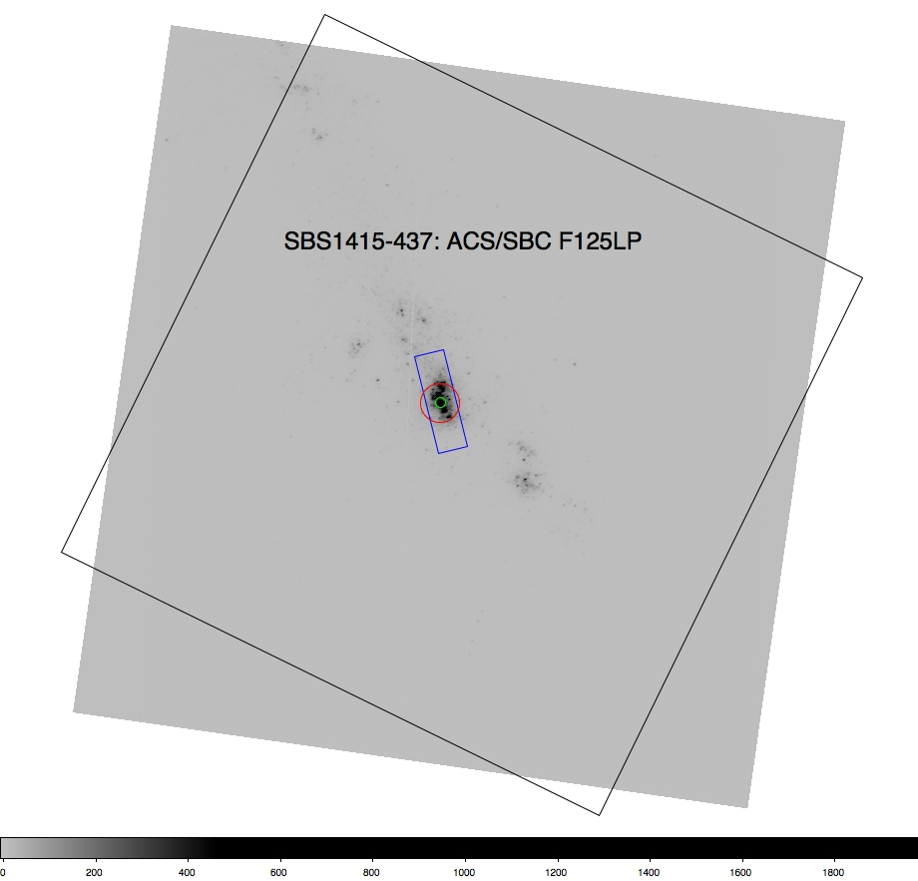
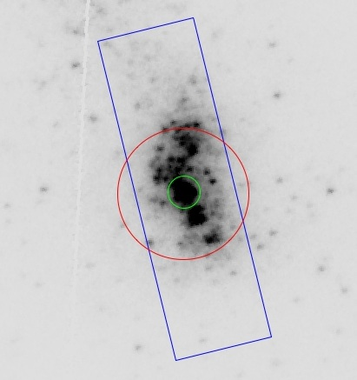
COS Observations of SBS 1415+437
metal-poor BCD
D = 13.6 Mpc
M ≈ 10⁹ Μ
Z ≈ 1/20 Z
Age (HII regions) ≈ 5 Myr
MMT
ACS/SBC
COS
FUSE
UV Source
FUSE data with S/N ≈ 4 (low)
Nebular emission-line long-slit (1.5”x5”) spectra from MMT (Thuan et al. 1999)

Slide 13
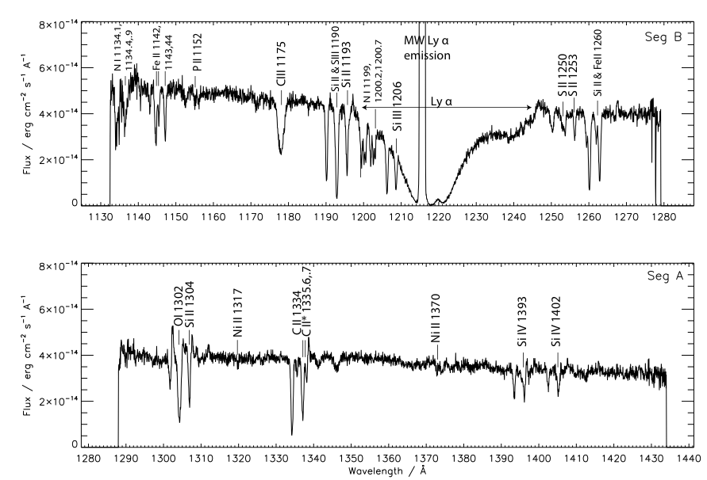
COS/FUV Spectra of SBS 1415+437
Stellar
Geocoronal

Slide 14
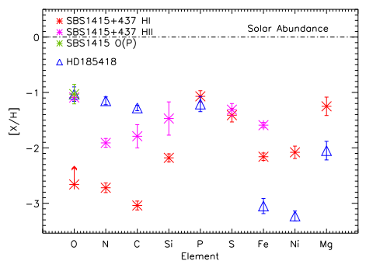
Abundances in SBS 1415+437
α elements O as traced by P (Lebouteiller et al. 2005), S, Mg consistent with each other and with values in HII region
Fe slightly lower in HI than in HII (but HII has large ionization corrections)
N lower in HI than in HII: N enrichment of HII regions or NI ionization effects in neutral ISM ?
Fe, Ni, Mg less depleted than in sightline towards local star HD 185418 (similar N(H)): Z effect ?
(Sonnentrucker et al. 2003)
(Sonnentrucker et al. 2003)
Notes:
Lower limits for O (geocoronal contamination), C (hidden saturation), Si (geocoronal contamination) in HI of SBS1451+437.

Slide 15
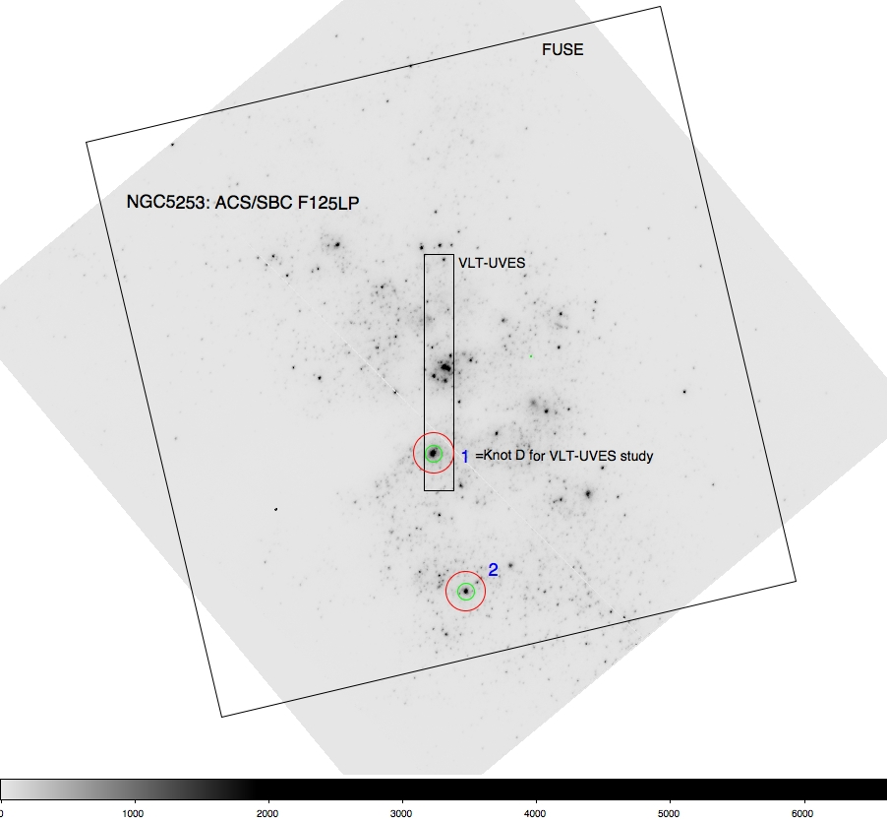
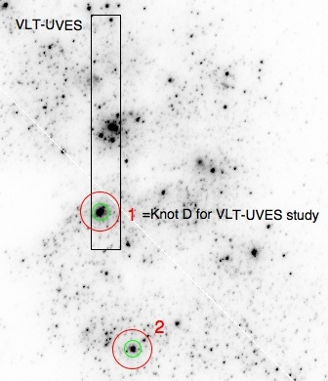
COS Observations of NGC 5253
Dwarf Starburst Galaxy
D = 1.7 Mpc
M ≈ 10⁹ Μ
Z ≈ 1/5 Z
Age (HII regions) ≈ 5 Myr
FUSE
COS
Separation:
~ 130 pc
ACS/SBC
UV Sources
Nebular emission-line long-slit
(knot D) spectra from VLT-UVES (Lopez-Sanchez et al. 2007)

Slide 16
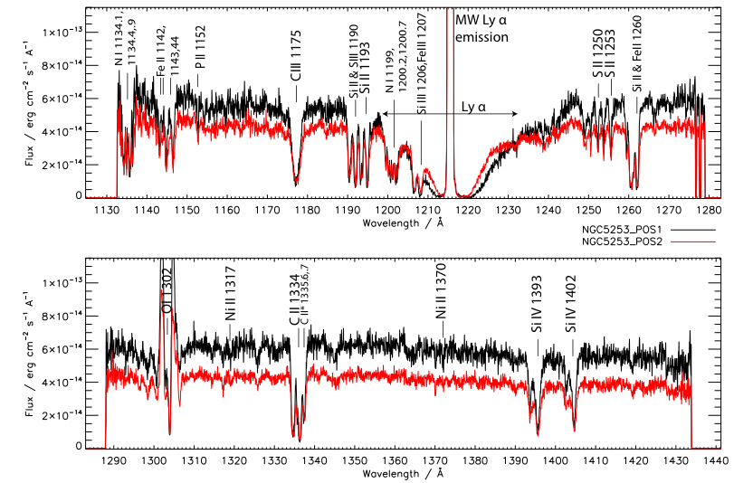
COS Spectra of NGC5253
Spectra in POS1 & POS2 with slightly different fluxes, otherwise
similar to each other
HI column density in POS1 higher by ~ 0.35 dex compared to POS2

Slide 17
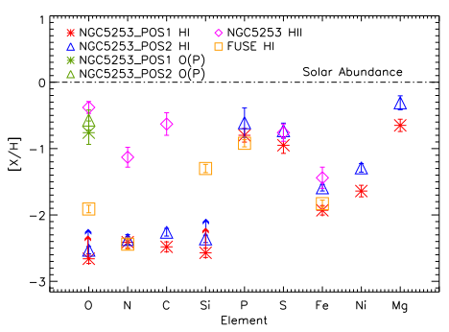
Abundances in NGC 5253
Trends in 2 COS positions similar, despite different (~ 0.35 dex) HI column densities
For both COS positions, same trends as observed for SBS 1451+437 for α elements and Fe-peak elements
In particular, N lower in HI than in HII
FUSE data mainly consistent with COS

Slide 18
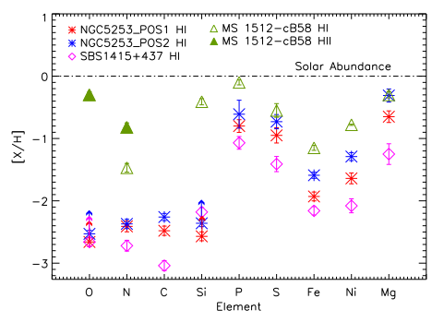
Comparison with LBG MS 1512-cB58
Same N abundance offset between HI and HII in LBG cB58
Relative trends in neutral ISM of z = 2.7 LBG cB58 quite similar to NGC 5253, except for N
Neutral- and ionized-gas abundances in L* LBG at z = 2.7 (a galactic bulge or an elliptical in formation?) just ~ 0.5 dex higher than NGC 5253
Teplitz et al. 2000, Pettini et al. 2002
Notes:
Si in cB58 comes from SiII1526 and 1808 (much fainter lines) ➔ no saturation

Slide 19
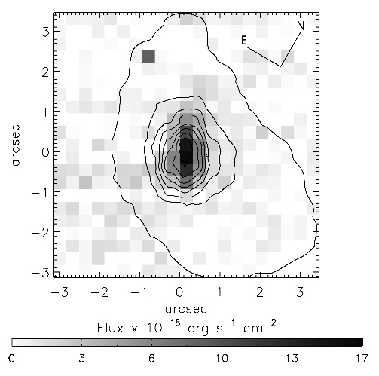
N Enrichment in HII Regions with IFU
James et al. 2009
Mkr 966 is BCD with anomalously high N/O
IFU data show evidence of broad & narrow components
  Broad component associated with high N_{e} (10⁷ cm⁻³)
Emission map of WR feature at λ 4658 in the inner core region of Mrk 966 correlates with broad component that only shows elevated N/O
Gemini/GMOS proposal submitted in Sep 2010 to obtain IFU data of COS SFG sample !

Slide 20
Summary and Conclusions
Sample of local SFGs observed with COS to address biases of FUSE observations (multiple sightlines, availability of ions, etc.)
The α element S, in addition to P used as tracer of O, is key to perform a direct comparison of the α-element abundances in the neutral and ionized gas.
The two cases studies so far show that all the α elements measured in HI with COS give consistent abundance values compared to each other.
HI abundances are similar to what found in the HII regions associated with the COS absorption-line spectra, except for N:
  N enrichment in the HII regions by WNL stars ?
  Same O metallicity in HI and HII ?
    O offset identified by FUSE due to observational biases ?
Two different sightlines in NGC 5253 have different HI column densities, but very similar abundances: homogeneity of the HI on physical scales of the order of few 100 pc ?

