Slide 1
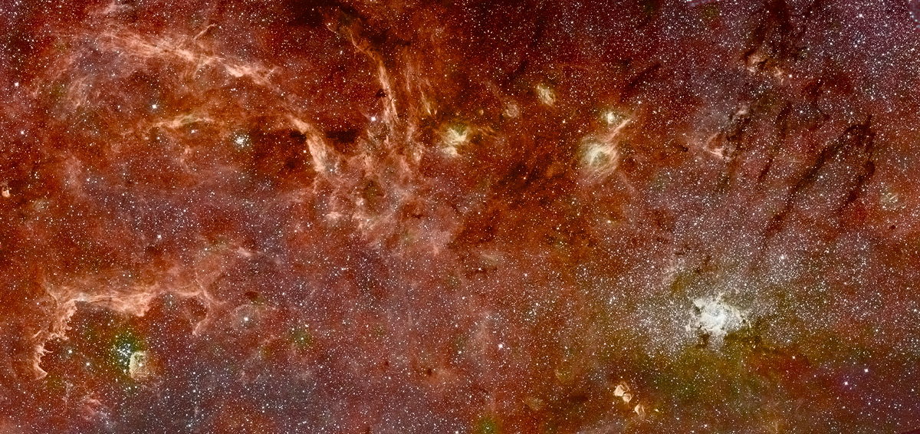
Multi-band Infrared Mapping of the Galactic Nuclear Region
Q. D. Wang (PI), H. Dong, D. Calzetti (Umass),
Cotera (SETI), S. Stolovy, M. Muno, J. Mauerhan, (Caltech/IPAC/JPL),
C. C. Lang (U. of Iowa), M. R. Morris, E. A. Mills (UCLA), G. Schneider (U. Arizona)

Slide 2
Why Galactic Center?
The only nuclear region in which stellar population can be resolved. We can learn about:
Spatial and kinematic distributions of individual stellar populations.
Star formation mode and history.
Initial mass function and mass/light ratio.
Interplay among stars, the ISM, and the SMBH.

Slide 3
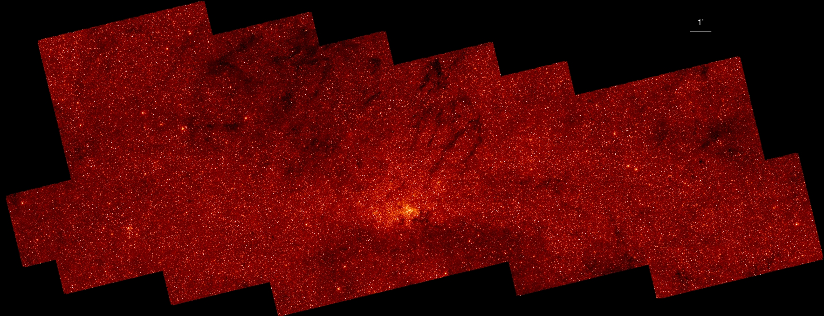
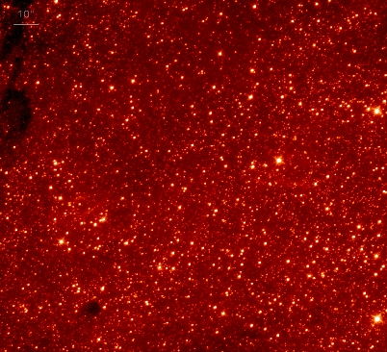
HST/NICMOS Pα Emission Survey of the Galactic Center: 1.90 μm Map
15’ (115 light-year)
Arches cluster
Sgr A*
Quintuplet cluster
39’ (300 light-year)
144 HST orbits, taken between Feb and June, 2008
→ 144X4X4=2304 images for each of the two wavelength filters
Resolution: 0.025 light-year (0.2”)
Instrumental background removal and astrometry correction (to better than 0.04”) are based mainly on overlapping regions (Dong et al. 2010).
The 1.9μm filter is sensitive to the stellar continuum emission.

Slide 4
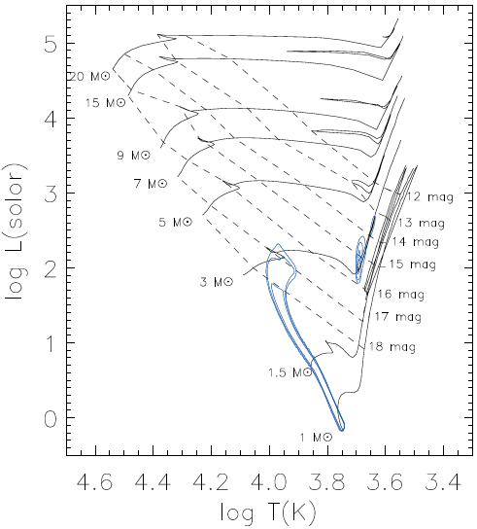
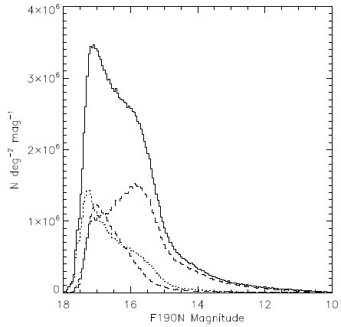
1.9 μm magnitude distribution
Total
Red clump
GC (2 < A_{K} < 5)
0.6 million stars are detected:
accounting for > 80% light
including all stars with M > 8 M and evolved lower mass ones.
strong red clump indicates a major starburst about 300 Myr ago.

Slide 5
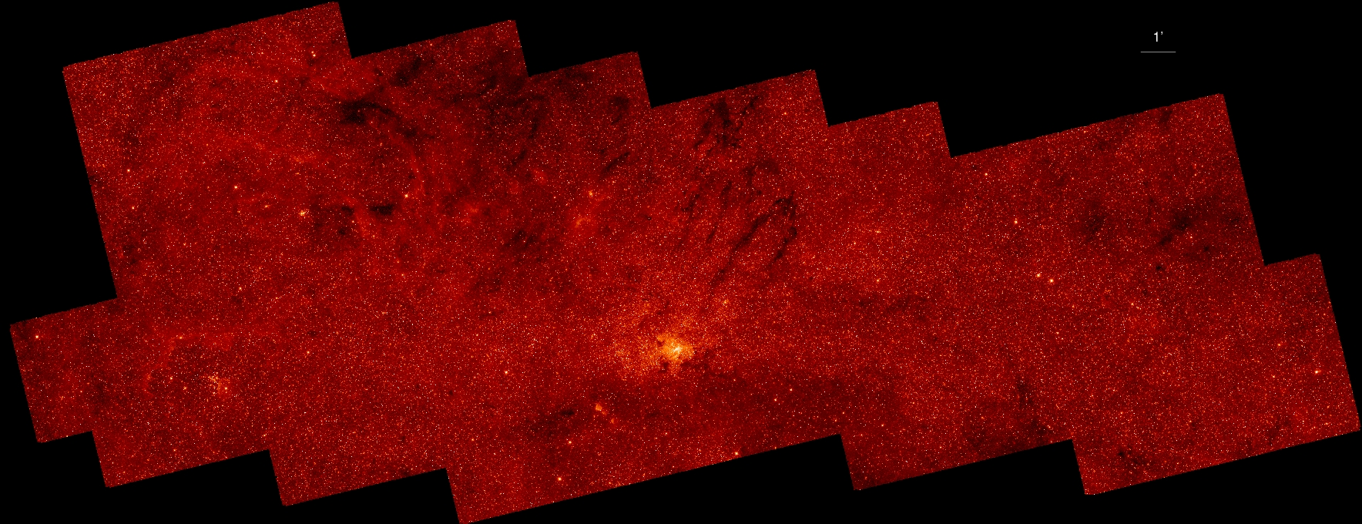
HST/NICMOS 1.87μm Map of the Galactic Center
The 1.87μm filter covers the Pα line.
Subtracting the 1.9μm map from the 1.87μm map adaptively.
  → A net Pα line emission map.

Slide 6
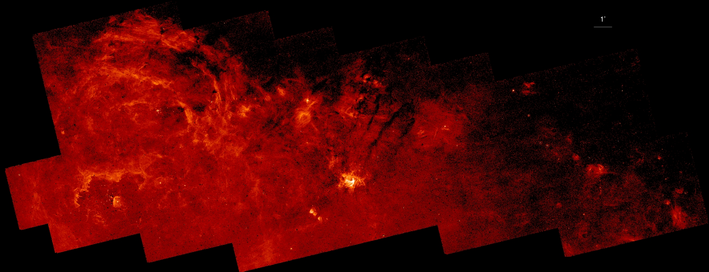
Net Pα Map of the Galactic Center
Arched HII filaments
Arches cluster
Sickle HII region
Sgr A*
Quintuplet cluster
Why do we need the HST?
Only observable from the space
Excellent imaging stability
Little background due to the Earth’s warm atmosphere
Wang et al. 2009

Slide 7
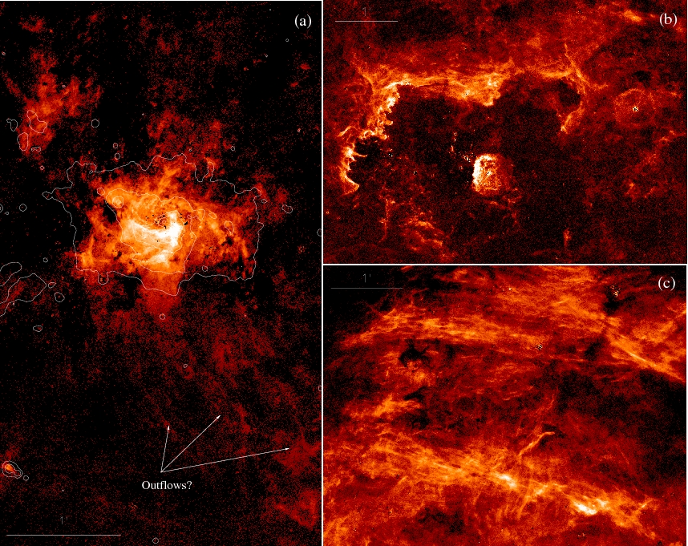
Ionized gas features resolved into arrays of organized linear filaments → strong local magnetic fields.

Slide 8
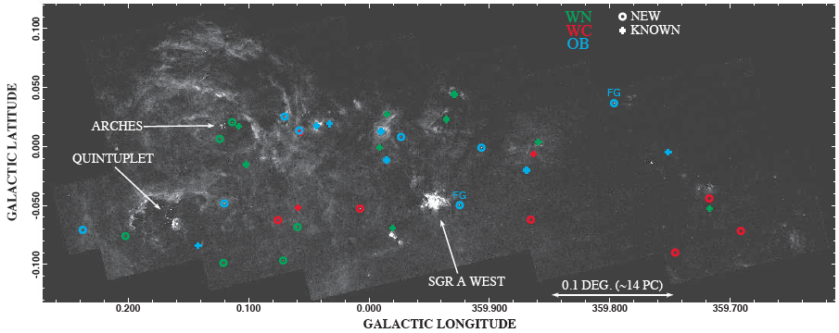
New Population of young massive stars
~170 stars show enhanced Pα emission.
~2/3 of them are located outside the three known clusters.
20 have been followed up spectroscopically, confirming that they are indeed massive stars (Mauerhan et al. 2009; 2010)
→ a new population of massive stars.

Slide 9
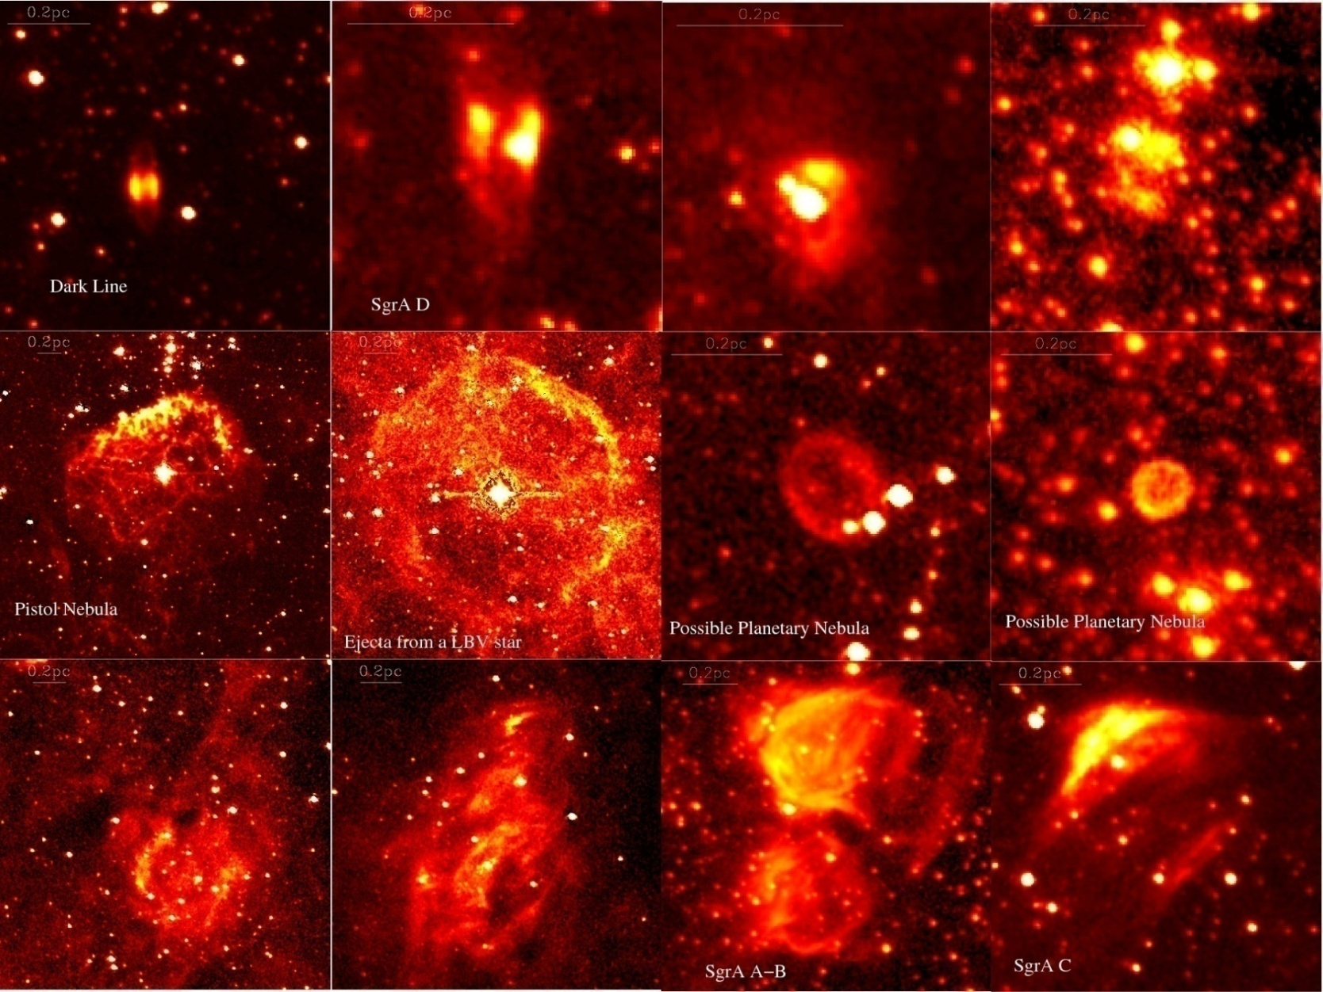
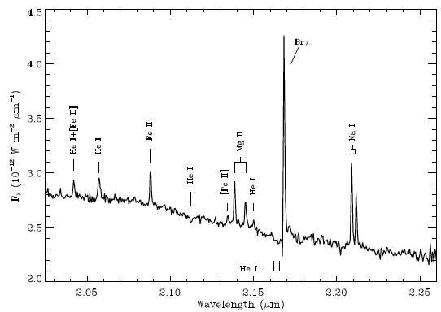
Detailed views of individual compact HII regions
Mauerhan et al. 2009

Slide 10
Summery
A new population of very massive stars in relative isolation and with strong winds.
Fine filamentary structures of ionized diffuse gas indicating profound influence of local strong magnetic field.
Compact nebulae, tracing various stages of massive star evolution
Evidence for a major starburst ~ a few 10⁸ yrs ago.

Slide 11
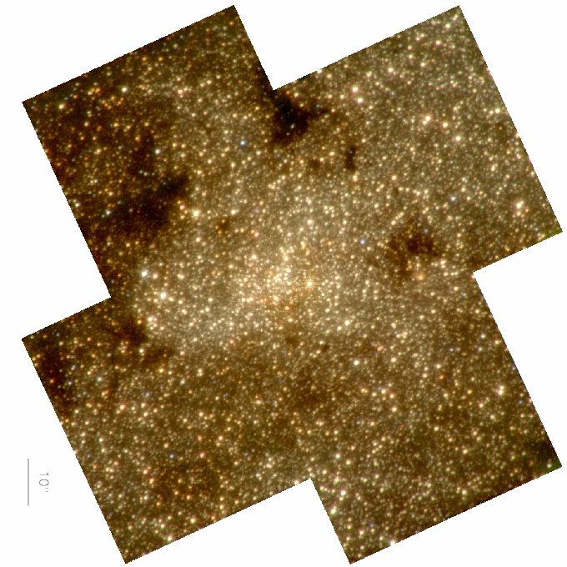
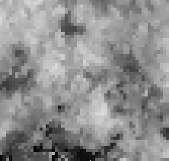
We need a WFC3 IR imaging survey!
SED fits for individual stars → foreground extinction distribution and intrinsic spectral shape.
Eventually proper motion mapping.
NICMOS image:
Red: H, Green: 1.9 Blue: K
Extinction map from SED fits for individual stars

Slide 12
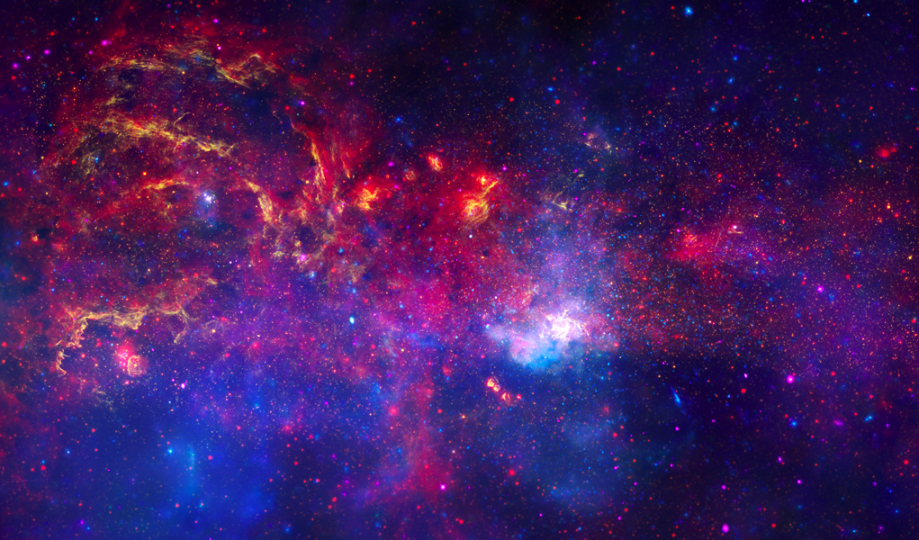
Great Observatory Survey of the GC

